Slide 1
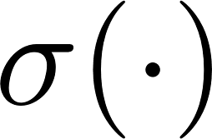
Intent Classification
Goals:
Work / Play Classification based on URL and App data
Smarter OS as a result of information sharing between the Apps: Next Session Type and Start Time prediction
Anomaly Detection
Proposed Model:
Multi-Modal Neural Network
Apps
MLP
Concat
MLP
work /
play
URLs
LSTM w/
FastText
Embeddings
Advantages:
Scalable to multiple input branches and multiple modalities (e.g. images, text)
Input branches are designed independently but trained jointly

Slide 2
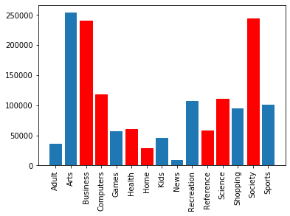
Data Exploration
work
play
URL data
URL
counts
1.5M rows, 15 categories
Example (informative):
original link: https://www.theverge.com/2019/7/1/20676939/nasa-orion-crew-capsule-launch-abort-system-test-emergency
tokenized link:
['theverge', 'nasa', 'orion', 'crew', 'capsule', 'launch', 'abort', 'system', 'test', 'emergency']
URL categories
Example (uninformative):
original link: https://www.google.com/search?q=test&oq=test&aqs=chrome..69i57j0l5.947j0j8&sourceid=chrome&ie=UTF-8
tokenized link:
['google', 'search', 'test', 'test', 'aqs', 'chrome', 'sourceid', 'chrome', 'UTF']

Slide 3
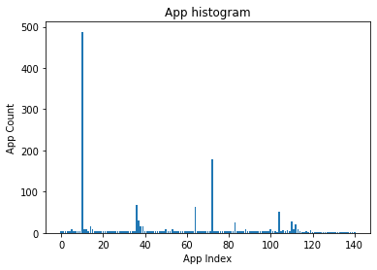
Data Exploration
App data
1.8M rows, 20K Apps
Based on App Interactivity dataset from cosmos database (commercial vs non-commercial apps)
App data is one-hot encoded (same Hamming distance between apps)
Can be ambiguous: 1355 / 20K Apps are labelled both (w)ork and (p)lay (at different times).
svchost.exe
MicrosoftEdgeCP.exe
conhost.exe
Code.exe

Slide 4



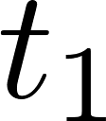
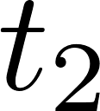
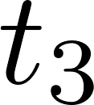
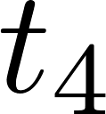
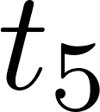
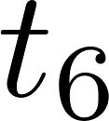


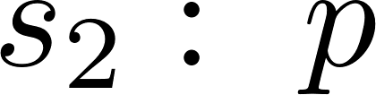
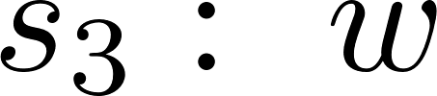


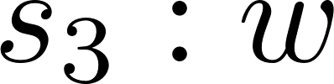

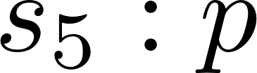
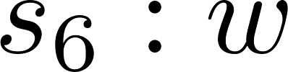
User Sessions
Fixed Session Length
Q1: What’s current session type and start-time?
Q2: What’s expected next session type and start-time?
A: Majority Vote
B: Count Based

Slide 5

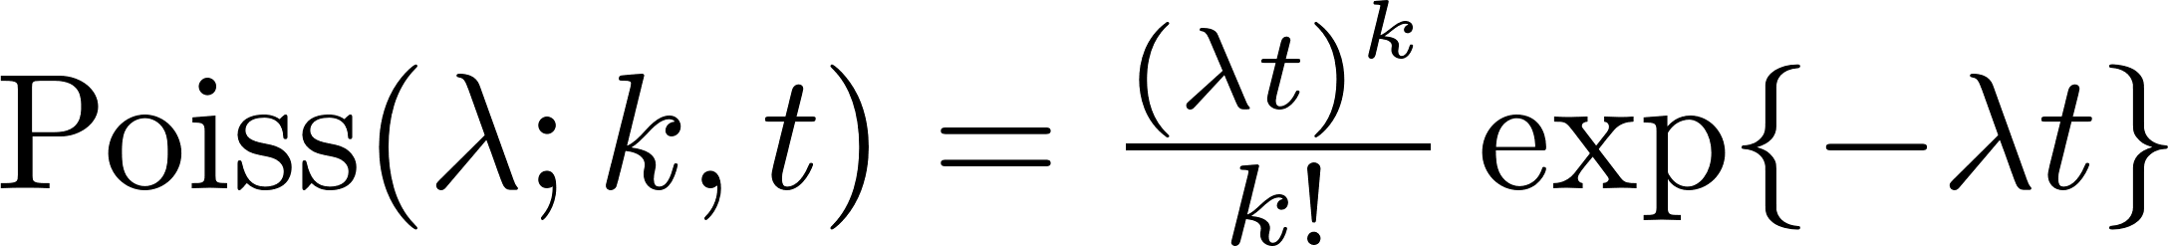
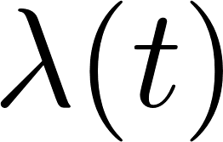
User Sessions
Variable Session Length
Q: How to predict / learn session duration?
A: Switching Random (Poisson) Process
B: Non-homogenous Poisson Process
Rate lambda is a function of time:

Slide 6
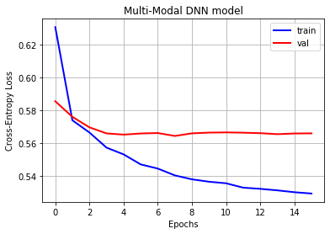
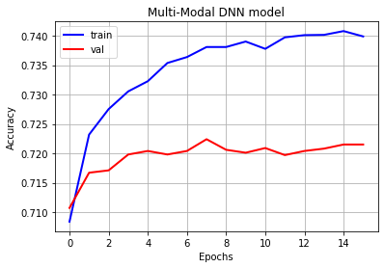
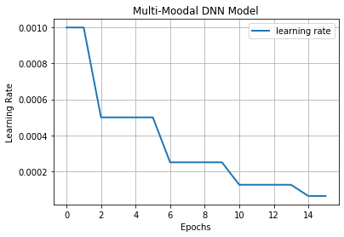
Experimental Results
Intent Classification (real dataset)
Flat validation loss = no signs of overfitting
Validation Accuracy is 72%
Learning rate schedule divides the learning by 2 every 4 epochs

Slide 7
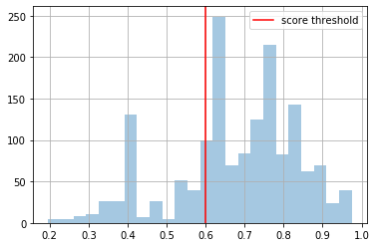
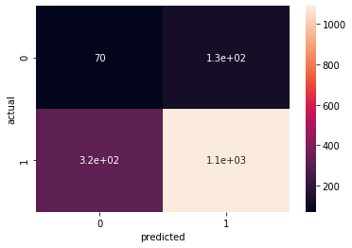
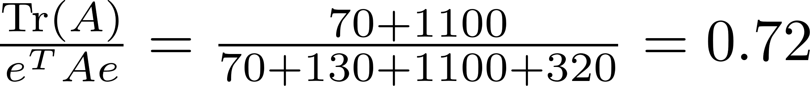
Experimental Results
Intent Classification (real dataset)
Legend:
0: play
1: work
Label = 0
Label = 1
Accuracy:

Slide 8
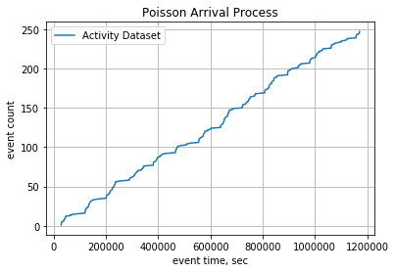
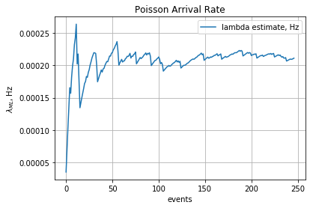

Experimental Results
Session Length Prediction:
MLE estimate derivation:

Slide 9
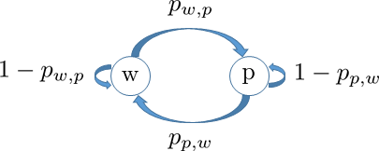
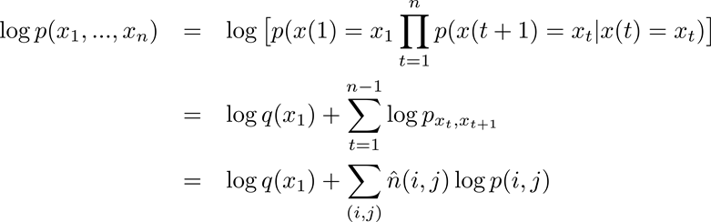
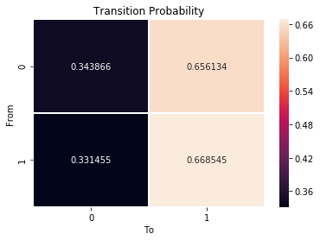

Experimental Results
Session Type Prediction:
Markov Chain

