Slide 1
Compression of MP3 1-D audio signal using DCT
1911001- Aakash Saroop
1911003- Bhairav Narkhede
1911014- Pathik Ghugare

Slide 2
Intorduction
A discrete cosine transform (DCT) is a method of representing a finite sequence of data points as a sum of cosine functions oscillating at different frequencies. A real-valued frequency decomposition of a real-signal x is obtained using the DCT (n). A DCT, in particular, is a Fourier-related transform that is comparable to the discrete Fourier transform (DFT) but only works with real values. Because of the high correlation in nearby coefficients, DCT can be utilised for voice compression. We can rebuild a sequence with great precision using only a few DCT coefficients. DCT's property of effective data reduction is aided by this characteristic.

Slide 3
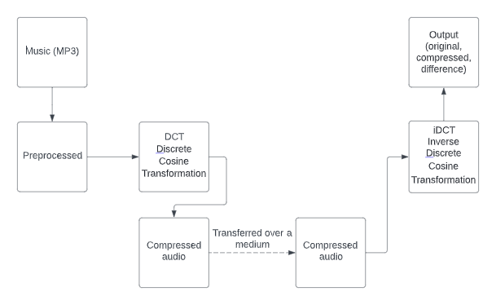
Implementation details
The code has been implemented using Matlab.
The input to the program is a .wav file.
Functions used include: user defined functions such as dct(), idct(). And other function such as pnsr(), immse(), snr() are also used for evaluation of the compressed signal.
Block diagram as shown below:

Slide 4
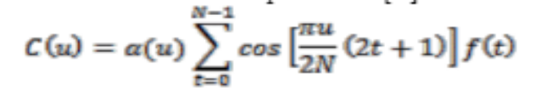

Sender Side
Discrete Cosine Transformation is used on the sender side.
DCT can be used for speech compression because of high correlation in adjacent coefficients.

Slide 5
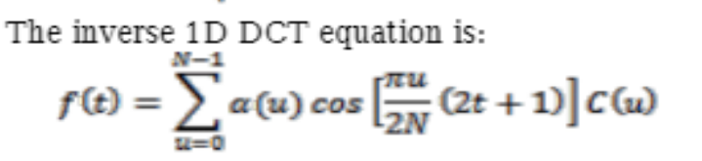

Receiver side
Inverse Discrete Cosine Transformation is used on the receiver side.
The compressed signal is present on the receiver side.

Slide 6
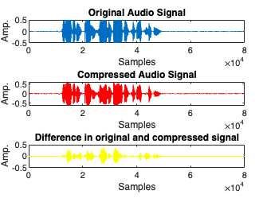
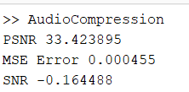
Difference between the original and compressed signal
Analysis of the Compression.

Slide 7
Thank you

