Slide 1
Charting your IT Journey
From Learning to Launching Your Career
Bhairesh M

Slide 2

Who am I, and what do I do?
Where do I work, and in what role?
What projects have I worked on, and what skills do I have?

Slide 3
Agenda
Online Learning & Resources
Coding Practices
Cracking Interviews
Understanding IT Company Culture

Slide 4
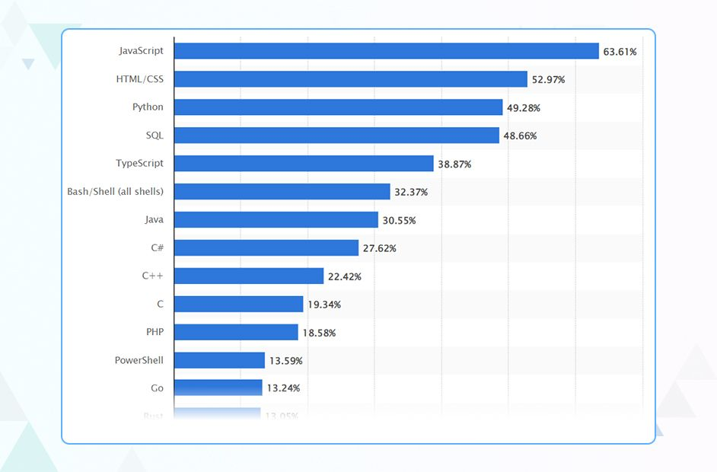
Most popular programming language
~98% of websites uses JS.
https://www.tiobe.com/tiobe-index/
https://distantjob.com/blog/programming-languages-rank/
Source: https://radixweb.com/blog/top-javascript-usage-statistics

Slide 5
Online Learning & Resources
Abundant platforms (Coursera, Udemy, YouTube, GoogleCloudSkills)
Community support(GitHub, StackOverflow, Discord)
Blogs, podcasts, news & free webinars
Learn slowly, and practice
Theory Overload vs Experiential Cycle

Slide 6
Practice & Hands-on Learning
Build real projects
Contribute to open-source(firsttimersonly)
Code challenges (HackerRank, LeetCode)
Develop a portfolio of work

Slide 7
Cracking Interviews
Technical & behavioral prep
Practice with mock interviews
Use platforms like InterviewBit & LeetCode

Slide 8
Understanding IT Company Culture
Research company values & team dynamics
Importance of cultural fit
Ask the right questions in interviews
Startups vs MNCs
Work culture

Slide 9
Key Takeaways
Leverage diverse online learning sources
Practice through real projects
Prepare comprehensively for interviews
Understand and align with company culture

Slide 10
Open floor for clarifications or questions?

Slide 11

Resources

Slide 12
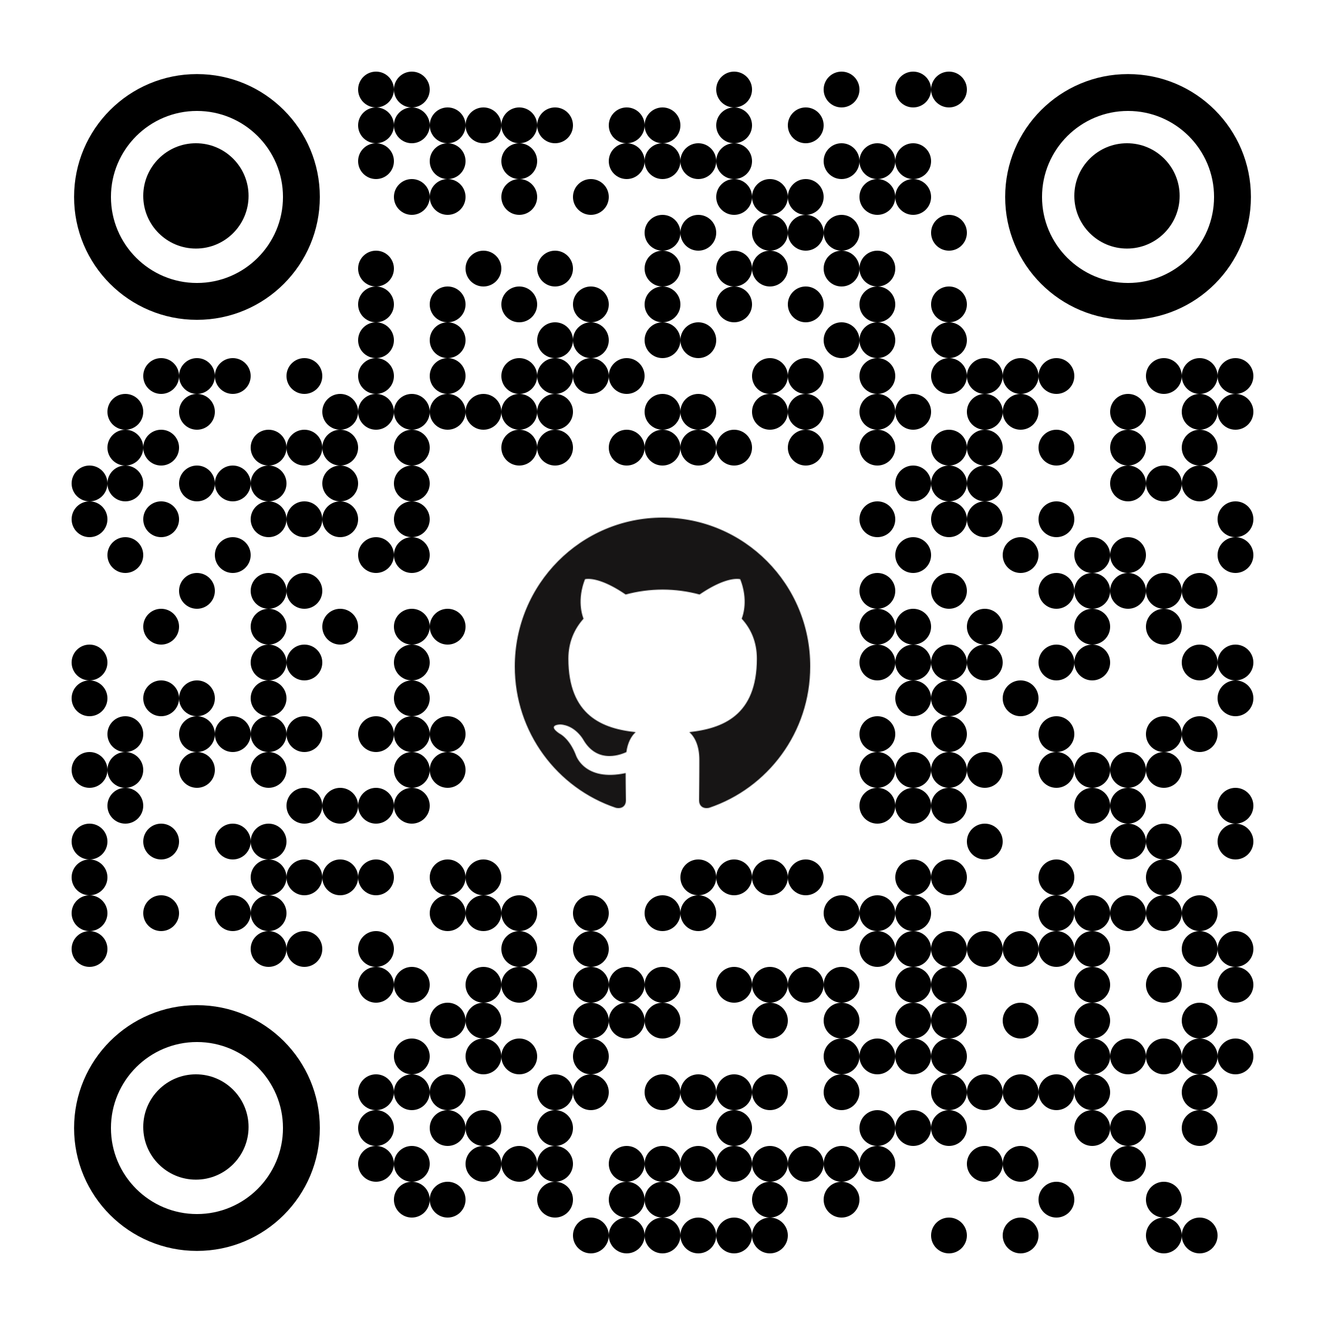
Thank you​

