Slide 1

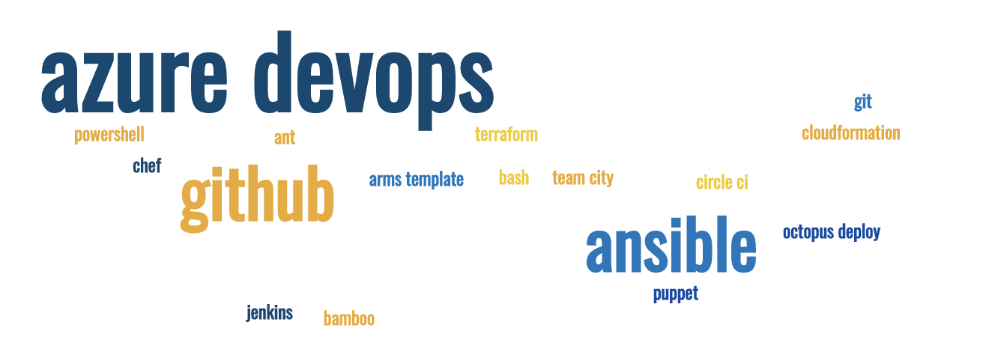
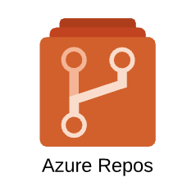
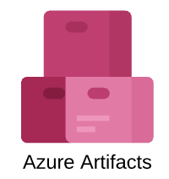
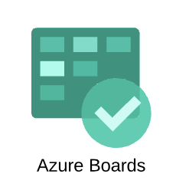

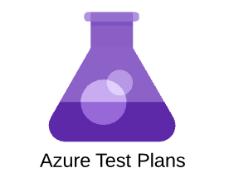
Azure DevOps part 1
Azure DevOps, Deep Dive – Part 1 Sujit Singh

Slide 2
Agenda
Automation
Software Configuration Management (SCM) / सॉफ़्टवेयर कान्फ़िगरेशन मैनज्मेंट
Version Control
Some Popular Tool
Example
Azure DevOps
Git and GitHub
Terraform, Cloud Formation, ARM Template

Slide 3
Automation
Why Automation
Manual vs Automation
Notes:
Repeatable process
Less chance of manual error
Builds confidence

Slide 4
SCM – Software Configuration Management
Significant process for software development
Monitor and track the changes in software
Notes:
SDLC
Started since 1960, however become more popular in 80s as configuration management,
CVS, concurrent version system.

Slide 5
Version Control
An important element of SCM
Mostly for managing the code and changes
Evolved from basic client server tool
Notes:
There are some document management tools which provide versions
Evolved from client server tools (VSS) to distributed version control system such as git.

Slide 6
Version Control – Popular tools
VSS
Git
GitHub
Azure DevOps
CVS
Terminology
Branch
History
Pull Request (PR)
Revision
Tag

Slide 7
Break
Comments
Notes:
Portal allows managing the resources from visual user interface with guided wizard and intuitive user interfaces.
There are many methods for accessing, managing and consuming azure resources but they all goes through ARM services. Individual services exposed for different type of use case scenarios.

Slide 8
Example – Azure DevOps
Free for 5 users
Projects
Repository
Pipelines
Artifacts

Slide 9
Example - Github
Organization
Personal
Repository
Actions

Slide 10
Example - Demo

Slide 11
What is next
Automation
DevOps
SCM
Github
Notes:
Github Pages

