Slide 1

Introduction
Introduction of cloud computing, digital age and QA with Bhaiya Jee
Sujit Singh

Slide 2
Agenda
Introduction
Digital Age
Industrial Revolution and implementation
The Digital Age
Cloud Computing
Evolution and timeline
Providers
Common patterns
Questions and next

Slide 3
Introduction
What is ‘Bhaiya Jee in UK’ (भैया जी इन यू के क्या है)
Why (क्यों)
Notes:
Introduction of speaker and idea behind Bhaiya Jee in UK.
why this session, intention and objective. Format of the session, Topics (general, specific)

Slide 4
Digital Age
Industrial Revolutions
Age of Canals
Started around 1770 to 1800
Canals, Shipping and boating etc. Helped moving the large objects
Notes:
https://en.wikipedia.org/wiki/Kondratiev_wave
https://breadtagsagas.wordpress.com/tag/age-of-steel-and-heavy-engineering/
Computing history, information available on internet,
First personal computer was become available during 70s, https://en.wikipedia.org/wiki/Cloud_computing#Early_history https://quantumcomputingtech.blogspot.com/2018/11/computer-history-timeline-up-to-2018.html

Slide 5
Digital Age
Industrial Revolutions
Age of steam engine and railways
Started around 1829 and become effective in 1848-1850. It helped British industrialization a lot
Notes:
https://en.wikipedia.org/wiki/Kondratiev_wave
https://breadtagsagas.wordpress.com/tag/age-of-steel-and-heavy-engineering/
Computing history, information available on internet,
First personal computer was become available during 70s, https://en.wikipedia.org/wiki/Cloud_computing#Early_history https://quantumcomputingtech.blogspot.com/2018/11/computer-history-timeline-up-to-2018.html

Slide 6
Digital Age
Industrial Revolutions
Age of Steel and Heavy engineering
Started around 1875 to 1895 when steel manufacturing and heavy engineering helped on larger scale. Lots of innovation done which require a lot of investment which was done by USA and Germany.
Notes:
https://en.wikipedia.org/wiki/Kondratiev_wave
https://breadtagsagas.wordpress.com/tag/age-of-steel-and-heavy-engineering/
Computing history, information available on internet,
First personal computer was become available during 70s, https://en.wikipedia.org/wiki/Cloud_computing#Early_history https://quantumcomputingtech.blogspot.com/2018/11/computer-history-timeline-up-to-2018.html

Slide 7
Digital Age - continue
Industrial Revolutions
Age of Oil, Electricity, the Automobile and Mass Production
Started in 1908, Exploration of oil and gas helped accelerating the growth. After the second world war it further accelerated. This is also known as golden age.
Notes:
https://en.wikipedia.org/wiki/Information_Age
Computing history, information available on internet,
First personal computer was become available during 70s, https://en.wikipedia.org/wiki/Cloud_computing#Early_history https://quantumcomputingtech.blogspot.com/2018/11/computer-history-timeline-up-to-2018.html

Slide 8
Digital Age - continue
Industrial Revolutions
Age of Software and Digital (aka Information Age)
Started around 1971 up to 2000 as dotcom and internet world. Availability and use in personal computers. From 2000 Mobile devices become popular and capable of processing digital information. This is known as Digital Age or Information age.
Notes:
https://en.wikipedia.org/wiki/Information_Age
Computing history, information available on internet,
First personal computer was become available during 70s, https://en.wikipedia.org/wiki/Cloud_computing#Early_history https://quantumcomputingtech.blogspot.com/2018/11/computer-history-timeline-up-to-2018.html

Slide 9
Digital Age
We are in the advance phase of Digital Age
Online education
Online shopping
Rise in the use of social media
Automated deliveries
Automated cars
Automated sensors
Notes:
https://en.wikipedia.org/wiki/Information_Age
Computing history, information available on internet,
First personal computer was become available during 70s, https://en.wikipedia.org/wiki/Cloud_computing#Early_history https://quantumcomputingtech.blogspot.com/2018/11/computer-history-timeline-up-to-2018.html

Slide 10
Cloud Computing
Introduction of Cloud Computing
Distributed computing
Client Server
Dotcom boom
Hosting
Notes:
Computing history and a lot of information available on internet,
First personal computer was become available during 70s,
There were client-server style computing where ‘terminals’ used to access powerful computer (servers). Mainframe and other UNIX servers used by various users over the network.
Personal computer become available during 70s however it become more popular in 80s and 90s
Amazon.com made computing available through ‘Amazon Web Services’, very interesting and turning point to make computing resources available as per the need to end users.
Microsoft which is provider of another largest and popular public cloud ‘Azure’ announced the plan to invest and build cloud computing infrastructure which was released in 2010.
There were rumors that Microsoft used AWS for initial days to support its cloud offering by deploying the application on AWS. Google made ‘Google app engine’ available around 2008. In July 2010 a private hosting provider Rackspace worked jointly with NASA to build first open source cloud platform OpenShift. OpenShift become popular among many large banks to provide private cloud.

Slide 11
Cloud Computing - continue
Notes:
Computing history and a lot of information available on internet,
First personal computer was become available during 70s,
There were client-server style computing where ‘terminals’ used to access powerful computer (servers). Mainframe and other UNIX servers used by various users over the network.
Personal computer become available during 70s however it become more popular in 80s and 90s
Amazon.com made computing available through ‘Amazon Web Services’, very interesting and turning point to make computing resources available as per the need to end users.
Microsoft which is provider of another largest and popular public cloud ‘Azure’ announced the plan to invest and build cloud computing infrastructure which was released in 2010.
There were rumors that Microsoft used AWS for initial days to support its cloud offering by deploying the application on AWS. Google made ‘Google app engine’ available around 2008. In July 2010 a private hosting provider Rackspace worked jointly with NASA to build first open source cloud platform OpenShift. OpenShift become popular among many large banks to provide private cloud.

Slide 12
Cloud Computing
break
Notes:
Computing history and a lot of information available on internet,
First personal computer was become available during 70s,
There were client-server style computing where ‘terminals’ used to access powerful computer (servers). Mainframe and other UNIX servers used by various users over the network.
Personal computer become available during 70s however it become more popular in 80s and 90s
Amazon.com made computing available through ‘Amazon Web Services’, very interesting and turning point to make computing resources available as per the need to end users.
Microsoft which is provider of another largest and popular public cloud ‘Azure’ announced the plan to invest and build cloud computing infrastructure which was released in 2010.
There were rumors that Microsoft used AWS for initial days to support its cloud offering by deploying the application on AWS. Google made ‘Google app engine’ available around 2008. In July 2010 a private hosting provider Rackspace worked jointly with NASA to build first open source cloud platform OpenShift. OpenShift become popular among many large banks to provide private cloud.

Slide 13
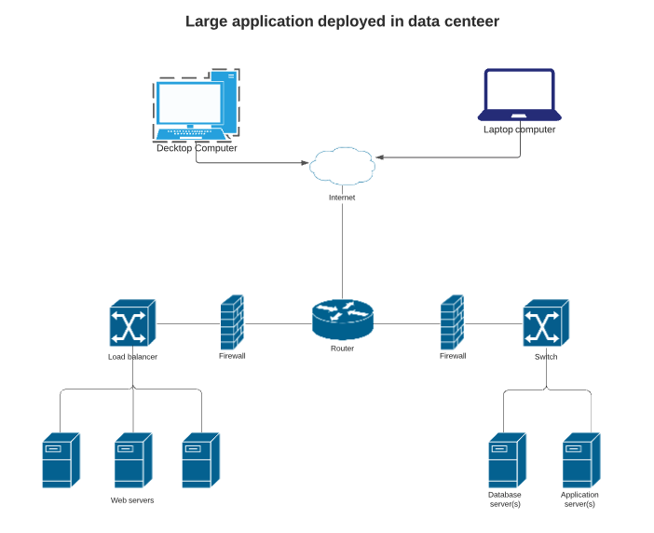
Cloud Computing
Evolution
Notes:
https://en.wikipedia.org/wiki/Information_Age
Computing history, information available on internet,
First personal computer was become available during 70s, https://en.wikipedia.org/wiki/Cloud_computing#Early_history https://quantumcomputingtech.blogspot.com/2018/11/computer-history-timeline-up-to-2018.html

Slide 14
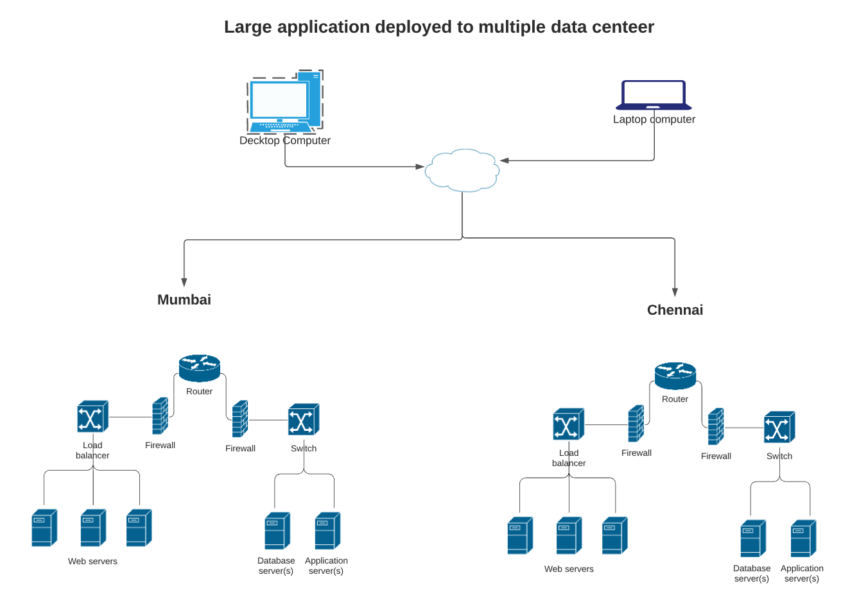
Digital Age - continue
Notes:
High Availability of servers and applications on redundant hardware.
Disaster Recovery and business continuity
Hosting providers become available, large enterprises have their hosting in house with racks of servers, networking and specialized skills called as ‘System Administrators’. Problems and need to have simplicity, cost effectiveness, less industrial waste….

Slide 15
Digital Age - continue
Introduction of Cloud Computing
Increase demand of servers and infrastructure for ecommerce (dotcom boom)
Complexity of infrastructure architecture
Cost
Knowledge based Business Model
Notes:
https://en.wikipedia.org/wiki/Information_Age
Computing history, information available on internet,
First personal computer was become available during 70s, https://en.wikipedia.org/wiki/Cloud_computing#Early_history https://quantumcomputingtech.blogspot.com/2018/11/computer-history-timeline-up-to-2018.html

Slide 16
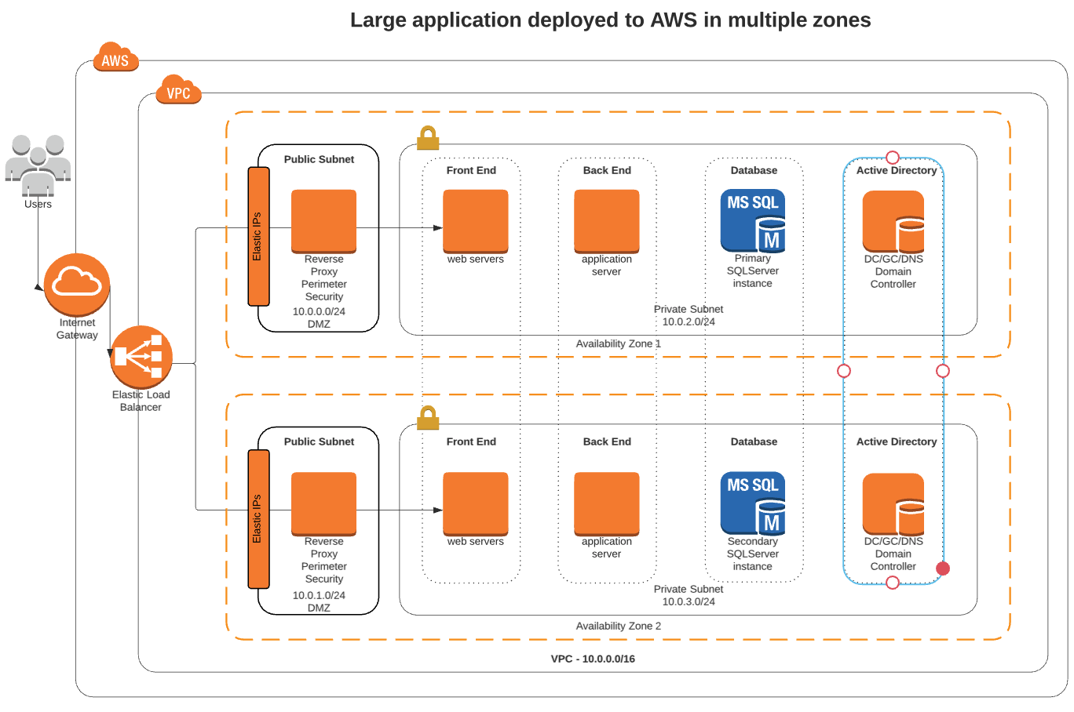
Digital Age - continue

Slide 17
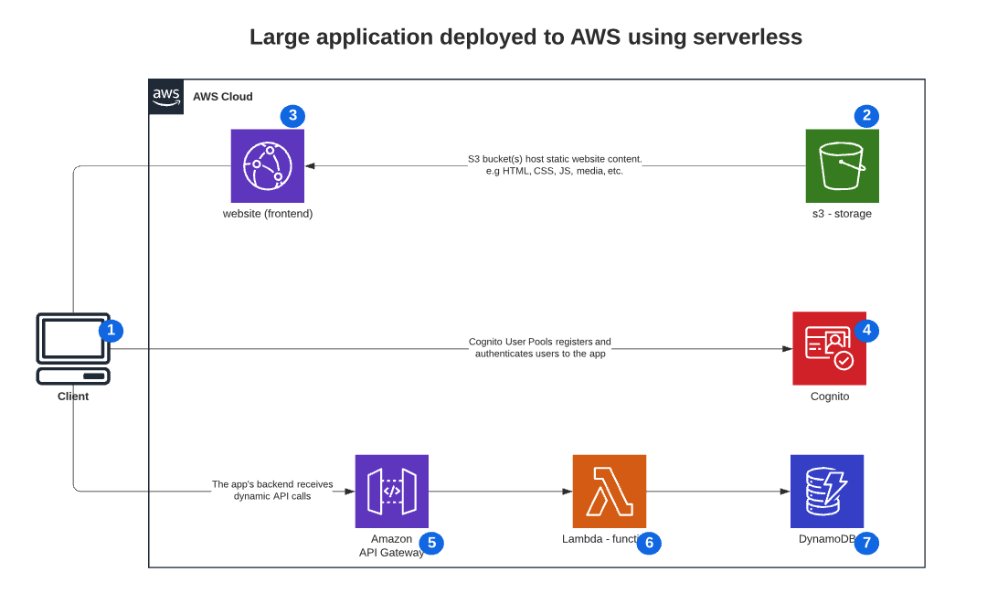
Digital Age - continue
Notes:
CDN - Content delivery network also refer as edge servers. They provide static documents (html, css, javascript, images etc)
Cognito helps user management for registration, password reset, authentication etc
Api gateway allows management of various internal endpoints/functions code deployed to Lambda (authentication, scaling etc).
Lambda – allows to deploy code to run as function
DynamoDB is one of many types of database as a service in cloud. Elastic databases.
S3 is storage solution (Simple storage service) allows to have plenty of storage as per the requirement.

Slide 18
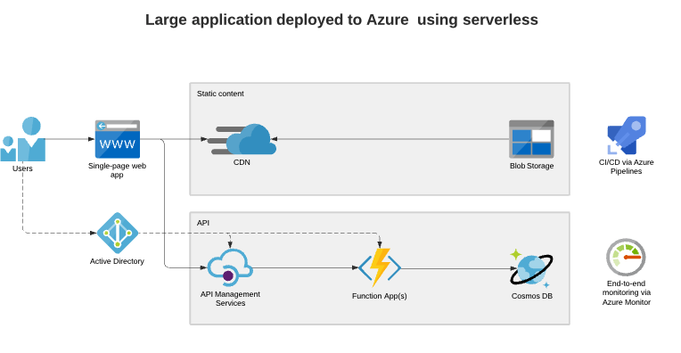
Digital Age - continue
Notes:
CDN - Content delivery network also refer as edge servers. They provide static documents (html, css, javascript, images etc)
Azure active directory with B2B and B2C allows user management, authentication and authorization to system
Api gateway allows management of various internal endpoints/functions code deployed to function apps or logic apps (authentication, security, routing, scaling etc).
Function Apps – allows to deploy code to run as function,
CosmosDB is one of many types of database as a service in cloud, store documents for faster access. Elastic databases.
Blob Storage is storage solution (Simple storage service) allows to have plenty of storage as per the requirement.
CI/CD via azure pipelines – Helps deployment of code on the basis of changes. (one of the many other attributes of DevOps)
Azure Monitor – monitors the resources, usability and varous other metrics to help improvement.

Slide 19
Cloud Computing
On demand computing – Started around 2006
Metering of consumption
Elasticity
On demand infrastructure
No maintenance
Public, Private or Hybrid
Competition and Growth
Notes:
Computing history and a lot of information available on internet,
First personal computer was become available during 70s,
There were client-server style computing where ‘terminals’ used to access powerful computer (servers). Mainframe and other UNIX servers used by various users over the network.
Personal computer become available during 70s however it become more popular in 80s and 90s
Amazon.com made computing available through ‘Amazon Web Services’, very interesting and turning point to make computing resources available as per the need to end users.
Microsoft which is provider of another largest and popular public cloud ‘Azure’ announced the plan to invest and build cloud computing infrastructure which was released in 2010.
There were rumors that Microsoft used AWS for initial days to support its cloud offering by deploying the application on AWS. Google made ‘Google app engine’ available around 2008. In July 2010 a private hosting provider Rackspace worked jointly with NASA to build first open source cloud platform OpenShift. OpenShift become popular among many large banks to provide private cloud.
There were resistance and reluctance to move to cloud by many banks, insurance and healthcare companies due to suspicion over security.
Cloud evolve from various other concepts such as Client-server, grid computing, peer-to-peer etc. (Botnet)
https://en.wikipedia.org/wiki/Cloud_computing#Early_history https://quantumcomputingtech.blogspot.com/2018/11/computer-history-timeline-up-to-2018.html

Slide 20
Cloud Computing
Providers
AWS (Amazon Web Services)
Microsoft Azure
Google Cloud Platform
Alibaba Cloud
IBM Cloud
Oracle Cloud
Salesforce
SAP
And many more..
Notes:
AWS is still major player with largest market share (around 31%)
Microsoft’s Azure is second larges cloud provider with around 20% share
Google cloud platform is still growing and have share around 7-8% (due to g-suites and cloud)
Alibaba cloud is at fourth position, this is largest cloud provider in china.

Slide 21
Cloud Computing
Service offering in Cloud and terminologies
IaaS
PaaS
SaaS
FaaS
And more such as XaaS

Slide 22
Cloud Computing - Market and pattern
Cloud Computing market
17000 crore worth in India
Expected to grow to 63000 crore by 2025
Worldwide it is going to grow by 3 times size of today
Paved the path for further innovation
Micro service architecture emerges
Artificial Intelligence
Automated virtual assistance
Sensors, location and user’s behavior based services
IoT (internet of things)
Data Science
Helps dealing with petabytes of data on regular basis for analytical information
Notes:
Cloud market is going to grow at the rate of 17% and above annually. This is an amazing time for people to learn and get along not only to get financial benefit but also to be ready for the new age of business.

Slide 23
Questions
BhaiyaJeeInUK facebook page
Bhaiyajee.co.uk (Comments section will be available soon)
Email: bhaiyajee.inuk@gmail.com
WhatsApp number will be available soon
Slack: bhaiyajee.slack.com

