Slide 1
On the importance of microservices in Hybrid Cloud solutions
Behnam Hajian
Senior Software Engineer
IBM api-connect
behnam@ca.ibm.com
GitHub: bhajian

Slide 2
Agenda
What is a Hybrid Cloud?
Why Hybrid Cloud?
How to approach Hybrid cloud with microservices
Application of hybrid cloud
Microservice architecture
Hybrid cloud architecture
IOT demo in hybrid cloud infrastructure
Q/A

Slide 3
What is a Hybrid Cloud?
In cloud computing, anything that involves multiple datacenters.
Hybrid cloud is a cloud computing environment which uses
  a mix of on-premises,
  private cloud
  and third-party,
  public cloud services
with orchestration between the two platforms.

Slide 4
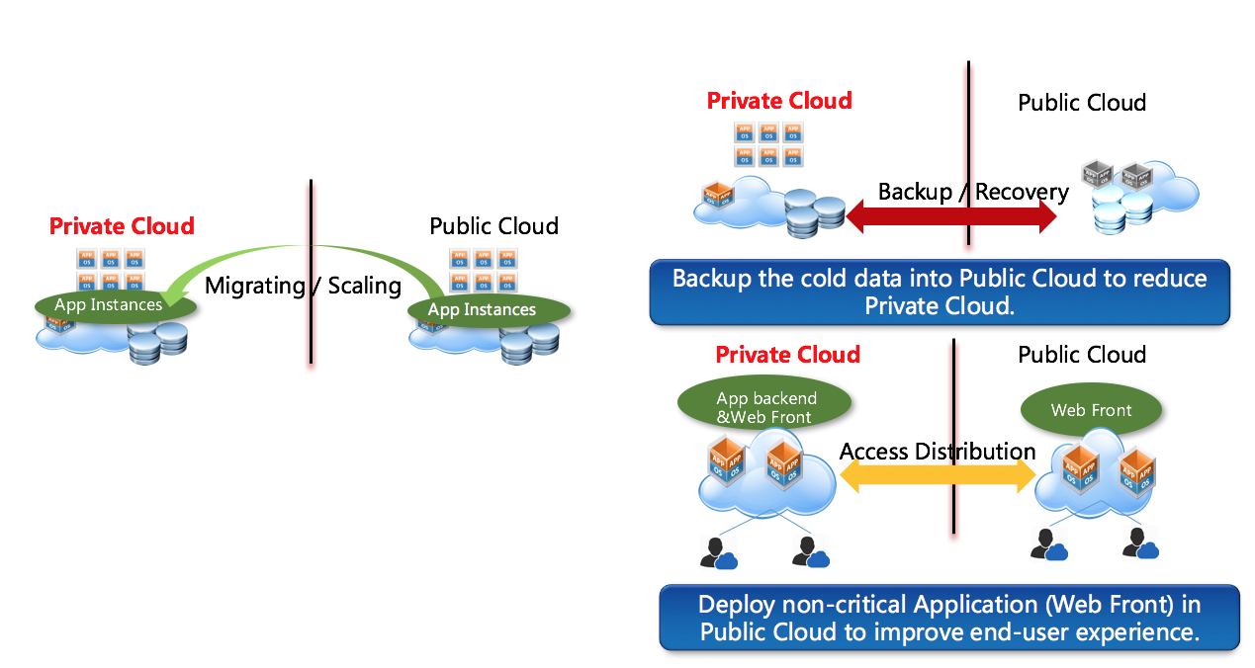
Hybrid cloud

Slide 5
Why Hybrid Cloud
workloads to move between private and public clouds as
  computing needs and costs change.
hybrid cloud gives businesses greater flexibility and more data deployment options.
Privacy & Security
Policies
  Companies’ code of conduct
  Country regulations
    Healthcare sensitive data
    Military sensitive data
    Financial Data

Slide 6
Why Hybrid Cloud
Public clouds are not entirely safe although we use SSL
Transferring certain information physically to other countries is illegal
  Australia -- Tied for highest ranks on laws against cybercrime and support for industry standards and global harmonization of rules
Privacy laws
  Canada: PIPEDA & HIPAA
    at the federal level, does not require all Canadian organizations to keep data in Canada.
    depending on which province your business is located in you could potentially be required to keep data within Canadian borders.
How about using Watson services which are not available on-prem ☹?

Slide 7
How to approach Hybrid cloud with microservices?
Monolithic applications can be successful, but
  Makes people feel frustrated when published to cloud
  We need services to be independently deployable and scalable
  They can also be managed by different teams
Microservices enables organizations to develop tiny modules with different security & privacy standards.

Slide 8
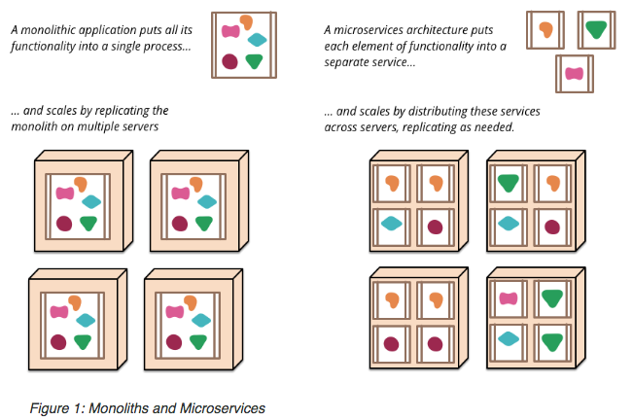
How to approach Hybrid cloud with microservices?

Slide 9
What is microservices?
"Microservices" - yet another new term on the crowded streets of software architecture [Martin Fowler].
In short, the microservice architectural style is an approach to developing a single application as a suite of small services,
  each running in its own process
  communicating with lightweight mechanisms,
    often an HTTP resource API,
  deployable by fully automated deployment machinery
  different programming languages
  use different data storage technologies [Martin Fowler].

Slide 10
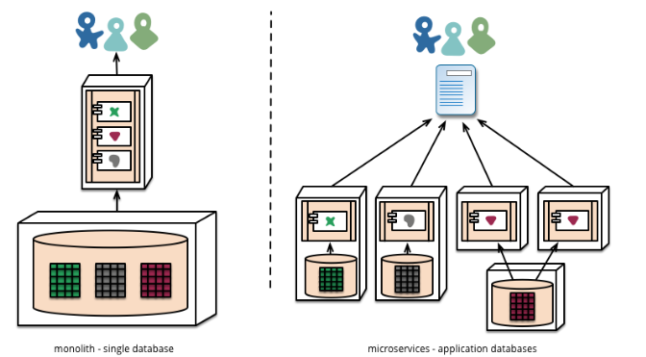

Slide 11
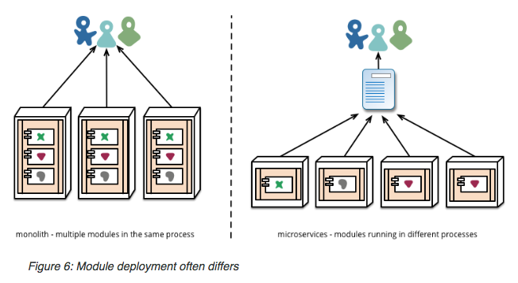
Pitfalls
Compatibility of microservices for different versions
UAT
DEV
PROD

Slide 12
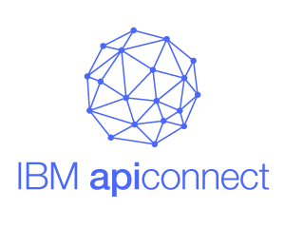
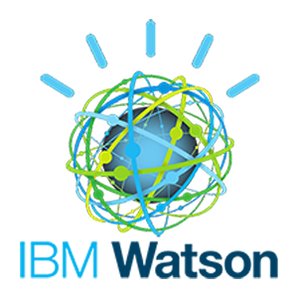
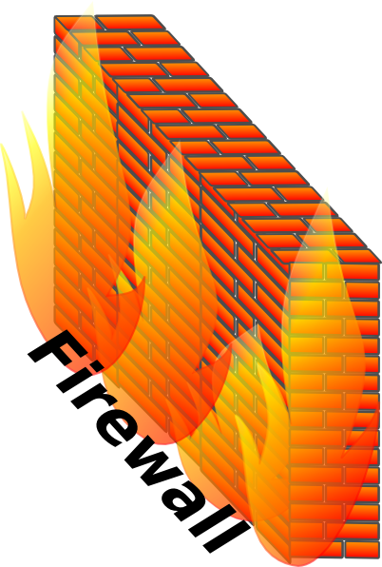




IOT Demo – Architecture1
Secured websocket
Secure connection (VPN) for sensitive data

Slide 13
IOT Demo – Architecture2
Secured websocket
Secure connection (VPN) for sensitive data

Slide 14
Thank you
Q/A

