Slide 1
On the importance of microservices in Hybrid Cloud solutions
Behnam Hajian
Senior Software Engineer
IBM api-connect
behnam@ca.ibm.com
GitHub: bhajian

Slide 2
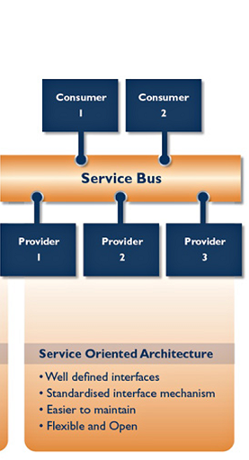
History of Service Oriented Architecture
SOA: Architectural style that supports service-orientation. application components provide services to other components via a communications protocol:
  RPC (Java Remote Object)
    Common Object Request Broker Architecture (CORBA)
    CORBA enables communication between software written in different languages and running on different computers.
  SOAP (WSDL)
  REST (JSON Schema) -> (swagger)
  ESB: Architectural model used for designing and implementing communication between mutually interacting software applications in SOA

Slide 3
What is microservices?
"Microservices" - yet another new term on the crowded streets of software architecture [Martin Fowler].
In short, the microservice architectural style is an approach to developing a single application as a suite of small services,
  each running in its own process
  communicating with lightweight mechanisms,
    often an HTTP resource API,
  deployable by fully automated deployment machinery
  different programming languages
  use different data storage technologies [Martin Fowler].

Slide 4
Microservice Definition
There are certain common characteristics around
  organization
  business capability,
  automated deployment,
  intelligence in the endpoints,
  and decentralized control of languages and data.

Slide 5
Monolithic style vs. Microservice
a monolithic application built as a single unit.
Enterprise Applications are often built in three parts:
  client-side
  Database
  server-side
Microservices enables organizations to develop tiny modules with different security & privacy standards.
  Use of hybrid cloud

Slide 6
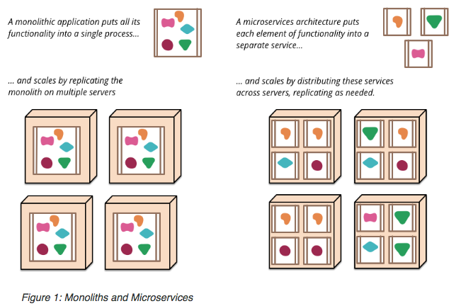
Scaling Microservices vs Monolith app

Slide 7
Characteristics of a Microservice Architecture
Componentization via Services
  services are out-of-process components who communicate with a mechanism such as a web service request, or remote procedure call.
    services are independently deployable
  Using services as components we need a more explicit component interface.
    Java is good in interfaces. Javascript is not ☹
    We use swagger as service definition and interface definition
  Remote calls are more expensive than in-process calls, and thus remote APIs need to be coarser-grained, which is often more awkward to use. (needs network/ http calls)

Slide 8
Characteristics of a Microservice Architecture
Organized around Business Capabilities
  splitting up into services organized around business capability
  Consequently the teams are cross-functional, including the full range of skills required for the development: user-experience, database, and project management.
  Any organization that designs a system (defined broadly) will produce a design whose structure is a copy of the organization's communication structure.

Slide 9
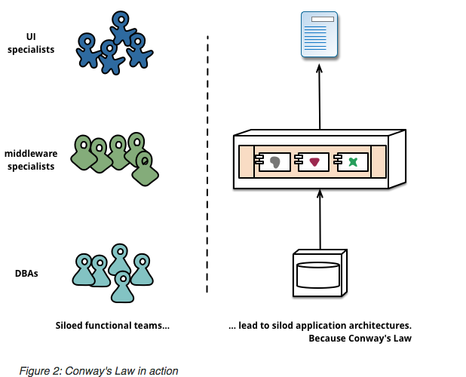
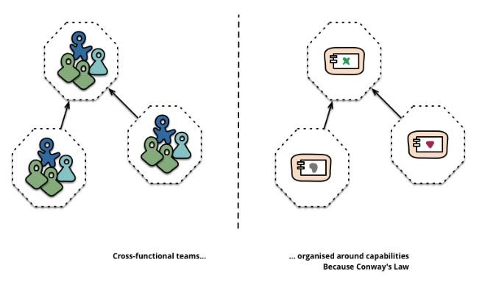
Characteristics of a Microservice Architecture

Slide 10
Characteristics of a Microservice Architecture
Products not Projects
  team should own a product over its full lifetime. A common inspiration for this is Amazon's notion of "you build, you run it”
  This brings developers into day-to-day contact with how their software behaves in production and increases contact with their users, as they have to take on at least some of the support burden.
Smart endpoints and dumb pipes
  In a monolith, the components are executing in-process and communication between them is via either method invocation or function call
  Microservices use a lightweight message bus. The infrastructure chosen is typically dumb
  simple implementations such as RabbitMQ or ZeroMQ don't do much more than provide a reliable asynchronous fabric

Slide 11
Characteristics of a Microservice Architecture
  we've seen many products and approaches that stress putting significant smarts into the communication mechanism itself. A good example of this is the Enterprise Service Bus (ESB), where ESB products often include sophisticated facilities for message routing, choreography, transformation, and applying business rules.
Decentralized Governance & Decentralized Data Management
  Use of Different languages
  Use of different Databases
  Use of different technologies
Microservices are plyglot

Slide 12
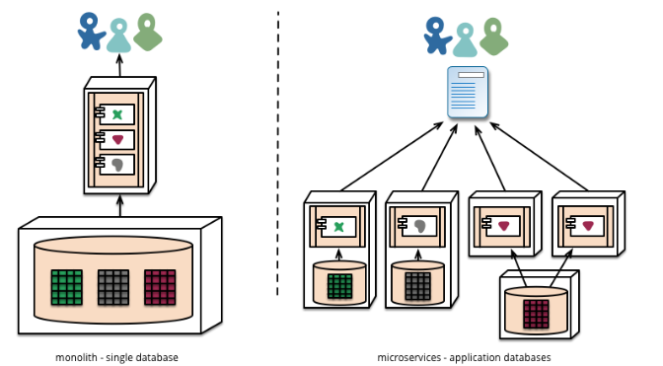
How to implement microservices

Slide 13
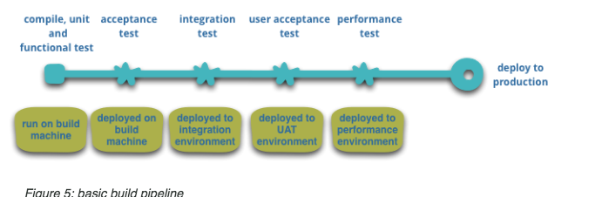
Characteristics of a Microservice Architecture
Infrastructure Automation
  We want as much confidence as possible that our software is working, so we run lots of automated tests. Promotion of working software 'up' the pipeline means we automate deployment to each new environment.

Slide 14
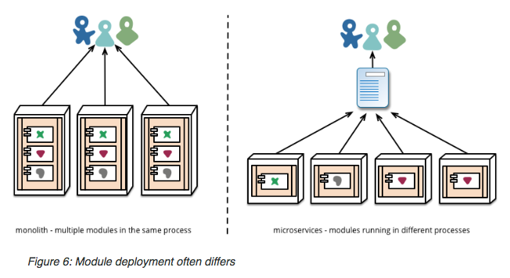
Pitfalls
Compatibility of microservices for different versions
Coordination:
UAT
DEV
PROD

Slide 15
Characteristics of a Microservice Architecture
Design for failure
  Any service call could fail due to unavailability of the supplier, the client has to respond to this as gracefully as possible.
  A consequence of using services as components, is that applications need to be designed so that they can tolerate the failure of services.
  Netflix's Simian Army induces failures of services and even datacenters during the working day to test both the application's resilience and monitoring.
Are Microservices the Future?
http://martinfowler.com/microservices/#what

Slide 16
Thank you
Q/A

