Slide 1
Python – Conditional Statements
If
If –else
If elif – Nested

Slide 2
Python - if --if-else
if expression:
statement(s)
if expression:
statement(s)
else:
statement(s)

Slide 3
Python- Elif Statement
The elif statement allows you to check multiple expressions for TRUE and execute a block of code as soon as one of the conditions evaluates to TRUE
if expression1:
statement(s)
elif expression2:
statement(s)
elif expression3:
statement(s)
else:
statement(s)

Slide 4
Elif- Example
var = 100
if var == 200:
print "1 - Got a true expression value"
print var
elif var == 150:
print "2 - Got a true expression value"
print var
elif var == 100:
print "3 - Got a true expression value"
print var
else:
print "4 - Got a false expression value"
print var
print "Good bye!"

Slide 5
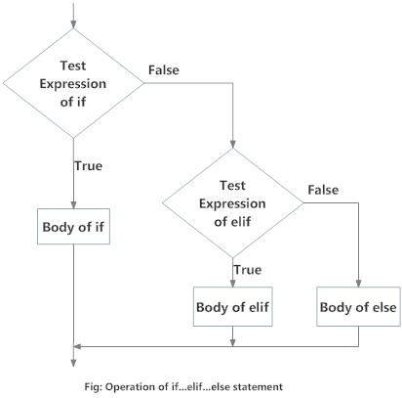
Python – if-elif -- Flowchart

Slide 6
Python Loops
while loop: Repeats a statement or group of statements while a given condition is TRUE. It tests the condition before executing the loop body.
For loop: Executes a sequence of statements multiple times and abbreviates the code that manages the loop variable.
nested loops: You can use one or more loop inside any another while, for or do..while loop.

Slide 7
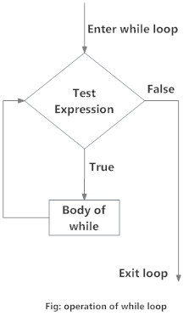
Python While Loops
While Loops :

Slide 8
Python While Loops
While Loops :
n = 100
s = 0
counter = 1
while counter <= n:
s = s + counter
counter += 1
print("Sum of 1 until %d: %d" % (n,s))

Slide 9
Python While –Else Loop
while condition:
statement_1
...
statement_n
else:
statement_1
...
statement_n

Slide 10
Python For Loops
A for loop is used for iterating over a sequence (that is either a list, a tuple or a string).
This is less like the for keyword in other programming language, and works more like an iterator method as found in other object-orientated programming languages.

Slide 11
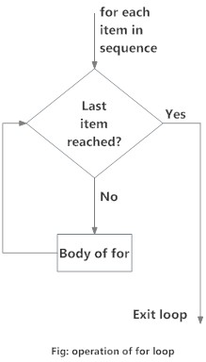
Python – For Loop Flowchart

Slide 12
Python For Loop Example
fruits = ["apple", "banana", "cherry"] for x in fruits: print(x)
Break: statement we can stop the loop before it has looped through all the items:
fruits = ["apple", "banana", "cherry"] for x in fruits: if x == "banana": break print(x)

Slide 13
Python – For Loop Continue Example
fruits = ["apple", "banana", "cherry"] for x in fruits: if x == "banana": continue print(x)

Slide 14
Python – Range Example
Range Example:
for x in range(6): print(x)
for x in range(2, 30, 3): print(x)

Slide 15
Python – Recursion
Python also accepts function recursion, which means a defined function can call itself.
def factorial(n):
if(n <= 1):
return 1
else:
return(n*factorial(n-1))
n = int(input("Enter number:"))
print("Factorial:")
print(factorial(n))

Slide 16
Python – Nested Loops
Python programming language allows to use one loop inside another loop. Following section shows few examples to illustrate the concept.
for iterating_var in sequence:
for iterating_var in sequence:
statements(s)
statements(s)
while expression:
while expression:
statement(s)
statement(s)

Slide 17
Python – Nested Loops - Example
The following program uses a nested for loop to find the prime numbers from 2 to 100:
i = 2
while(i < 100):
j = 2
while(j <= (i/j)):
if not(i%j): break
j = j + 1
if (j > i/j) : print i, " is prime"
i = i + 1
print "Good bye!"

Slide 18
Python – Loop Control statement
break statement
Terminates the loop statement and transfers execution to the statement immediately following the loop.
Continue statement
Causes the loop to skip the remainder of its body and immediately retest its condition prior to reiterating.
pass statement
The pass statement in Python is used when a statement is required syntactically but you do not want any command or code to execute.

Slide 19
Functions
A function is a block of organized, reusable code that is used to perform a single, related action. Functions provide better modularity for your application and a high degree of code reusing.
As you already know, Python gives you many built-in functions like print(), etc. but you can also create your own functions. These functions are called user-defined functions.

Slide 20
Functions - Continued
You can define functions to provide the required functionality. Here are simple rules to define a function in Python.
Function blocks begin with the keyword def followed by the function name and parentheses ( ( ) ).
Any input parameters or arguments should be placed within these parentheses. You can also define parameters inside these parentheses.
The first statement of a function can be an optional statement - the documentation string of the function or docstring.
The code block within every function starts with a colon (:) and is indented.
The statement return [expression] exits a function, optionally passing back an expression to the caller. A return statement with no arguments is the same as return None

Slide 21
Function Definition
def functionname( parameters ): "function_docstring" function_suite return [expression]
def printme( str ):
print str
Return
def sum( arg1, arg2 ):
# Add both the parameters and return them."
total = arg1 + arg2; # Here total is local variable.
print "Inside the function local total : ", total
return total;

Slide 22
Calling Function
# Now you can call sum function
sum( 10, 20 );
print "Outside the function global total : ", total

