Slide 1
Selenium Training
Day 5

Slide 2
Selenium – Framework
TestNG Framework
Annotations in TestNg
TestNG XML
Page Object Model
Automation Framework Integration

Slide 3
Test NG Framework Introduction
TestNG is an open source automated testing framework; where NG of TestNG means Next Generation. TestNG is similar to JUnit but it is much more powerful than JUnit but still it’s inspired by JUnit. It is designed to be better than JUnit, especially when testing integrated classes

Slide 4
Advantages of TestNG framework
It gives the ability to produce HTML Reports of execution
Annotations made testers life easy
Test cases can be Grouped & Prioritized more easily
Parallel testing is possible
Generates Logs
Data Parameterization is possible

Slide 5
Installation of TestNG
Installation of Test NG Steps
http://toolsqa.com/selenium-webdriver/install-testng/

Slide 6
Test NG Annotation
@BeforeSuite
The annotated method will be run only once before all tests in this suite have run.
@AfterSuite
The annotated method will be run only once after all tests in this suite have run.
@BeforeClass
The annotated method will be run only once before the first test method in the current class is invoked.
@AfterClass
The annotated method will be run only once after all the test methods in the current class have run.

Slide 7
Test NG Annotation
@BeforeTest
The annotated method will be run before any test method belonging to the classes inside the <test> tag is run.
@AfterTest
The annotated method will be run after all the test methods belonging to the classes inside the <test> tag have run
@BeforeMethod
The annotated method will be run before each test method.
@AfterMethod
The annotated method will be run after each test method.

Slide 8
Test NG Annotations
@DataProvider
Marks a method as supplying data for a test method. The annotated method must return an Object[ ][ ], where each Object[ ] can be assigned the parameter list of the test method. The @Test method that wants to receive data from this DataProvider needs to use a dataProvider name equals to the name of this annotation.
@Test
Marks a class or a method as a part of the test.
@Listeners
Defines listeners on a test class.

Slide 9
Before Test Significance
It can be used in Scenarios in which before starting the Tests we need to perform some action
opening the browser
Setting up the test data
Reading environment details
All these actions can be performed as per the requirements of the framework

Slide 10
Demo on TestNG
Classes Example in eclipse for demo
TestNGExample1
TestCases
SampleTest
Data_Provider
LoginTest
BeforeAfterTest
TestNGAssert
Run Test from TestNG xml

Slide 11
Test NG Assertions
Assert.assertEqual(String actual, String expected) :Asserts that two Strings are equal. If they are not, an AssertionError is thrown
Assert.assertEquals(boolean actual, boolean expected) : Asserts that two booleans are equal. If they are not, an AssertionError is thrown
Assert.assertTrue(condition) : Asserts that a condition is true. If it isn’t, an AssertionError is thrown
Assert.assertTrue(condition, message) : Asserts that a condition is true. If it isn’t, an AssertionError, with the given message, is thrown.
AssertNull(object) :This assertion checks for a object, if it is null or not. When an object is ‘null’ the assertion returns an exception resulting in aborting the test. The syntax is as follows:

Slide 12
TestNG XML
The main advantage of using TestNG framework in Selenium is its ease of running multiple tests from multiple classes using just one configuration (We can also have many configurations, which depends upon how we design our test). Testng.xml is an XML file that describes the runtime definition of a test suite. It describes complex test definition while still remain easy to edit.

Slide 13
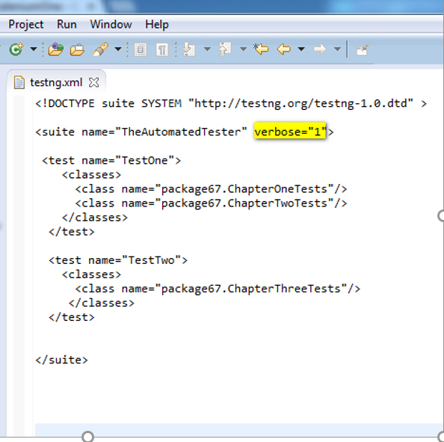
TestNG XML Structure
The testng.xml file will have following hierarchy
The root tag of this file is <suite>.
<suite> tag can contain one or more
<test> tags.
<test> tag can contain one or more
<classes> tags.
<classes> tag can contain one
or more <method> tags.

Slide 14
Parallel Execution
Test NG also allows the test cases to be executed parallelly
TestNG provides multiple ways to execute tests in separate threads. In testng.xml, if we set 'parallel' attribute on the tag to 'tests', testNG will run all the ‘@Test’ methods in tag in the same thread, but each tag will be in a separate thread
If we want to run methods/classes in separate threads, we need to set 'parallel' attribute on the tag to 'methods' / 'classes‘

Slide 15
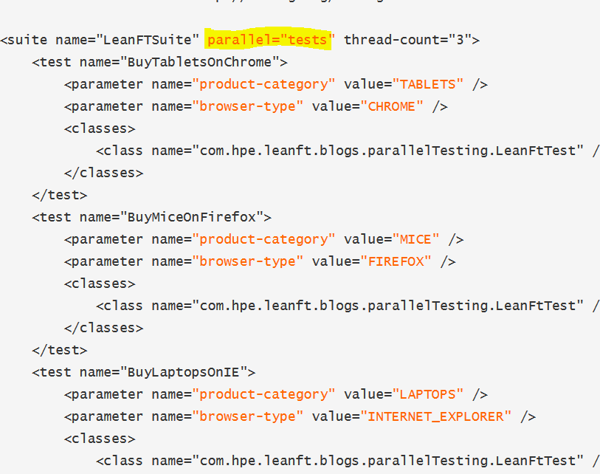
Parallel Execution

Slide 16
Page Object Model Framework
Page Object Model is a design pattern to create Object Repository for web UI elements.
Under this model, for each web page in the application, there should be corresponding page class.
This Page class will find the WebElements of that web page and also contains Page methods which perform operations on those WebElements.

Slide 17
Advantage of POM
Page Object Patten says operations and flows in the UI should be separated from verification. This concept makes our code cleaner and easy to understand.
The Second benefit is the object repository is independent of test cases, so we can use the same object repository for a different purpose with different tools. For example, we can integrate POM with TestNG/JUnit for functional Testing and at the same time with JBehave/Cucumber for acceptance testing.
Code becomes less and optimized because of the reusable page methods in the POM classes.
Methods get more realistic names which can be easily mapped with the operation happening in UI. i.e. if after clicking on the button we land on the home page, the method name will be like 'gotoHomePage()'.

Slide 18
Automation Framework integration

