Slide 1
Selenium Training
Day 3

Slide 2
Selenium – Java Concepts
Exception Handling
Method Overloading and Overriding
Abstract Classes and Interface

Slide 3
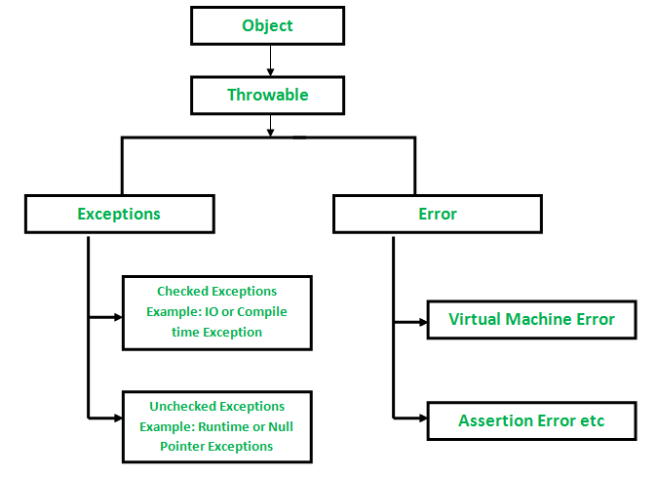
Exception Handling
An exception is an unwanted or unexpected event, which occurs during the execution of a program i.e. at run time, that disrupts the normal flow of the program’s instructions.

Slide 4
Checked and Unchecked Exception
Checked: are the exceptions that are checked at compile time. If some code within a method throws a checked exception, then the method must either handle the exception or it must specify the exception using throws keyword.
Unchecked are the exceptions that are not checked at compiled time. In C++, all exceptions are unchecked, so it is not forced by the compiler to either handle or specify the exception. It is up to the programmers to be civilized, and specify or catch the exceptions.

Slide 5
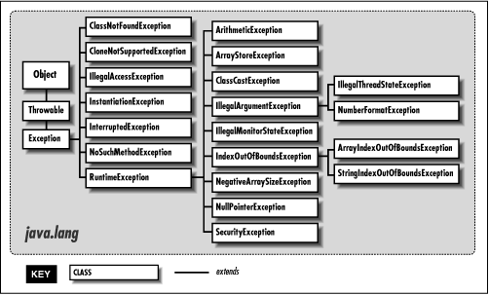
Exception class Hierarchy

Slide 6
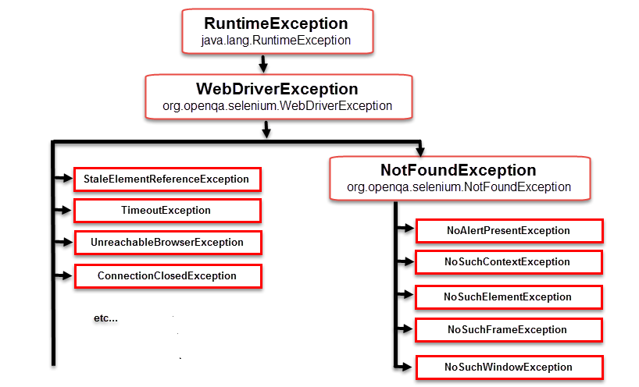
Exceptions in Selenium

Slide 7
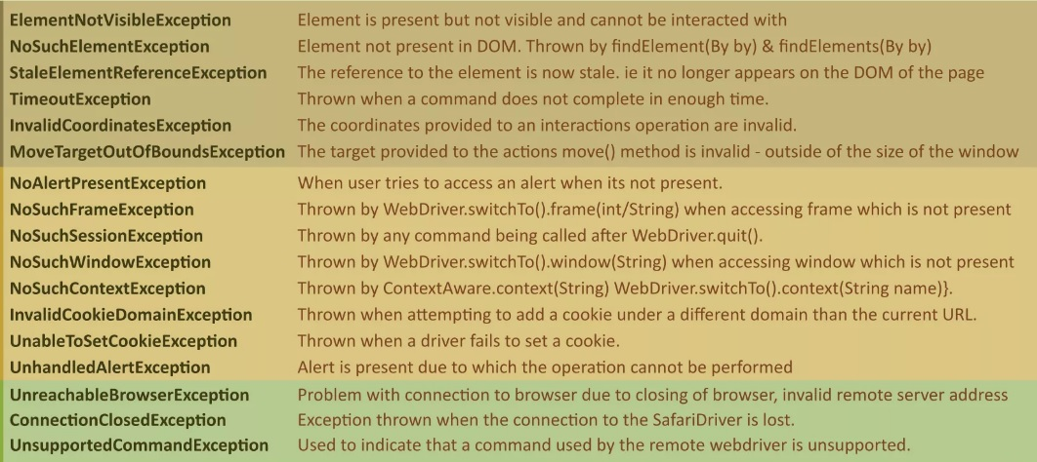
Exceptions in Selenium

Slide 8
Exception Handling Keywords
Throw: keyword is used to throw exception to the runtime to handle it.
Throws: When we are throwing any exception in a method and not handling it, then we need to use throws keyword in method signature to let caller program know the exceptions that might be thrown by the method. The caller method might handle these exceptions or propagate it to it’s caller method using throws keyword. We can provide multiple exceptions in the throws clause and it can be used with main() method also.

Slide 9
Exception Handling Keywords
try-catch – We use try-catch block for exception handling in our code. try is the start of the block and catch is at the end of try block to handle the exceptions. We can have multiple catch blocks with a try and try-catch block can be nested also. catch block requires a parameter that should be of type Exception.
finally – finally block is optional and can be used only with try-catch block. Since exception halts the process of execution, we might have some resources open that will not get closed, so we can use finally block. finally block gets executed always, whether exception occurred or not.

