Slide 1

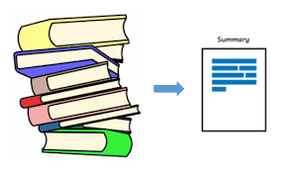
AKSHAR
GUIDE :
Dr. Rekha Chaturvedi
TEAM :
Konagandla Bhaskar
Kartik Sharma
P Venkata Hemanth

Slide 2
AIM OF THE PROJECT
To reduce the hectic work with large corpus of text.
Leaving Mundane tasks to machines.
Understanding large textual data in an easy and fun way.

Slide 3
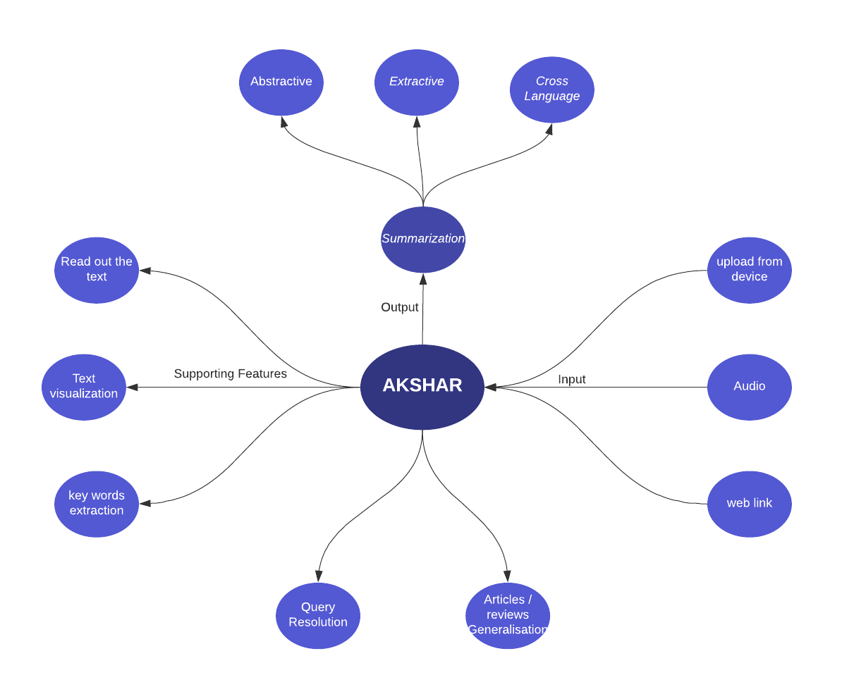
PROJECT OVERVIEW
insert text

Slide 4
OBJECTIVES
ü The model must summarize the given corpus of text ( of any length). ü Help visualizing the text for the user. ü Keywords extraction. ü Reading out the text. ü Give short information upon user’s search query. ü Cross language Text summarization

Slide 5
Text
sentence 1
sentence 2
sentence 3
sentence 4
sentence 5
Abstractive
Summarizer
Summary
New Sentences
Text
sentence 1
sentence 2
sentence 3
sentence 4
sentence 5
Summary
sentence 1
sentence 3
sentence 5
Extractive
Summarizer

Slide 6
EXTRACTIVE METHODS
OUR METHODOLOGIES
Input
Preprocessing
Redundancy removal
assign score
select sentences
final summary

Slide 7
Assign Score
Calculate word Frequences
Normalize word frequencies
calculate sentence Scores
OUR METHODOLOGIES
select top n senteces
sort them in relative order
Final Summary

Slide 8
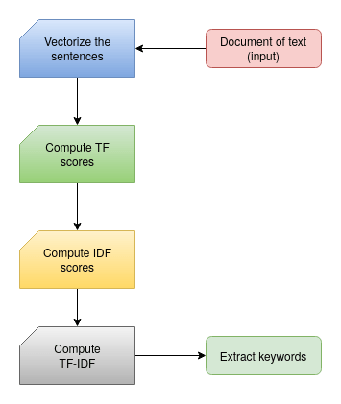
OUR METHODOLOGIES
Keywords Extraction

Slide 9
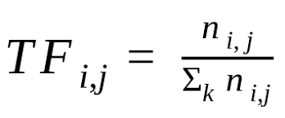
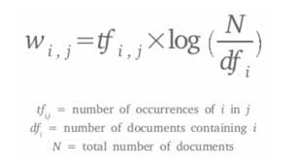
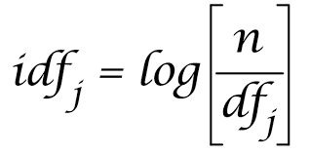
Keywords Extraction
OUR METHODOLOGIES
TERM FREQUENCY(TF)
TERM FREQUENCY- INVERSE DOCUMENT FREQUENCY
(TF-IDF)
INVERSE DOCUMENT FREQUENCY(IDF)

Slide 10
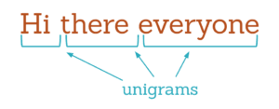
Unigrams
OUR METHODOLOGIES

Slide 11
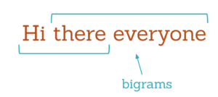
Bigrams
OUR METHODOLOGIES

Slide 12

Trigrams
OUR METHODOLOGIES

Slide 13
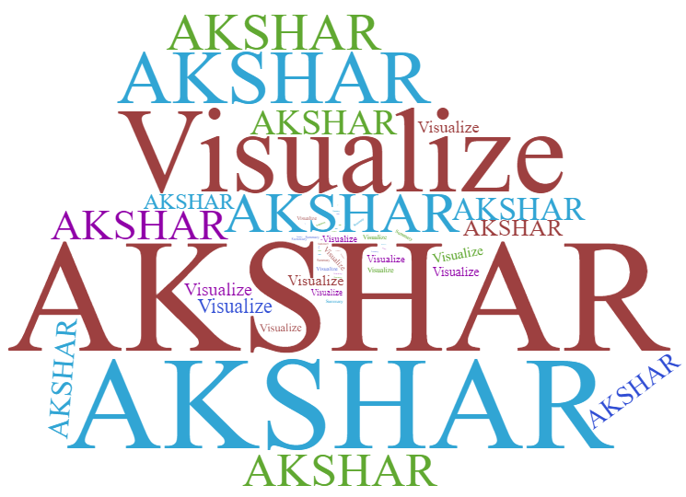
OUR METHODOLOGIES
Word Cloud

Slide 14
OUR METHODOLOGIES
Extractive Answering

Slide 15
OUR METHODOLOGIES
Abstractive Methods

Slide 18
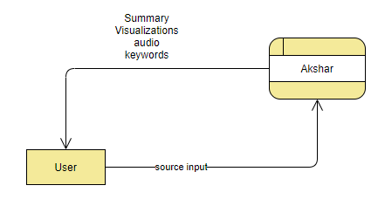
LEVEL - 0
DATA FLOW DIAGRAM
0

Slide 19
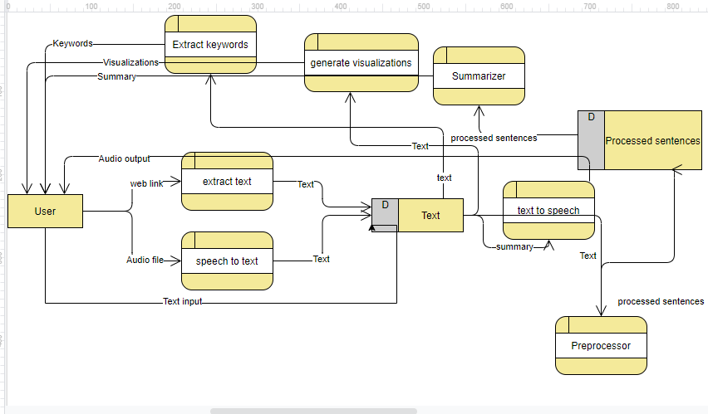
LEVEL - 1
7
DATA FLOW DIAGRAM
6
5
1
4
2
3

Slide 20
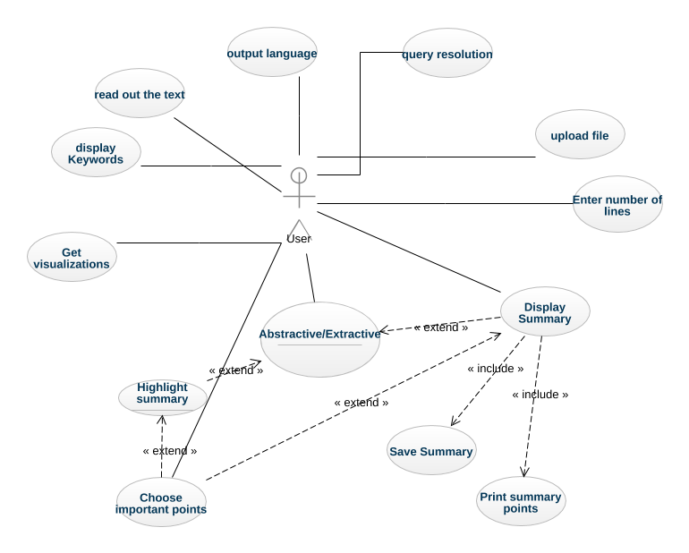
USER
USE CASE DIAGRAM

Slide 21
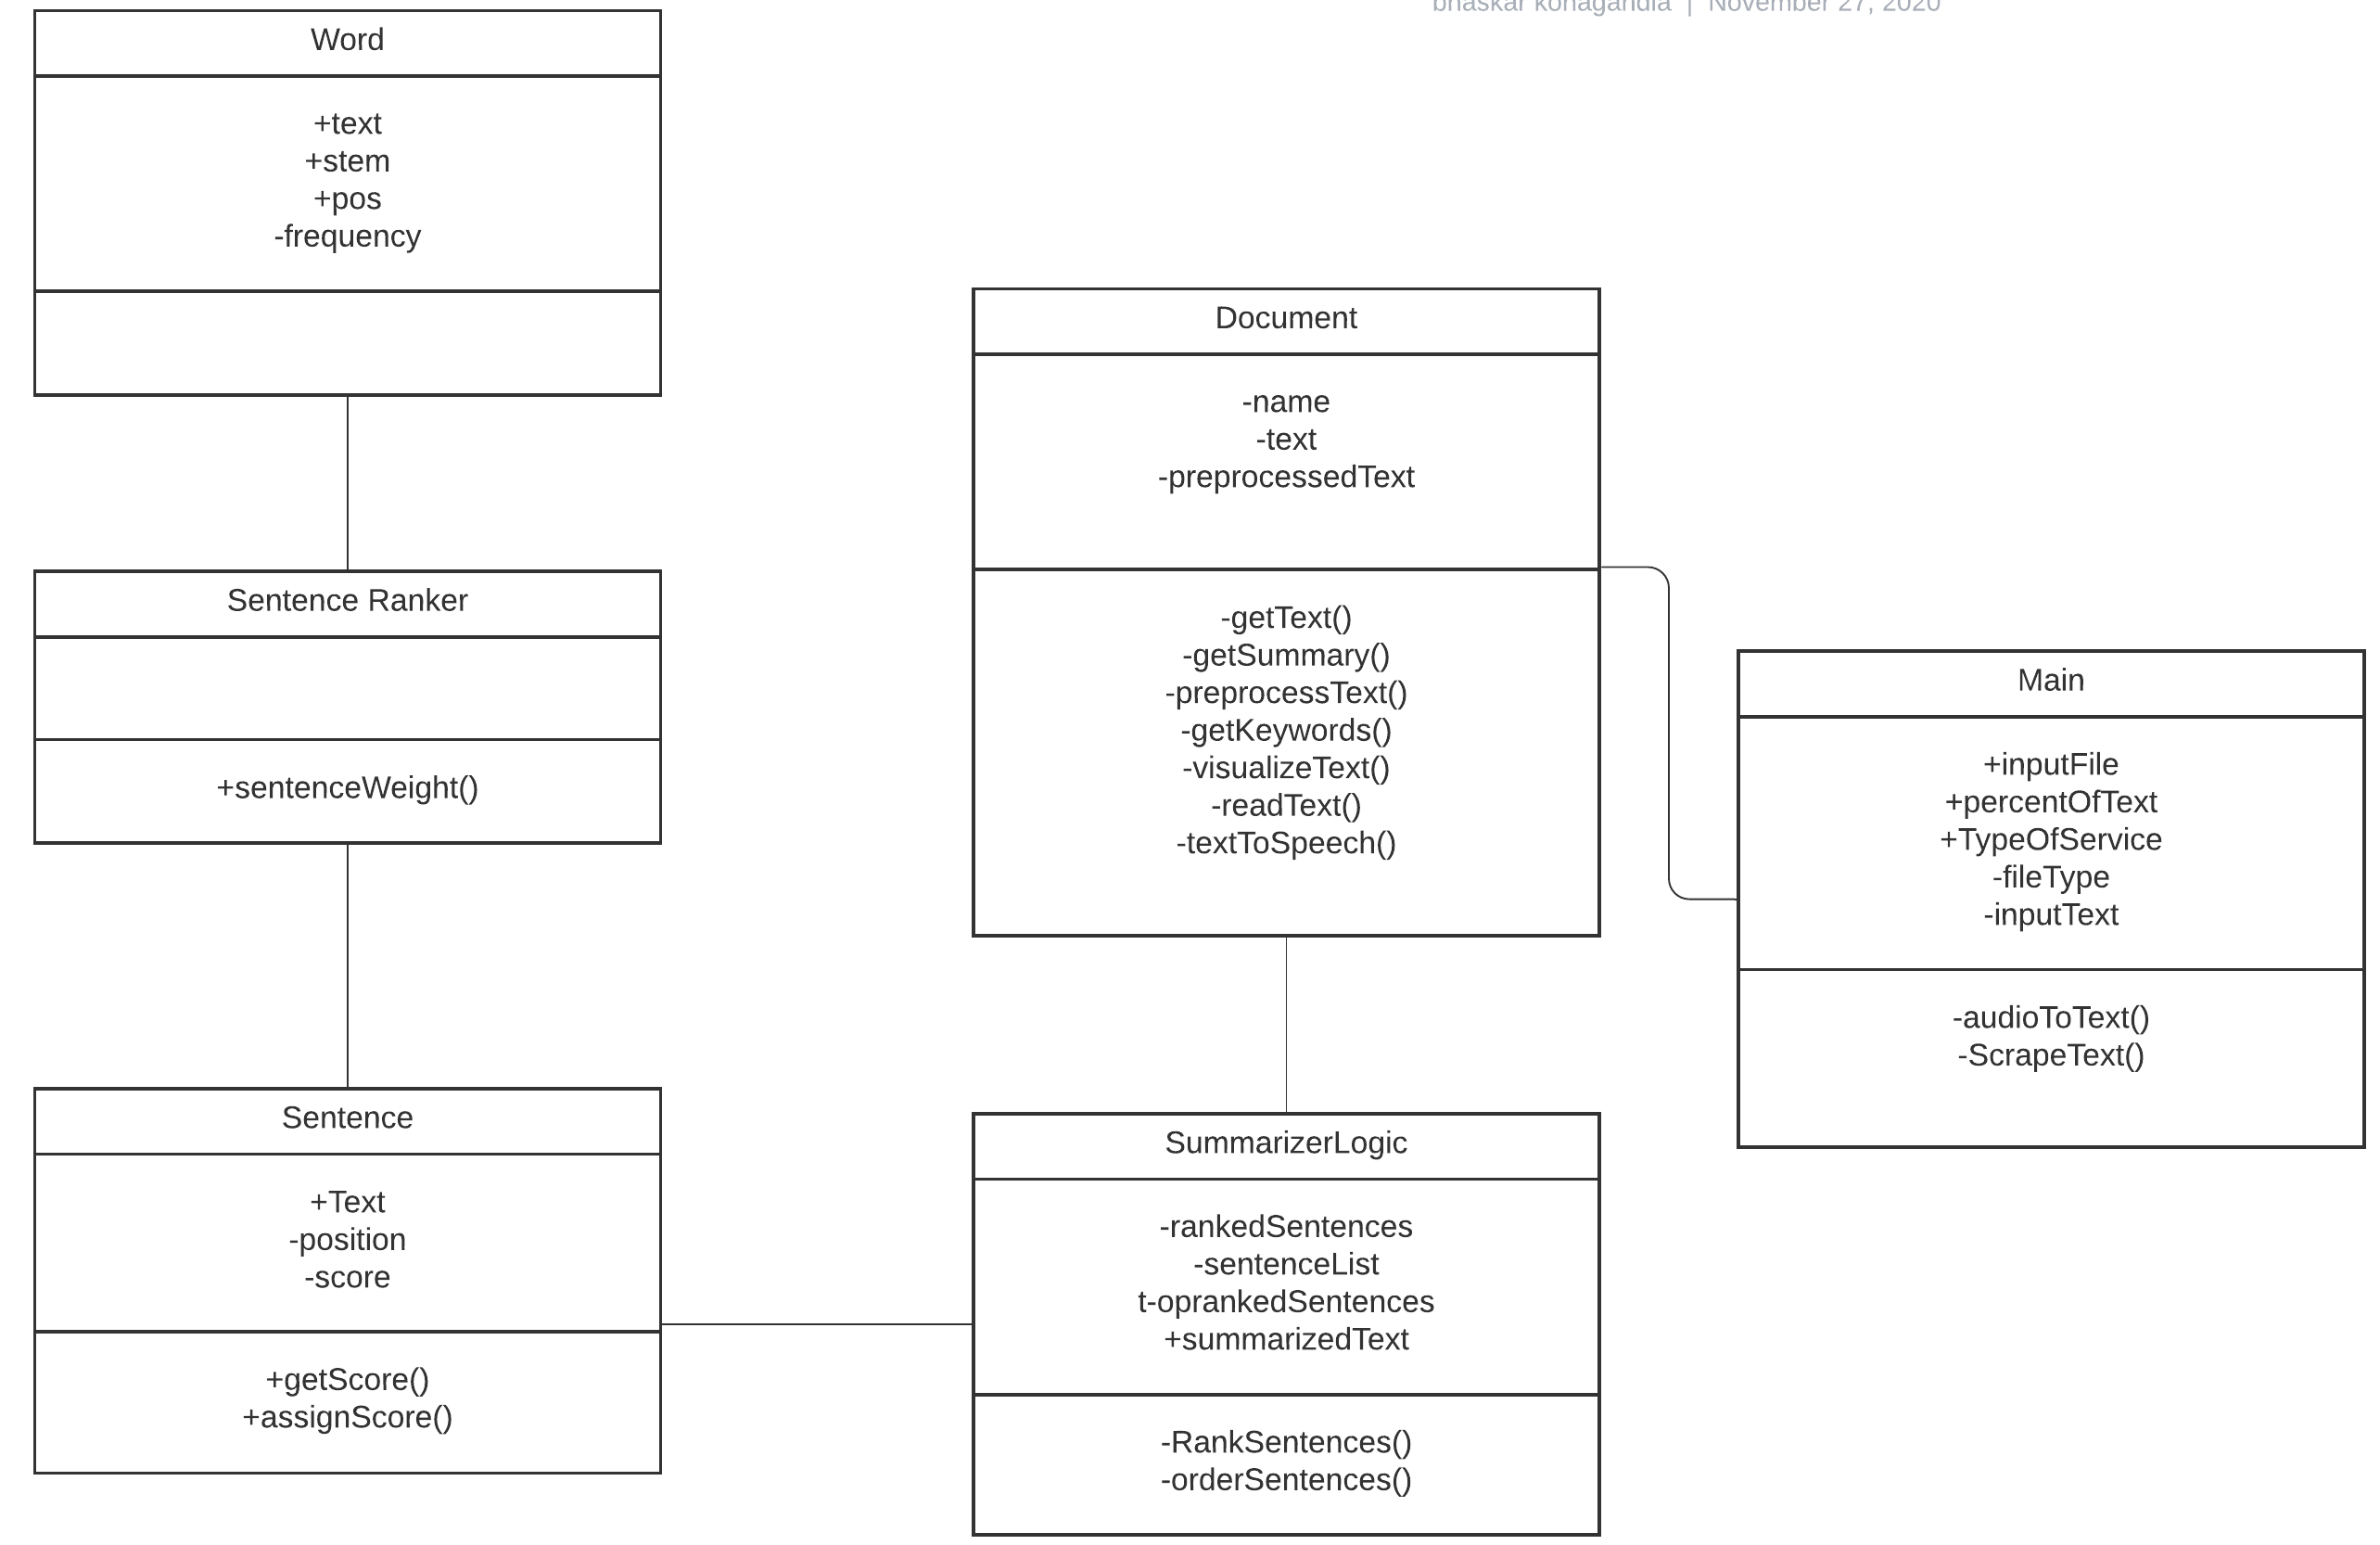
CLASS DIAGRAM

Slide 22
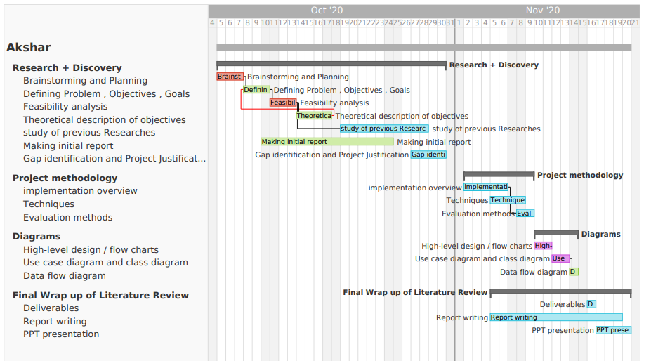

Slide 23
?
Why we need this

Slide 24
Challenges
Extract hidden semantic relationship
Relevance detection
Appearance of pronouns during extractive text summarization which will make the summary unclear.
If unnecessary topic is also present in the source text , there are chances of getting them during the summary generation if topic is taken care then this problem can be taken care to some extent.

Slide 25
CONCLUSION

Slide 26


