Slide 1
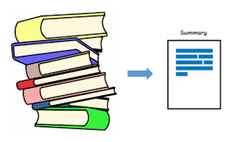

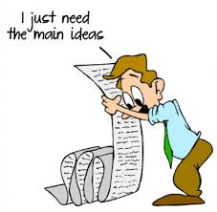
Presentation on AKSHAR
at
AMITY UNIVERSITY RAJASTHAN, JAIPUR (INDIA)
For partial fulfillment of the degree
of
Bachelor of Technology
in
Computer Science and Engineering
Under the Guidance of
Dr. Rekha Chaturvedi
Asiistant Professor (CSE)
By
Konagandla Bhaskar A20405217088
Kartik Sharma A20405217121
P Venkata Hemanth A20405217065
12th June 2021

Slide 2
Abstract
There are lot of actions that we do on data that takes much time and consume more human resources.
Natural Language Processing allow computers to track, extract, and analyse the vast array of information.
This application is an one stop solution for most of the text related tasks that we encounter daily on our large corpus of data which include large articles , text documents etc.
It manages user given data and aids users to grasp much information and get valuable insights of their data.
The application provides textual summary of input in both extractive and abstractive ways.
Sentence ranking is used for giving scores and extracting senteces for extractive summaries.
Tf - idf method is used for getting keywords.
web scraping is used for getting text from internet during the extraction of summaries or for the sake of getting answers to the users questions.
Also, the application generates visualizations of your textual data ( through word cloud representations , statistics of different kinds of words ) , keywords extraction etc. for gaining better knowledge.
Users can also query their own text for answers or just give an question to the application which can try to fetch relevant answers.

Slide 3
Aim
To reduce the hectic work with large corpus of text.
Leaving Mundane tasks to machines.
Understanding large textual data in an easy and fun way.
Problem Definition
This project is based on shrinking the text to the extent that is useful for the user. The aim is to generate summaries by keeping sentence relativity , meaning and mainly important and required information form the original text , also to request answers to the questions generated by users , to make some visuals out of text that will help more for us to get into it.

Slide 4
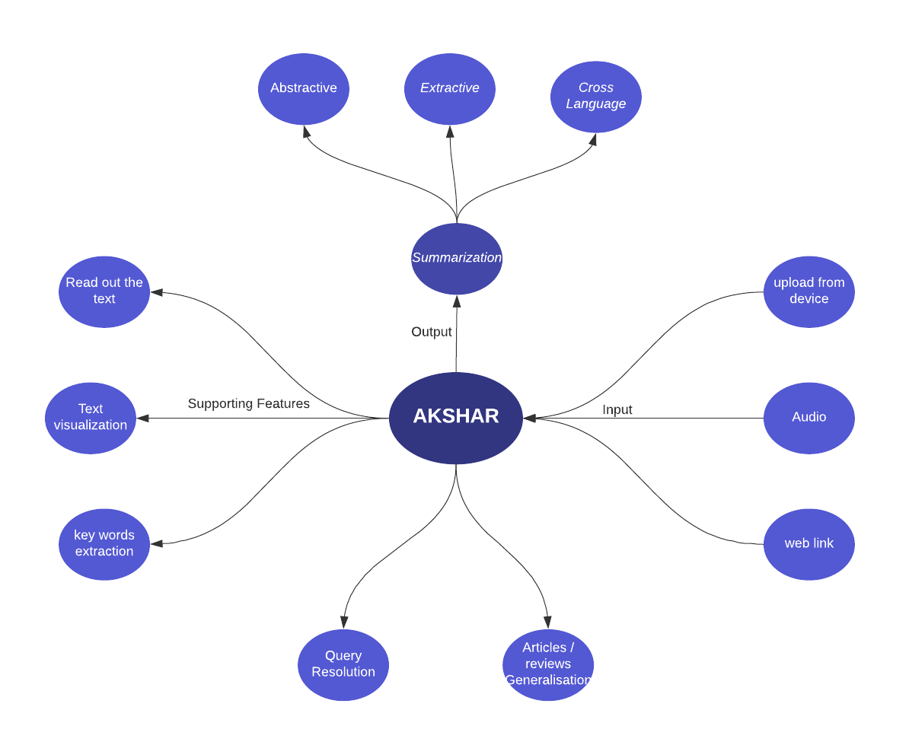
PROJECT OVERVIEW
insert text

Slide 5
OBJECTIVES
ü The model must summarize the given corpus of text ( of any length). ü Help visualizing the text for the user. ü Keywords extraction. ü Reading out the text. ü Give short information upon user’s search query. ü Cross language Text summarization

Slide 6
Text
sentence 1
sentence 2
sentence 3
sentence 4
sentence 5
Abstractive
Summarizer
Summary
New Sentences
Text
sentence 1
sentence 2
sentence 3
sentence 4
sentence 5
Summary
sentence 1
sentence 3
sentence 5
Extractive
Summarizer

Slide 7
EXTRACTIVE METHODS
OUR METHODOLOGIES
Input
Preprocessing
Redundancy removal
assign score
select sentences
final summary

Slide 8
Assign Score
Calculate word Frequences
Normalize word frequencies
calculate sentence Scores
OUR METHODOLOGIES
select top n senteces
sort them in relative order
Final Summary

Slide 9
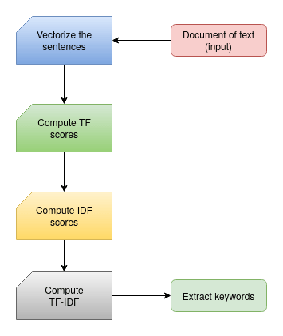
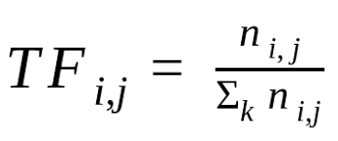
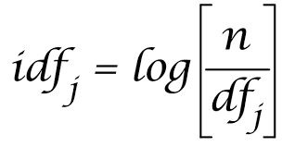
Keywords Extraction
OUR METHODOLOGIES
TERM FREQUENCY(TF)
INVERSE DOCUMENT FREQUENCY(IDF)

Slide 10
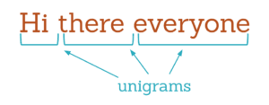
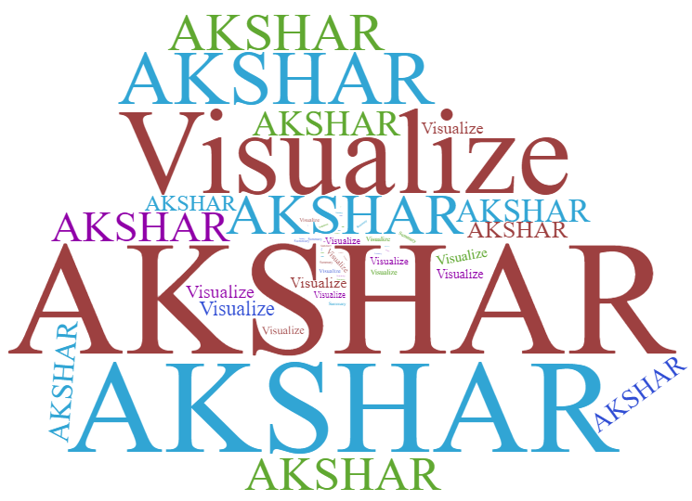
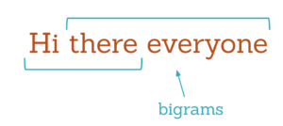
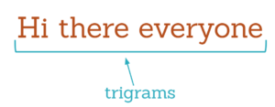
n-grams
Word Cloud
OUR METHODOLOGIES

Slide 11


Query Resolution
OUR METHODOLOGIES
Extractive
answering
Specific
Internet
Akshar
Extractive
Summary
Internet
Generic

Slide 12
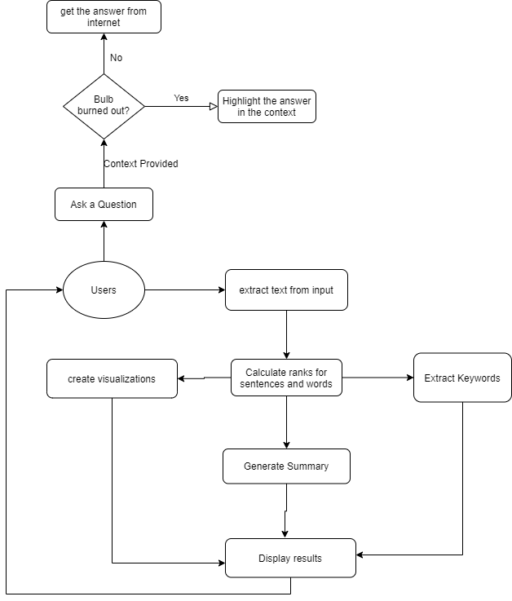
System Architecture

Slide 13
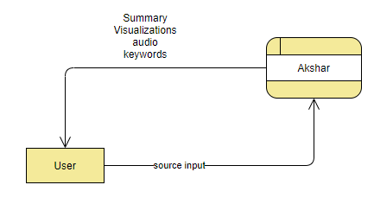
LEVEL - 0
DATA FLOW DIAGRAM
0

Slide 14
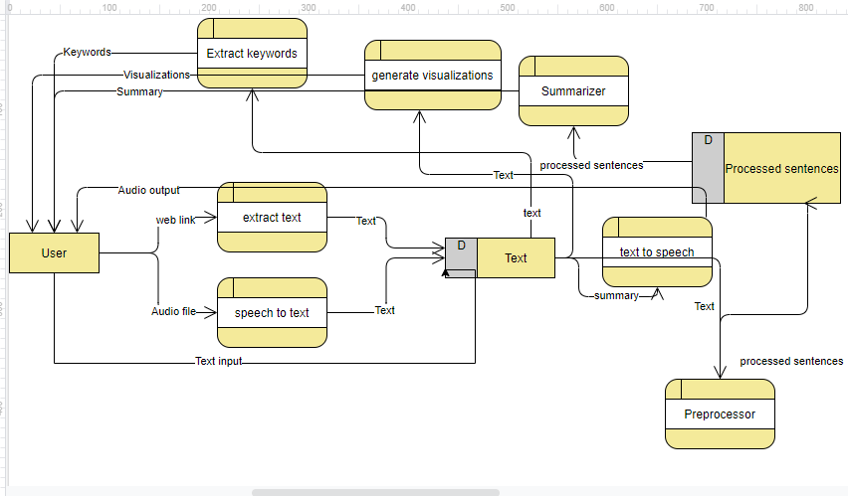
LEVEL - 1
7
DATA FLOW DIAGRAM
6
5
1
4
2
3

Slide 15
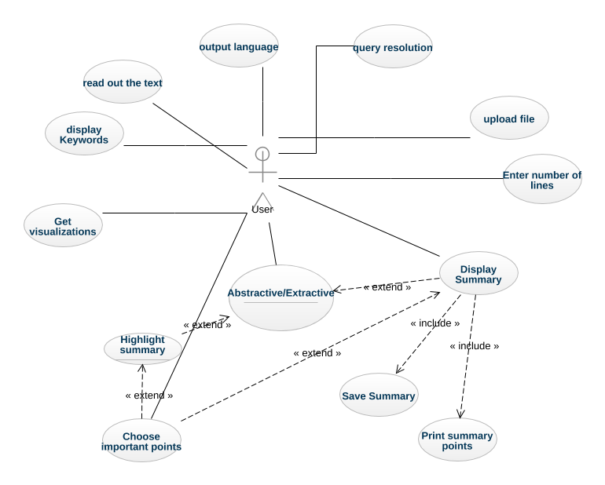
USER
USE CASE DIAGRAM

Slide 16
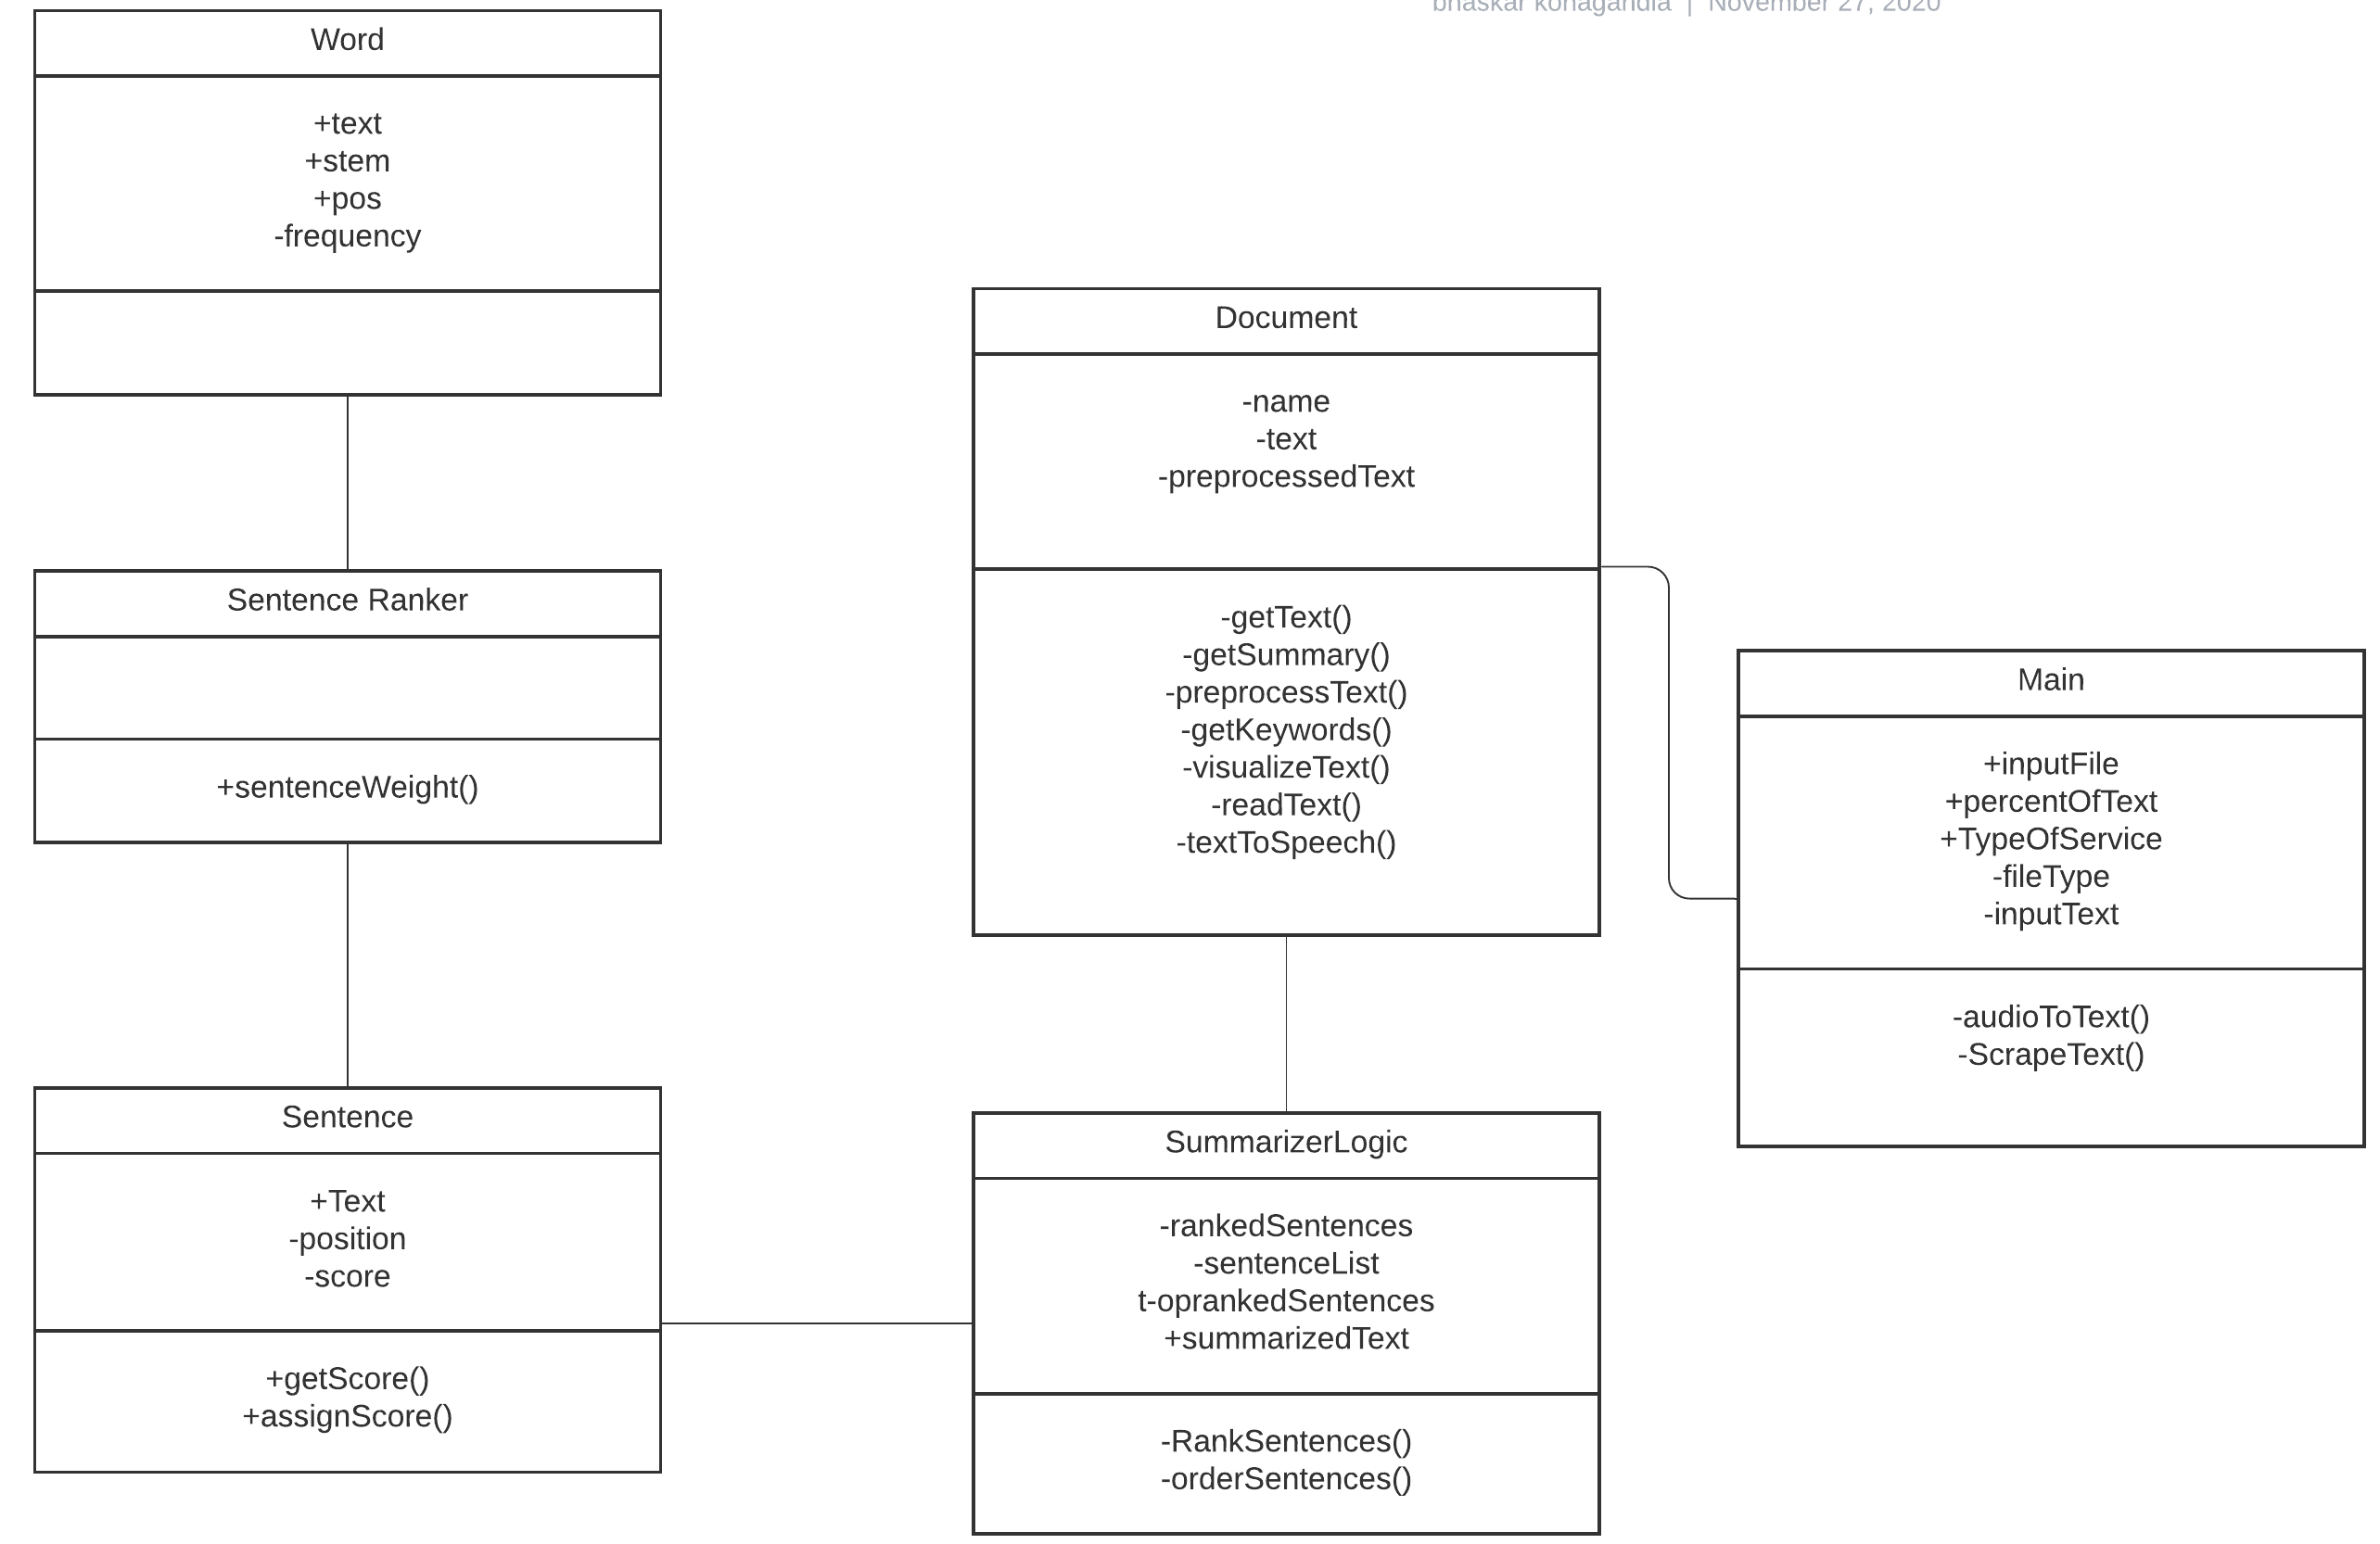
CLASS DIAGRAM

Slide 17
System Configuration and Software Used
Software Requirements
System Configuration
HTML
CSS
JAVA SCRIPT
PYTHON
Flask
System : Any processor after Pentium
Hard Disk : 40GB
Monitor : 14’ColourMonitor
Mouse : Optical Mouse
Ram : 2 GB

Slide 18
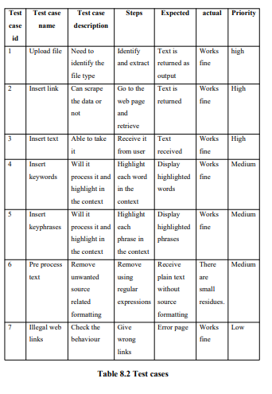
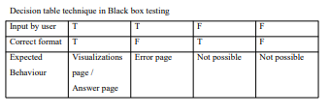
Testing

Slide 19
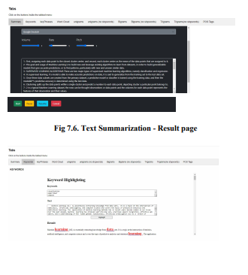
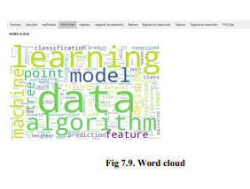
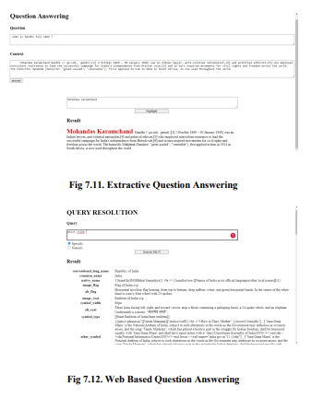
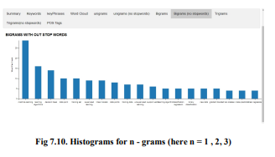
Results

Slide 20
Challenges
Extract hidden semantic relationship
Relevance detection
Appearance of pronouns during extractive text summarization which will make the summary unclear.
If unnecessary topic is also present in the source text , there are chances of getting them during the summary generation if topic is taken care then this problem can be taken care to some extent.

Slide 21
Conclusion
&
Future Scope

Slide 22


