Slide 1
Eduthon 2020
IIIT Lucknow
Formal submission
By Ashit Mehta and Vaibhav Suri

Slide 2





The project
An augmented reality + 3D based application aimed towards aiding teachers to interact with students with a new level of immersion.
Made with Unity, EchoAR, Google Polykit, ARcore.

Slide 3


The Idea
We aim to supplement school teachers tools that may help them to increase interactivity with their students during video call classes.
Immersion AR to make learning exciting.
Attractive Beautiful models catches students’ attention.
Visual AId Visual learning helps information retention in students.

Slide 4
In the wake of the pandemic, teachers and students are pushed into a difficult situation, for which they are unprepared.

Slide 5

Online classes can be stressful to little minds.
And we are here to bring a little excitement to the experience.

Slide 6
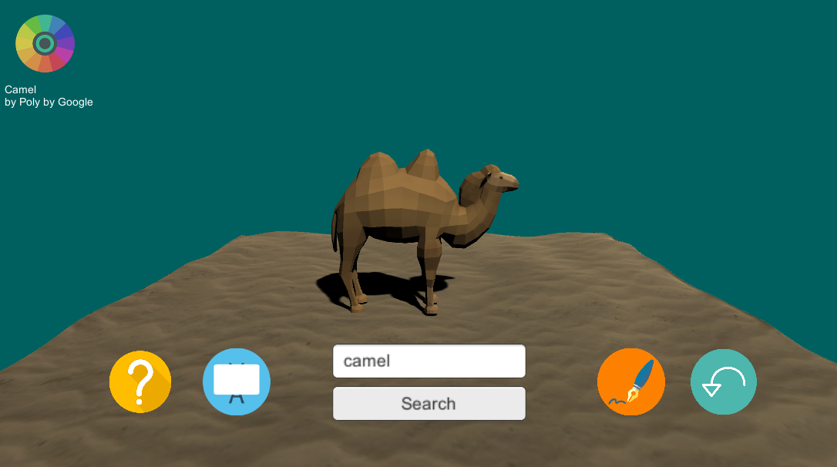
Using the Google Polykit API and EchoAR cloud solutions, we have created a tool for teachers to instigate visual learning in students through the use of attractive models.

Slide 7
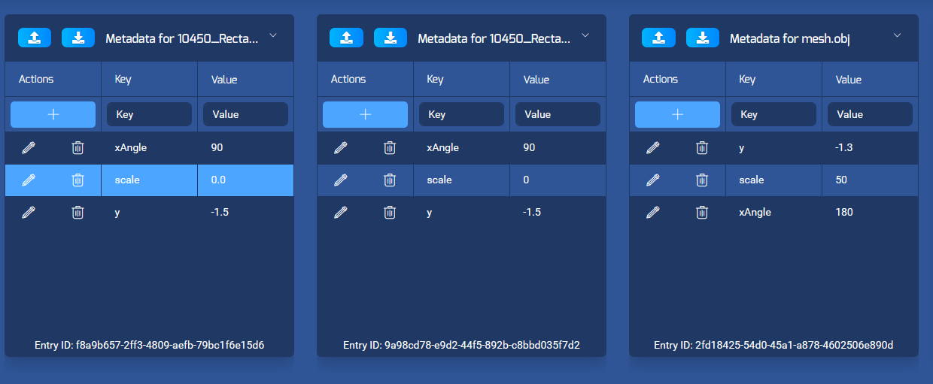
Using the EchoAR dashboard, the AR model behaviours shared over cloud in real time can be controlled, by changing the metadata.

Slide 8
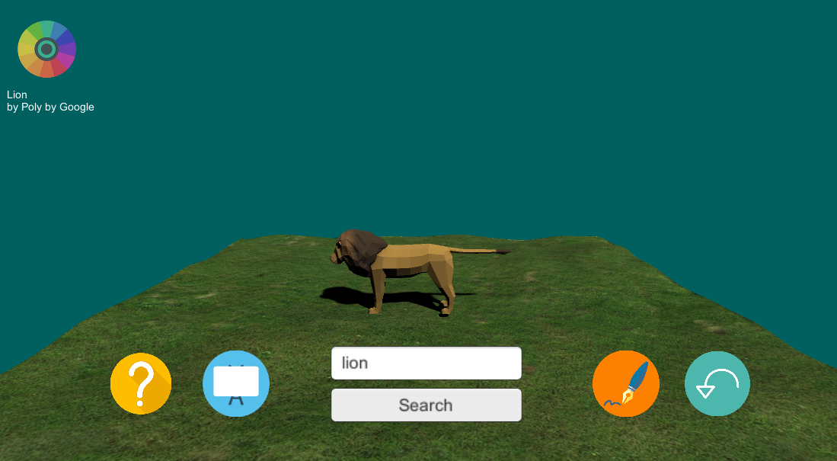
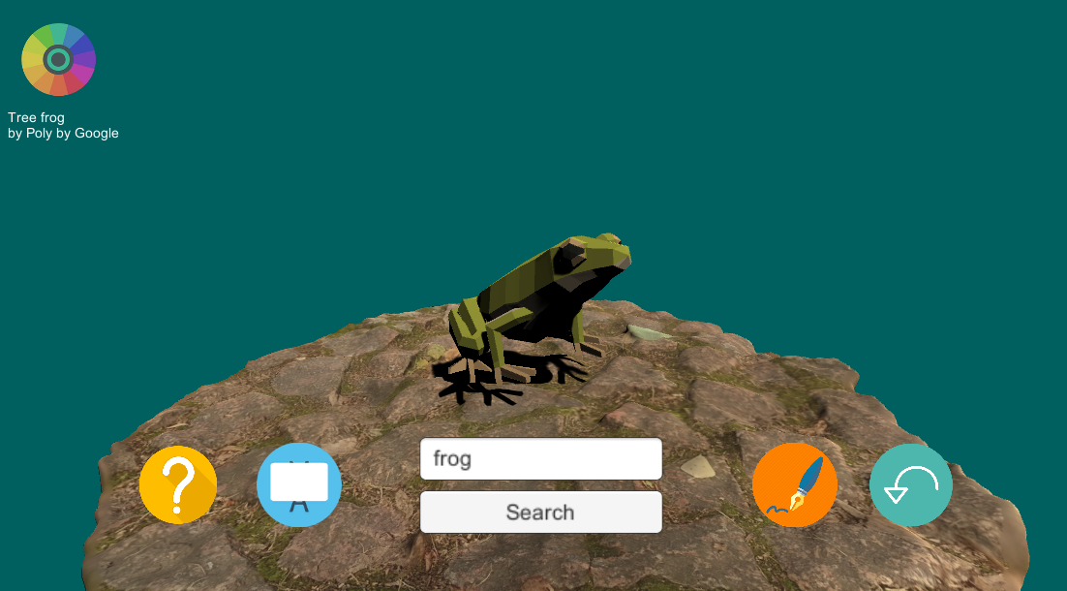
Teachers can choose from a wide selection of 3D models available in the Google Polykit that can be directly placed in AR/VR settings as well. EchoAR dashboard can be used to control actions, environments and behaviours of the models.

Slide 9
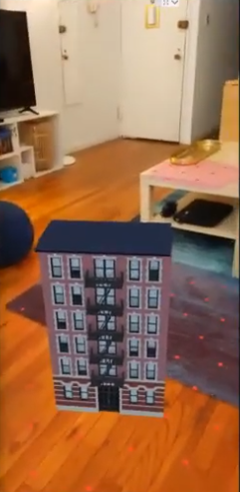
Built within an ARcore application, the models can be viewed in Augmented Reality using plane detection technology. We can even integrate cloud based solutions within the app so the students can view them themselves.

Slide 10
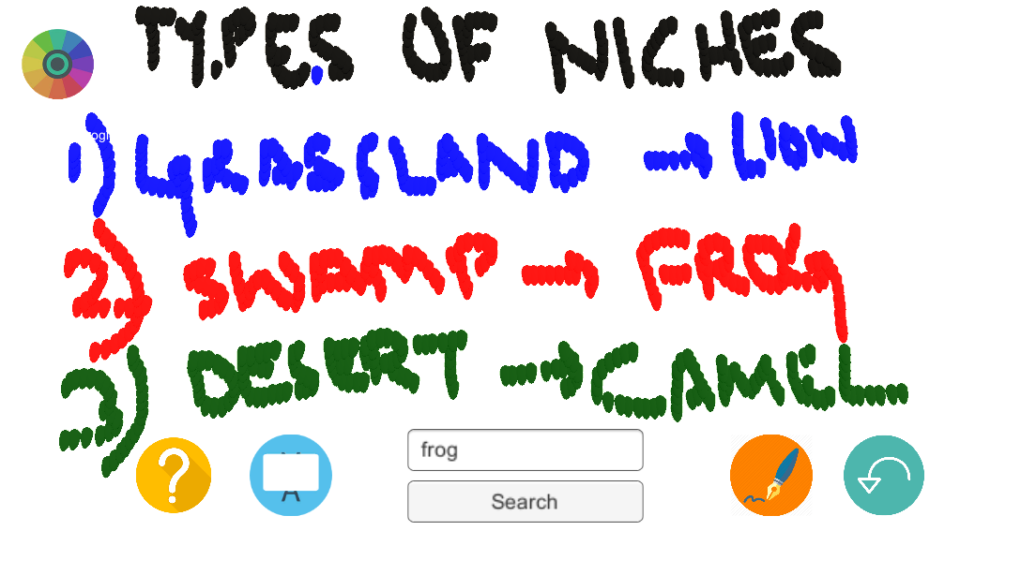
A whiteboard tool also included in the application for teacher’s aid. In a cloud based application, this is also visible to all students.

Slide 11
Future Prospects
A VR classroom setting that can pique the interest of the students even more can be used in the application.
Animated selection of models can be curated to easily help visualise even complex natural processes.
Avatar based classroom setting can be integrated.
(We are already working on the classroom solution.)

Slide 12
Thank You!

