Slide 1

Project Title - Seasonal Agriculture Performance Analysis
Student Name : Bhakthi Acharya B T
College Name- Srinivas University ,Mukka ,Mangalore
AICTE STU ID : STU6a5e536de96731784566637

Slide 2

PROBLEM STATEMENT
Agricultural activities are influenced by seasonal variations in environmental conditions, farming practices, resource availability and market conditions. As a result, agricultural performance may differ from one season to another. However, raw agricultural data does not clearly explain how agricultural performance changes across seasons or what patterns can be observed in different seasonal conditions. The problem is to analyze the given agricultural dataset and investigate seasonal differences in agricultural performance by identifying meaningful patterns, trends, relationships and variations within the available data.

Slide 3
Project Description
Seasonal Agriculture Performance Analysis
Analysed agricultural production data to evaluate crop performance across different seasons, regions, and years. Used Python, Pandas, NumPy, Matplotlib, and Seaborn for data cleaning, exploratory data analysis, statistical analysis, and visualization. Identified seasonal production trends, high-performing crops and regions, and key factors affecting agricultural performance. Generated evidence-based insights and business recommendations to support better crop planning and resource allocation.

Slide 4

WHO ARE THE END USERS?
👨‍🌾 Farmers – to decide which crops to grow and when.
🏛️ Agricultural Government Departments – to plan agricultural policies and support programs.
🌾 Agricultural Planners – to analyse seasonal crop performance and production trends.
💰 Agricultural Businesses – to plan procurement, supply, and resource allocation.
🔬 Agricultural Researchers – to study crop and seasonal patterns.
🏦 Financial Institutions – to assess agricultural trends when planning loans or financial support.

Slide 5

Technology Used
🐍 Python – Data analysis and processing
🐼 Pandas – Data cleaning and manipulation
🔢 NumPy – Numerical calculations
📊 Matplotlib – Data visualization
📈 Seaborn – Statistical visualizations
☁️ Google Colab – Development and analysis environment

Slide 6
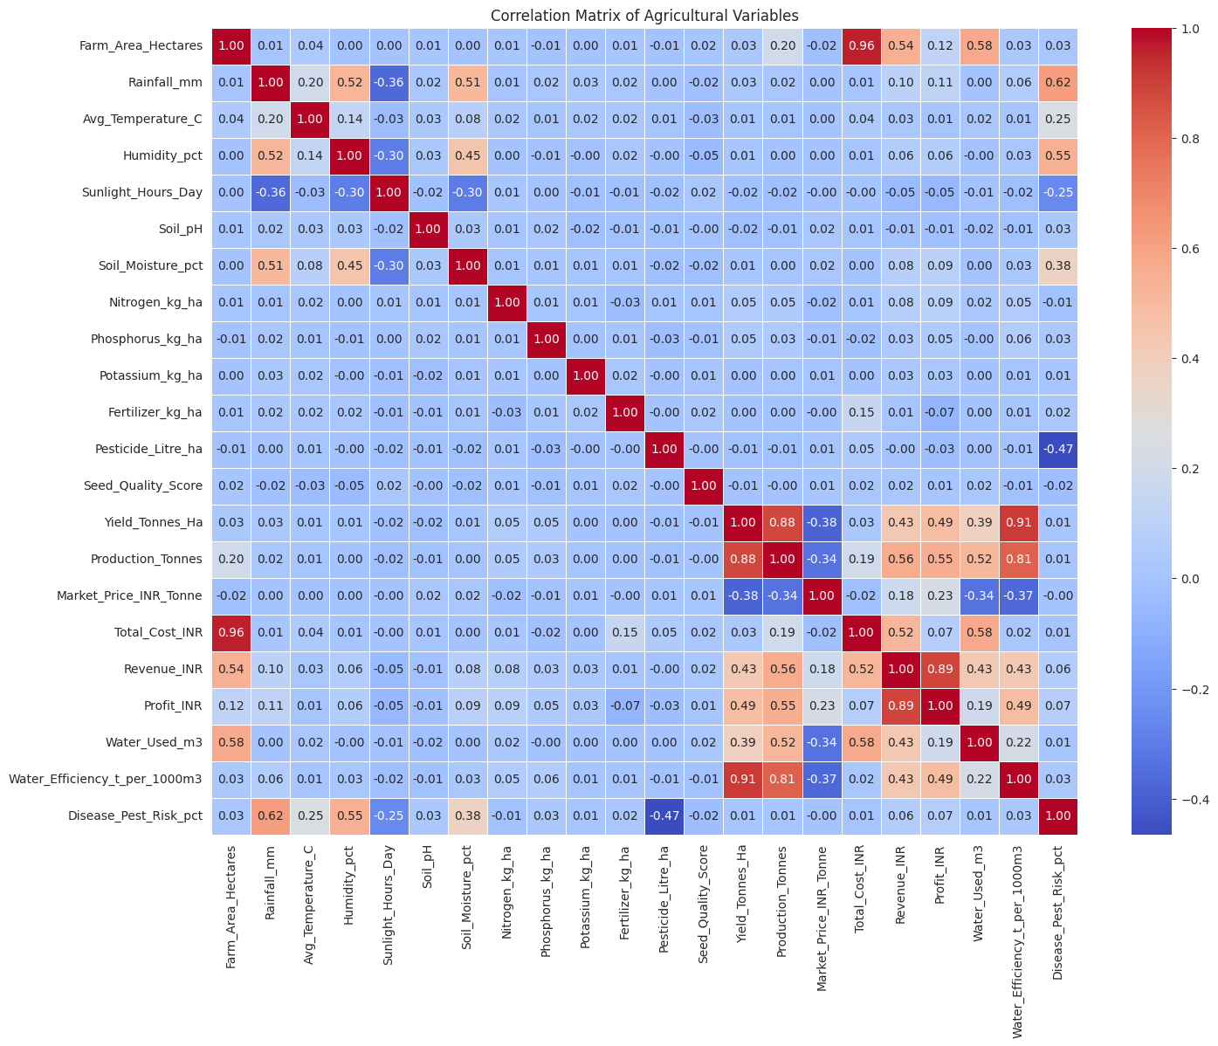
RESULTS
Correlation Analysis

Slide 7
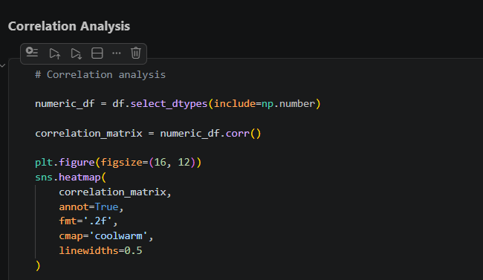
RESULTS
Correlation Analysis

Slide 8
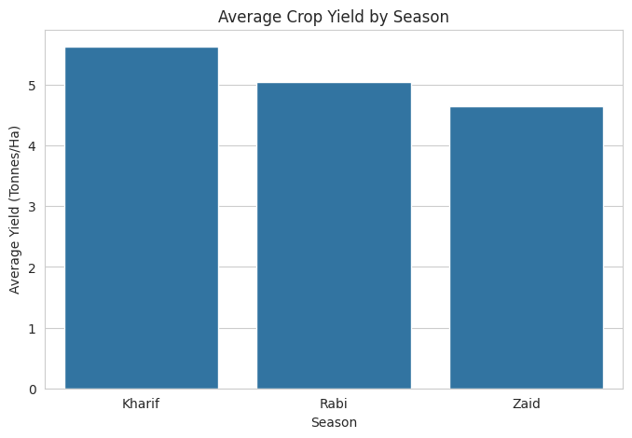
RESULTS
Seasonal Comparisons

Slide 9
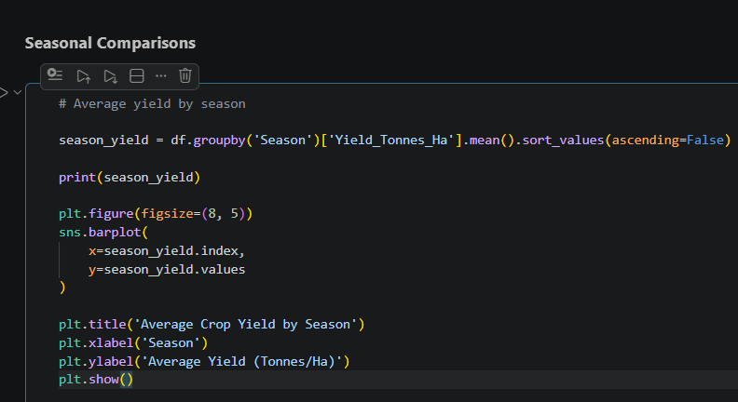
RESULTS
Seasonal Comparisons

Slide 10
Future scope
🤖 Machine Learning Prediction – Predict future crop production and yield.
🌦️ Weather Data Integration – Include rainfall, temperature, and other weather factors.
📊 Interactive Dashboard – Develop a Power BI dashboard for real-time exploration.
🌱 Crop Recommendation – Recommend suitable crops based on season and region.
📱 Decision-Support System – Build a system that helps farmers make data-driven decisions.

Slide 11
GitHub Link
https://github.com/bhakthi-7/Seasonal-Agriculture-Performance-Analysis

Slide 12
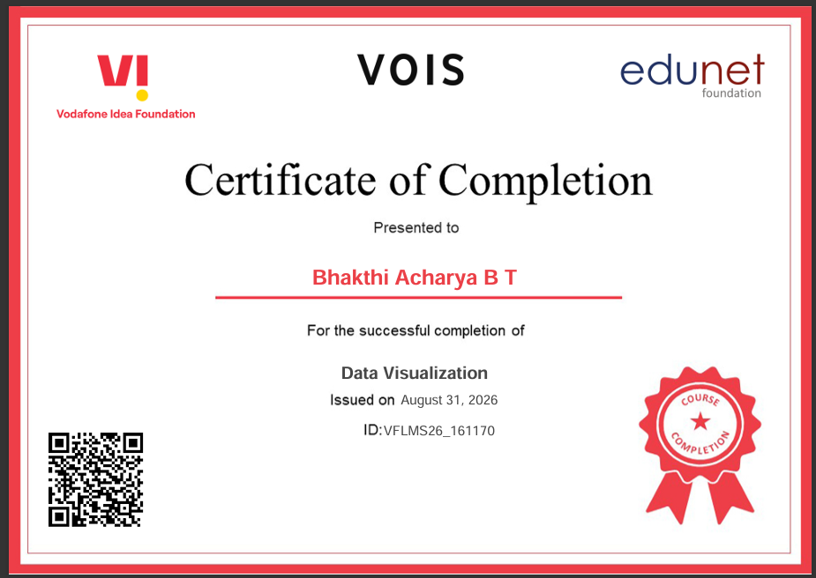
VOIS Course completion certificate -
Course name- Data Visualization

Slide 13
Thank you
.
.

