Slide 1
Office SharePoint 2013 client-side rendering – Introduction to CSR and using JSLink
Bhakthi Liyanage
SPS Charlotte 15
19 September 2015

Slide 2



Who am I?
Sr. SharePoint Architect
15+ years in the IT industry
10+ years in SharePoint
bhakthil@gmail.com
@bhakthil
https://www.linkedin.com/pub/bhakthi-liyanage/14/15/912

Slide 3



EVENT Sponsors
Diamond, Platinum & Gold sponsors have tables
Please visit them and inquire about their products & services
Also they have lots of awesome schwag that you can’t live without! ☺

Slide 4

Connecticut SharePoint users group
Different SharePoint discussions each month on various topics.
Meets 3rd Thursday of every month
Microsoft Office (Hartford)
280 Trumbull St, Hartford CT 06103
http://www.meetup.com/ctspug

Slide 5

Special October session!
Michelle Caldwell (MVP) will be making a stop at the CTSPUG
Microsoft Store in West Farms Mall
Wednesday – October 14th
Register today!
http://www.meetup.com/ctspug

Slide 6
Introduction
What is Client-side Rendering
Client-side rendering provides a mechanism that you can use to produce your own output for a set of controls that are hosted in a SharePoint page.
This mechanism enables you to use well-known technologies, such as HTML and JavaScript, to define the rendering logic of certain SharePoint objects.
Content types, List views, Web parts, List forms and search results
In client-side rendering you can specify your own JavaScript resources and host them in the data storage options available to your farm solution such as the _layouts folder, or Style Library.
What is JSLink
JSLink is a new property introduced in SharePoint 2013 that is available in Webparts, List views, fields and content types. This property points to a JavaScript file which can be used to manipulate the object.

Slide 7
Advantages
Performance – Rendering is done in Client Side and the burden is taken away from the server. This means that the pages can load faster when using CSR.
Minimum Learning Curve – CSR uses standard technologies like HTML5, CSS3 and JavaScript which developers are already familiar with.
Ease of Development – SharePoint developers are already familiar standard technologies like HTML5, CSS3 and JavaScript. This should reduce development time, and less bugs.
Flexibility – It is very easy to target and overwrite just specific objects and parts of the object. For example, a particular field, the header, footer, or the entire view. You also can use any JS plugins such as jQuery.

Slide 8
Disadvantages
Compatibility– Since the scripts are executed in the client browser, the functionality is subject to browser restrictions. With XSLT, this was not the case as XSL is executed in the server-side.
Performance – This was noted as an advantage as well. However, if the user machine is older and does not have the latest browser versions, the JS files will not be executed properly and will be very slow causing browser crashes.

Slide 9
High Level Steps Involved in implementing JSLink solution…….
Create JavaScript file – this can be done using VS or any other text editor.
Deploy that to _layouts folder(in case of server side deployment) or upload it to a any document library(_catalogs, Site Assets library or Style Library)
Point your SharePoint object JSLink property to the JS file

Slide 10

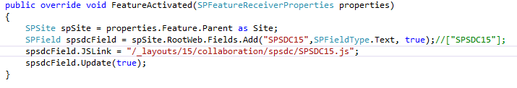

Configuring JSLink property to a field
On the Sever
Set the SPField.JSLink property in the Field XML definition
Using Server OM in feature activation event
Set the SPField.JSLink property in with powershell

Slide 11
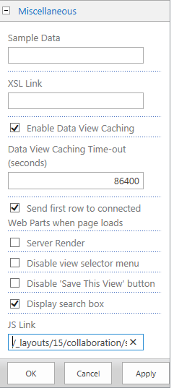
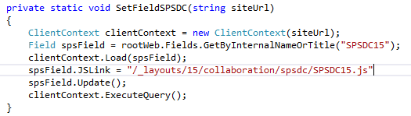
Configuring JSLink property to a field
On Client
Set the SPField.JSLink property in CSOM
Set JS Link property in the UI

Slide 12
Demo

Slide 13
Session Info
The code sample can be found at

