Slide 1
SharePoint Online Administration and Automation with CSOM and PowerShell
Bhakthi Liyanage
SPS Atlanta 2016
11 June 2016

Slide 2


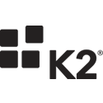





Please thank our sponsors!
Platinum Sponsors

Slide 3




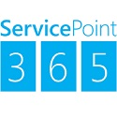
Please thank our sponsors!
Gold Sponsors

Slide 4
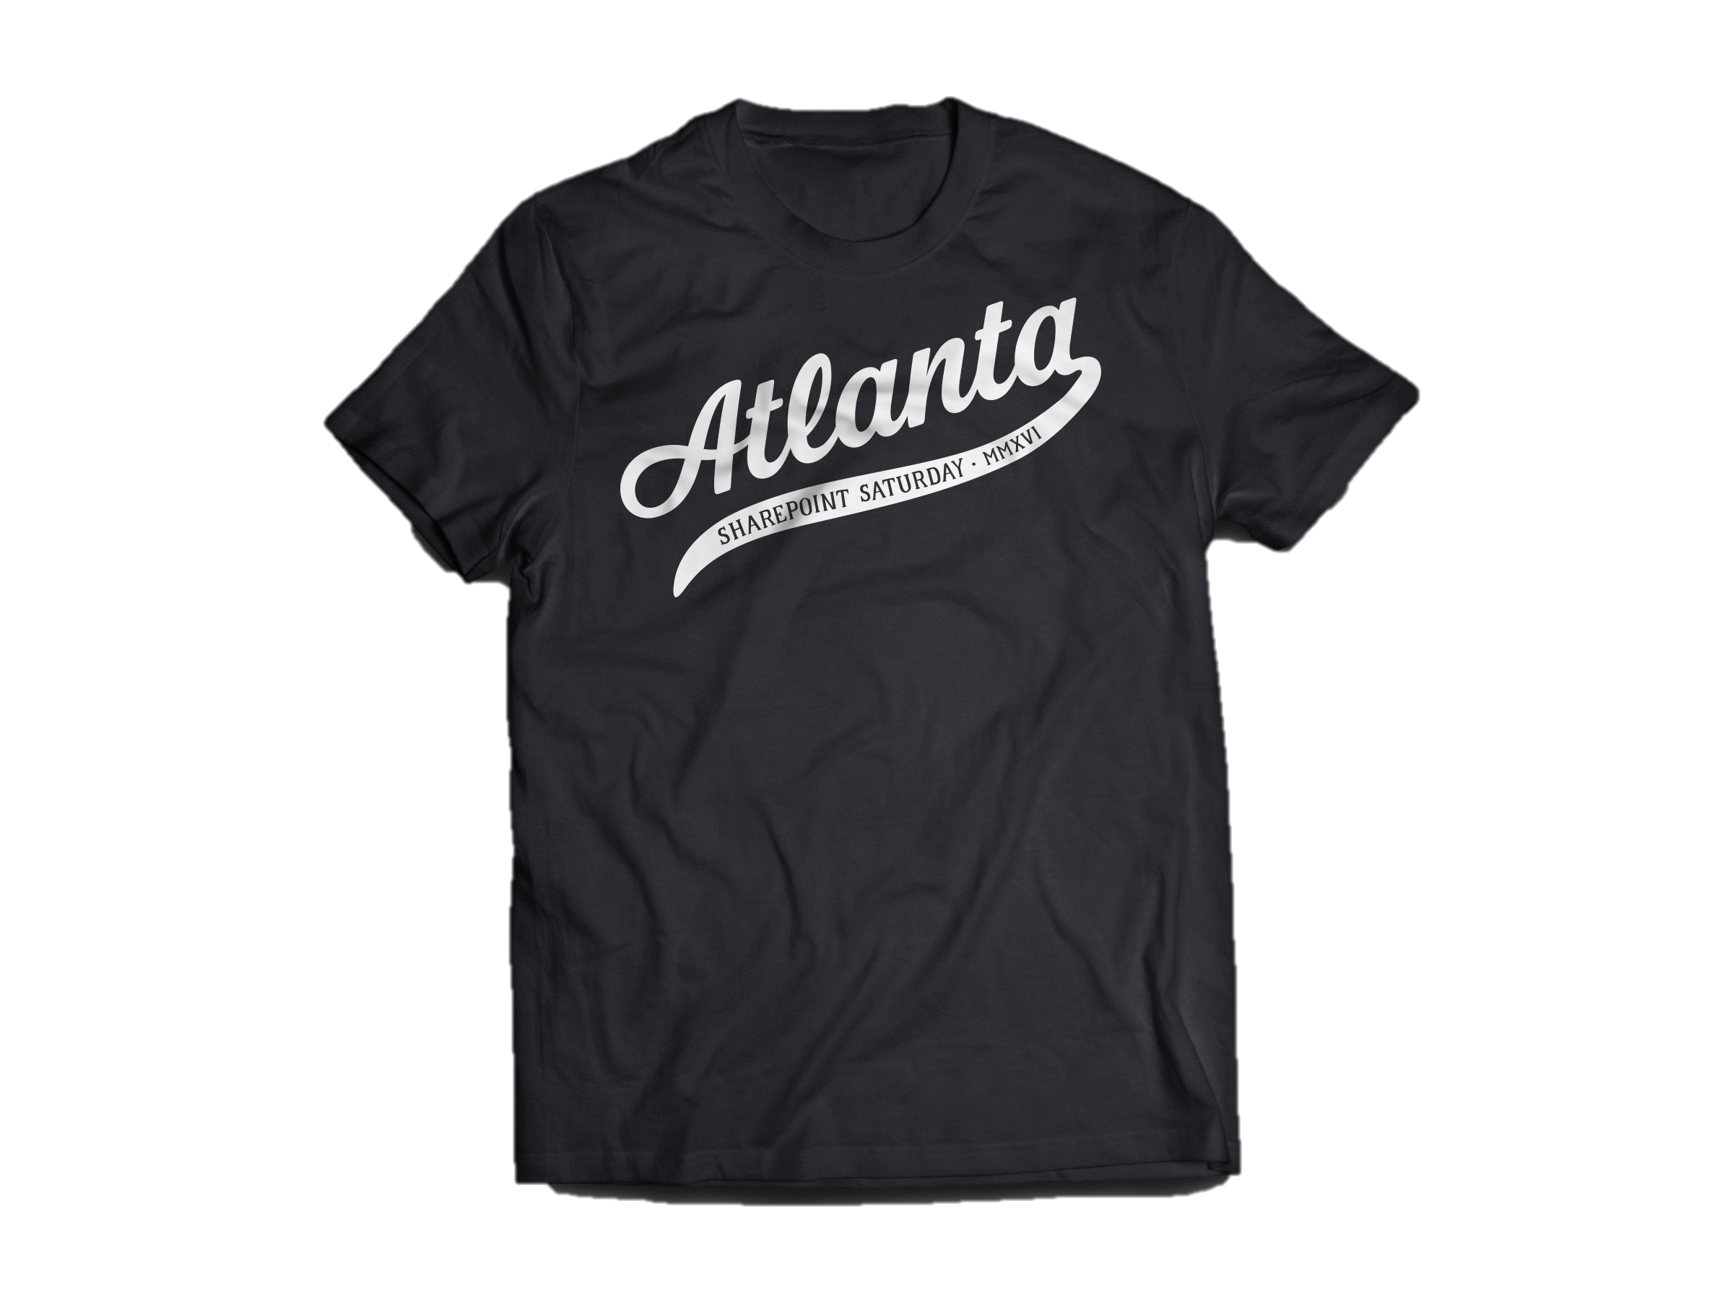

Attendee Shirts & Speaker Shirts

Slide 5
Atlanta SharePoint + Office 365 User Group
Thank a volunteer!!
Join us at www.atlspug.com
@atlspug and #atlspug
Meet at Microsoft MTC in Alpharetta
3rd Monday of Every Month

Slide 6




Who am I?
Sr. SharePoint Architect
15+ years in the IT industry
10+ years in SharePoint
bhakthil@gmail.com
@bhakthil
https://www.linkedin.com/pub/bhakthi-liyanage/14/15/912
https://github.com/bhakthil

Slide 7
Introduction – Windows PowerShell
What is Windows PowerShell?
Windows PowerShell is an interactive, object-oriented command-line scripting environment that utilizes small programs called cmdlets.
Advantages:
Interactive – type a simple command and retrieve lot of information
Simple and logical operations –
eg. Get-Process retrieves all the process running
Scripting capability – collection of PowerShell commands in a file
portable and can be shared
scripting tasks can be scheduled
.Net framework application – honors the current user privileges

Slide 8
Why PowerShell for SharePoint in the first place?
Complements STSADM commands
Provides more capabilities than UI
Automation of Farm/Site Collection/Site administration via scripting
Eg. Automating solution deployment, site provisioning and user provisioning. Etc.
2 main flavors of SharePoint PowerShell
SharePoint 2013 Management Shell – Used to manage on premise installations
Very powerful (Index of Windows PowerShell cmdlets for SharePoint 2013)
700+ cmdlets
SharePoint Online Management Shell – Used to manage SharePoint Online site administration
Very limited capabilities
30+ cmdlets (Index of Windows PowerShell for SharePoint Online cmdlets

Slide 9
Introduction - Managed CSOM
What is CSOM?
Client Side Object Model (CSOM) provides the capability of leveraging SharePoint features out side of SharePoint farm server environment.
SharePoint 2013 has three client object models for managed code: .NET, Silverlight, and mobile.
The SharePoint 2013 object model for .NET Framework is used in .NET Framework applications that run on a non-phone Windows client. Any of the following counts as such a client:
A user's computer
A server that is external to the SharePoint 2013 farm
A web role or worker role on Microsoft Azure

Slide 10
Introduction - Managed CSOM
Why CSOM with PowerShell?
Scalable – functionality can be added as separate PS files
Faster – faster execution, faster development, faster deployment
Portable
Low resource consumption – less memory
Simple
What is the down side?
Learning curve of CSOM

Slide 11
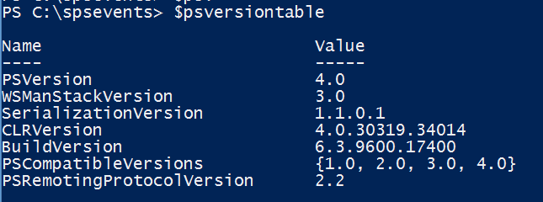
Getting started
Confirm Windows Management Framework version
Download and Install the latest WMF
(http://www.microsoft.com/en-us/download/details.aspx?id=40855)
Enable scripting
Get-ExecutionPolicy – retrieves the current policy
Set-ExecutionPolicy Unrestricted
Install SharePoint client SDK (http://www.microsoft.com/en-us/download/details.aspx?id=35585)
Should be at least 3.0

Slide 12
Demo

Slide 13
Session Info
The code sample can be found at
https://github.com/bhakthil/SPS

Slide 14
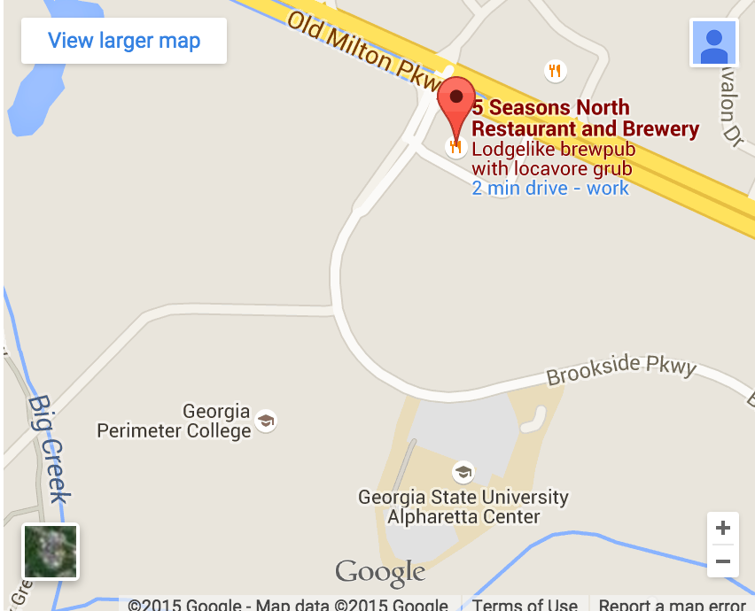
Join us for SharePint
5 Seasons Brewery (North)
Right after the event ends
The parking is located directly in front of brewery
See the SPSATL Website for more info and directions

