Slide 1
Solving complex business problems: No-code approach with designer workflows and SharePoint REST API
Bhakthi Liyanage
SPS Toronto 2016
07 July 2016

Slide 2











Thank You Sponsors!
GOLD
SILVER
BRONZE / PRIZES

Slide 3
Agenda
Who am I?
Objectives
Overview
Workflow Configuration
Demo

Slide 4




Who am I?
Sr. SharePoint Architect
16+ years in the IT industry
11+ years in SharePoint
bhakthil@gmail.com
@bhakthil
https://www.linkedin.com/pub/bhakthi-liyanage/14/15/912
https://github.com/bhakthil

Slide 5
objectives
Learn what’s new in Workflow Setup in SharePoint 2013
Learn how to authenticate from Workflow Manager via SharePointWorkflow App
Learn how to leverage SharePoint 2013 REST API to extend workflow capabilities

Slide 6
overview
Quick Introduction to SharePoint 2013 Workflow Engine
Workflow engine is no longer inside SharePoint
Workflows are executed in Workflow Manager Client 1.0
WM is powered by Windows Workflow Foundation 4
WM & SP communicate over HTTPS via REST API, secured using OAuth2 (S2S)
Same applies to Office 365 & on-premises

Slide 7
overview
Quick Introduction to SharePoint 2013 Workflow Engine
SharePoint 2013
Solutions
Content
Web Applications, Site Collections, Lists, Libraries, items, documents, files, etc.
SharePoint 2010 Workflows
Tools
Events
REST Calls
VS
Apps
OAuth2
Workflow Farm
SharePoint 2013 OM
Workflow Manager
Designer
Workflow Manager Client 1.0
Events
Workflow Service Manager
Interop
Service Bus
Deployment
Messaging
Instances
Workflow Service Application Proxy

Slide 8
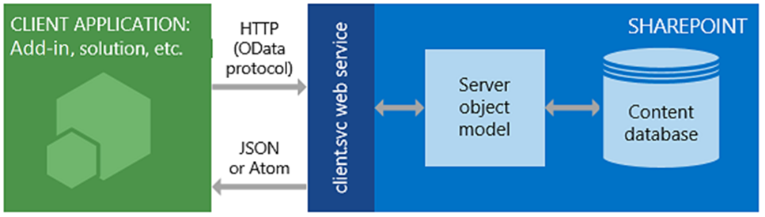
overview
SharePoint 2013 REST architecture
If you want to do this to an endpoint | Use this HTTP request | Keep in mind
Read a resource | GET
Create or update a resource | POST | Use POST to create entities such as lists and sites.
Update or insert a resource | PUT | Use PUT and MERGE operations to update existing SharePoint objects.
Delete a resource | DELETE | Use the HTTP DELETE command against the specific endpoint URL to delete the SharePoint object represented by that endpoint.

Slide 9
overview
SharePoint Designer + REST API = Complex Workflows
REST API Provides most of the SharePoint functionality over HTTP
- Very Powerful
Feature Rich
Enables various clients to consume SP resources – Java, PHP, NodeJS,…
SharePoint Designer 2013 provides Call HTTP Web Service action that enables calling external web services

Slide 10


Workflow configuration
Permission Setup
Activate ‘Workflows can use app permissions’ feature at site level
Elevate App permission
Trust the new app with extra permissions
WorkflowApp Usage

Slide 11
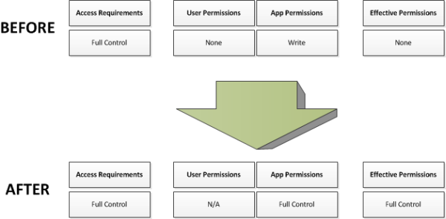
Workflow configuration
Why do we need configuration?
Designer authored workflows
Do not have permissions to use SharePoint's REST API
Are not apps & thus have no special permissions
Designer has a new App Step action, but site should give access to run it
Elevate privileges

Slide 12
Workflow configuration
Permission Setup
i) Activate ‘Workflows can use app permissions’ feature at site level
ii) Elevate App permission

Slide 13
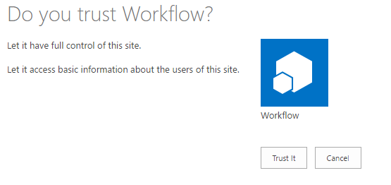
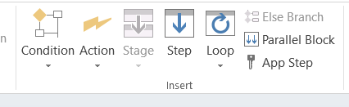
Workflow configuration
Permission Setup
iii) Trust the new app with extra permissions
iv) Use Workflow activities inside App Step

Slide 14
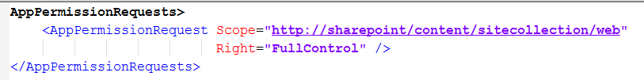
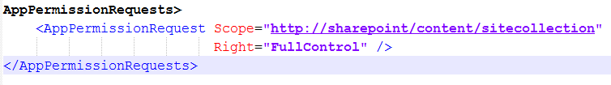
Workflowapp configuration
Special Considerations – Not properly documented** on MSDN
Permission setup for the site level access – will give you access only at the site level
Permission setup for the site collection level access
Run in parent SC and access SC and any Sub Web Beneath it
Run in a Sub Web and access its Parent Site Collection Above it

Slide 15
demo
Site provisioning WF
User Provisioning WF

Slide 16
references
Get to know the SharePoint 2013 REST service
https://msdn.microsoft.com/en-us/library/office/fp142380.aspx
Create a workflow with elevated permissions by using the SharePoint 2013 Workflow platform
https://msdn.microsoft.com/en-us/library/office/jj822159.aspx
REST API reference and samples
https://msdn.microsoft.com/en-us/library/office/jj860569.aspx
SharePoint 2013 workflow fundamentals
https://msdn.microsoft.com/en-us/library/office/jj163181.aspx

Slide 17

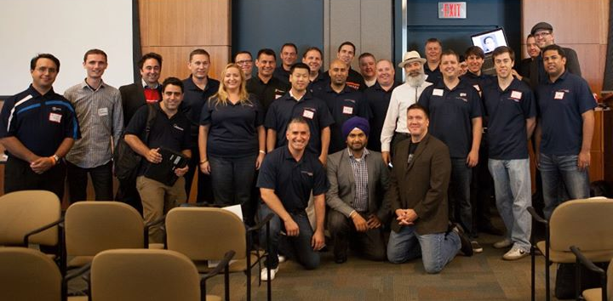
THANK YOU & See you next year!
Join us for SharePint after the event @ 5:30pm
6982 Financial Dr. and don’t forget to submit feedback after each session for your chance to win great prizes at the end of the day!
https://www.surveymonkey.com/r/spstoronto2016
Thank you!
Toronto Enterprise Collaboration User Group Change Management, Governance, SharePoint, Office 365, Yammer, PowerBI, etc
http://www.meetup.com/TSPBUG/ Toronto SharePoint Users Group
http://tspug.com/

