Slide 1

CWFM / Kronos Contractor Billing Automation
Project
UltraTech | Information Technology

Slide 2
About project & Benefits
CWFM – Contractor's bill Automation
Generation of billing system for CWFM Contractors, considering high level of automations. This system will benefit the users / organization in below terms.
This solution will help automation of billing process for 50+ manufacturing plants, 4,700+ contractors & 10,500 bill on an average per month.
Standardized bill format across UTCL Manufacturing vertical for Workman contractors
Minimal manual intervention and Easy tracking of bills by both contractors and UltraTech Functions.
Up to 50% Reduction in lead time of bill payments to contractors. High compliances & controls.
Processes in Automation Scope
Invoice Generation on Contractors behalf for Service & BSR type workorders.
Invoice Approvals by department users.
Statutory Payments / Reimbursement like PF, ESI, Bonus, Leave etc
Auto Service Entry, MIRO Posting & UKSC Case creation.

Slide 3




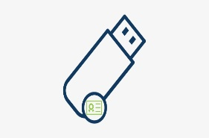
Information flow
CWFM – Contractor's bill Automation
Verification
1st Level Approval
2nd Level Approval
Invoice for Approval
Invoice
Invoice
Contractor
ER/HR Department
Section Head(SH)
Department Head(DH)
Will Validate the Invoice
Dispute management
SH will be first level of Approval for Invoice.
DH can block partial amount, if needed.
Final Approval
3rd Level Approval
Invoice
Invoice
Signed invoice
Unit Head(UH)
Finance Head(FH)
Digital Signature
Contractor
UH will be the final stage of Approval.
Invoice will go to UH for Approval if Invoice amount falls between configured value.
Invoice will go to FH for Approval if Invoice amount falls between configured value e.g.. Above 10 Lacs
FH can override amount blocked by DH.

Slide 4
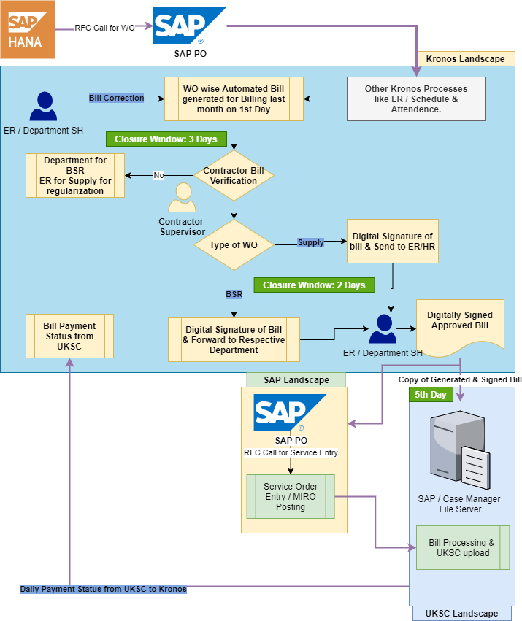
Current Landscape
CWFM – Contractor's bill Automation

Slide 5
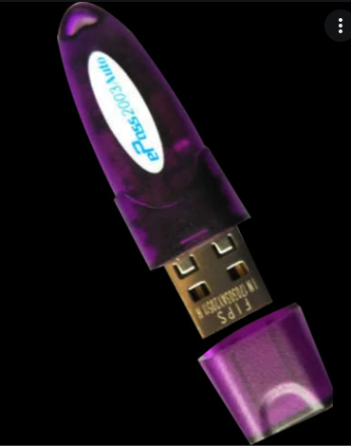
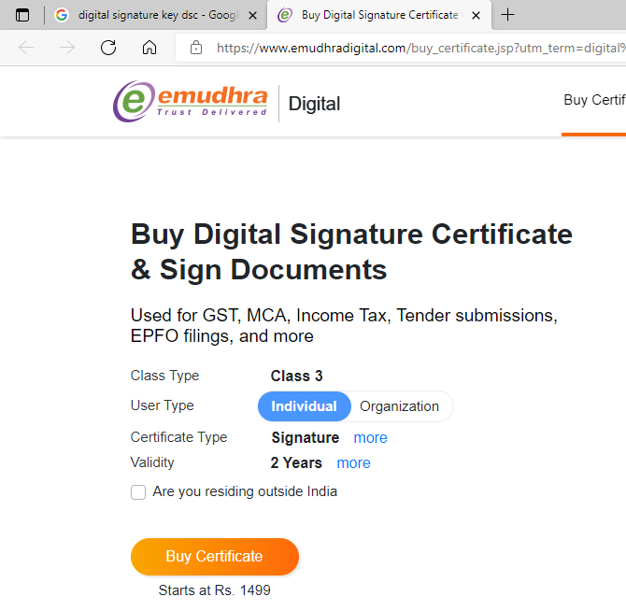
Change in Process for contractors
CWFM – Contractor's bill Automation – Processes in scope
No more BVR Report extraction for bill generation.
No more bill generation, printing and physical signoff.
No more visiting to departments for bill signoff.
No more coordination with commercials to get payment status.
Online varication of Invoices.
Adherence of Scheduling.
Attendance regularization.
Procurement of DSC keys in case they do not have.
Digital signature on invoices using digital signature (DSC).
Ensuring DSC are renewed well in Advance to avoid delay in bill singing.

Slide 6


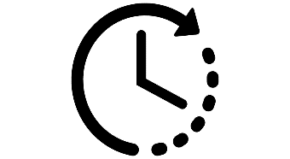

Project Expected Benefits
CWFM – Contractor's bill Automation – Project Benefits
Complete Paperless Process.
Dashboard & MIS Reporting System .
Reduction in TAT
End to End Digitization including dispute Management

