Slide 1


Bank of Baroda Hackathon - 2022
Technology Partner
Your Team Name :
1. Bunty khetmalas
2. Maya pawar
3. Bhakti jare
4. Prachi thange
Date – 19 Sep 2022

Slide 2
Problem Statement?
Why did you decide to solve this Problem statement?
Visually impaired persons have to encounter numerous complications in banking activities due to imperfect vision. To provide a solution to this problem, we have introduced a methodology of a banking virtual assistant '(Invisible Helper)'. The current user-independent system presented here will provide the opportunity to perform several tasks of banking services. Users interact with systems through voice assistants and catboats. The voice assistant is commonly used in smartphones and laptops. AI-based Voice assistants are operating systems that can recognize human voices and respond via integrated voices. The ultimate goal of this project is to add features to improve customers’ banking experience. In the banking industry, the introduction of Artificial Intelligence has driven chatbots and changed the face of the interaction between banks and customers.

Slide 3
User Segment & Pain Points
Which user /advertiser segment would be early adopter of your product & why?
A virtual assistant is an intelligent application that can perform tasks or provide services for a person responding to orders or inquiries. Users may use voice commands to request their Banking Virtual Assistant (BVA) to answer the questions and handle other essential activities like transferring money, generating passbooks, loan inquiries, and Payment schedules. Customers communicate via text or voice command to gain quick answers to banking queries, and personalized financial advice and can even carry out transactions. Voice-enabled banking virtual assistants can handle payments and transfers, credit card activation, password resets, and pay alerts and reminders for customers anytime and from anywhere.

Slide 4
Pre-Requisite
What are the alternatives/competitive products for the problem you are solving?
Voice Based Form Filling
Voice Based Account details, Balance inquiry, view transaction
Voice Based Credit card lock and unlock
Voice Based Payment processing and scheduling
AL-Ml Technology
Deploy on cloud platform

Slide 5
Azure tools or resources
Azure tools or resources which are likely to be used by you for the prototype, if your idea gets selected
Microsoft-windows sapi – speech recognition
Google API – text to speech
NPL – keyword matching
Front end – html , css , js
Backend –python flask

Slide 6
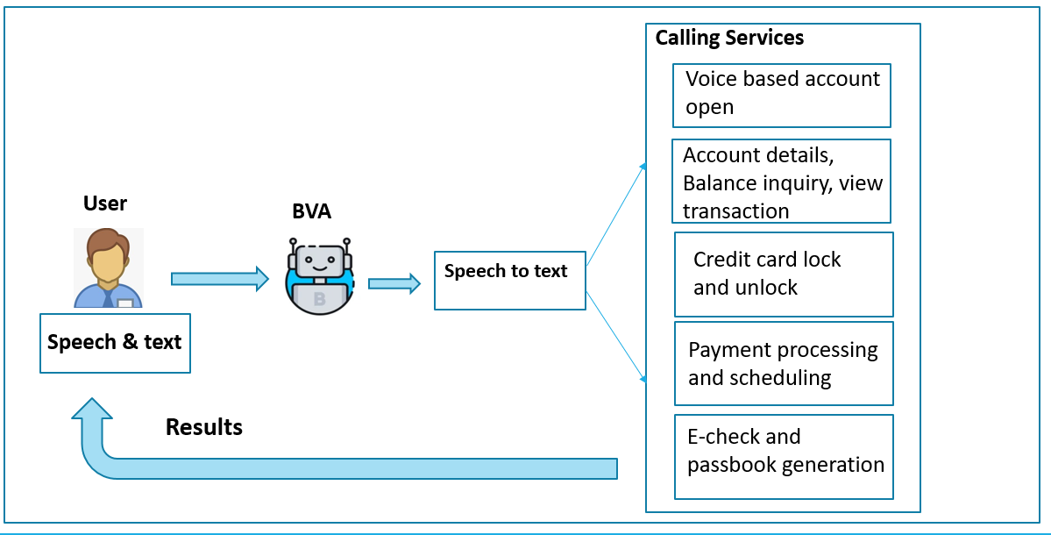
Any Supporting Functional Documents
Present your solution, talk about methodology, architecture & scalability

Slide 7
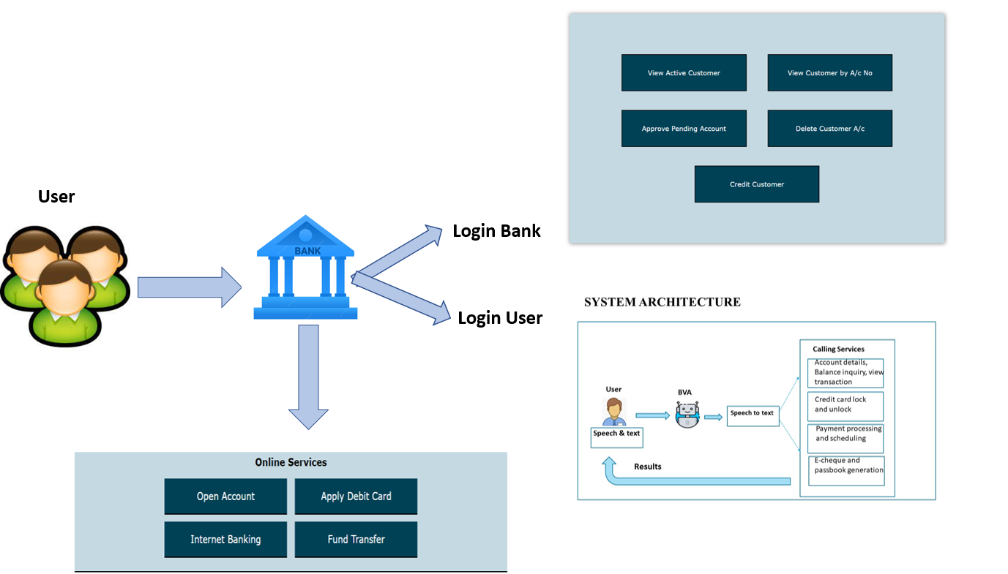
Banking System Architecture

Slide 8
Key Differentiators & Adoption Plan
How is your solution better than alternatives and how do you plan to build adoption?
In recent years, several major banks have launched new banking virtual assistants to help customers manage their online banking and everyday inquiries. Using the power of artificial intelligence (AI), these virtual assistants can help customers save time on basic banking tasks and get more value out of their bank accounts.
More people are getting accustomed to using voice-activated devices like Alexa, Siri and Google Assistant to do their everyday web searches, manage tasks, get directions, ask questions or give commands to smart devices within their homes. As voice technology gets more efficient and accurate, it could be easier for many people to conduct their banking by just talking to a virtual assistant on their phone, instead of entering information manually.
For the same reasons that online banking and mobile banking services have become more prevalent, several banks offer a more comprehensive range of virtual assistant capabilities.

Slide 9
GitHub Repository Link & supporting diagrams, screenshots, if any
How far it can go?

Slide 10
Thank You
Team member names :
1. Bunty khetmalas
2. Maya pawar
3. Bhakti jare
4. Prachi thange

