Slide 1
IMAGE FORGERY DETECTION
STATISTICAL MACHINE LEARNING
BHAKTI BATRA - MT19115
ANMOL JAIN - MT19005

Slide 2
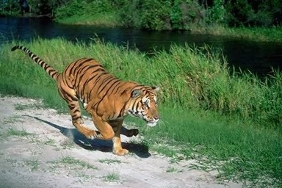
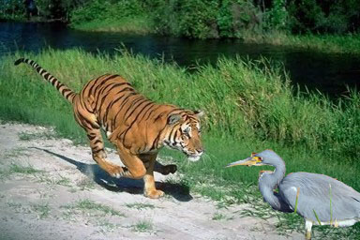
Problem Statement
Detect copy-move forgery : the images are moved from one authentic image to another authentic image.
CASIA -2 Dataset is used, divided into training and testing data.
Tampered images: 5123, Authentic images : 7491
Authentic Image Tampered Image

Slide 3
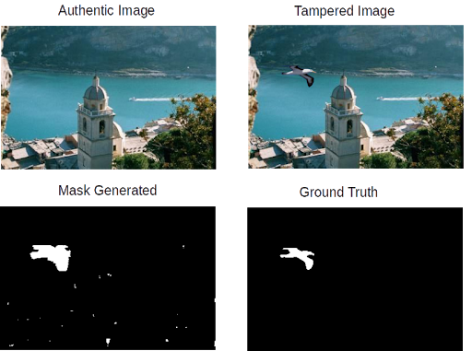
Preprocessing
CNN model was applied for feature extraction
Trained on the patches of tampered regions and any regions for authentic images.
For tampered region extraction, mask extraction done manually as well as ground truth used.
Model was trained on both the results.
7 convolutional, 2 max-pool and 1 dense layer used.
Training phase required softmax layer as well.

Slide 4
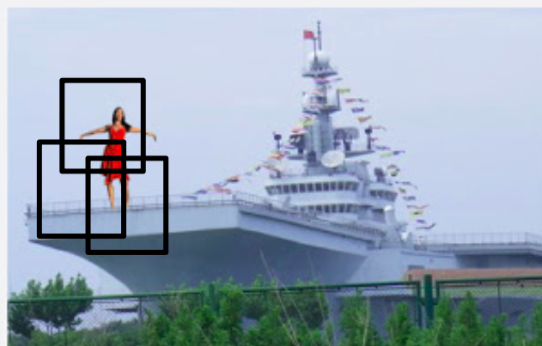
Feature Engineering & Feature Extraction
Tampered region patches were used to train the model.
SRM filter and Xavier initialisation was employed.
After training the model, each image was represented as a feature vector of 400D.
Image was divided into patches of size 128X128X3.
Stride set to 128.
Each image has different dimensions
Feature fusion was done in the end to obtain a single vector.

Slide 5
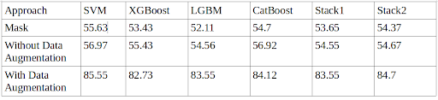
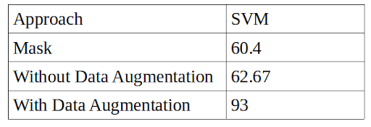
Analysis
CNN parameters
250 epochs
Learning rate: 0.0001
Batch size : 200
Activation: relu
Minimum loss obtained: 0.3

Slide 6
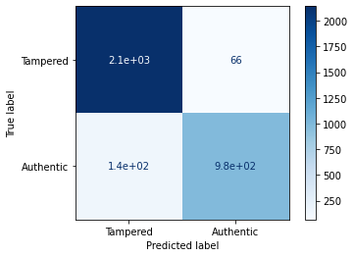
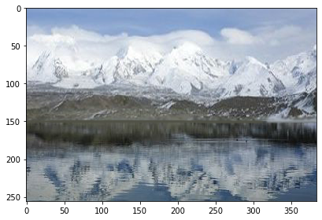
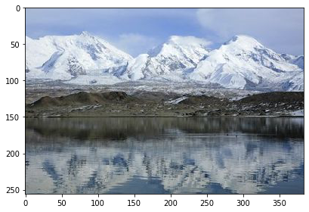
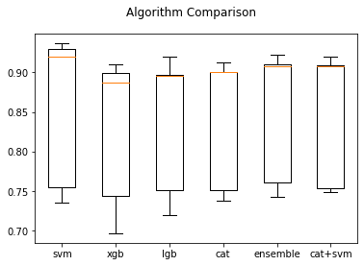
Results
Tampered
Misclassified Image
Original

