Slide 1
Introduction of Generative AI
Created by Jagat Pal

Slide 2
Introduction to AI
What is Artificial Intelligence (AI)?
1.Artificial Intelligence (AI) is a branch of computer science that aims to create systems capable of performing tasks that typically require human intelligence.
2. These tasks include problem-solving, learning, decision-making, and language understanding. AI is broadly categorized into:
Narrow AI (Weak AI) – AI designed for a specific task (e.g., recommendation systems, voice assistants).
General AI (Strong AI) – AI with human-like cognitive abilities (still theoretical).
Super AI – AI surpassing human intelligence (a hypothetical concept).

Slide 3
Introduction to machine learning
What is Machine Learning (ML)?
Machine Learning (ML) is a subset of AI that enables computers to learn from data without being explicitly programmed.
ML algorithms find patterns in data and make predictions or decisions based on new inputs.
Types of Machine Learning
Supervised Learning – The algorithm learns from labeled data (e.g., spam detection in emails).
Unsupervised Learning – The algorithm identifies patterns in unlabeled data (e.g., customer segmentation).
Reinforcement Learning – The algorithm learns through trial and error using rewards (e.g., self-playing chess programs).

Slide 4
Application of AI and ML
AI & ML Applications
Image & Speech Recognition (e.g., facial recognition, virtual assistants)
Natural Language Processing (e.g., chatbots, translation)
Healthcare (e.g., disease prediction, drug discovery)
Finance (e.g., fraud detection, algorithmic trading)
Autonomous Systems (e.g., self-driving cars, robotics)

Slide 5
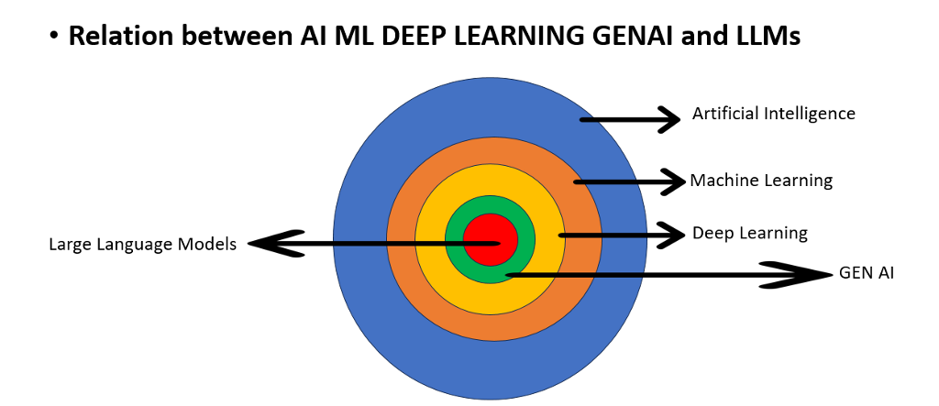
Difference between AI, ML, DL and Gen AI

Slide 6
Introduction of Generative AI
What is Generative AI?
Generative AI refers to a type of artificial intelligence designed to create new content.
2. Generative AI primarily analyzes existing data and then produces original data, such as text,
images, music, and more.
3. Generative AI uses advanced machine learning models, particularly neural networks, that
learn patterns from vast amounts of data and use that knowledge to generate new, similar content.

Slide 7
Large language model
A "Large Language Model" refers to a type of artificial intelligence model that is designed to understand and generate human-like text based on the input it receives.
These models are typically trained on massive datasets containing a wide range of text from the internet, books, articles, and more.
3. They use deep learning techniques, particularly transformer architectures, to process and
generate text.
4. A Transformer is a deep learning model architecture designed for natural language
processing (NLP) tasks such as language translation, text generation, and question-
answering. It was introduced in the paper "Attention Is All You Need" (2017)
5. These models are pre-trained on vast datasets, which allows them to learn linguistic patterns, semantics, and context.
6. These models can perform various NLP tasks, such as text generation, text completion, translation, summarization, question answering, and more.
7. They have been used in a wide range of applications, including chatbots, language translation services, content generation, and even code generation.

Slide 8
Small language model
1 ."Small language model" usually refers to a language model with fewer parameters
compared to larger models. Examples are Phi-1, Phi-2, Lamini, etc.
2. Reduced Model Size: Small language models consume less memory and computational
resources
3. Resource Efficiency: Resource is less so management is easy
4. Domain-Specific Use: We can build domain-specific small language models for our use such as
legal, medical, etc.
5. Fast Inference: Smaller models typically require less computation during inference, which
leads to faster response times.

Slide 9
Multimodal Large Multimodal LLM
Multimodal LLMs are the language model which deals with text (translation, language modeling), image (object detection,image classification), or audio (speech recognition).
For example, text-to-image models like Midjourney, Stable Diffusion, and Dall-E are multimodal.
3. Multimodal can mean one or more of the following:
Input and output are of different modalities (e.g. text-to-image, image-to-text)
Inputs are multimodal (e.g. a system that can process both text and images)
Outputs are multimodal (e.g. a system that can generate both text and images)

Slide 10
Core Generative AI Models: LLMs
Milestone LLM Models
BERT: Bidirectional Encoder Representations from Transformers (BERT) was developed by Google
GPT: GPT stands for "Generative Pre-trained Transformer".The model was developed by OpenAI
XLM: Cross-lingual Language Model Pretraining by Guillaume Lample, Alexis Conneau.
T5: The Text-to-Text Transfer Transformer It was created by Google AI
Megatron: Megatron is a large, powerful transformer developed by the Applied Deep Learning Research team at NVIDIA
M2M-100: multilingual encoder-decoder (seq-to-seq) model researchers at Facebook

Slide 11
Core Generative AI Models: LLMs
OpenAI LLM Models
GPT-4 and GPT-4 Turbo: A set of models that improve on GPT-3.5 and can understand as well as generate natural language or code
GPT-3.5: A set of models that improve on GPT-3 and can understand as well as generate natural language or code
DALL·E: A model that can generate and edit images given a natural language prompt
TTS: A set of models that can convert text into natural sounding spoken audio
Whisper: A model that can convert audio into text

Slide 12
Large language model
Google AI LLM model
1.PalM2
2. Gemini-Pro
3. Gemini-Pro-vision
Open source LLM models
Bloom
Lama2
PalM
Falcon
Claude
MPT-30B
Stablelm

Slide 13
New LLM model
Deepseek-R1 model(LLM)- this model generate by deepseek AI Chinese based company

Slide 14
Prompt Engineering
Prompt Engineering :
Prompt engineering is the process of designing and refining prompts to effectively interact with AI models, particularly large language models like GPT-3 and GPT-4. The goal is to craft prompts that guide the model to produce the desired output.
Purpose: Helps in obtaining accurate and relevant responses from AI models.
Techniques: Involves experimenting with different wordings, structures, and contexts to see what works best.
Importance: Good prompt engineering can significantly improve the quality and usefulness of AI-generated responses.
What is Completion in Generative AI?
Completion in Generative AI refers to the ability of an AI model to predict and generate missing or next sequences of text, code, images, or other content based on a given input. This is widely used in text autocompletion, code generation, and creative content generation.

Slide 15
Use cases of generative AI
Text Generation & Processing
Example: Chatbots & Virtual Assistants
AI-powered chatbots like ChatGPT, Google Bard, and Claude provide human-like responses in conversations.
Used in customer support, content writing, and personal assistants (Siri, Alexa).
Code Generation & Completion
Example: AI-Powered Coding Assistants
GitHub Copilot, CodeGPT, and Tabnine help developers by suggesting and completing code.
Image Generation & Editing
Example: AI Art & Design
Tools like DALL·E, Stable Diffusion, and MidJourney create realistic or artistic images from text prompts.

