Slide 1


Chronic Diseases Risk Prediction Initiative
Team 1

Slide 2
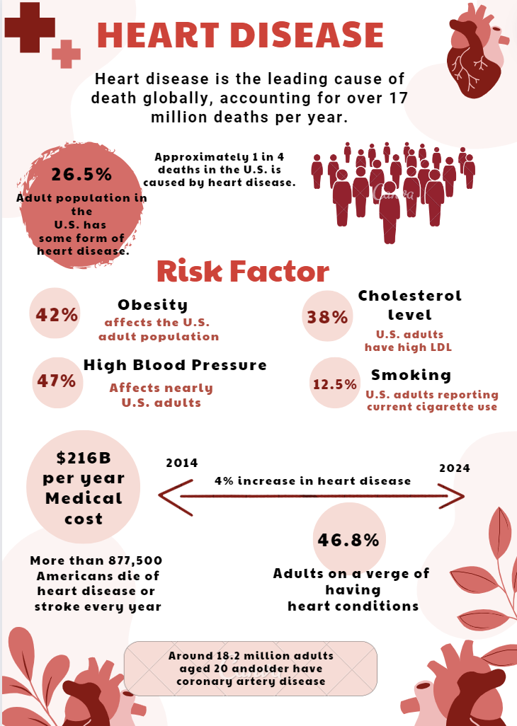
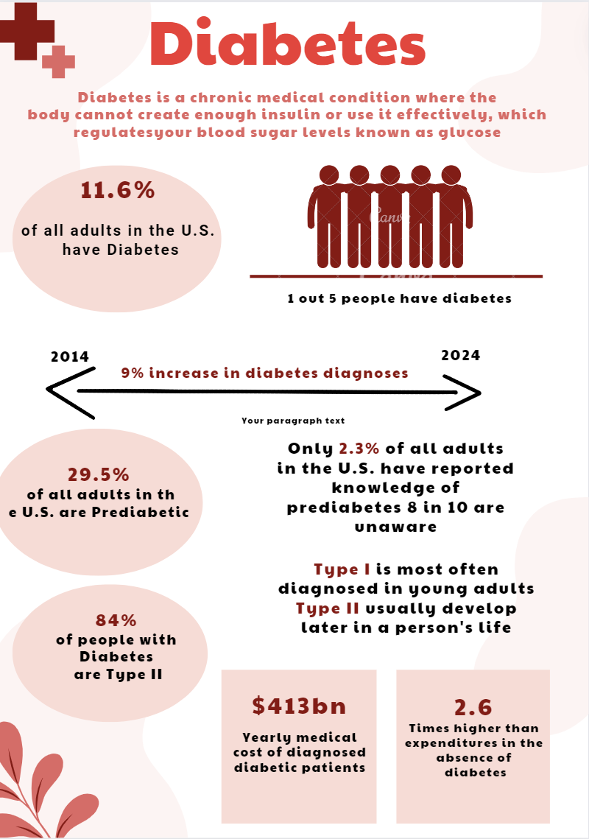
Business Question and Intro
What lifestyle factors and health behaviors emerge as the most significant predictors of chronic disease risk ?

Slide 3
Intro about BRFSS data – What is it
The Behavioral Risk Factor Surveillance System (BRFSS) is a collaborative project between the CDC and all 50 US states and territories collecting health-related data
Demographics
Chronic Health ​
Conditions
Type of Cancer
Respiratory Health
Navigating Challenges: From Data
Discovery to Model Precision
02.
03.
01.
Data Cleaning Challenge:
Faced challenges in meticulously cleaning data, addressing missing values, outliers, duplicates, and refining for analytical robustness.
Model Accuracy Optimization Challenge:
Encountered complexities in optimizing model accuracy, balancing variables to ensure a reliable and insightful outcome.
Data Discovery Challenge:
Overcame hurdles in finding and accessing the diverse datasets required for analysis.
.

Slide 4
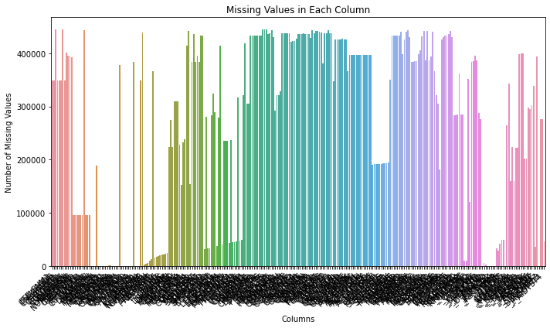
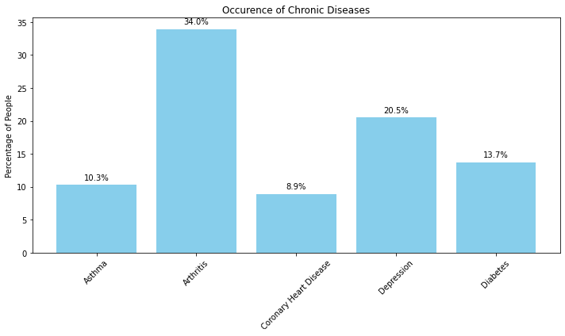
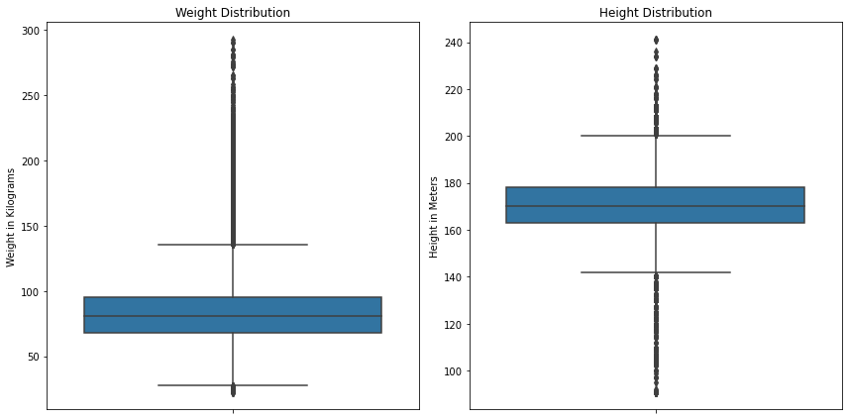
Exploratory Data Analysis
445132
327
Respondents
Questions Asked

Slide 5



Data Cleaning and Preparation Process
Data Pre-processing: We processed 2022 data from the BRFSS, narrowing it down to 79 key columns. This included cleaning, filling missing values, and simplifying the data to ensure quality and focus for our analysis.
Data Cleaning
Targeted Removals: Discarded non-essential columns including CRGVPRB3, CAREGIV1, etc.
Missing Value Handling: Addressed blanks with context-specific values; e.g., MSCODE defaults to '5'.
Standardization Efforts: Ensured uniformity in variables like MARIJAN1 for dataset consistency.
Data Transformation
Categorical Recoding: Binary transformation for variables (e.g., DIABETE4 as 1 or 0).
Conditional Adjustments: Managed special cases by applying conditions (e.g., _SEX '1' implies PREGNANT '2').
Preemptive Filling: Pre-populated missing values in critical variables to align with study parameters.
Data Reduction
Attribute Pruning: Removed duplicate attributes; recalculated necessary metrics like _BMI5.
Category Consolidation: Refined MARITAL status into broader categories for simplicity.
Smoker Category Synthesis: Integrated smoker data from _SMOKER3 into a cohesive _SMOKGRP.

Slide 6
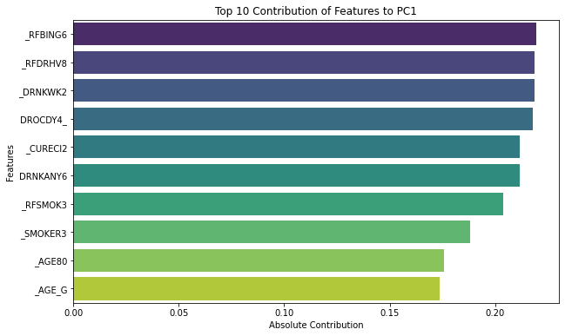
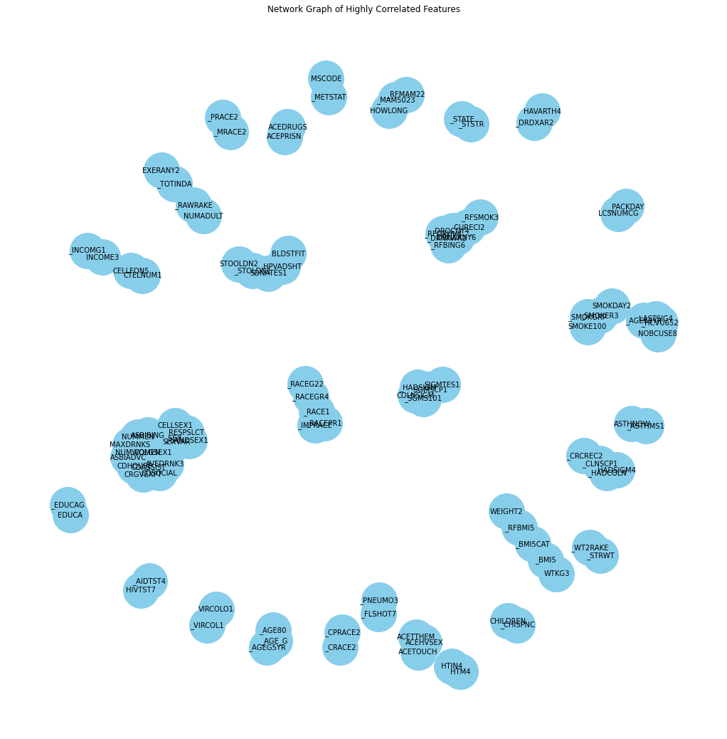
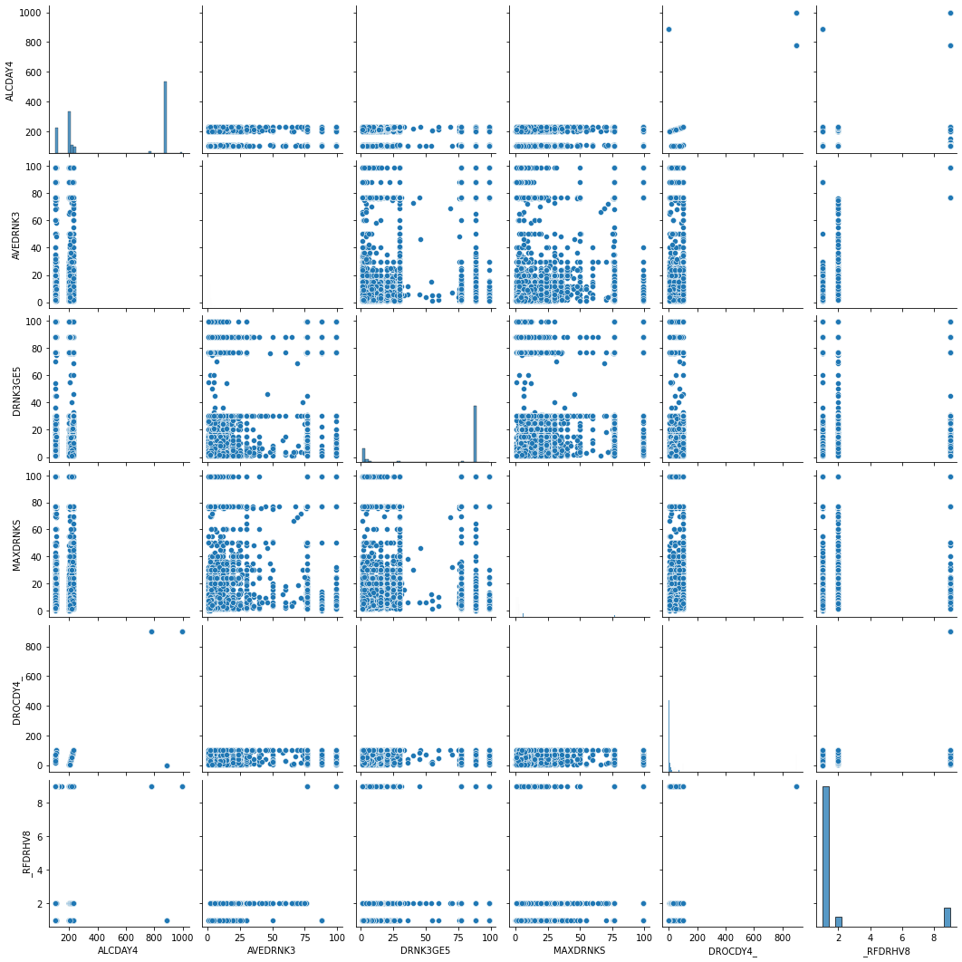
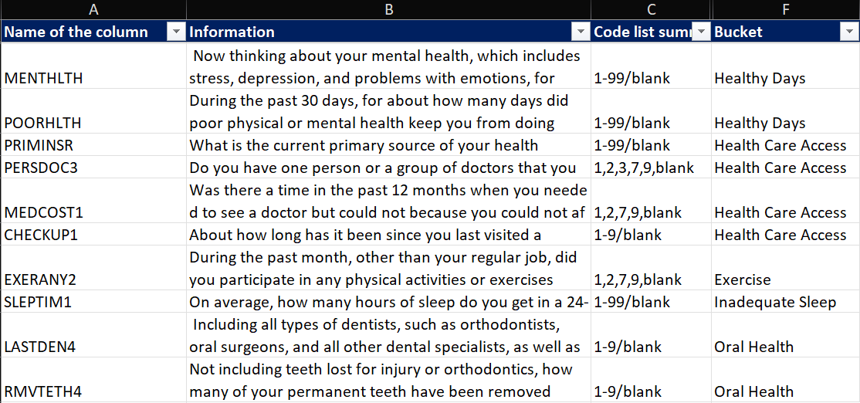
Data Clustering and Correlations

Slide 7
Models applied for Diabetes Prediction
Decision Tree
Performance: Accuracy of Test segment 78%, with tree depth 62
Optimized with GridSearchCV to reduce overfitting; Max Depth of 9 and Min Samples Split of 5.
Performance: Test Accuracy of 85%, F1 Score of 0.92
Logistic Regression
Performance: Training Accuracy of 85%, F1 Score of 0.024 on test data.
Applied Sequential Feature Selection to enhance model performance.
Poor performance due to assumption of linear relationship
.
Random Forest
Used GridSearchCV for hyperparameter tuning.
Achieved an Accuracy of 85% and a Weighted F1 Score of 0.80 on test data.

Slide 8
Models applied for Heart Disease Prediction
Logistic Regression
Performance: Training Accuracy of 91%, F1 Score of 0.0548 on test data.
Feature selection techniques were applied to refine model inputs
Unable to model complex non-linear relationships
.
Decision Tree
Performance: Accuracy of Test segment of 89%, with tree depth 52
Final model reducing overfitting with a Max Depth of 9 and Min Samples Split of 2.
Performance: Test Accuracy of 94%, F1 Score of 0.97.
Random Forest
Hyperparameter tuning conducted with a focus on improving F1 Score.
Test Accuracy of 93% and Weighted F1 Score of 0.91 achieved.

Slide 9
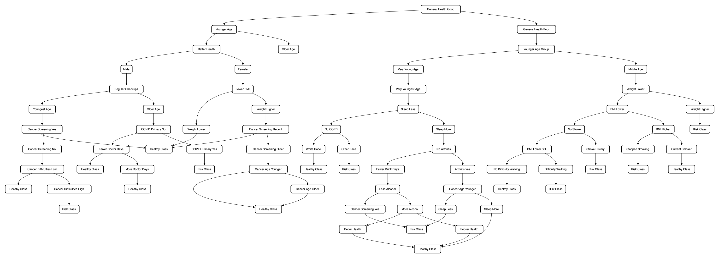
Diabetes

Slide 10
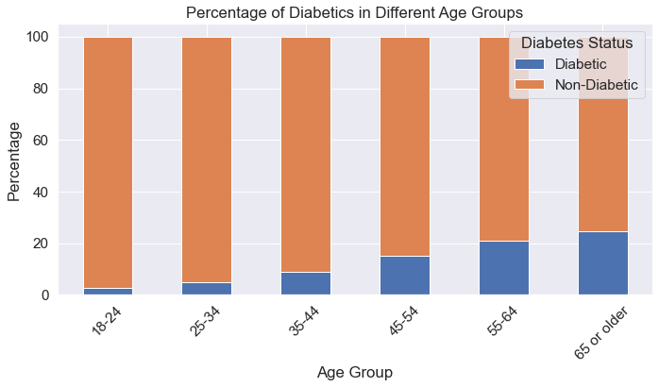
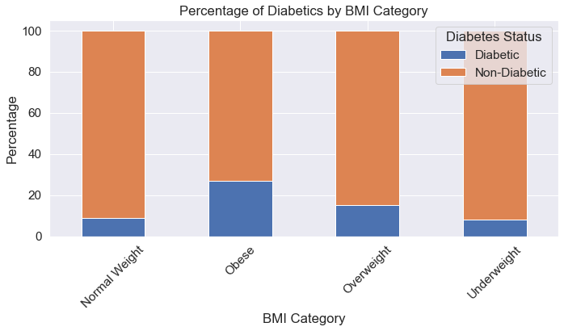
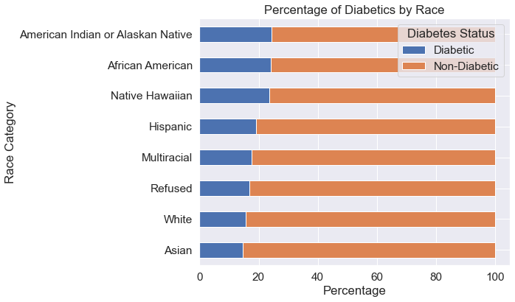
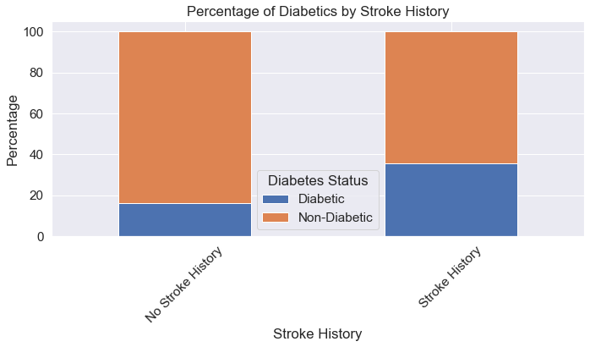
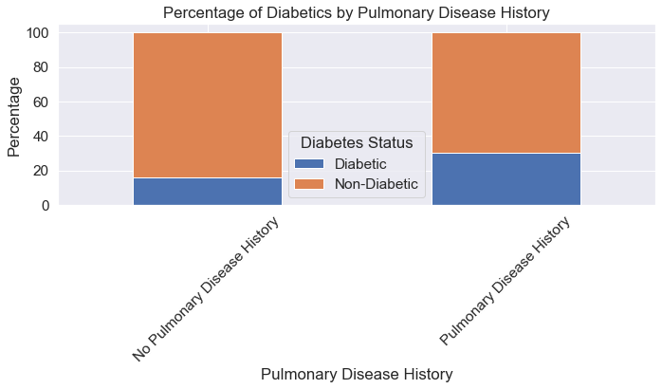
Segments of Diabetic Patients

Slide 11
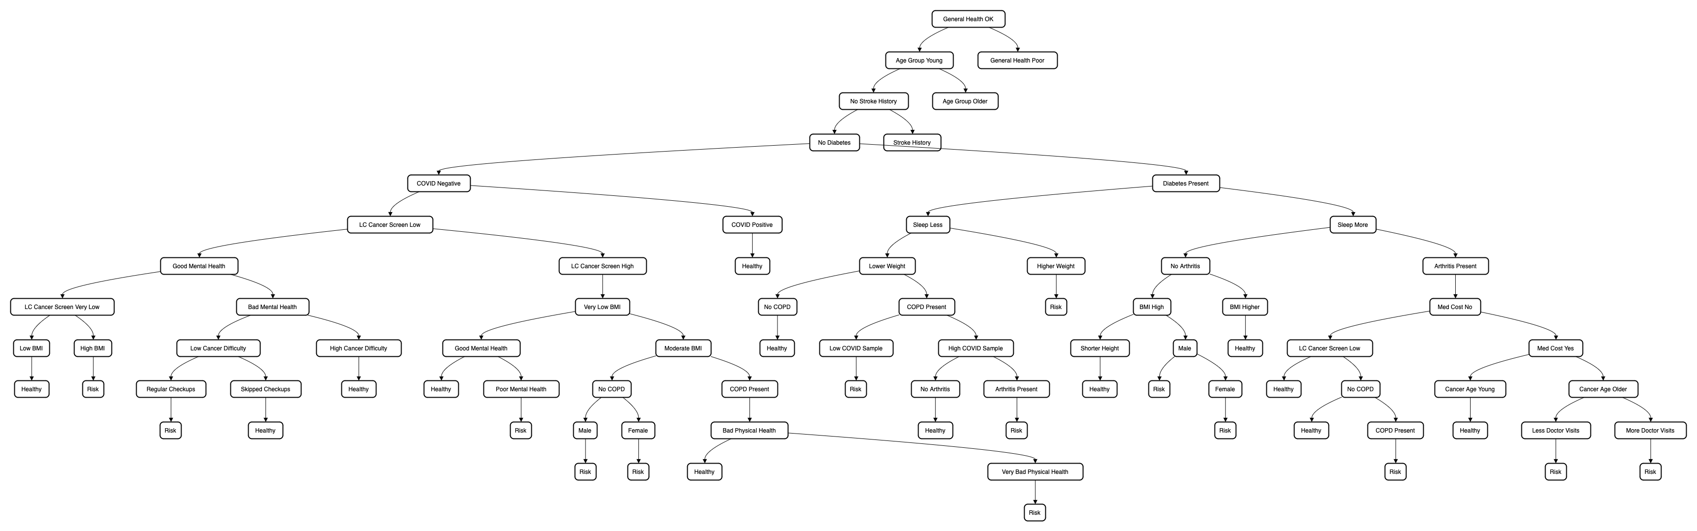
Heart Disease

Slide 12
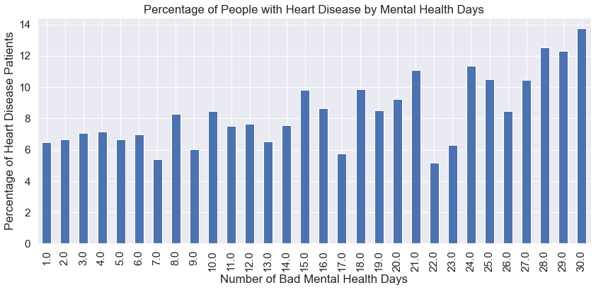
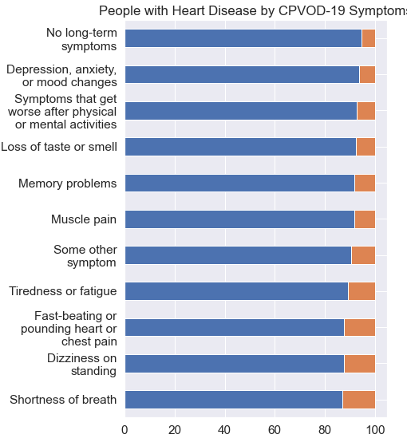
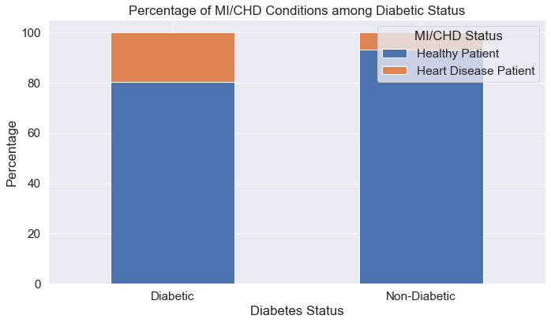
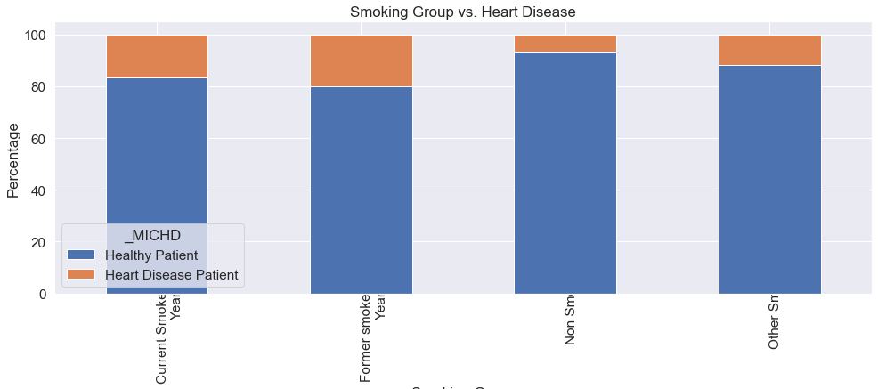
Segments of Heart Disease Patients

Slide 13

High Risk Patient Segments
Diabetic Patients
Heart Patients
Above the age of 45
BMI more than 30 (Overweight and Obese)
History of Stroke or Pulmonary Disease
Young Cancer patients
People of color
Arthritis or difficulty walking
Current Smoker
Lesser sleep time
Diabetic patients with history of Arthritis and Pulmonary Disease
BMI more than 30 (Overweight and Obese)
People with pool mental health
Former and Current Smoker
Young Cancer patients
COVID positive patients with long lasting symptoms (Shortness of breath, dizziness, chest pains, memory problems)

Slide 14

Thank you!

Slide 15
Team Members
Akanksha Nangia | NUID: 002818837
Bhakti Ramesh Chotalia | NUID: 002822459
Rishabh Ashutosh Joshi | NUID: 002877315
Stuti Saxena | NUID: 002820418
Venkata Sai Akhil Vidiyala | NUID:

