Slide 1
NexusCollab
Where collaboration meets innovation, transforming your learning into real-world impact
Team C

Slide 2
Agenda
Business Problem
Introducing our Product
Market Segmentation
Results
Competition – Secondary Data
Competition – CLV Analysis
Survey Data Collection Demographics
Summary of Variable Graphs
Segmentation Results and Descriptions
Business Implications and Market Outreach
Limitations

Slide 3
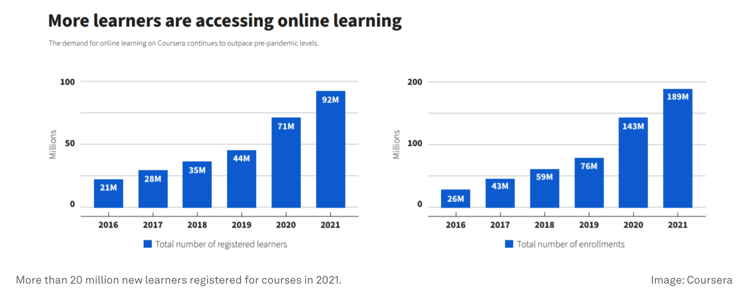
Education market Landscape
Evaluate the positioning and estimate customer lifetime value across different competitors in existing market.
Introducing a new education platform devised from existing gaps and unmet consumer needs in the current education subscription services market.
Identify and differentiate distinct consumer segments and their characteristics in the market
Develop a Go-To-Market strategy to introduce our new product for target customer group

Slide 4





Competiton – Secondary data
Active Users (Globally): | 142 million | 64 million | 41 million | 10 million | 27 million
Course Offerings: | Approximately 7,000 courses | 210,000+ | 3,500+ | 440+ | 16000+
Subscription Model: | Coursera Plus | Udemy Business | EdX for Business | DataCamp Premium | Linkedin Premium
Subscription Cost (Monthly): | $59 | $20 | $29 | $13 | $19.99
Annual Revenue (2023): | $636 million | $728.9 million | $44 million | $12.5 million | $15 billion
Overall Rating: | 4.5 | 4.5 | 4.5 | 4.3 | 4.4

Slide 5
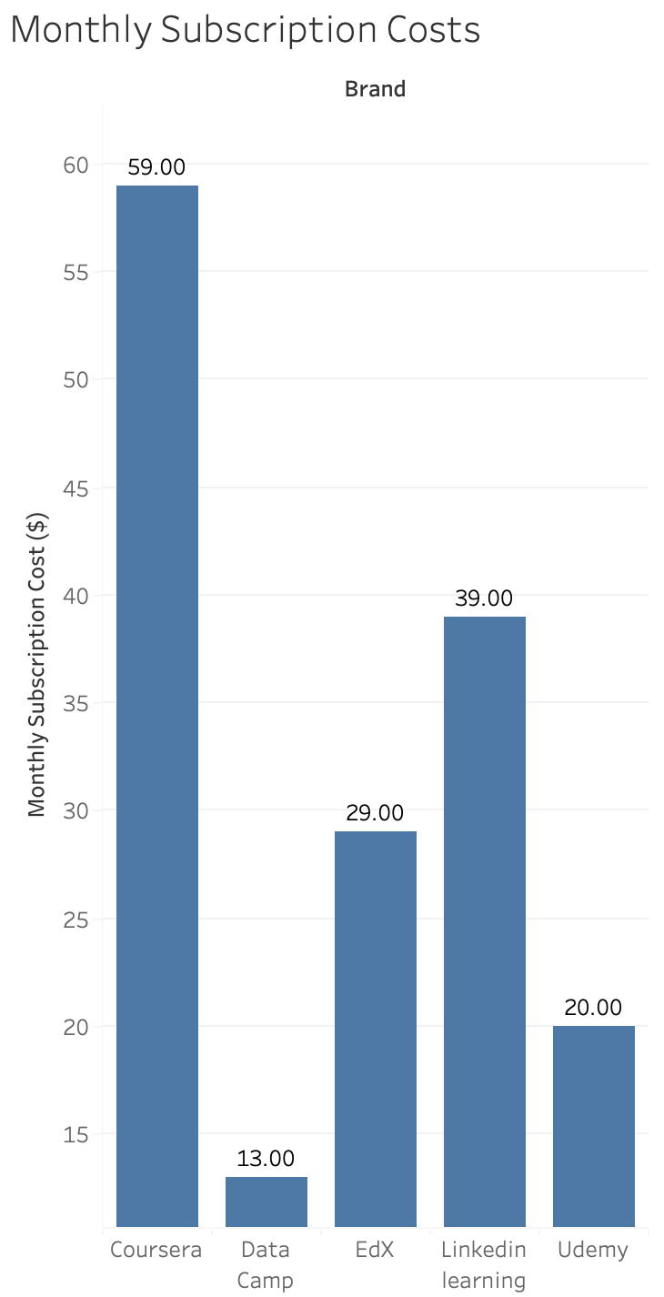
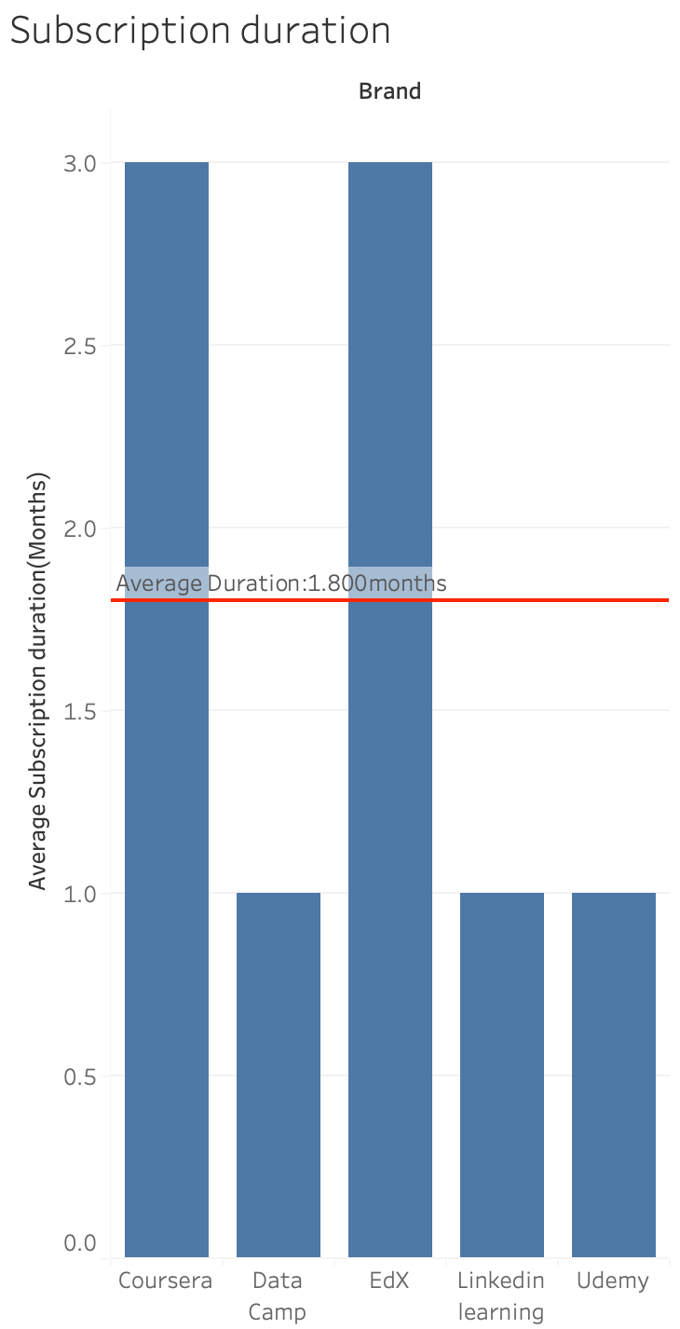
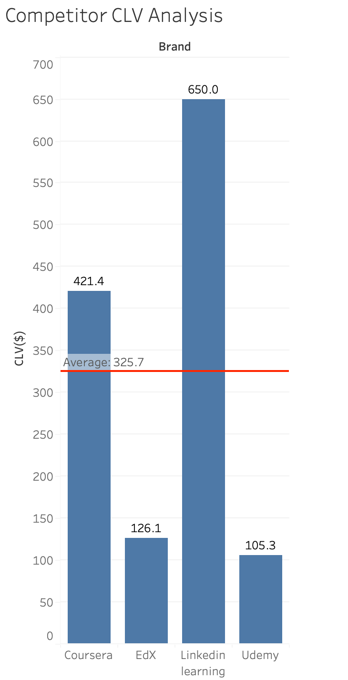
Competiton – CLV

Slide 6
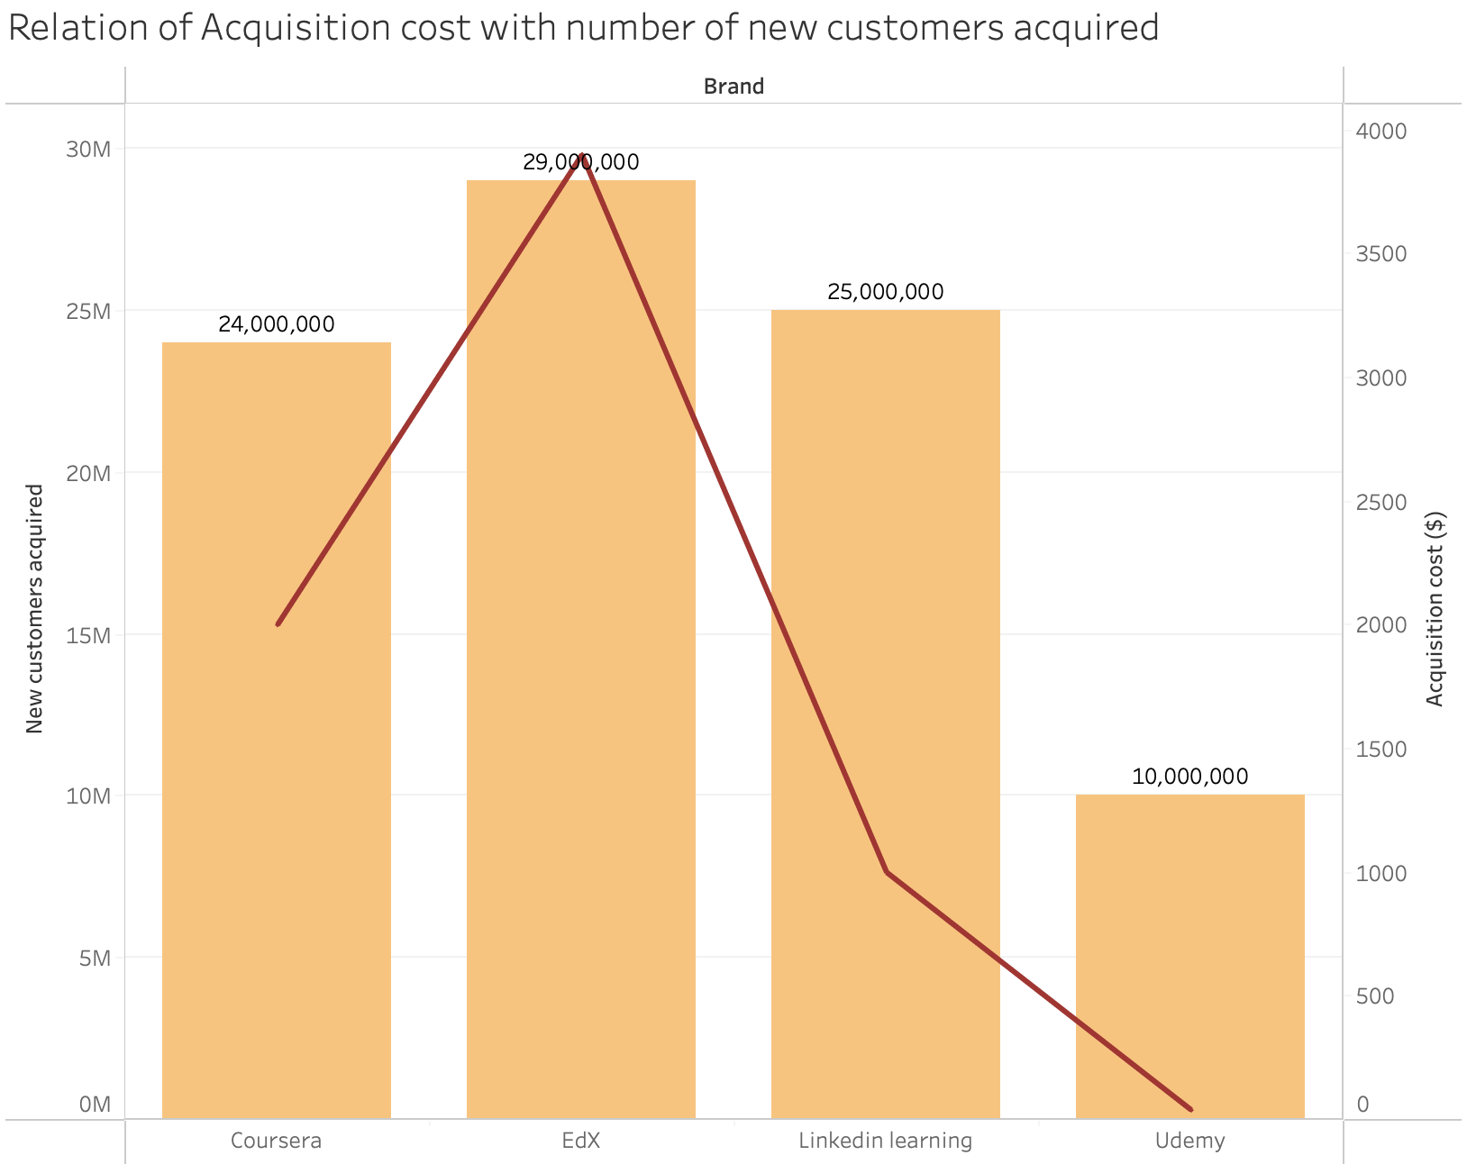
Competiton – CLV

Slide 7
Competiton – Retention strategies
University and Industry Partnerships | MicroMasters and Professional Certificate Programs | Integration with LinkedIn | Mobile-Friendly Design | Skill Tracks and Career Tracks
Financial Aid and Scholarships | Gobal University Partnerships | Learning Paths | Gamification | Hands-On Learning
Coursera for Business | Audit Tracks for Free Learning | Skill Assessments | Interactive Course Content | Community Projects
Certification and Degree Programs | Open edX Community | Content for Professionals | Personalized Learning Paths | DataCamp Workspace

Slide 8








Introducing our product
Real-World Projects
Project Showcase and Portfolio
Highly Accredited Courses
Collaboration Tools
Industry Partnerships
Mentorship and Guidance

Slide 9
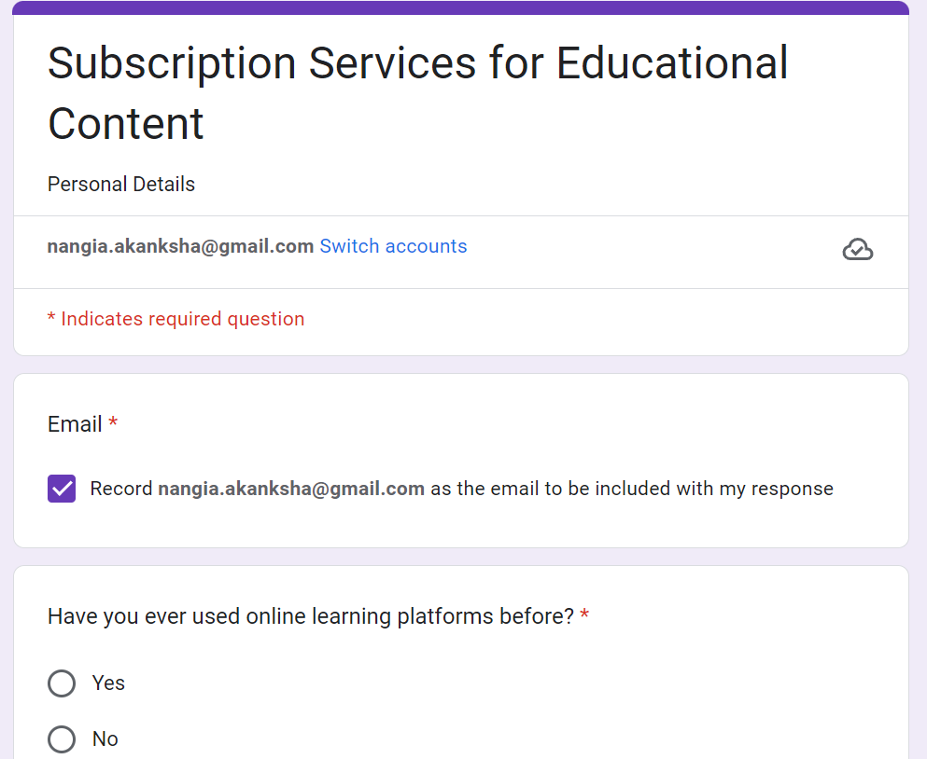
Survey to Understand Market Segmentation

Slide 10
Summary of variables graphs
Gender Ratio
Age Group
Usage of Education Services Duration
Work Experience
Competitor Brand Perception

Slide 11
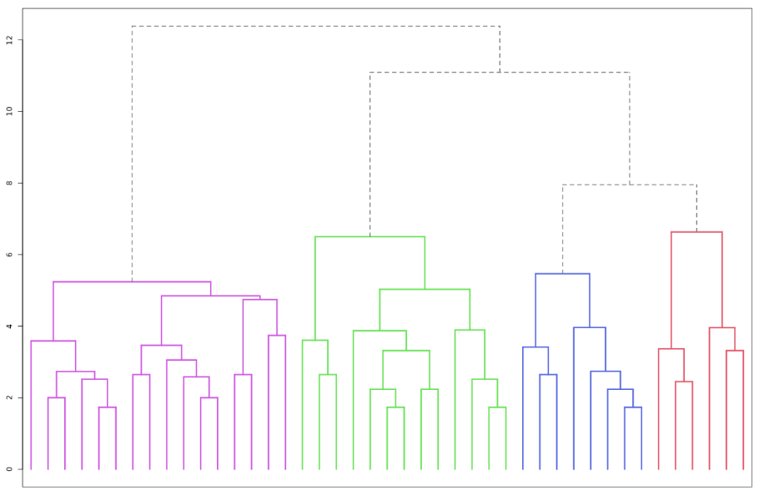
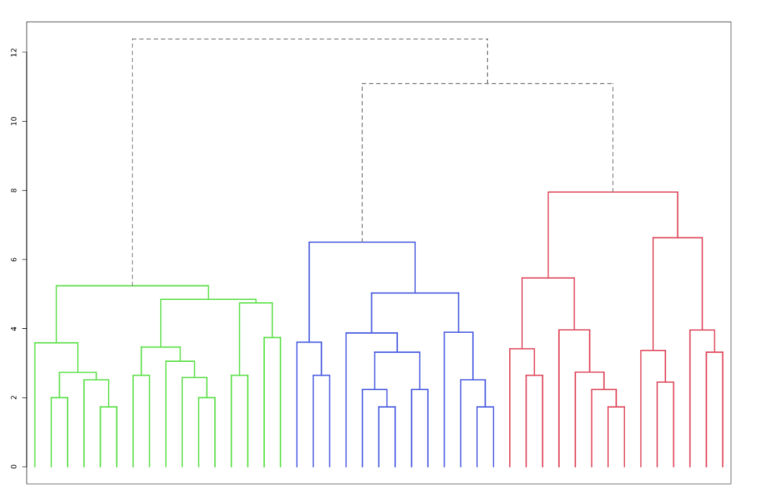
Segmentation results - Dendograms

Slide 12
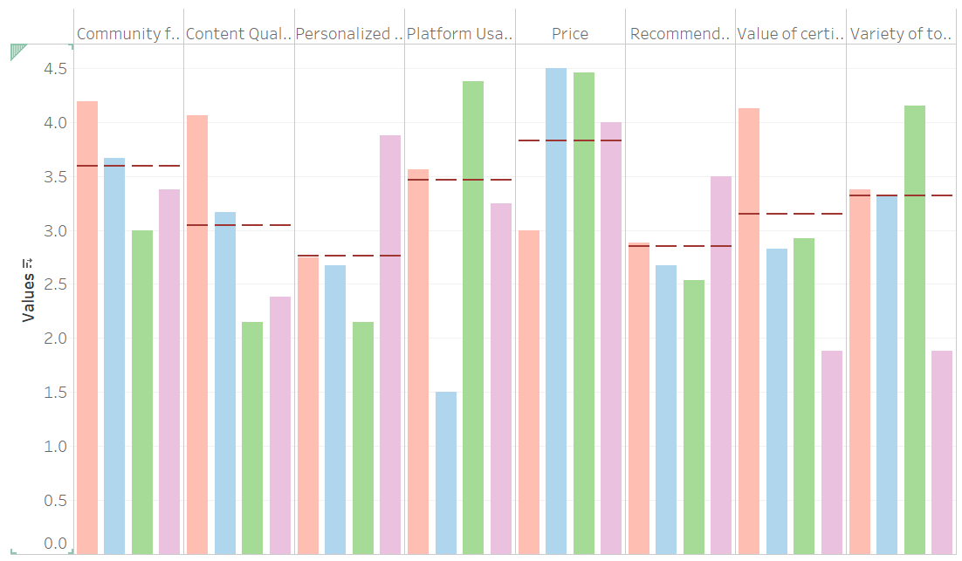
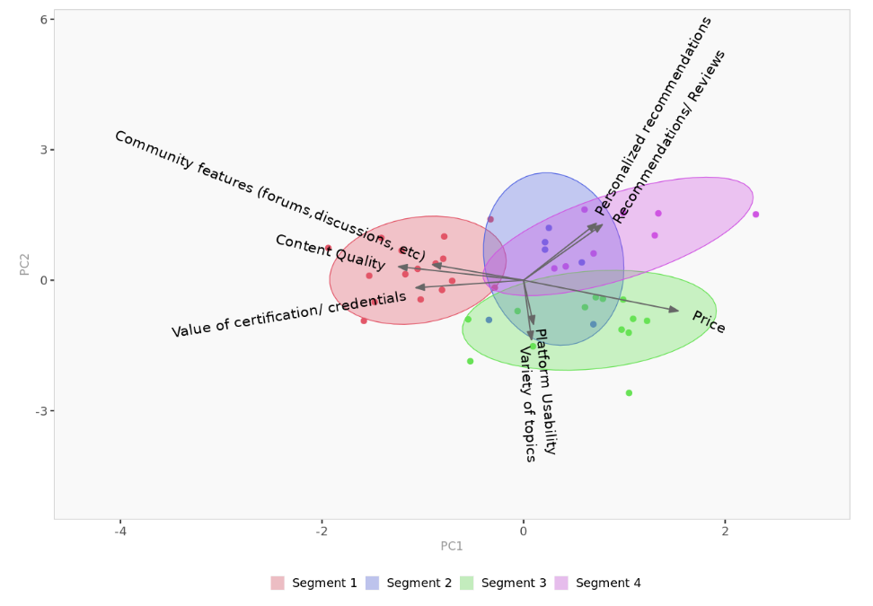
Segmentation descriptions

Slide 13



Price-Sensitive Students
Differentiator
Very strong preference for affordable educational services
Value access to a wide range of topics
While not as high as Engaged Explorer, they still value community engagement to a considerable extent
Not swayed by platform usability
18-24 Years
Monthly Engagement
50% Females
3-6 hours/ Month
Mia, a university student with an eye for value, navigates through a diverse array of educational topics, finding gems that fit her tight budget and expansive academic interests.
1-3 Years
$1-$51
Less than $10,001
Wide range of pay-per courses from top global universities
“As a student juggling finances, I hunt for courses that give the most bang for my buck; I'd be thrilled to see more budget-friendly options that don't skimp on the diversity of subjects

Slide 14
Proactive High-Risk
Informed Actives
Optimistic Moderates
Annual Subscriptions
Monthly Subscriptions
Monthly Subscriptions
12 Months Engagement
9-12 Months Engagement
6-7 Months Engagement
Negative Sentiments
Negative Sentiments
Mixed Sentiments
Provide comprehensive prevention resources and regular health check-up reminders
Offer emotional support services and counseling resources to improve sentiment.
Personalized plans and frequent follow-ups to ensure engagement
Regular updates on the latest research and treatment options.
Organize webinars and virtual meetups with healthcare professionals
Encourage participation in community support groups and events.
Provide detailed information about available resources and their benefits
Provide detailed information about home care and preventive measures
Enhance engagement through interactive content like quizzes and challenges.
Offer regular newsletters with tips for maintaining a healthy lifestyle and updates on new resources.

Slide 15

Engaged Explorers
Differentiator
Prioritize high-quality educational content
Significantly concerned with the value that certifications and credentials will bring to their education
Likely to engage in forums and discussions for their learning experience.
Give importance to quality over price
25-34 Years
Weekly Engagement
63% Males
5-6 hours/ Week
Jacob, an interactive community enthusiast, thrives on rich discussions within his favorite online learning platforms while meticulously curating the credentials that will propel his early career.
3-5 Years
$51-$100
$10,000 - $20,000
Prestigious educational and professional certifications
“The courses I've taken have been instrumental in my professional growth; I'm on the lookout for courses that not only teach but also connect me with a community.

Slide 16

Practical Professionals
Differentiator
Looks for practicality in services, with a focus on usability and price
Greatest importance on how user-friendly the platform is
Prioritize having a variety of subjects to choose from
Not focused on spending money on services
25-34 Years
Weekly Engagement
84% Males
1-4 hours/ Week
Michael, with his wealth of experience, opts for pragmatic and user-friendly educational services that promise tangible benefits without the need for financial investment.
3-5 Years
$0
$10,000 - $20,000
Options of freely available courses/certifications to advance careers
“I need an educational platform that fits into my busy schedule and gives me real skills I can use; I value straightforward courses with clear outcomes over fancy features

Slide 17

Selective Learners
Differentiator
Rely on the recommendations and reviews of others, to ensure a more tailored and quality experience
Highly value services that offer personalized learning recommendations
Consider the cost of services when making their decision
Less concerned with a broader variety of topics
25-34 Years
Monthly Engagement
62% Males
> 6 hours/ Month
Sophia, a young professional, dedicates her limited free time to personalized learning experiences that promise growth, ensuring each dollar she spends maximizes her career trajectory.
> 3 Years
$1 - $100
> $20,000
Targeted course recommendations for professional development
“My time is precious, so personalized courses that align with my career goals are ideal; I'm looking for even smarter recommendations that can further personalize my learning journey ahead.

Slide 18
Target Segment: Engaged Explorers
Desire for Practical Applications
Networking and Professional Growth
Credentialing and Portfolio Building
Engaged users lead to higher CLV
Potential for Upselling
Likely to become brand advocates

Slide 19
Go To Market Strategy
Medium- long term
Short term
Full Product Launch with refined features based on user feedback
Scale Partnerships with educational institutions, content providers, and industry bodies
Establish a robust support system to help users maximize their platform use
Scale up marketing efforts to include success stories and testimonials
Continuous user feedback using analytics to track engagement and success rates
IMMEDIATE
Release a Minimum Viable Product to a select group of users for beta testing to gather feedback
Start targeted advertising and content marketing focused on platforms frequented by the Segment
Community Building by engaging industry influencers to start discussions on relevant topics and hosting virtual events or webinars
Deepen understanding of our TPP’s specific needs and preferences
Initiate conversations with potential industry partners
Craft a compelling value proposition highlighting collaboration, real-world learning, and professional growth

Slide 20

Limitations
Sample Bias: The analysis might not fully show the varied experiences and needs of all customers if the sample doesn't represent everyone.
Demographic Range: Not covering a wide range of demographics might miss important insights from key market segments.
Response Rate: Low response rates can limit the generalizability of the survey findings to the entire target population.
Social Desirability Bias: People might give answers they think are more liked, not necessarily true, potentially misdirecting the survey outcomes.
Question Interpretation: Variability in how respondents interpret survey questions can lead to inconsistencies in responses, affecting the accuracy of the data collected.
Survey Fatigue: Long surveys may lead to respondent fatigue, resulting in rushed or incomplete answers that can affect data quality.

Slide 21
Thank you!

