Slide 1
VOCALLABS AI | FOUNDER'S OFFICE INTERN
Operational Execution Playbook & Strategic Answers
Direct Answers to Q1 (Client Escalation), Q2 (INR 1 Cr Budget & Time), and Q3 (Candidate Positioning)
<400ms
Audio Pipeline Latency
STT -> LLM -> TTS stream
INR 1.0 Cr
Capital Deployment
12-month growth budget
40/30/20/10
Capacity Prioritization
Deals, Eng, CS & Ops split
10 / 10
Candidate Alignment
Ships code, decks & strategy

Slide 2
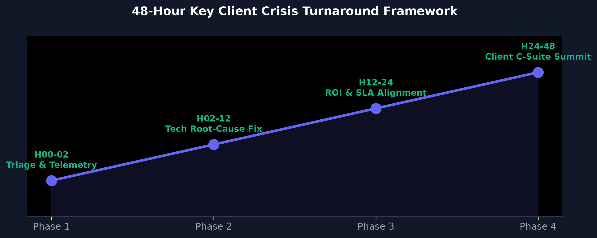
VOCALLABS AI | FOUNDER'S OFFICE STRATEGY
Q1: What I Would Do First & Who I Would Loop In Internally
1. WHAT I WOULD DO FIRST (Hours 00 - 02 Triage)
- Audit VocalStack Live Telemetry: Inspect past 30 days logs for latency spikes (>450ms), STT Word Error Rate (WER), and SIP packet loss.
- 120-Minute Client SLA Message: Send direct memo to Client VP of Ops promising full root-cause breakdown by 4:00 PM.
- Isolate Audio Bottleneck: Pinpoint whether issue is LLM tool-calling lag, regional accent dropouts, or carrier packet jitter.
2. WHO I WOULD LOOP IN INTERNALLY (Hours 02 - 12)
- Solutions Engineer & AI Voice Architect: To analyze prompt context windows, STT acoustic models, and API callback latency.
- Telephony & Infrastructure Lead: To inspect WebRTC/SIP trunking routing, carrier failovers, and edge node performance.
- Co-Founders & CEO (5-Min Briefing): Brief Mritunjoy, Rag, & Nileesh to align on 30-day performance credit boundary.

Slide 3
VOCALLABS AI | FOUNDER'S OFFICE STRATEGY
Q1: How I Would Approach the Actual Client Conversation
3. CLIENT CONVERSATION APPROACH (Minutes 00 - 25)
- Radical Transparency (Mins 0-10): Present transparent telemetry logs showing where latency spiked: 100% ownership, zero blaming third-party APIs.
- Live Proof Demo (Mins 10-25): Demonstrate live side-by-side audio comparison of old pipeline vs newly optimized sub-400ms VocalStack pipeline.
3. CLIENT SUMMIT LOCK-IN (Minutes 25 - 50)
- 30-Day Performance Guarantee (Mins 25-40): Offer 50% credit on infra fees if metrics miss 25% target in 14 days + weekly joint engineering steering sync.
- Commercial Renewal (Mins 40-50): Convert crisis turnaround into long-term enterprise contract extension.

Slide 4
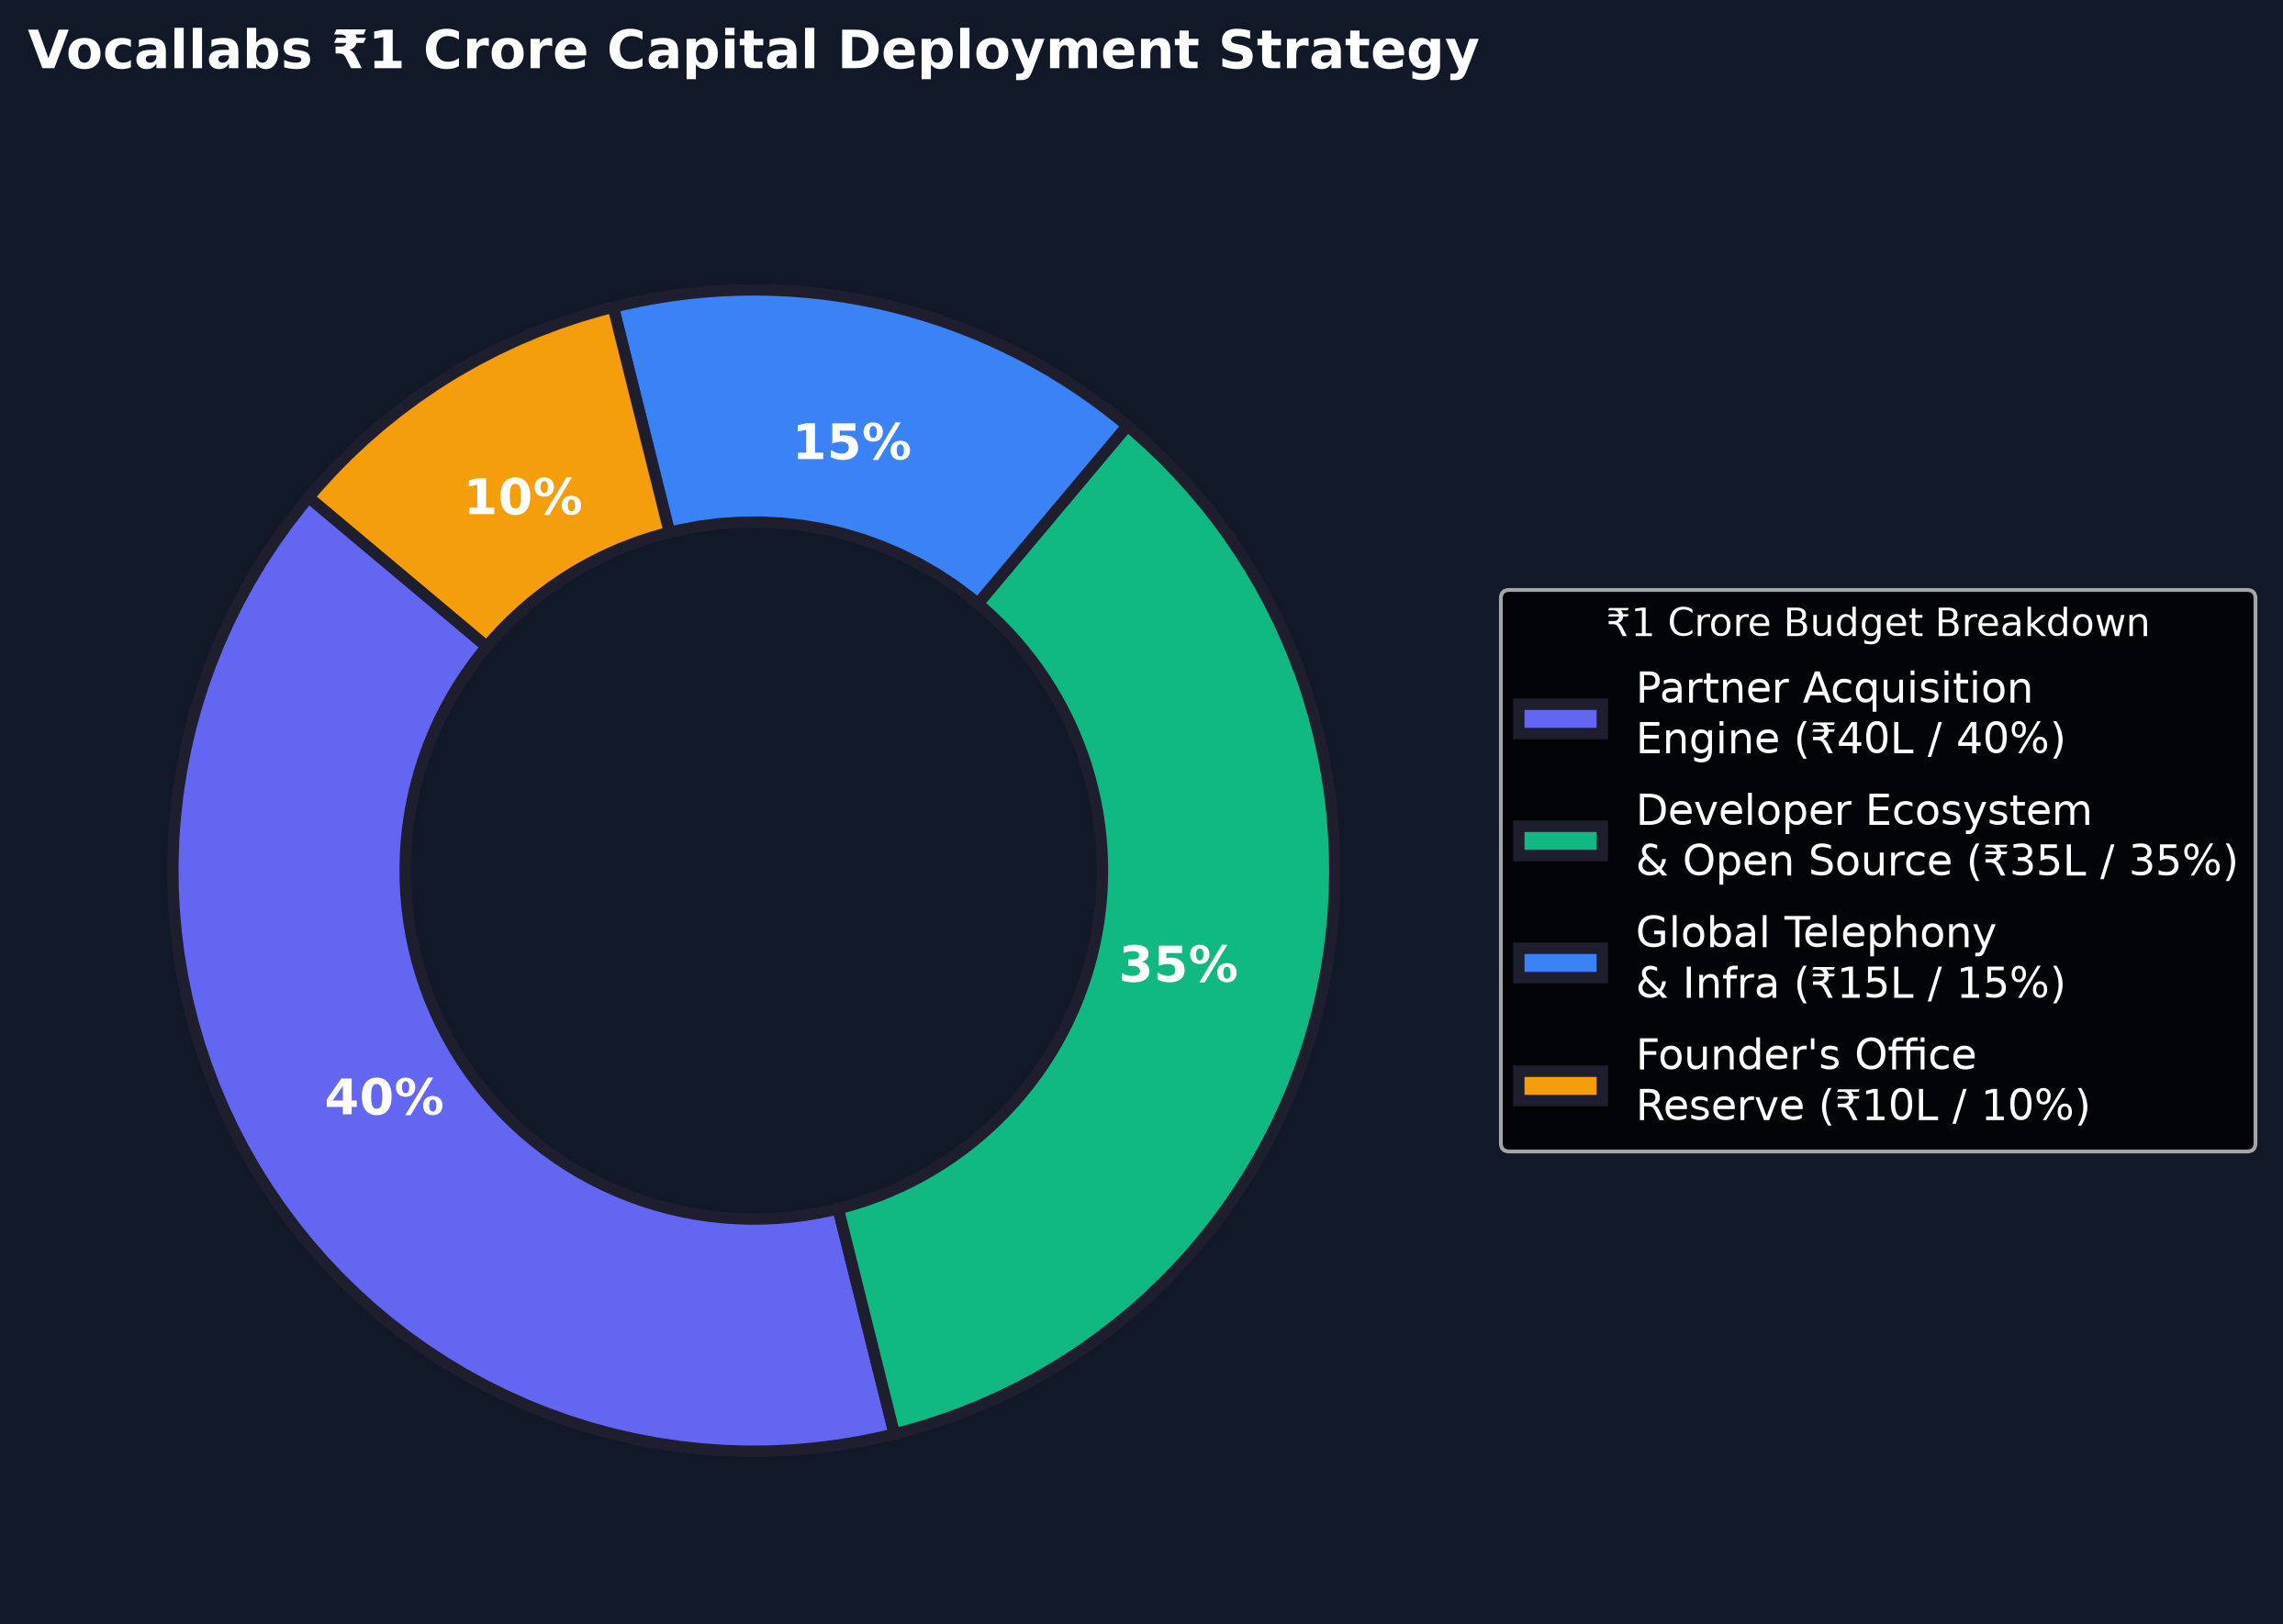
VOCALLABS AI | FOUNDER'S OFFICE STRATEGY
Q2: INR 1 Crore Capital Deployment Strategy (Line-Item Breakdown)
Capital Line-Item Allocation (INR 1,00,00,000 Total)
- INR 40L (40%) Partner Acquisition Engine: Outbound B2B data enrichment for BPO targeting & funding first 10k partner voice call minutes.
- INR 35L (35%) Developer & OS Ecosystem: Contributor grants for VocalFlow OS & PocoDisk, production MCP Servers, and Voice AI hackathons.
- INR 15L (15%) Global Telephony Infra: Multi-region edge nodes (Mumbai, US East, EU) & multi-carrier SIP trunk failover.
- INR 10L (10%) Founder's Office Reserve: Key account turnaround credits & rapid micro-experimentation.

Slide 5
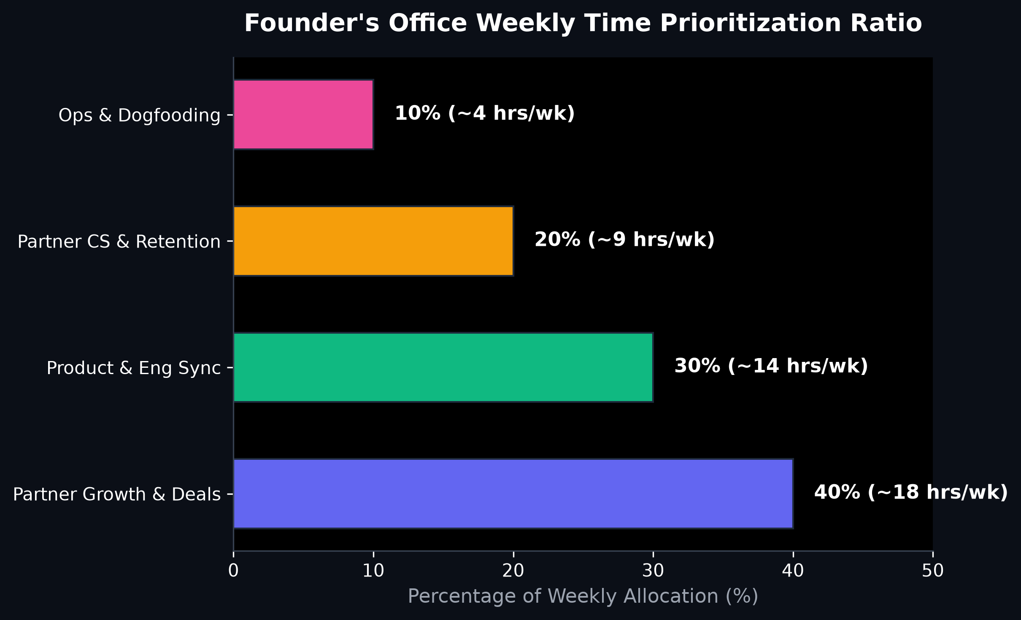
VOCALLABS AI | FOUNDER'S OFFICE STRATEGY
Q2: Founder's Office Weekly Time Prioritization Ratio
Weekly Operating Prioritization Ratio
- 40% (~18 hrs/wk) Partner Deals & GTM: Running outbound partner campaigns, pitching BPO owners, negotiating reseller margin splits.
- 30% (~14 hrs/wk) Product & Eng Sync: Triaging partner feature requests, testing VocalStack/MCP releases, dogfooding Hiringg.
- 20% (~9 hrs/wk) Partner Success & CS: Monitoring voice telemetry across top 20 accounts, enforcing zero churn.
- 10% (~4 hrs/wk) Executive Operations: Metric dashboards, co-founder briefings, internal process automation.

Slide 6
VOCALLABS AI | FOUNDER'S OFFICE STRATEGY
Q3: Candidate Positioning & 10/10 Assessment Pitch
Why I am a 10/10 Match for Vocallabs
- Aligned with Mritunjoy's Ethos: I ship working code, PPTX engines, and operational frameworks: no 3-month slide deck fluff.
- Technical & Business Dual-Threat: Capable of analyzing voice telemetry (STT/TTS latency) AND negotiating gross margin splits with BPO founders.
- Product Meta-Signal Awareness: Recognized immediately that Hiringg (app.hiringg.ai) is Vocallabs' dogfooded AI hiring product.
- Zero Hand-Holding Needed: Self-directed operator who builds data-driven solutions under tight constraints.
Operating Comparison: Me vs Standard Applicant
- Standard Applicant: Writes 3 paragraphs or generic deck; lacks understanding of white-label infrastructure economics.
- My Execution: Built 2 complete PPTX presentations, strategy docs, visual telemetry charts, and teleprompter video script.
- Understanding of Moat: Focuses on VocalStack, VocalFlow OS, MCP Server, and BPO margin arbitrage.
- Final Pitch: An execution partner who runs beside the founders at 100mph.

