Slide 1
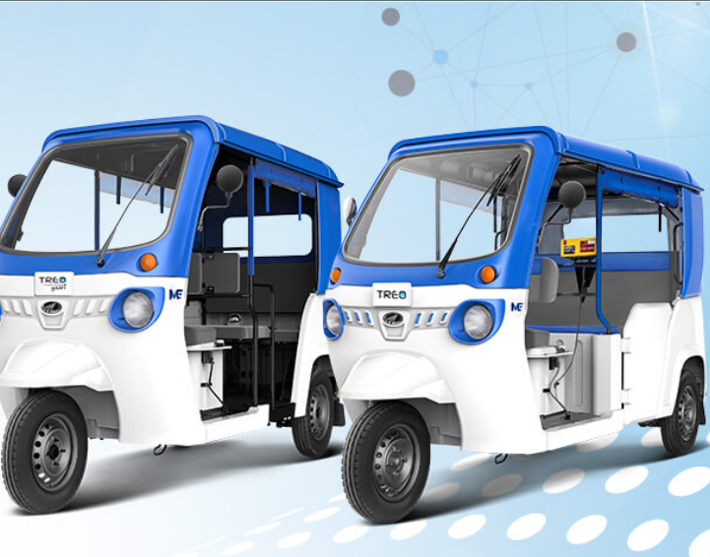
BUDDY E-RIKSHAW SERVICES
MINI PROJECT
Project By:
Khush Mohammad
Lokesh Bhakuni
B.Tech CSE
Project Submitted to:
Ms. Richa Pandey

Slide 2

ACKNOWLEDGEMENT
I would like to express my sincere thanks to Ms. Richa Pandey mam, for her valuable guidance and support in starting of the project.
And I also would like to thank my group member for his support in this project.

Slide 3

TEAM MEMBERS:
1) Khush Mohammad
(Project Leader and Coder)
Student ID- 200111004
2) Lokesh Bhakuni
(Coder and Tester)
Student ID- 200111254

Slide 4

INTRODUCTION
In this mini project we are going to create an online directory of E-Rickshaw services.
The directory will contain all information like rickshaw owners basic information, official ID, vehicle information, service time availability and other required necessary things.
The directory will be sorted based on the routes and areas where the rickshaw owner will provide its services.
The webpage will contain two login gateway one for customer and another for rickshaw service provider.

Slide 5
KEY POINTS
THE KEY FEATURES AND POINTS OF THIS MINI PROJECT OR IDEAS ARE AS:
Door to Door Services.
Both Travel as well as carrier transport facilities.
Focus on green Environment.
24*7 Door to Door Facility.
Boost employment opportunities for small E-Rikshaw owners.
Minimal charges/Fair Prices.

Slide 6

THANK YOU
GO GREEN
SAVE ENVIRONMENT

