Slide 1

House Prices: Advanced Regression Techniques
Project 3
Brian HALBUR
Adam Brush

Slide 2
Overview
Given 79 variables, covering >2700 homes in Ames IA our challenge was to predict the final price of each home.
We used a linear regression model for our predictions
Kaggle competition scored this on root mean square error (RMSE)
Notes:
With 79 explanatory variables describing (almost) every aspect of residential homes in Ames, Iowa, this competition challenges you to predict the final price of each home.

Slide 3
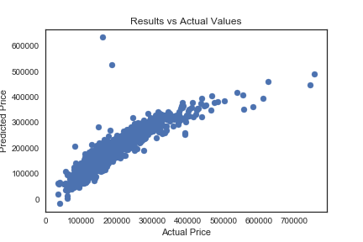
Model selection
Isolated numerical data (roughly 30 variables)
Ran basic linear regression (scikitlearn)
First submission scored .14153
Roughly 2,500th out of 4300 entries

Slide 4
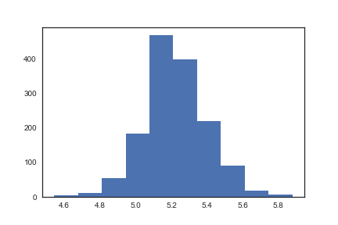
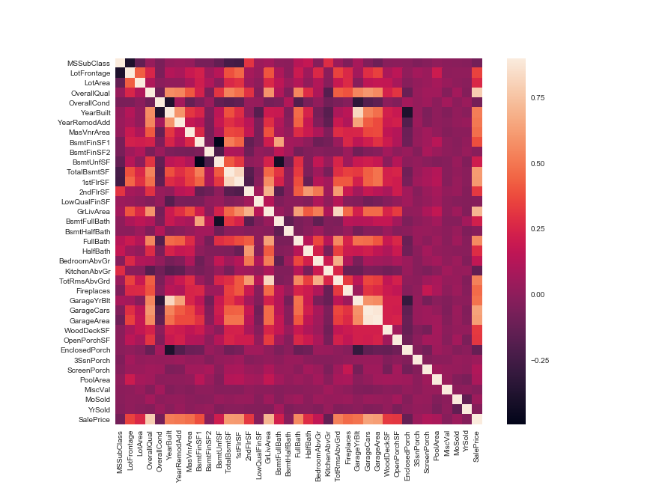
Data Visualization and interpretation
Log Transformed house prices to normalize the distribution
Visualized with a histogram

Slide 5
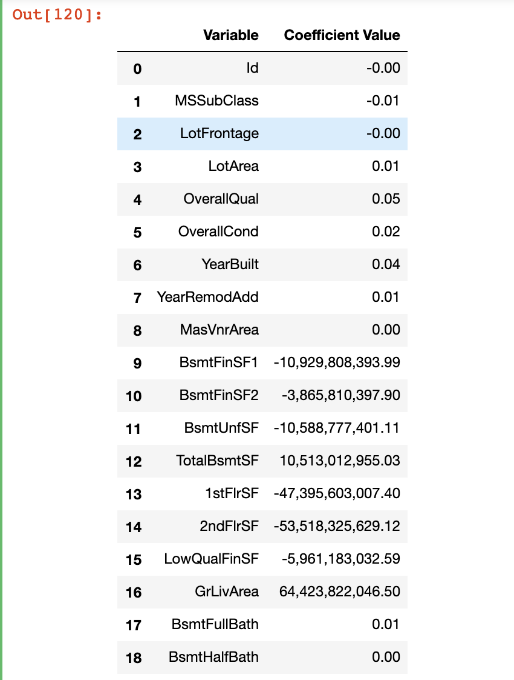
Standard Scaling and Coefficients
Standard scaled all input variables.
This allows for comparability of coefficient values generated by the regression model
We noticed some strong colinear variables, which may have been overfitting the model
Selectively removed some of these colinear variables
Surprisingly very little change in results

Slide 6
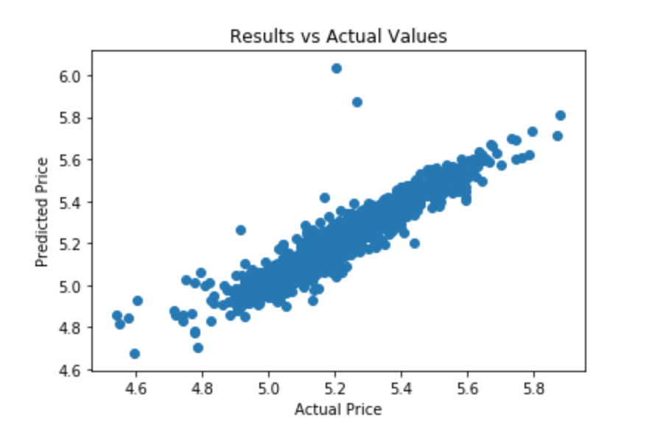
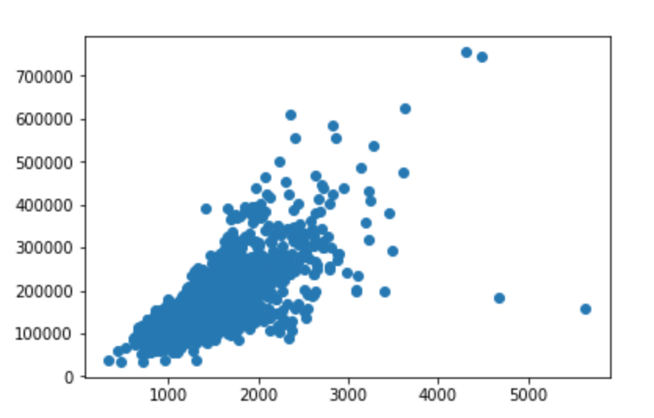
Removing Outliers
Identified outliers based on residual and price per sq. ft.
Removed these entries from the training data.
Regression trained without these two outliers advanced us roughly 500 places on the leaderboard (~2,000th)

Slide 7
EncodinG Categorical Variables
Used label encoding on all text variables to include them in our linear regression model
Moved us up ~500 spots on the leaderboard
Attempted one hot encoding but the model was worse than the label encoded model.

Slide 8
Attempting Stacked regression models
Attempted to use a stacked regression model with no luck
Stacked models included:
Gradient Boosting Regressor
Support Vector Regression (SVR)
Lasso Regression
Elastic Net Regression
Some of these models provided better results on the training data
None of them individually or as a stacked model provided better results on the test data

Slide 9

Final Score
Placed 1531 out of 4300 entries .12633

