Slide 1

House Prices: Advanced Regression Techniques
Project 3
Brian HALBUR
Adam Brush

Slide 2
Overview
Given 79 variables, covering >2700 homes in Ames IA our challenge was to predict the final price of each home.
We used a linear regression model for our predictions
Notes:
With 79 explanatory variables describing (almost) every aspect of residential homes in Ames, Iowa, this competition challenges you to predict the final price of each home.

Slide 3
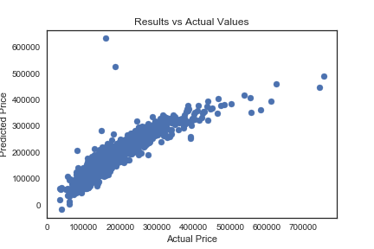
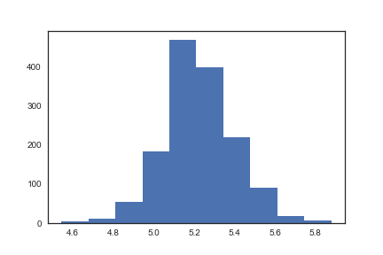
Visualizing the Data
2nd Step: Use Standard Scaler and use Log-Normalized Sales Prices
First Step: Plot variables after running linear regression

Slide 4
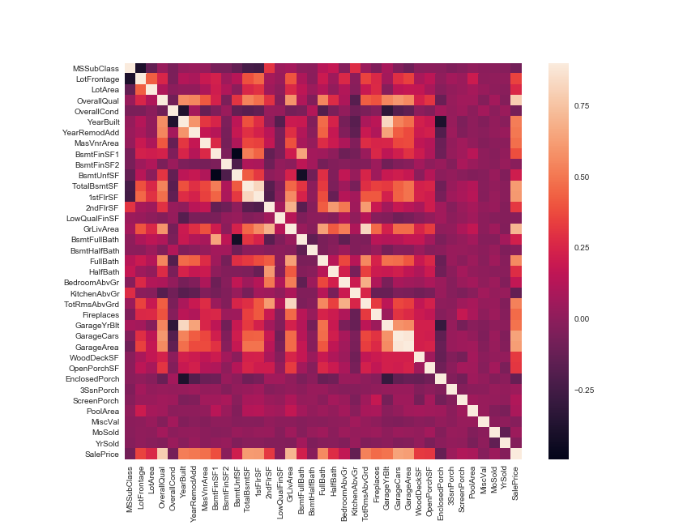
Step 4: Label encode all categorical Variables
Step 3: Visualize correlation between variables

Slide 6
The process

Slide 7
Our Score

