Slide 1



CONTINUOUS INTEGRATION
TravisCI vs CircleCI vs Jenkins
Rohit Chandra
Danish Siddiqui
Shivani Bhalchandra
Ahmet Bahcivan

Slide 2
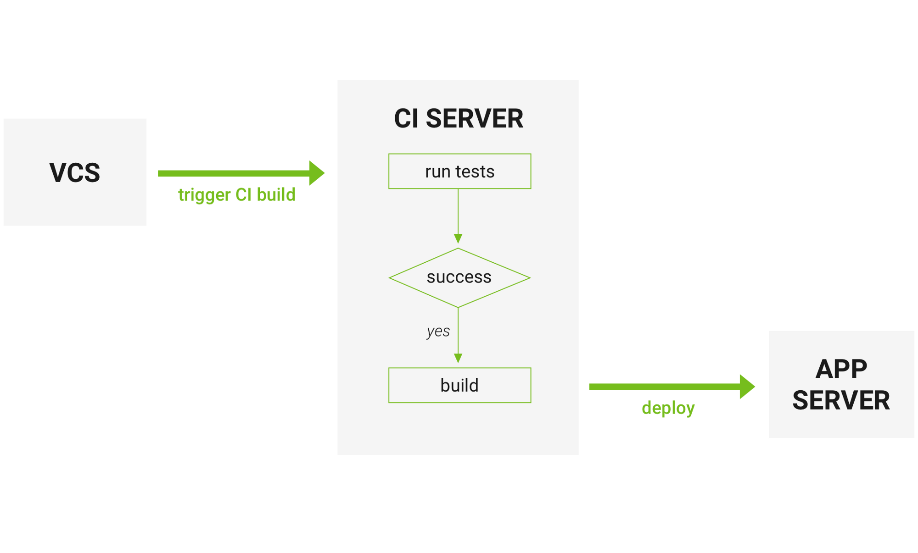
Continuous Integration
Notes:
Developers check the code locally on their computers
When completed — they commit changes to the repository
Repository sends a request (webhook) to CI system
CI server runs job (tests, coverage, check syntax and others)
CI server releases saved artifacts for testing
If the build or tests fail, the CI server alerts the team
The team fixes the issue

Slide 3
Features :
CircleCI is a cloud-based system — no dedicated server required, and you do not need to administrate it. However, it also offers an on-prem solution that allows you to run it in your private cloud or data center.
It is free even for business account
Rest API — you have an access to projects, build and artifacts The result of the build is going to be an artifact or the group of artifacts. Artifacts could be a compiled application or executable files (e.g. android APK) or metadata (e.g. information about the tests`success)
CircleCI caches requirements installation. It checks 3rd party dependencies instead of constant installations of the environments needed
You can trigger SSH mode to access container and make your own investigation (in case of any problems appear)
That’s a complete out of a box solution that needs minimal configuration\adjustments
CircleCI is compatible with:
Python, Node.js, Ruby, Java, Go, etc
Ubuntu (12.04, 14.04), Mac OS X (paid accounts)
Github, Bitbucket
AWS, Azure, Heroku, Docker, dedicated server
Jira, HipChat, Slack

Slide 4
CircleCI Pros:
Fast start
CircleCI has a free plan for enterprise projects
It’s easy and fast to start
Lightweight, easily readable YAML config
You do not need any dedicated server to run CircleCI
CircleCI Cons:
CircleCI supports only 2 versions of Ubuntu for free (12.04 и 14.04) and MacOS as a paid part
Despite the fact CircleCI do work with and run on all languages tt supports only the following programming languages “out of the box”:
Go (Golang), Haskell, Java, PHP, Python, Ruby/Rails, Scala
Some problems may appear in case you would like to make customizations: you may need some 3rd party software to make those adjustments
Also, while being a cloud-based system is a plus from one side, it can also stop supporting any software, and you won’t be able to prevent that

Slide 5
Travis CI and CircleCI are almost the same
Both of them:
Have YAML file as a config
Are cloud-based
Have support of Docker to run tests
What does TravisCI offer that CircleCI doesn’t?
Option to run tests on Linux and Mac OS X at same time
Supports more languages out of the box:
Android, C, C#, C++, Clojure, Crystal, D, Dart, Erlang, Elixir, F#, Go, Groovy, Haskell, Haxe, Java, JavaScript (with Node.js), Julia, Objective-C, Perl, Perl6, PHP, Python, R, Ruby, Rust, Scala, Smalltalk, Visual Basic
Support of build matrix / other Cl’s have TOX option to be able to build matrix

Slide 6
Travis CI Pros:
Build matrix out of the box
Fast start
Lightweight YAML config
Free plan for open-sourced projects
No dedicated server required
Travis CI Cons:
Price is higher compared to CircleCI, no free enterprise plan
Customization (for some stuff you’ll need 3rd parties)

Slide 7
Features:
Jenkins is a self-contained Java-based program, ready to run out-of-the-box, with packages for Windows, Mac OS X and other Unix-like operating systems
With hundreds of plugins in the Update Center, Jenkins integrates with practically every tool in the continuous integration and continuous delivery toolchain
Jenkins can be extended via its plugin architecture, providing nearly infinite possibilities for what Jenkins can do
Various job modes: Freestyle project, Pipeline, External Job, Multi-configuration project, Folder, GitHub Organization, Multibranch Pipeline
Jenkins Pipeline. That’s a suite of plugins which supports implementing and integrating continuous delivery pipelines into Jenkins. Pipeline provides an extensible set of tools for modeling simple-to-complex delivery pipelines “as code” via the Pipeline DSL
Allows you to launch builds with various conditions.
You can run Jenkins with Libvirt, Kubernetes, Docker, and others.
Rest API — have access to Controlling the amount of data you fetch, Fetch/Update config.xml, Delete a job, Retrieving all builds, Fetch/Update job description, Perform a build, Disable/Enable a job

Slide 8
Jenkins Pros:
Price (it’s free)
Customization
Plugins system
Full control of the system
Jenkins Cons:
Dedicated server (or several servers) are required. That results in additional expenses. For the server itself, DevOps, etc…
Time needed for configuration / customization

Slide 9
Conclusion
What CI system to chose? That depends on your needs and the way you are planning to use it.
CircleCI is recommended for small projects, where the main goal is to start the integration as fast as possible.
Travis CI is recommended for cases when you are working on the open-source projects, that should be tested in different environments.
Jenkins is recommended for the big projects, where you need a lot of customizations that can be done by usage of various plugins. You may change almost everything here, still this process may take a while. If you are planning the quickest start with the CI system Jenkins might not be your choice.

Slide 10
recourses
https://djangostars.com/blog/continuous-integration-circleci-vs-travisci-vs-jenkins/

