Slide 1

Project Title – Food Ordering System
Group members with Student Id
Vaishnavi Bhalerao - 21204007
Mayuresh Kalkar - 21204010
Sahil Jadhav - 21204013
Project Guide - Prof. Sonal Jain

Slide 2
Contents
Introduction
Objectives
Key Features
Project Outcomes
Technology Stack
Project Design
Flow Chart
Scope

Slide 3
1. Introduction
Problem Identified :
Increased human efforts.
Slow process.
Lack of time.
Solution Proposed :
It’s just one click away. It’s fast, easy and comfortable.
It saves human efforts and time.
This project reduces the manual work.
On time delivery.

Slide 4
2. Objectives
To develop a system that will allow our user to place order effortlessly with generic images of the meal
To serve best service to our users.
To design a system that can process multiple orders at a time.
To Minimize human efforts and time of ordering.

Slide 5
4. Key Features
Create an Account
• Log-in in the system.
• Select an item from the menu.
• Add an item to their current order.
• Review their current order.
• Remove an item/remove all items from their current order.
• Provide payment details.
• Place an order.

Slide 6
5. Outcome of Project
User will be able to login.
If the user doesn’t have an account, then he/she can also sign-in in our account.
The Customer can select , remove and edit his favorite food items.
The Customer can Pay and Print the bill.
Customer's data will be stored in database.

Slide 7
6. Technology Stack
FRONT END - Java Core(GUI)
BACK END - Xampp
Concept Used – Swing/applet
IDE Used – Eclipse, Vscode
Operating System – Windows 10,Windows 11

Slide 8
7. Project Design

Slide 9
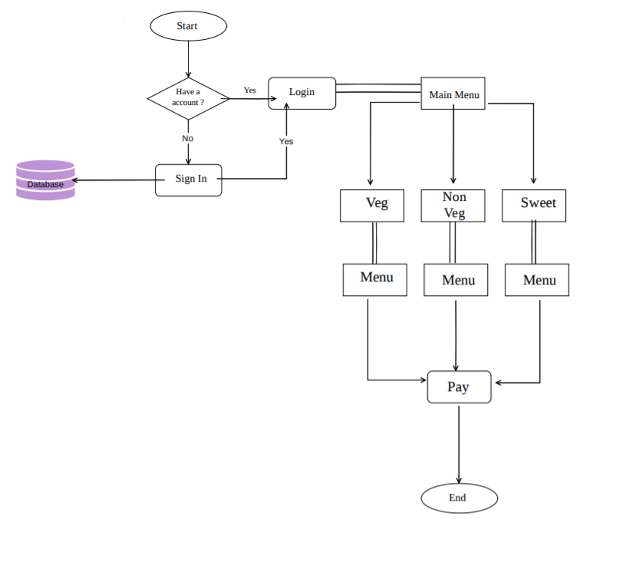
8. Flow Chart

Slide 10
3. Scope
Keeping a track on the orders by implementing a tracking system.
Implementation of API for paying the orders.

Slide 11
Thank You...!!

