Slide 1


Agile Scrum
Presentators:
Vismita M Loni
Shubham Bhamare

Slide 2
Topic Overview
What is SDLC?
What is Agile?
Waterfall Vs Agile
Frameworks to implement Agile
Scrum approach to work
Scrum Roles
Scrum Artifacts
Scrum Events
Scrum Metrics
Conclusion

Slide 3
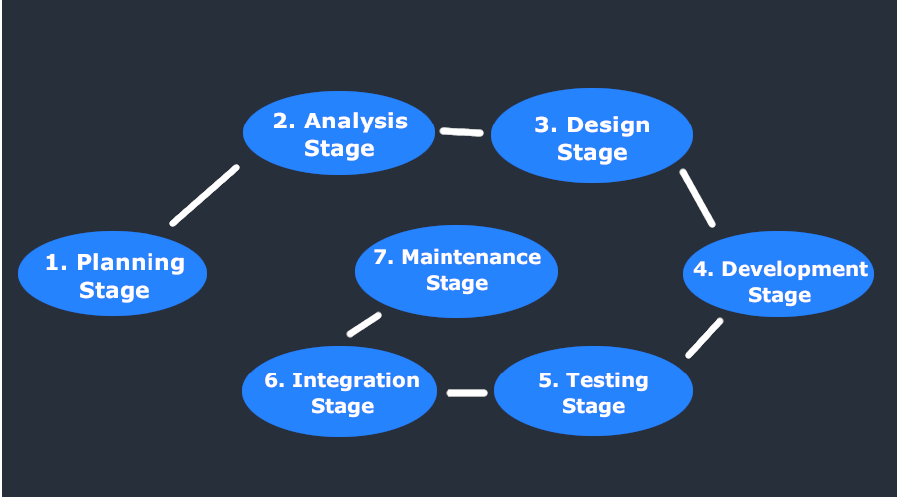
SDLC(Software Development Life Cycle)
SDLC is a process followed for a software project, within a software organization. It consists of a detailed plan describing how to develop, maintain, replace and alter or enhance specific software. The life cycle defines a methodology for improving the quality of software and the overall development process.

Slide 4
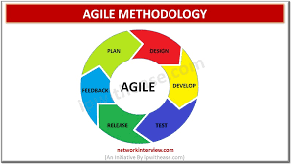
What is Agile?
The Agile methodology is a project management approach that involves breaking the project into phases and emphasizes continuous collaboration and improvement. Teams follow a cycle of planning, executing, and evaluating.

Slide 5
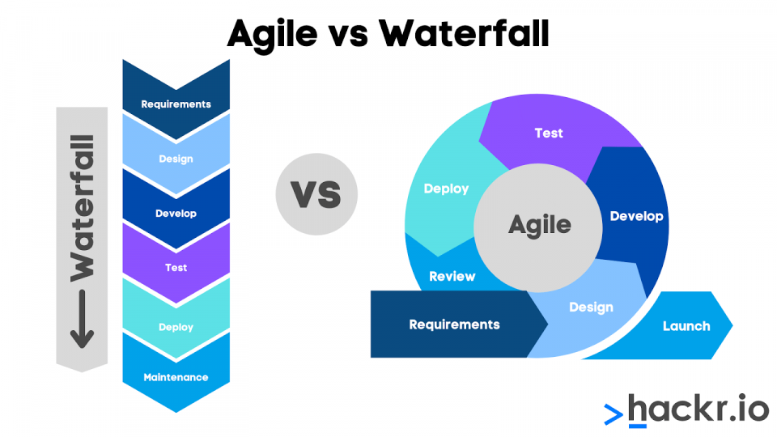
Waterfall vs Agile model
Also known as the traditional approach to software development, the Waterfall model follows a linear approach to software development. Because of this, it is also known as the Linear-Sequential Life Cycle Model.
The Agile software development methodology focuses on a continuous iteration of development and testing during the entire software development process. The SDLC model increases communication among clients, developers, and testers.

Slide 6
Framework to Implement Agile
There are different framework to implement agile model. They are:
1)Scrum
2)XP
3)Kanban
4)DSDM(Dynamic Systems Development Method)
Most widely used framework to implement is Scrum because:
1)Simple to understand
2)It is lightweight yet incredibly powerful set of values, principles, and practices

Slide 7
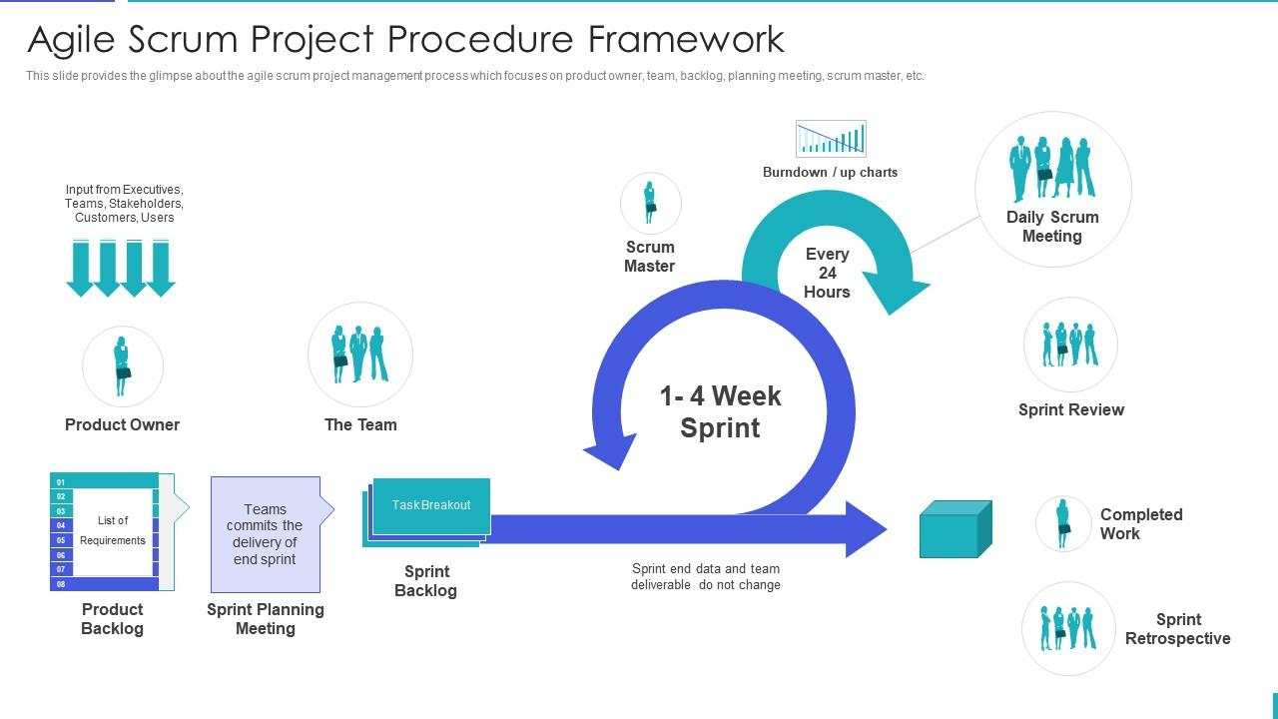
Scrum's Approach to Work

Slide 8

Scrum Roles
The scrum roles describe the minimum responsibilities of those who make up the scrum team.
As with anything in project management, the scrum methodology needs people to be executed. For this purpose, it defines three scrum roles, a scrum master, a product owner and a development team, made up of several team members.

Slide 9
1.Product Owner
A very important Stakeholder in SCRUM team.
Determines product backlog.
May represent a larger group.
Responsible to prioritizing to BI.
Ensure business relevance.
Must be available to the team.

Slide 10
2.SCRUM Master
Represent management to the project.
Typically filled by PL or PM.
Responsible for Scrum values and practices.
Removes impediments.
Facilitates understanding between team and PO.
Helps provide visibility into progress of team.

Slide 11
3.Scrum Team
Typically consists from six to ten members.
Cross functional.
Responsible for implementing the sprint backlog.
Self organizing.
Membership can change only between sprints.

Slide 12
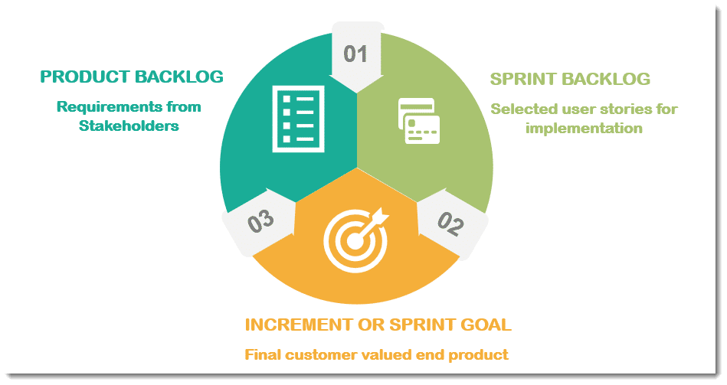
Scrum Artifacts
Artifacts are something that we create, e.g., a tool to solve a problem or a value that adds transparency.
There are three primary Scrum artifacts, namely:-
Product Backlog
Sprint Backlog
Sprint Goal (or increment)

Slide 13
1.Product Backlog
The Product Backlog is a dynamic list of features, requirements, improvements, etc. which acts as an input for the Sprint Backlog.
It is a customer's requirement that gets captured to understand the client's need.
It is, practically, the team’s “To Do” list. Each item logged in the product backlog is referred to as a Product Backlog Item (PBI).
Product Owner creates Product Backlog.

Slide 14
2.Sprint Backlog
Sprint Backlog is the list of finalized user stories, work items, bug fixes, etc., completed & selected by the scrum team for implementation & execution in the current sprint cycle.
Hence, Sprint Backlog is a further division of requirements that are gathered in a Product Backlog, which is given an effort-hour estimate, i.e., an estimate of the effort required to finish each task. This effort is measured in the number of hours.
It is created by the Scrum Team.

Slide 15
3.Sprint goal/Increment
The Sprint Goal is the useable end product derived from the completion of a sprint. It is also called as an increment.
This sprint goal is demonstrated at the “End-of-Sprint Demo”.
It defines the objective that has to be met as decided by the development team.
It is derived after a discussion between the Product Owner (PO) & the Scrum Team (Development Team).

Slide 16
SCRUM EVENTS
Scrum Process Framework can be viewed by means of a sequence of events and the corresponding artifacts.
The Scrum events are time-boxed events.
That means, in a project, every scrum event has a predefined maximum duration.
These events enable transparency on the project progress to all who are involved in the project.

Slide 17
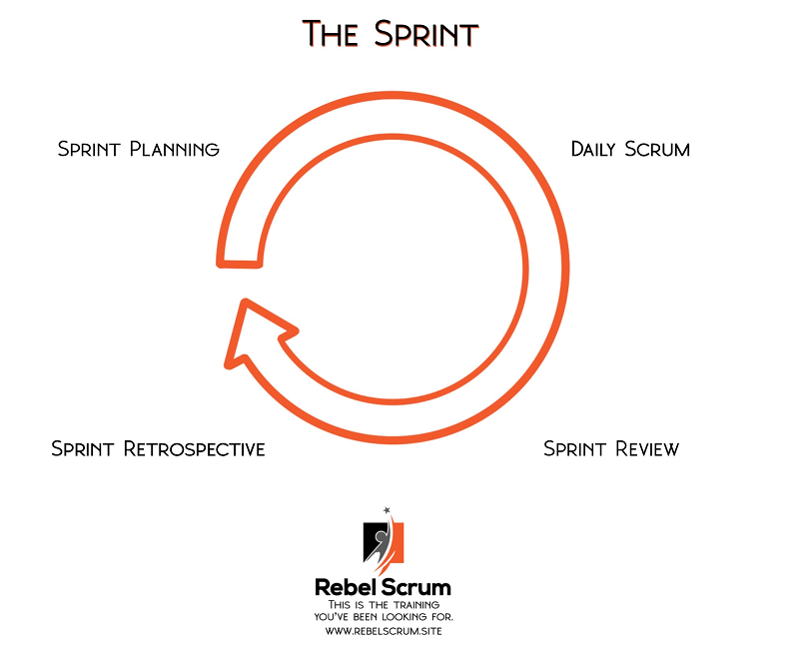
The five Scrum events are:
Sprint planning
Daily scrum
Sprint review
Sprint retrospective
The Sprint

Slide 18
SCRUM METRICS
Metric-It is a quantifiable measure which is use to track the status of a specific process.
Traditional project management uses key performance indicators (KPIs) and milestones
The milestones and metrics allow team members to keep track of their goals.
The agile framework relies on a few scrum metrics to do this.
Scrum metrics are quantitative measurements used to track and evaluate the progress, performance, and effectiveness of a Scrum team and the Scrum framework.
These metrics provide valuable insights into the team's productivity, predictability, quality, and overall project health. Typically scrum team performance is measured by calculating the deliverables and effectiveness of the scrum team.
Scrum metrics have three major goals:
To measure the team’s predictability
To measure their efficiency
To measure developer happiness

Slide 19
Scrum Metrics—Measuring Deliverables
The following metrics can help measure the work done by scrum teams and value delivered to customers:
1. Sprint Goal Success
2. Team Velocity
3. Sprint Burndown
4. Escaped Defects and Defect Density
Scrum Metrics—Measuring Effectiveness
The following metrics can help assess the effectiveness of scrum teams in meeting business goals:
1. Time to Market
2. ROI
3. Capital Redeployment
4. Customer Satisfaction

Slide 20
Scrum Metrics—Monitoring the Scrum Team
These metrics can help a scrum team monitor its activity and identify problems early on, before they impact development:
1. Daily Scrum and Sprint Retrospective
2. Team Satisfaction
3. Team Member Turnover
Scrum Reporting—Which Metrics to Report to Stakeholders?
The most important thing stakeholders need to know about your scrum project is whether it is on track. The following metrics might help communicate this, and explain deviations from the expected project path:
Sprint and release burndown
Sprint velocity
Escaped defects

Slide 21

CONCLUSION
Transitioning to an agile framework such
as scrum requires a new mindset and
overall cultural adjustments. And like
all change, it doesn't come easy.
But when teams and organizations
fully commit to scrum, they'll discover
a new sense of flexibility, creativity,
and inspiration - all of which will lead
to greater results.

Slide 22
THANK YOU!!!

