Slide 1
CIS 626 Week 1
Highley

Slide 2
In This Presentation
Course Overview
Week 1 Overview
Discussion question
Chapter 1
Install Python
Chapter 2
Chapter 3
LiveLab Exercises

Slide 3
Course Overview

Slide 4
Communication
Blackboard
Weekly module
Week’s overview document
Sometimes a video/slide show (like this one)
Other materials
Grades
Submit longer assignments
Discussion board
Wimba
Wednesday evening
Liang (textbook) website
http://www.cs.armstrong.edu/liang/py/
LiveLab programming exercises
Videos

Slide 5
Week 1 Overview

Slide 6
Discussion Question
Go to Blackboard and answer the first discussion question.
Respond to two classmates.

Slide 7
Chapter 1
Read Chapter 1
Watch the video / view the slides
Special instructions to set up the slides to execute code during a presentation

Slide 8
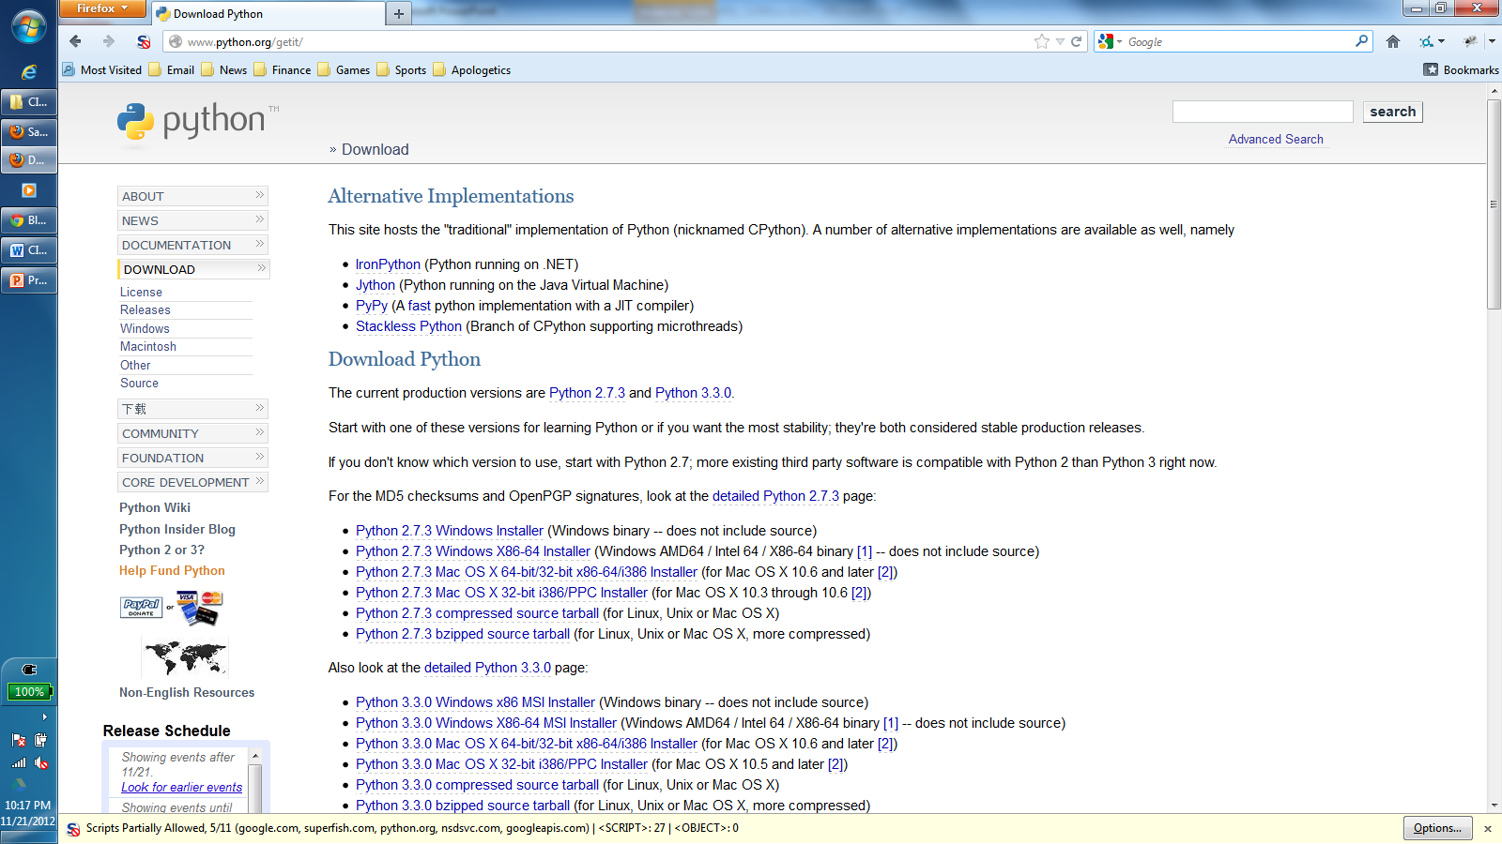
Download and Install Python
Go to http://www.python.org/getit/

Slide 9
Download and Install Python
Our textbook uses Python 3.
Later in the semester we will use boto, which (as of the time of this writing) is only supported with Python 2.
We will start in Python 3 and switch mid-semester.
So download Python 3 for now.
Unlike most programming language updates, Python 3 is not backward-compatible with Python 2.

Slide 10
After Installation
After you have installed Python, you should have access to two Python in two ways
command line
IDLE
See the video if necessary

Slide 11
Chapter 2
Read Chapter 2
Watch the video / view the slides

Slide 12
Chapter 3
Read Chapter 3
Watch the video / view the slides

Slide 13
Exercises
Complete the exercises that you find on LiveLab.

