Slide 1
Intermediate programming
Session 02
Rafael Avigad John Robertson
ICT40220 Certificate IV in Information Technology (Programming)
Cluster: Intermediate programming and open source (IPOS)
ICTPRG439 | Use pre-existing components
ICTPRG429 | Maintain open-source code programs
ICTPRG443 | Apply intermediate programming skills in different languages

Slide 2
Defining Modular programming
Part 1

Slide 3

What is modular programming?
Notes:
"Modular programming is a software design technique that emphasizes the separation of functionality into independent, interchangeable modules. A module in this context is a self-contained component of a system that encapsulates specific functionality and interfaces with the rest of the system in a well-defined, minimal manner. It's like building with Lego blocks, each block (or module) does one thing well and can be connected to other blocks to create a larger structure (or program)."

Slide 4
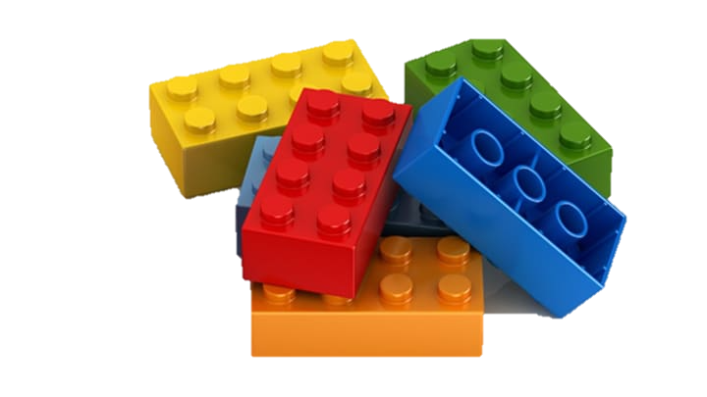
Benefits
Reusability
Maintainability
Testing and debugging
Collaboration
Notes:
Reusability: Once a module is written, it can be reused across the program, or even in other programs. This saves time and effort and promotes code consistency.
Maintainability: When functionality is separated into modules, it becomes easier to maintain and update the software. If a change needs to be made to a specific feature, you only have to modify the related module, minimizing the risk of unintentionally affecting other parts of the program.
Testing and Debugging: It's easier to test and debug modules as standalone units, and any bugs that are found and fixed in a module will be fixed everywhere the module is used.
Collaboration: In large projects, different teams can work on different modules simultaneously with less risk of interfering with each other's work."

Slide 5
Downsides
Complexity
Testing and debugging (weren’t you on the other slide???)
Integration/version control
Notes:
Increased Complexity: While modular programming can simplify individual components of a program, it can also increase the overall complexity of a system. Managing how modules interact and ensuring they function correctly together can become a challenging task, especially in large software projects.
Design Overhead: To design a program in a modular way, careful planning is required upfront to define clear, sensible boundaries for modules. This can increase the amount of time spent in the design phase, which might not be ideal for small projects or prototypes.
Dependencies Between Modules: If not managed well, modules can become tightly coupled, meaning a module depends heavily on the internal workings of another module. This can create issues when trying to modify, update, or reuse a module. The aim should always be to create loosely coupled modules where possible.
Version Control: When reusing modules across different projects, it's vital to ensure that all projects are using the correct version of the module. If a module is updated for one project, it could potentially break functionality in another project that relies on the old version.
Integration Issues: Individual modules might work perfectly in isolation but fail when integrated due to unforeseen conflicts or discrepancies between module interfaces.

Slide 6
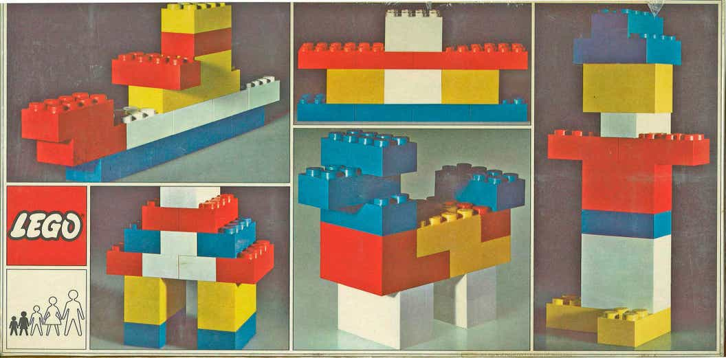
Making a start
Notes:
Ask students to create a simple function in a file (say “hello world”) and then create a new file and import that module: e.g. import my_module: This imports the whole module, and we can use its functions like so: my_module.hello_world().
from my_module import hello_world: This imports only the hello_world function from the module, and we can use it directly like so: hello_world().
import my_module as mm: This imports the module but gives it a shorter alias, useful for modules with longer names. We can use its functions like so: mm.hello_world().
See the GitHub repo for additional exercises

Slide 7
Pass-by-reference
Part 2

Slide 8
What.
Recall: variables created in a function stay in the function (true of most languages)
But, in low level languages, when we call a function with arguments, the parameters can:
Provide the address in memory of something (a reference)
Provide the something (a value)
Discuss: consider how the above relates to whether functions can change (mutate) things outside their scope

Slide 9
Python is a bit different
In Python everything is an object
Yes, E.V.E.R.Y.THING
Variables are just names for the addresses of objects!
Remember: “the map is not the territory; the name is never the thing named!” –Gregory Bateson.
Tip: look behind the curtain with id(my_var)
Notes:
Python's parameter passing model is a bit different from some other programming languages. It's often characterized as "pass-by-object-reference" or "pass-by-assignment". Essentially, when you pass a variable to a function in Python, you're passing a reference to the object that the variable refers to, not the actual object itself.
To understand this, it's essential to understand that in Python, everything is an object. Whether it's a number, a string, a list, or a custom class - they're all objects. And variables in Python are references to these objects.

Slide 10
Python parameters in depth
When you pass a variable to a function you are passing a reference
You are assigning the (named) addresses in the arguments to the names defined by the parameters
When the addresses reference an immutable object, effectively any changes you make only stay in the function
When it’s mutable, you can change the object and those changes persist out of scope
Discuss: WHY???
Notes:
when you pass a variable to a function, Python passes the reference to the function. Therefore, if the object is mutable (like lists or dictionaries), the function can modify the object, and the changes are visible outside the function. This is because the function and the calling code are both referencing the same object.
However, if the object is immutable (like integers or strings), the function cannot modify the object. Any changes made inside the function will create a new object, and the variable in the calling code will continue to reference the original object.

Slide 11
Try this code:
def modify(n, list_):
n = 2
list_.append(3)
n = 1
list_ = [1, 2]
modify(n, list_)
print(n) # Outputs: 1
print(list_) # Outputs: [1, 2, 3]
Notes:
In this example, n is an integer (an immutable object), so the change inside the modify function doesn't affect the original variable. However, list_ is a list (a mutable object), so the change inside the function is visible outside the function.
Now, comparing Python with a lower-level language like C, in C, we explicitly have two distinct modes of passing parameters: pass-by-value and pass-by-reference.
In pass-by-value (the default in C), a copy of the value is made and passed to the function. Changes to the copy inside the function do not affect the original variable.
In pass-by-reference, a pointer to the original variable is passed to the function. Changes to the variable inside the function do affect the original variable. This is somewhat analogous to passing mutable objects in Python.
However, Python's model isn't exactly like C's pass-by-reference, because you can't directly change the value of a passed variable (like you could with a dereferenced pointer in C). It's more accurate to say Python has a single way of passing variables that behaves somewhat like pass-by-value for immutable objects, and somewhat like pass-by-reference for mutable objects.

Slide 12
Introduction to 2d data structures
Part 3 (optional)

Slide 13
Consider
Discuss how can you make a Python list 2-dimensional? (or 3 for that matter?)
What are some possible applications?
How would you code and parse a 2D data structure?
To be continued next week…

Slide 14
Revision
What is a module in Python? How do you create one?
What is the purpose of the import statement in Python? Can you provide a code example of its usage?
How can you import only a specific function or class from a module in Python? What is the syntax for this?

Slide 15
Revision
How would you explain Python's parameter passing mechanism? Is it more similar to pass-by-value or pass-by-reference?
Given the following Python code, what will be the output and why?

Slide 16
def modify_list(lst):
lst.append("new")
lst = ["completely", "new"]
items = ["original"]
modify_list(items)
print(items)

Slide 17
Revision
If Python uses pass-by-reference, why doesn't reassigning a variable inside a function change the original variable outside the function? How is this related to the mutability of Python objects?

