Slide 1
Comparison of marker based Predictions using RRBLUP and Bayesian lasso
Anita Sharma
Stat: 841 Final Project
Fall 2018

Slide 2
INTRODUCTION:
Genomic predictions have emerged as a powerful tool to improve the selection of individuals before phenotyping in plants and livestock.
The reason behind this:
enables breeders to make selection at early stage ensuring rapid genetic gain, and
reduce phenotyping costs.

Slide 3
METHODS AND MATERIALS:
The dataset was taken from BGLR package in CRAN R.
The data comes from an experiment carried out to detect and locate QTLs for complex traits in a mice population (Valdar et al. 2006a; 2006b).
There are 1814 individual mice, each genotyped for 10,346 polymorphic markers.
The trait used are body mass index (BMI) and the body length related to obesity.
Covariate used: Gender
Methods used for prediction: RRBLUP, Bayesian Lasso
Packages used: rrBLUP and BGLR

Slide 4
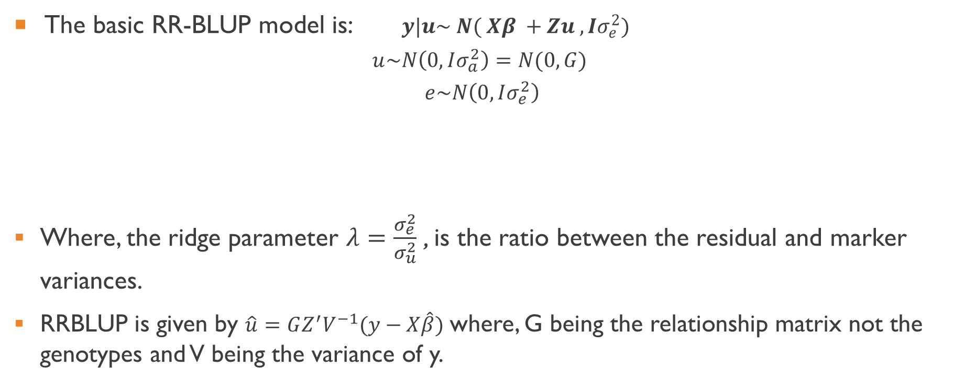
Ridge-regression BLUP (rrBLUP)
The basic RR-BLUP model is:$y|u\sim N( Xβ +Zu ,Iσ_{e}^{2})$
$$u\sim N\left(0, Iσ_{a}^{2}\right)=N(0,G)$$
$$e\sim N\left(0, Iσ_{e}^{2}\right)$$
Where, the ridge parameter $λ=\frac{σ_{e}^{2}}{σ_{u}^{2}}$ , is the ratio between the residual and marker variances.
RRBLUP is given by $\hat{u}=GZ^{′}V^{−1}(y−X\hat{β})$ where, G being the relationship matrix not the genotypes and V being the variance of y.

Slide 5

Bayesian LASSO
LASSO combines model selection with prediction.
The prior used is Laplace or Double exponential prior.
The basic linear model is given by:
$$y|β,σ^{2}\sim N(Xβ,I_{n}σ^{2})$$

Slide 6
PREPARATION
The data was divided into training and validation set with 60% and 40% in training and validation set respectively.
The model utilizing information from the training set was used to predict for the validation set.

Slide 7
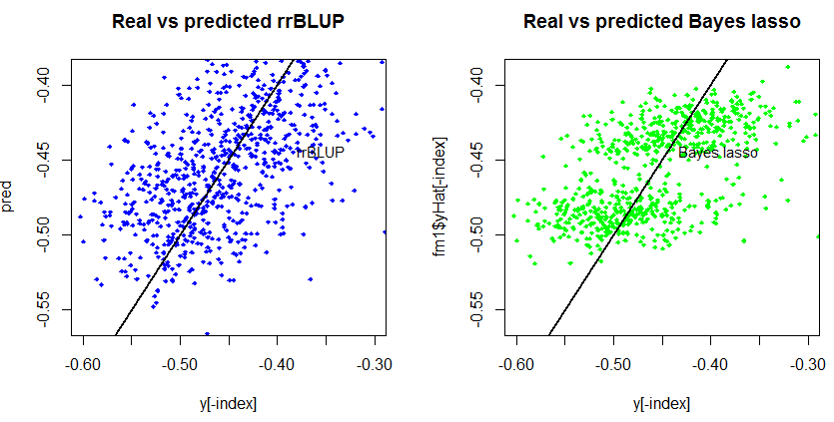
Predictions FOR BMI

Slide 8
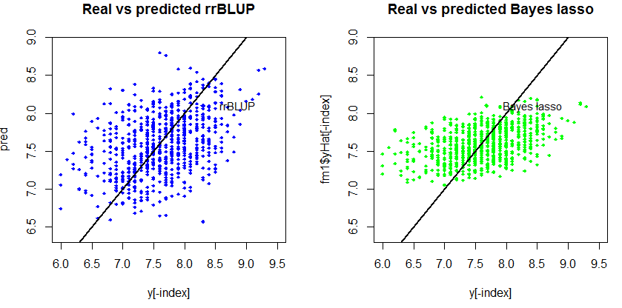
Predictions FOR BODY LENGTH

Slide 9
RESULTS AND CONCLUSIONS
For BMI | Correlation | RMSE
RRBLUP | 0.5154682 | 0.05359368
BAYES LASSO | 0.5661756 | 0.04709157
Bayesian LASSO performed better than RRBLUP in predicting BMI.

Slide 10
RESULTS AND CONCLUSIONS:
For Body length | Correlation | RMSE
RRBLUP | 0.3905411 | 0.5493247
BAYES LASSO | 0.4298184 | 0.4784702
Bayesian LASSO performed better than RRBLUP in predicting body length.

Slide 11
THANK YOU!!

