Slide 1
Brewery EDA MSDS 6306 10/11/2022
Anish Bhandari
Carolina Craus

Slide 2
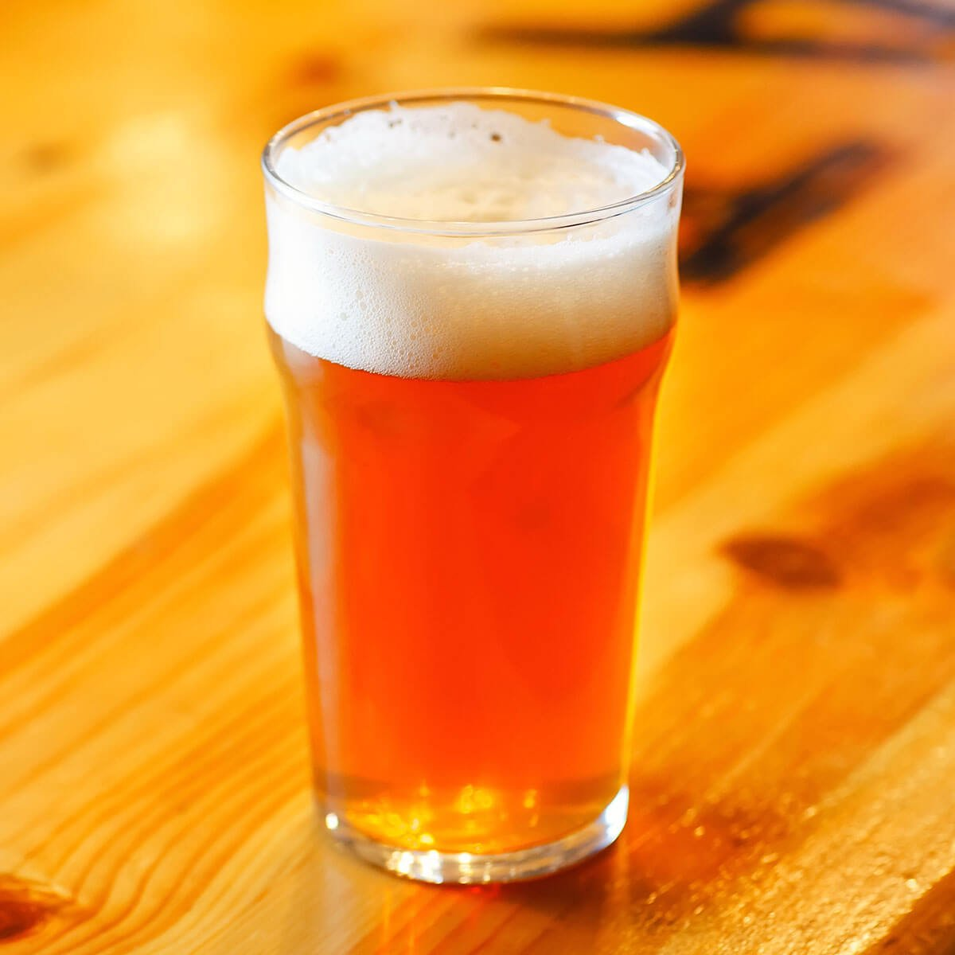
Agenda
No. of Breweries
Missing Values
ABV and IBU – Descriptive Stats
ABV and IBU – Relationship
Modelling ( Ale and IPA)
ABV and IBU – Relationship in Ale and IPA
Anheuser-Busch Acquisition Potential

Slide 3
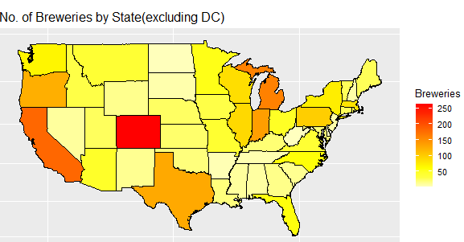
No. of Breweries
At least 2 in each state
West region has the most breweries
Midwest region is close second
Washington DC has 1 brewery
162
State (Position) | No. of Breweries
Colorado (1) | 265
California (2) | 183
Michigan (3) | 162
265
2
2
183
State (Position) | No. of Breweries
Delaware (49) | 2
West Virginia (50) | 2

Slide 4
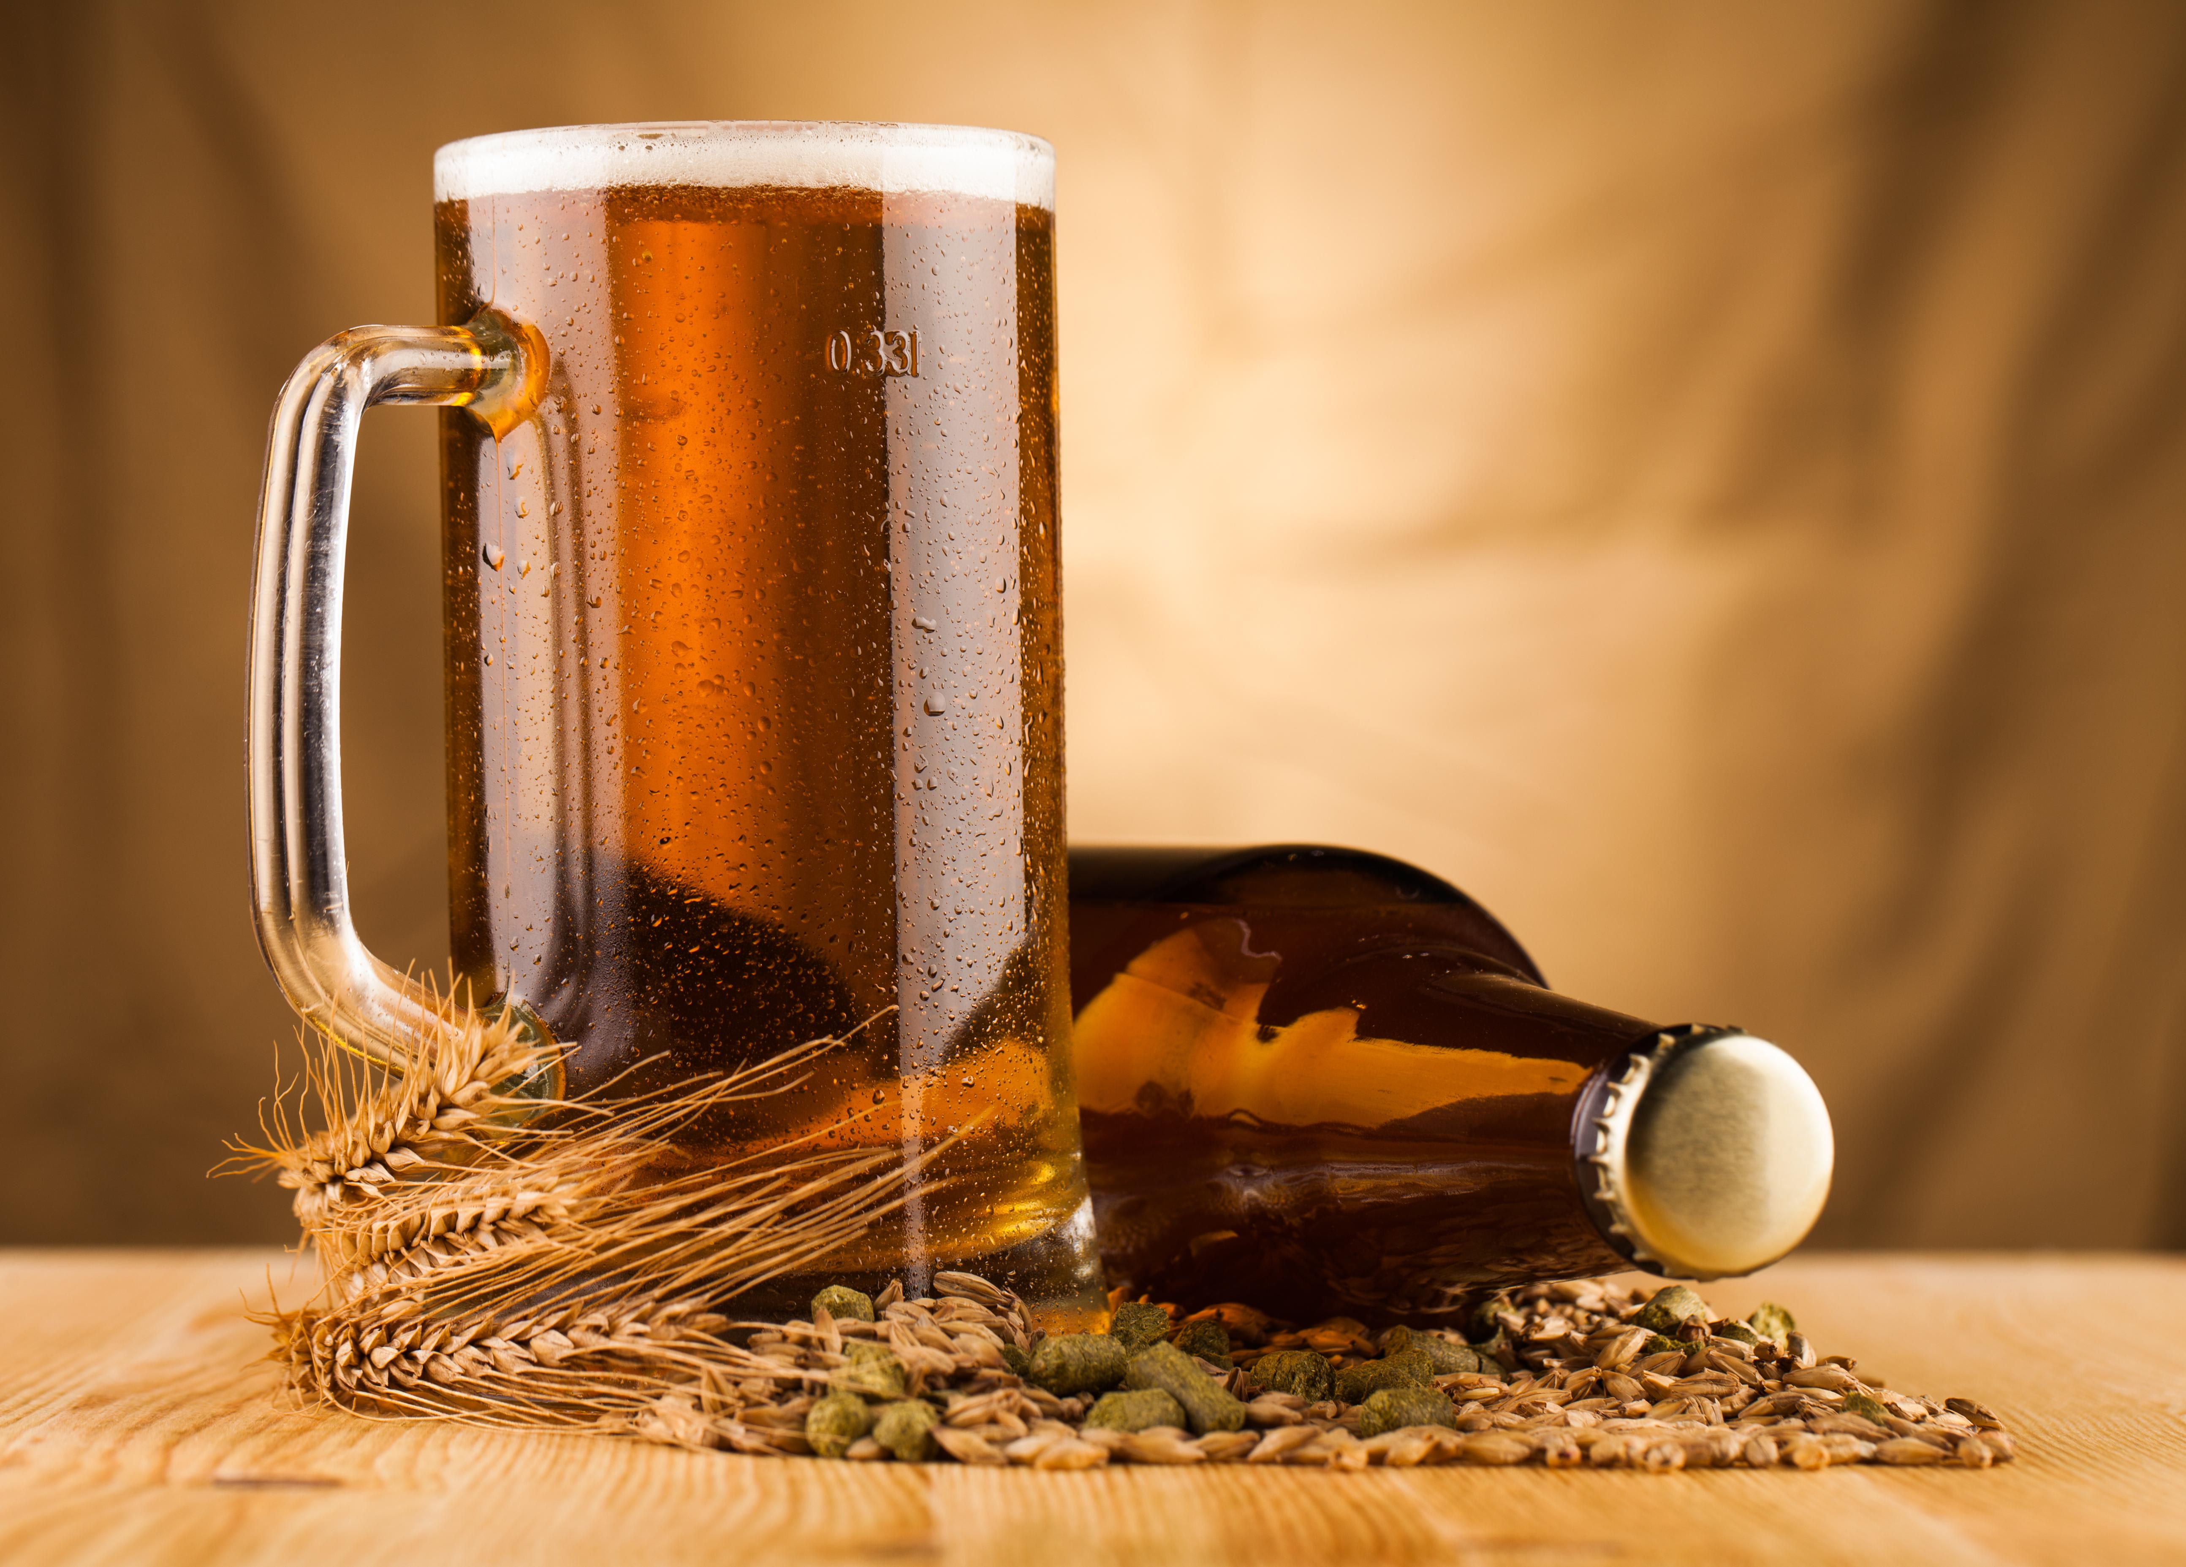

Missing Values
ABV and IBU with missing values
Filter the properties for analysis
IBU harder to measure compared to ABV
ABV | IBU
62 | 1005
2.6% | 41.7 %

Slide 5
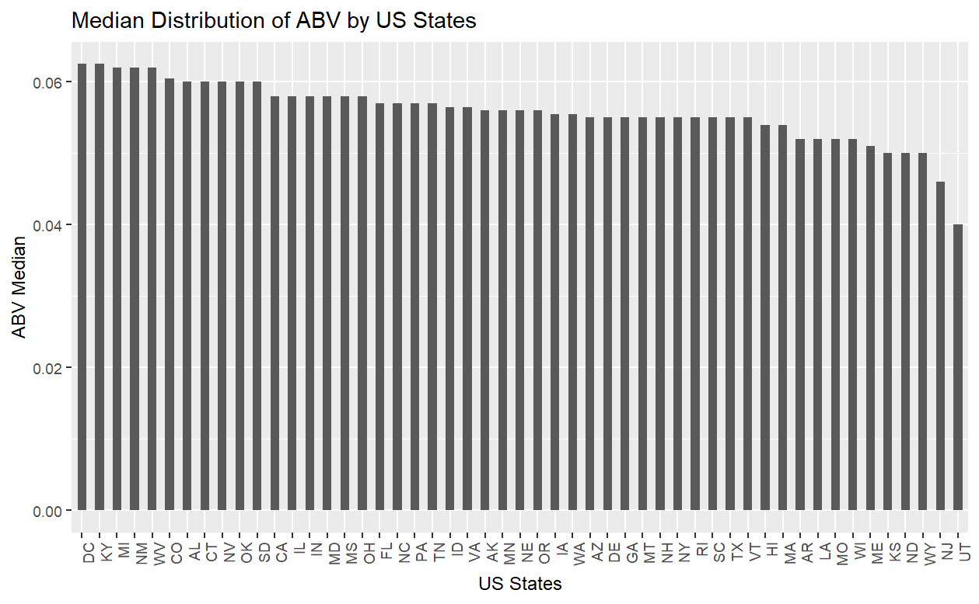
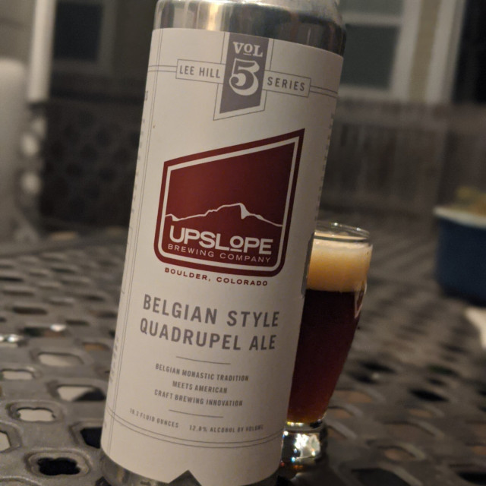
ABV – Descriptive Statistics
Maximum | Colorado (12.8%)
Highest Median | DC & Kentucky(6.25%)
Lowest Median | Utah (4 %)

Slide 6
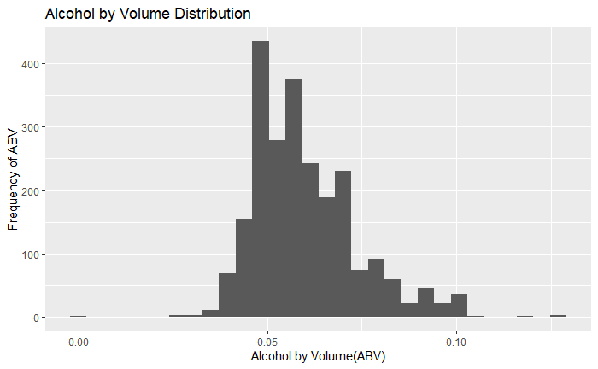
ABV – Descriptive Statistics (Contd.)
Min = 0.1 % (Non-alcoholic)
Max = 12.8 %
Right Skewed
Mean = 6.0 %
Median = 5.6 %

Slide 7
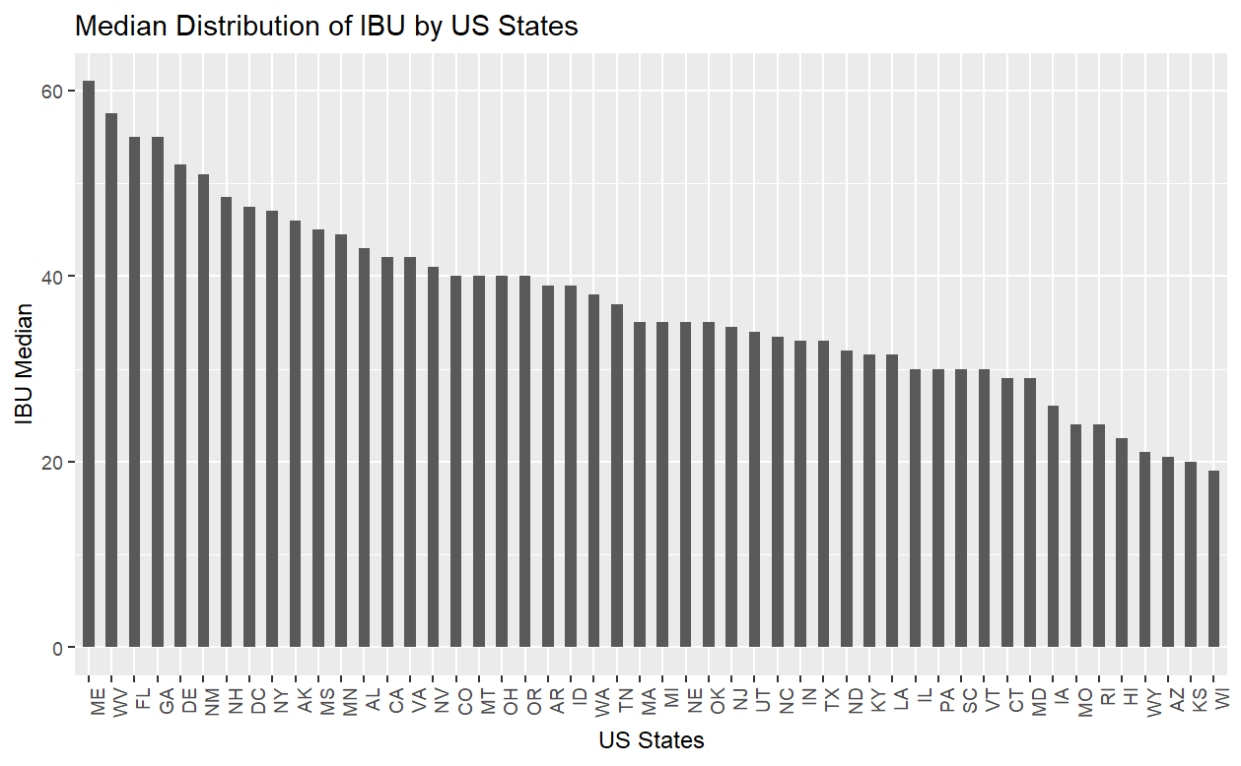

IBU – Descriptive Statistics
Highest Median | Maine (61)
Lowest Median | Wisconsin (19)
Maximum | Oregon
Notes:
Highest median IBU → Maine(61) followed by West Virginia(57.5) and Florida(55).
Lowest median IBU → Wisconsin (19) followed by Kansas(20), and Arizona(20.5).
The maximum IBU (138) is Bitter Bitch Imperial beer from Astoria Brewing Company located in Astoria, Oregon.

Slide 8
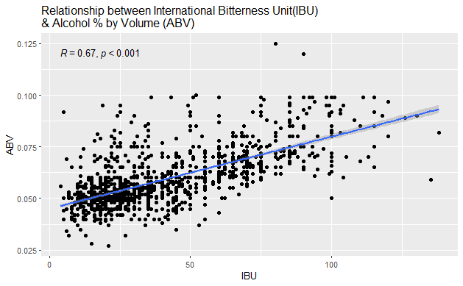
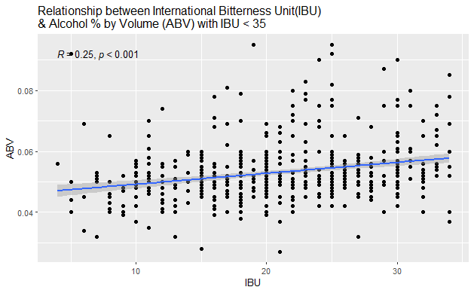
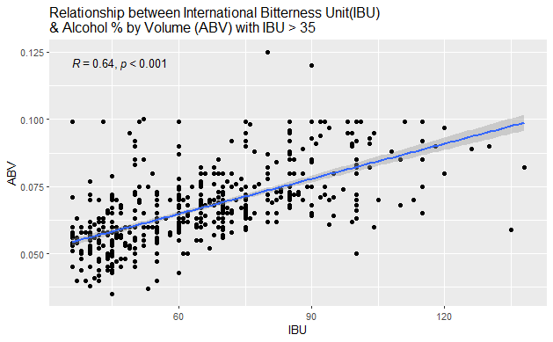
ABV and IBU - Relationship
Correlation Coefficient = 0.67
Positive linear relation
IBU > 35
Correlation Coefficient = 0.64
Positive linear relation
IBU < 35
Correlation Coefficient = 0.25
Opportunity for Optimization

Slide 9
Modeling Ale and IPA
Ales
Correctly Predicted: 147
Incorrectly Predicted: 26
ALE
IPA
IPAs
Correctly Predicted: 97
Incorrectly Predicted: 26
ALE
147
26
IPA
13
97
Accuracy = 86.2 %

Slide 10
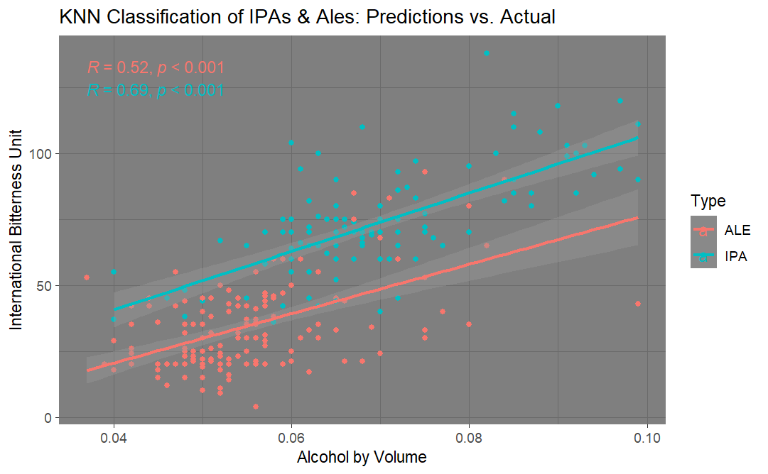
ABV and IBU – Relationship in Ale and IPA
Strong relationship between AVB & IBU
IPA
Positive Linear Relation
Correlation Coefficient = 0.69
ALE
Positive Linear Relation
Correlation Coefficient = 0.52
IPA classification performed slightly better than Ale

Slide 11
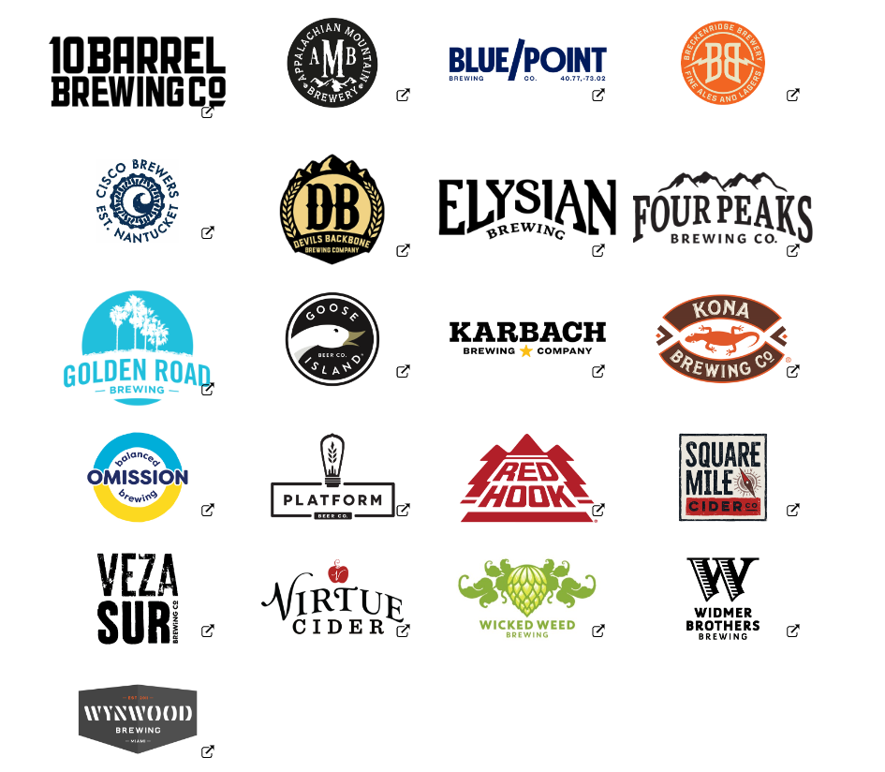


Anheuser-Busch Acquisition Potential
Median IBU | Median ABV
50 | 6.9 %
Potential acquisition target
Similar profile (based on median IBU and ABV)
~ Median IBU
Slightly lower ABV
State where Anheuser-Busch doesn’t own a microbrewery

Slide 12






Thank you
Anish Bhandari
Carolina Craus
asbhandari@mail.smu.edu
ccraus@mail.smu.edu
817-917-8780
512-998-3169

