Slide 1


ANGULAR

Slide 2
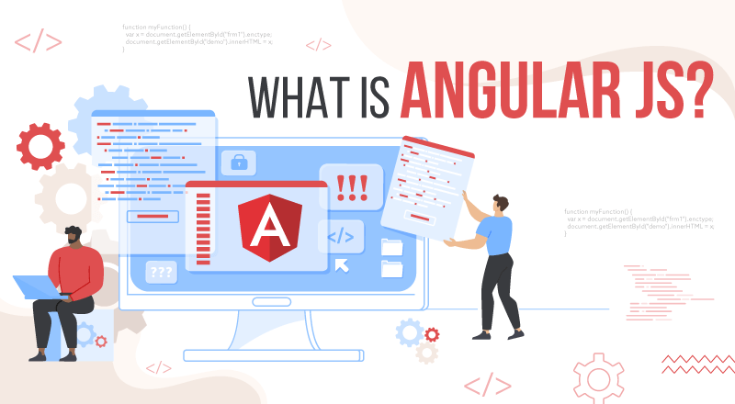
What Is Angular?
Angular is an open-source, JavaScript framework written in TypeScript. Google maintains it, and its primary purpose is to develop single-page applications.
As a framework, Angular has clear advantages while also providing a standard structure for developers to work with.
It enables users to create large applications in a maintainable manner.

Slide 3

Why Do You Need a Framework?
Frameworks in general boost web development efficiency and performance by providing a consistent structure so that developers don’t have to keep rebuilding code from scratch.
Frameworks are time savers that offer developers a host of extra features that can be added to software without requiring extra effort.

Slide 4
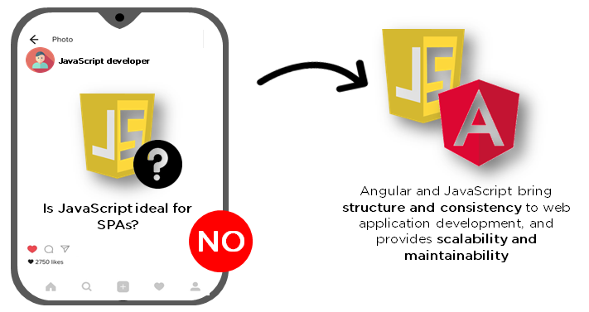
Why Angular?
JavaScript is the most commonly used client-side scripting language. It is written into HTML documents to enable interactions with web pages in many unique ways. As a relatively easy-to-learn language with pervasive support, it is well-suited to develop modern applications.
But is JavaScript ideal for developing single-page applications that require modularity, testability, and developer productivity? Perhaps not.
These days, we have a variety of frameworks and libraries designed to provide alternative solutions. With respect to front-end web development, Angular addresses many, if not all, of the issues developers face when using JavaScript on its own.

Slide 5
Features of Angular
Document Object Model
Testing
Data Binding
TypeScript

Slide 6
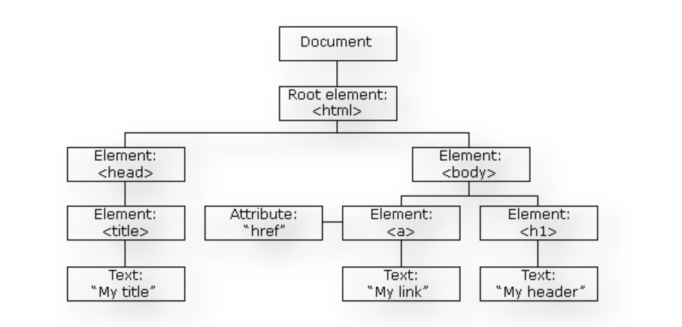
DOM (Document Object Model)
Angular uses regular DOM. Consider that ten updates are made on the same HTML page. Instead of updating the ones that were already updated, Angular will update the entire tree structure of HTML tags.

Slide 7
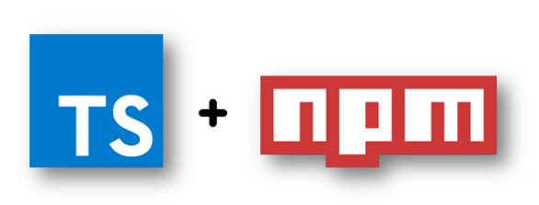
TypeScript defines a set of types to JavaScript, which helps users write JavaScript code that is easier to understand. All of the TypeScript code compiles with JavaScript and can run smoothly on any platform. TypeScript is not compulsory for developing an Angular application. However, it is highly recommended as it offers better syntactic structure—while making the codebase easier to understand and maintain.
TypeScript

Slide 8
Data binding is a process that enables users to manipulate web page elements through a web browser. It employs dynamic HTML and does not require complex scripting or programming. Data binding is used in web pages that include interactive components, such as calculators, tutorials, forums, and games. It also enables a better incremental display of a web page when pages contain a large amount of data.
Angular uses the two-way binding. The model state reflects any changes made in the corresponding UI elements. Conversely, the UI state reflects any changes in the model state. This feature enables the framework to connect the DOM to the model data through the controller.
Data Binding

Slide 9

Angular uses the Jasmine testing framework. The Jasmine framework provides multiple functionalities to write different kinds of test cases. Karma is the task-runner for the tests that uses a configuration file to set the start-up, reporters, and testing framework.
Testing

Slide 10
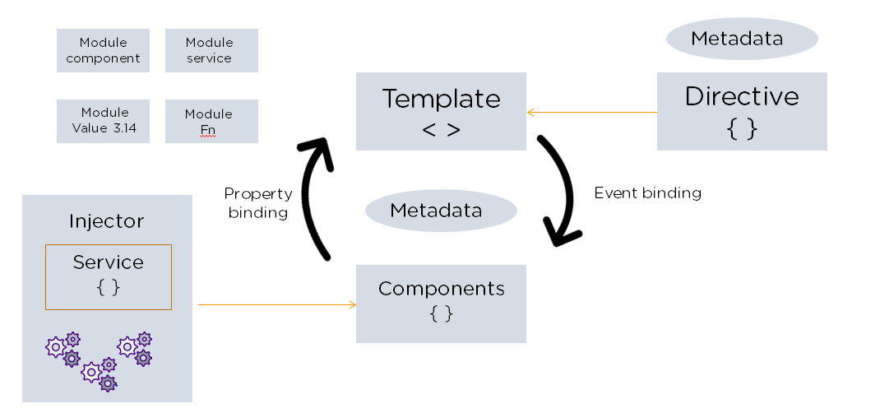
Angular Architecture
Angular is a full-fledged model-view-controller (MVC) framework. It provides clear guidance on how the application should be structured and offers bi-directional data flow while providing real DOM. .

Slide 11




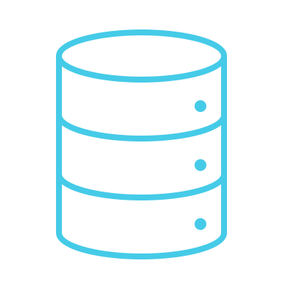
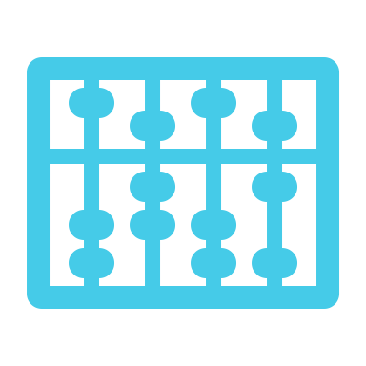
This building blocks of an Angular application
Modules
Templates
Metadata
Components
Services
Dependency Injection

Slide 12

Thank you
someone@example.com

