Slide 1
About Yagrima Computer Lab
Presented By:-
Name:____________
Class: ____________
Roll no.:___________

Slide 2
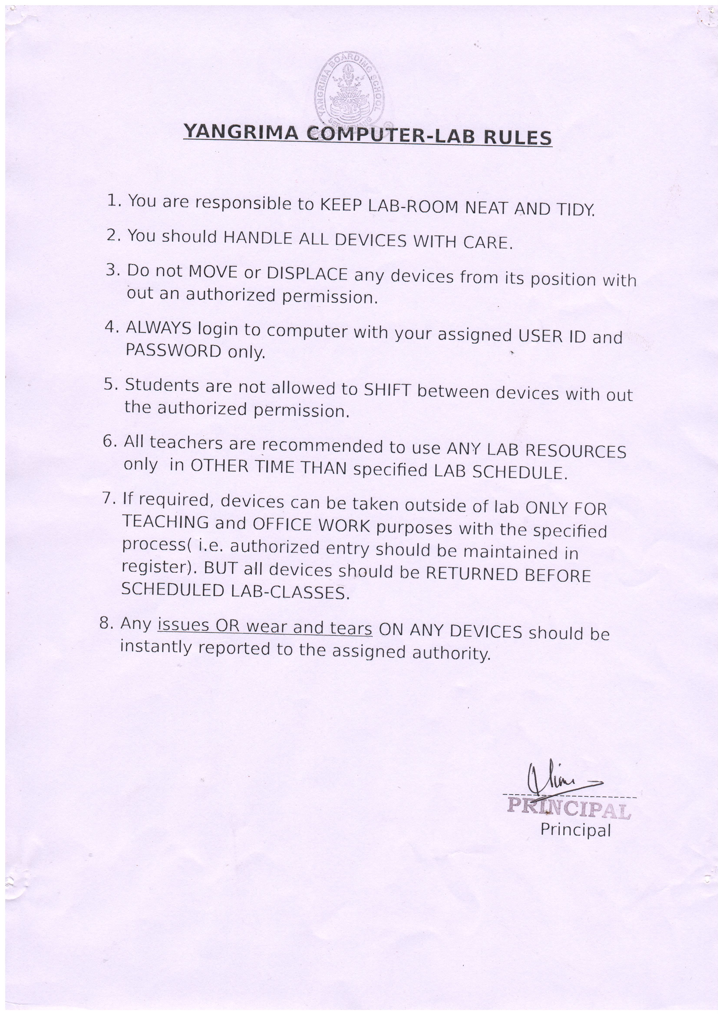

Slide 3
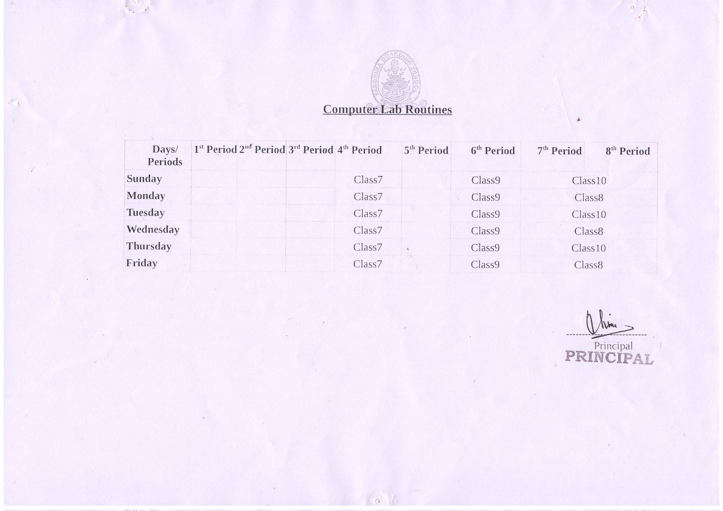

Slide 4
Thanks For Keeping Things As It Is At Their Right Places

Slide 5
Please Help To Keep Lab Neat and Tidy

Slide 6
Thanks..
The End

