Slide 1
V
VARAD NETRALAYA
Advanced Eye Care & Phaco Surgery Center
Official Website — Features & Future Scope Proposal
What We Built | Technologies Used | What More We Can Deliver
PRESENTED TO
Dr. Raosaheb Kundlik Borude
Senior Ophthalmologists — DOS, AIOS, MOS
★ 4.9 Google Rating • 439+ Reviews • Savedi, Ahilyanagar

Slide 2
WHAT WE BUILT
Complete Website Features Delivered
🏠 Premium Hero Section
⭐ Google Reviews Carousel
Full-width hero banner with hospital logo, embedded YouTube video player, doctor names, 4.9★ Google rating badge, and animated call-to-action buttons.
4.9★ patient testimonials from Google Reviews displayed in animated slider cards.
ℹ️ About Us Page
📸 Photo Gallery
Hospital history, vision, mission, and core values with smooth scroll animations and glassmorphism card design.
OPD rooms, operation theatre, diagnostic equipment, and consultation chambers showcase.
🩺 6 Eye Treatment Service Cards
❓ Interactive FAQ Accordion
Cataract Surgery, Retina & Diabetic Eye Care, Computerized Eye Testing, Automated Perimetry, Pediatric Eye Care, Refractive Correction.
6 frequently asked questions with expandable answers — timings, doctors, insurance, surgery info.
👨‍⚕️ Doctor Profile Cards
📅 Online Appointment Booking
Detailed profiles of Dr. Smita Patare (DOS, AIOS, MOS) and Dr. Raosaheb Borude (MOS, AIOS) with qualifications, experience, and specialties.
Name, phone, date picker form + direct WhatsApp chat + click-to-call buttons.
📊 Live Animated Statistics
📞 Contact & Google Maps
30,000+ Happy Patients, 18,000+ Successful Surgeries, 15+ Years Experience — numbers animate on scroll.
Full address, phone numbers, email, working hours, and embedded Google Maps navigation link.
🛡️ Insurance & Cashless Section
🦶 Professional Footer
Zurich Kotak, Star Health, HDFC ERGO, ICICI Lombard, Niva Bupa, SBI General — full cashless information.
Quick links, eye specialties list, contact info, YouTube channel link, social media icons, copyright.
VARAD NETRALAYA

Slide 3
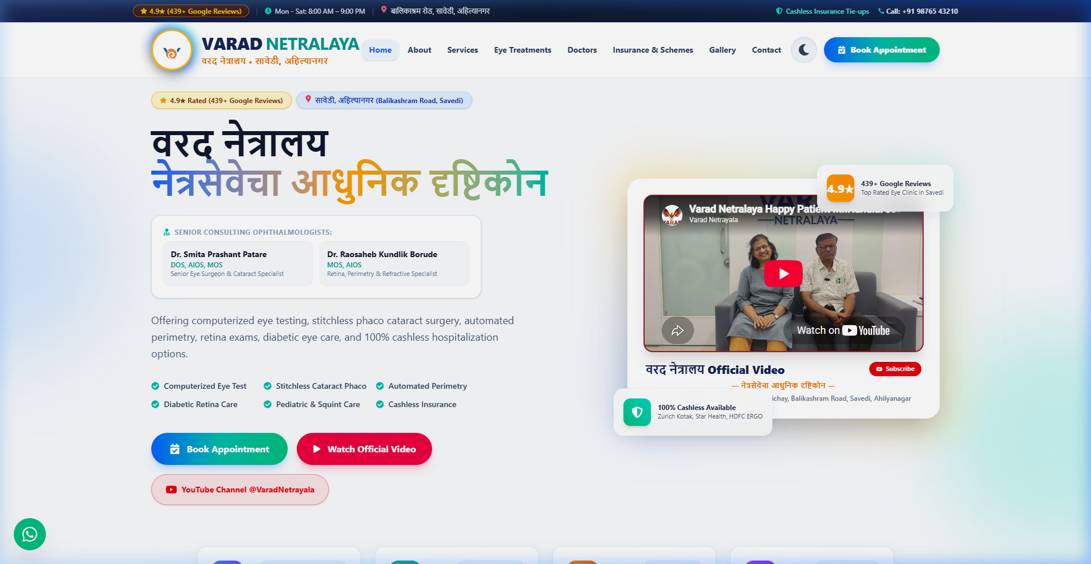
LIVE PREVIEW — HOMEPAGE
Hero Section with YouTube Video & Logo
KEY HIGHLIGHTS
▸ HD Crystal-Clear Hospital Logo in circular golden badge
▸ Official YouTube video plays directly on website
▸ 4.9★ Google Rating badge with 439+ reviews count
▸ Doctor names and qualifications visible at first glance
▸ "Book Appointment" gradient CTA button
▸ "Watch Official Video" opens full-screen cinema modal
▸ YouTube Channel @VaradNetrayala subscribe link
▸ Light blue background with floating glassmorphism badges
▸ 100% responsive — works on mobile, tablet, desktop
VARAD NETRALAYA

Slide 4
TECHNOLOGIES USED
Modern Tech Stack Powering The Website
React 19
Component-based architecture for fast, dynamic user interfaces. Used by Facebook, Instagram, Netflix.
Frontend Framework
Vite 8
Ultra-fast build tool — website compiles in under 400ms. Instant hot-reload during development.
Build & Dev Server
Tailwind CSS v4
Utility-first CSS for pixel-perfect responsive design. Clean, modern, and highly maintainable code.
Styling Framework
Framer Motion
Smooth scroll animations, hover effects, card transitions, and animated statistics counters.
Animation Library
VARAD NETRALAYA

Slide 5
SPECIAL PREMIUM FEATURES
What Makes This Website Stand Out
🌙 Dark / Light Mode Toggle
🎨 3D Animated Preloader
One-click switch between light mode and deep dark mode. The entire website transforms — comfortable for patients reading at night.
When the website loads, a spinning 3D animated Varad Netralaya logo appears with a glowing ring — premium first impression.
🎥 Direct YouTube Video Player
📱 100% Mobile Responsive
Your official YouTube video (a38nME-7Ocg) plays directly on the homepage. No need for patients to leave the website.
Website looks perfect on phones, tablets, and desktops. Mobile menu drawer, touch-friendly buttons, optimized images.
📺 YouTube Channel Integration
🔄 Smooth Scroll Animations
Subscribe button links directly to youtube.com/@VaradNetrayala. Patients can follow your channel in one click.
Every section fades in beautifully as you scroll down. Cards hover and lift on mouse interaction.
💬 Floating WhatsApp Chat
📍 Google Maps Direct Link
Green WhatsApp icon always visible on screen. Patients tap it and chat directly with your reception desk.
Clicking the address opens Google Maps with Varad Netralaya's exact pin (4PCG+JR8, Savedi). Instant navigation.
VARAD NETRALAYA

Slide 6
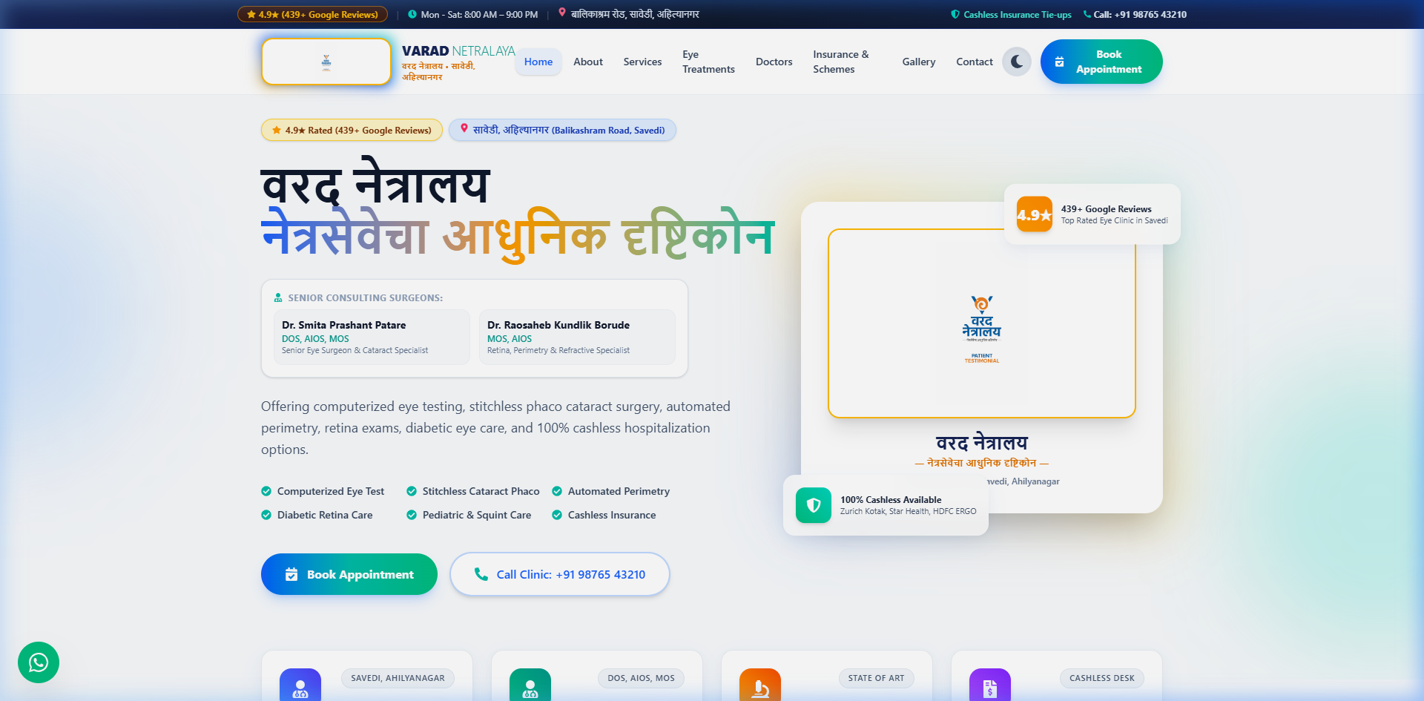
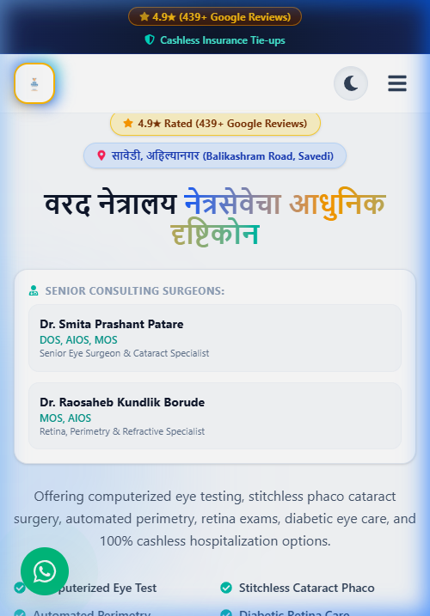
DARK MODE & MOBILE VIEW
Works Beautifully on Every Device & Theme
Dark Mode View
Mobile View
VARAD NETRALAYA

Slide 7
WHAT MORE WE CAN DO
Future Services & Growth Opportunities
🌐 Custom Domain & Live Hosting
🤖 AI ChatBot (24/7 Support)
Launch the website on www.varadnetralaya.com with SSL security certificate and high-speed cloud hosting. Your own professional web address.
Intelligent WhatsApp and website chatbot — answers OPD timings, doctor availability, surgery info, and books appointments automatically.
📱 Android & iOS Mobile Application
📈 Google Ads & SEO Marketing
Dedicated Varad Netralaya mobile app on Google Play Store and Apple App Store — appointment booking, reports, push notifications.
Rank #1 on Google for "Eye Hospital Savedi", "Cataract Surgery Ahilyanagar". Run targeted Google and Facebook ads to attract patients.
💳 Online Payment Gateway
🔔 SMS & WhatsApp Reminders
Accept OPD consultation fees online via Razorpay, PhonePe, Google Pay, or UPI. Patients pay before arriving.
Automated appointment reminders, follow-up messages, and post-surgery care instructions sent via SMS and WhatsApp.
📊 Admin Dashboard & Patient CRM
🎬 YouTube Content & Video Marketing
Secure admin panel to manage appointments, patient records, daily reports, revenue tracking, and staff scheduling.
Professional patient testimonial videos, doctor Q&A sessions, and surgery explainer videos for @VaradNetrayala channel growth.
VARAD NETRALAYA

Slide 8
✓
Thank You!
The website is live and ready for your review.
All changes and customizations can be made based on your feedback.
LIVE DEMO
http://localhost:5173/
GitHub: github.com/bhandarisaurabh500/Varad-HospitalManagment
YouTube: youtube.com/@VaradNetrayala
Google Maps: 4PCG+JR8, Savedi, Ahilyanagar 414003
Saurabh Bhandari — Full Stack Developer & UI/UX Designer
We look forward to your feedback 🙏

