Slide 1

Winsteel Engineering Works Pvt. Ltd.

Slide 2
STANDARD OPERATING PROCEDURE
Design, Engineering, Manufacturing and Supply of Bridge Construction Equipment, Formwork and False work Fabrication
Applicable Standards:
IS 7307:2016, IS 9595:1980, ISO 9001:2015
Winsteel Engineering Works Pvt. Ltd.
Scope:
the complete workflow for design, engineering, manufacturing, inspection, surface treatment, assembly, supply, and after-sales support for bridge construction equipment, formwork, false work, Movable scaffolding, and fabricated structural systems.

Slide 3
1. PURPOSE
The purpose of this SOP is to establish a systematic procedure for the design, engineering, manufacturing, quality control, inspection, packing, transportation, and supply of bridge construction equipment and fabricated systems in compliance with applicable Indian Standards and quality management requirements.
Winsteel Engineering Works Pvt. Ltd.

Slide 4
2. OBJECTIVE
Ensure product quality, safety, and reliability.
Maintain compliance with IS 7307:2016, IS 9595:1980, and ISO 9001:2015.
Winsteel Engineering Works Pvt. Ltd.
Standardize manufacturing and engineering processes.
Ensure timely delivery and customer satisfaction.
Maintain traceability and documentation throughout the project lifecycle.

Slide 5
3. APPLICABLE STANDARDS
Standard | Description
IS 7307:2016 | Code of Practice for Construction Equipment
IS 9595:1980 | Specification for Steel Scaffolding and Tubular Structures
ISO 9001:2015 | Quality Management System
Approved WPS | Welding Procedure Specifications
Approved Drawings | Client Approved Drawings and Documents
Winsteel Engineering Works Pvt. Ltd.

Slide 6
4. OUR COMMITMENT
Winsteel Engineering Works Pvt. Ltd.
Quality
Safety
Precision
Innovation
Timely Delivery

Slide 7
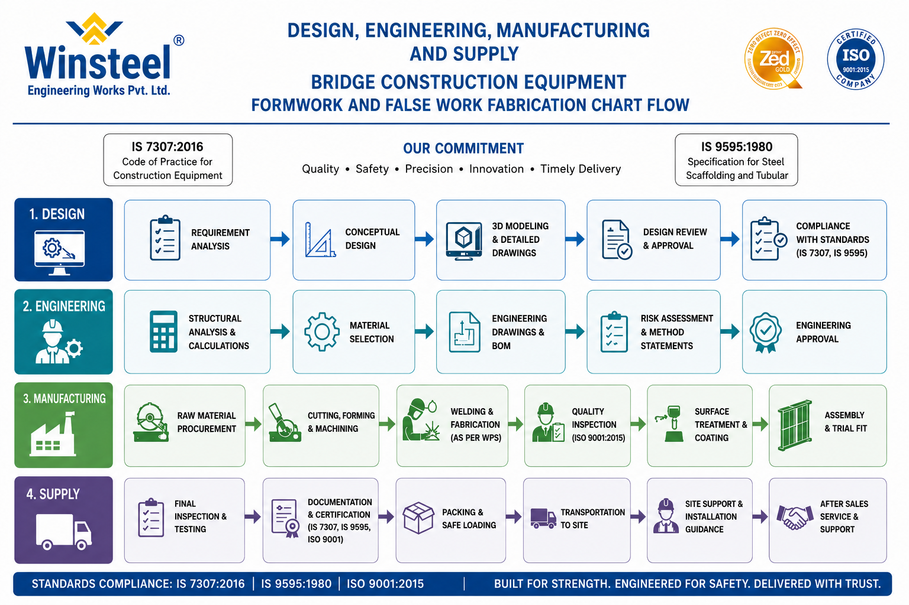
5. PROCESS FLOW OVERVIEW
1-Design
2-Engineering
3-Manufacturing
4-Supply
Winsteel Engineering Works Pvt. Ltd.

Slide 8
6. DESIGN PROCEDURE
6.1 Requirement Analysis
Activities
Review client specifications and tender drawing.
Understand project scope, loading conditions, geometry, and site constraints.
Identify design codes and standards.
Conduct feasibility review.
Responsibility
Design Department
Project Coordinator
Winsteel Engineering Works Pvt. Ltd.
Documents
Client specifications
Design basis report
Technical inputs

Slide 9
6.2 Conceptual Design
Activities
Develop conceptual layouts and preliminary schemes.
Select suitable construction methodology.
Evaluate stability and constructability.
Responsibility
Design Engineers
Winsteel Engineering Works Pvt. Ltd.
Deliverables
Concept drawings
Preliminary calculations
Concept approval documents

Slide 10
6.3 3D Modeling & Detailed Drawings
Activities
Prepare 3D models and fabrication drawings.
Generate GA drawings, shop drawings, and assembly details.
Verify dimensions and interfaces.
Responsibility
CAD Team
Design Department
Winsteel Engineering Works Pvt. Ltd.
Software
AutoCAD
Tekla
SolidWorks or equivalent

Slide 11
6.4 Design Review & Approval
Activities
Conduct internal design review.
Verify calculations and safety factors.
Obtain client approval before manufacturing.
Responsibility
Design Head
QA/QC Department
Client Representative
Winsteel Engineering Works Pvt. Ltd.

Slide 12
6.5 Compliance Verification
Activities
Ensure compliance with IS 7307 and IS 9595.
Confirm structural adequacy and safety.
Review all revisions and approvals.
Records
Approved drawings
Design calculation sheets
Compliance reports
Winsteel Engineering Works Pvt. Ltd.

Slide 13
7. ENGINEERING PROCEDURE
7.1 Structural Analysis & Calculations
Activities
Perform structural analysis for dead load, live load, wind load, and erection load.
Validate member capacities and stability.
Prepare calculation reports.
Responsibility
Structural Engineers
Winsteel Engineering Works Pvt. Ltd.
Deliverables
Structural calculation report
Load analysis sheets

Slide 14
7.2 Material Selection
Activities
Select material grades based on design requirements.
Verify material standards and availability.
Ensure traceability of raw materials.
Responsibility
Engineering Department
Procurement Team
Winsteel Engineering Works Pvt. Ltd.
Typical Materials
Structural Steel
Plates
Pipes
Fasteners

Slide 15
7.3 Engineering Drawings & BOM
Activities
Prepare detailed fabrication drawings.
Generate Bill of Materials (BOM).
Issue controlled drawings for production.
Responsibility
Engineering Department
Winsteel Engineering Works Pvt. Ltd.

Slide 16
7.4 Risk Assessment & Method Statement
Activities
Identify project risks and mitigation measures.
Prepare erection and fabrication method statements.
Conduct safety review.
Responsibility
Safety Department
Project Team
Winsteel Engineering Works Pvt. Ltd.

Slide 17
7.5 Engineering Approval
Activities
Final engineering review.
Client approval and release for manufacturing.
Records
Approved engineering documents
Method statements
Inspection plans
Winsteel Engineering Works Pvt. Ltd.

Slide 18
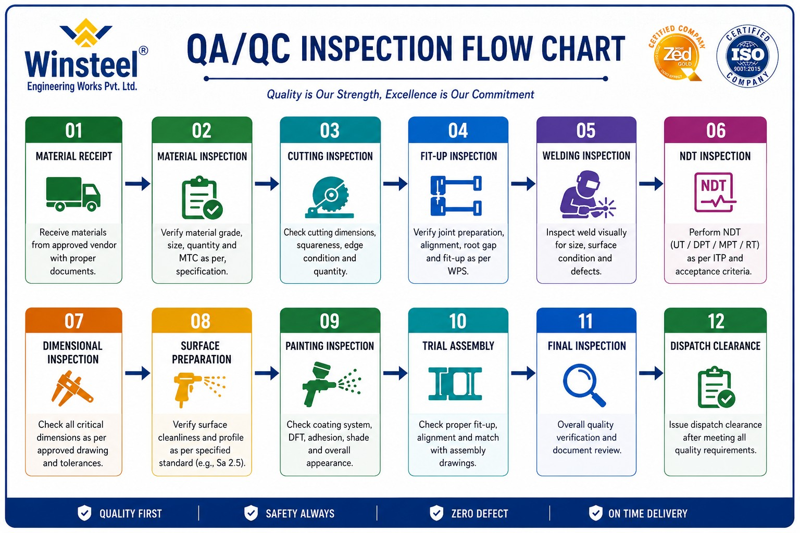
Winsteel Engineering Works Pvt. Ltd.

Slide 19
8. MANUFACTURING PROCEDURE
8.1 Raw Material Procurement
Activities
Procure approved raw materials from qualified vendors.
Verify Mill Test Certificates (MTC).
Conduct incoming inspection.
Responsibility
Procurement Department
QA/QC Department
Winsteel Engineering Works Pvt. Ltd.
Inspection
Visual inspection
Dimensional verification
Material traceability check

Slide 20
8.2 Cutting, Forming & Machining
Activities
Perform cutting using approved equipment.
Carry out bending, drilling, and machining.
Ensure dimensional accuracy.
Equipment
CNC cutting machines
Drilling machines
Hydraulic presses
Winsteel Engineering Works Pvt. Ltd.
Quality Control
Dimensional inspection
Fit-up verification

Slide 21
8.3 Welding & Fabrication
Activities
Welding shall be performed as per approved WPS.
Qualified welders shall carry out fabrication.
Maintain welding consumable control.
Standards
Approved WPS/PQR
Relevant welding codes
Winsteel Engineering Works Pvt. Ltd.
Inspection
Visual inspection
Weld quality verification
NDT where applicable

Slide 22
8.4 Quality Inspection
Activities
Perform stage-wise inspection.
Verify dimensions, weld quality, and fitment.
Ensure ISO 9001:2015 compliance.
Responsibility
QA/QC Department
Winsteel Engineering Works Pvt. Ltd.
Inspection Records
Inspection reports
Calibration records
Checklists

Slide 23
8.5 Surface Treatment & Coating
Activities
Surface preparation by approved mechanical cleaning methods.
Primer application immediately after cleaning.
Final painting as per approved DFT requirements.
Requirements
DFT as per approved specification.
Approved color shade: Win-Blue and Yellow.
Winsteel Engineering Works Pvt. Ltd.
Inspection
Surface cleanliness check
DFT measurement
Visual coating inspection

Slide 24
8.6 Assembly & Trial Fit
Activities
Conduct trial assembly of components.
Verify alignment, dimensions, and functionality.
Resolve fit-up issues before dispatch.
Responsibility
Production Department
QA/QC Team
Winsteel Engineering Works Pvt. Ltd.

Slide 25
9. SUPPLY PROCEDURE
9.1 Final Inspection & Testing
Activities
Conduct final dimensional inspection.
Verify quality records and approvals.
Perform load testing where applicable.
Responsibility
QA/QC Department
Client Inspector (if required)
Winsteel Engineering Works Pvt. Ltd.

Slide 26
9.2 Documentation & Certification
Documents
Inspection reports
Material Test Certificates
Welding records
Paint inspection reports
Compliance certificates
ISO certificates
Standards
IS 7307
IS 9595
ISO 9001:2015
Winsteel Engineering Works Pvt. Ltd.

Slide 27
9.3 Packing & Safe Loading
Activities
Use suitable packing materials.
Protect components against damage during transportation.
Ensure safe loading practices.
Responsibility
Dispatch Department
Winsteel Engineering Works Pvt. Ltd.

Slide 28
9.4 Transportation to Site
Activities
Arrange transportation as per dispatch plan.
Ensure safe handling during transit.
Track delivery schedule.
Responsibility
Logistics Department
Winsteel Engineering Works Pvt. Ltd.

Slide 29
9.5 Site Support & Installation Guidance
Activities
Provide erection guidance.
Assist with installation procedures.
Address technical queries at site.
Responsibility
Site Support Team
Project Engineers
Winsteel Engineering Works Pvt. Ltd.

Slide 30
9.6 After Sales Service & Support
Activities
Provide post-delivery technical support.
Attend client concerns and corrective actions.
Maintain customer feedback records.
Responsibility
Service Department
Winsteel Engineering Works Pvt. Ltd.

Slide 31
10. QUALITY CONTROL REQUIREMENTS
All inspections shall be documented.
Measuring instruments shall be calibrated.
Winsteel Engineering Works Pvt. Ltd.
Full traceability shall be maintained.
Welding consumables shall be controlled.
Non-conformance shall be recorded and corrected.

Slide 32
11. SAFETY REQUIREMENTS
PPE shall be mandatory in all production areas.
Hot work permits shall be followed.
Winsteel Engineering Works Pvt. Ltd.
Lifting tools and tackles shall be certified.
Safe material handling practices shall be followed.
Emergency procedures shall be displayed.

Slide 33
12. RECORDS TO BE MAINTAINED
Approved drawings
Structural calculations
BOM records
Material Test Certificates
Welding records
Inspection reports
Calibration certificates
Paint inspection reports
Dispatch records
Client approvals
Winsteel Engineering Works Pvt. Ltd.

Slide 34
13. RESPONSIBILITY MATRIX
Department | Responsibility
Design | Concept and detailed design
Engineering | Structural calculations and engineering approvals
Procurement | Material sourcing and vendor coordination
Production | Fabrication and assembly
QA/QC | Inspection and quality assurance
Safety | Safety implementation and monitoring
Dispatch | Packing and transportation
Site Team | Installation support
Winsteel Engineering Works Pvt. Ltd.

Slide 35
14. REVISION CONTROL
Revision | Description | Date
00 | Initial Release | As Applicable
Winsteel Engineering Works Pvt. Ltd.

Slide 36
15. CONCLUSION
This SOP establishes a comprehensive and standardized approach for the successful execution of bridge construction equipment, formwork, false work, scaffolding, and fabricated structural projects while ensuring compliance with applicable standards, quality requirements, and client expectations.
Winsteel Engineering Works Pvt. Ltd.
Built for Strength. Engineered for Safety. Delivered with Trust.

Slide 37

THANK YOU
Winsteel Engineering Works Pvt. Ltd.

