Slide 1

Winsteel Engineering Works Pvt. Ltd.

Slide 2
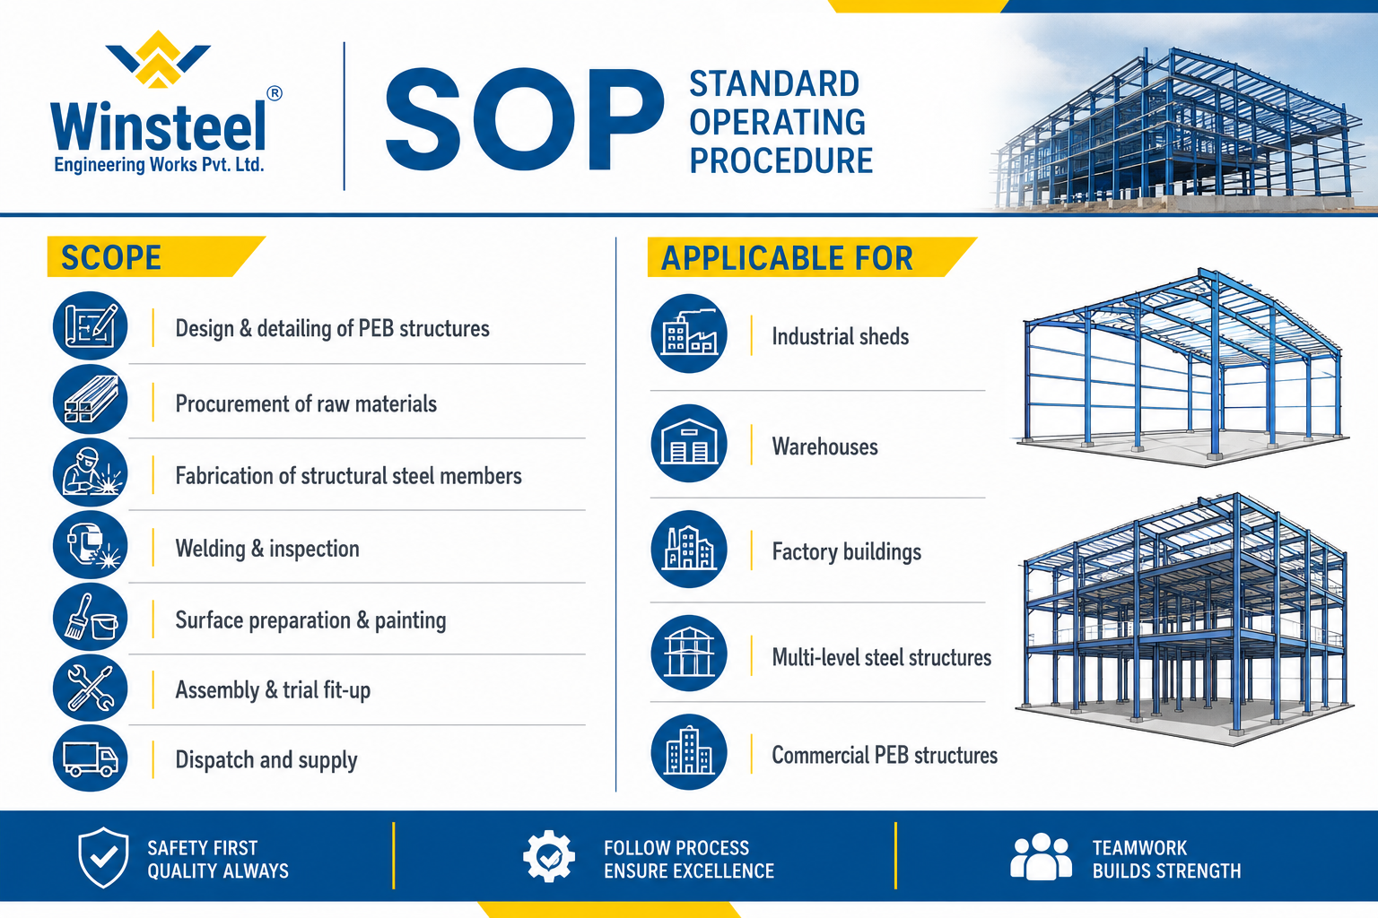
Winsteel Engineering Works Pvt. Ltd.

Slide 3
2. APPLICABLE STANDARDS
IS 800:2007 – General Construction in Steel
IS 2062 – Structural Steel Specification
IS 875 – Design Loads
IS 1893 – Earthquake Resistant Design
IS 9595 –Gas Metal Arc Welding
IS 816 – Welding Code
AWS D1.1 – Structural Welding Code
SSPC / ISO 8501 – Surface Preparation Standards
Winsteel Engineering Works Pvt. Ltd.

Slide 4
3. RESPONSIBILITIES
Department | Responsibility
Design Department | Structural analysis & detailing
QA/QC Department | Inspection & quality control
Production Department | Fabrication & assembly
Purchase Department | Procurement of approved materials
Dispatch Department | Packing & delivery
Winsteel Engineering Works Pvt. Ltd.

Slide 5
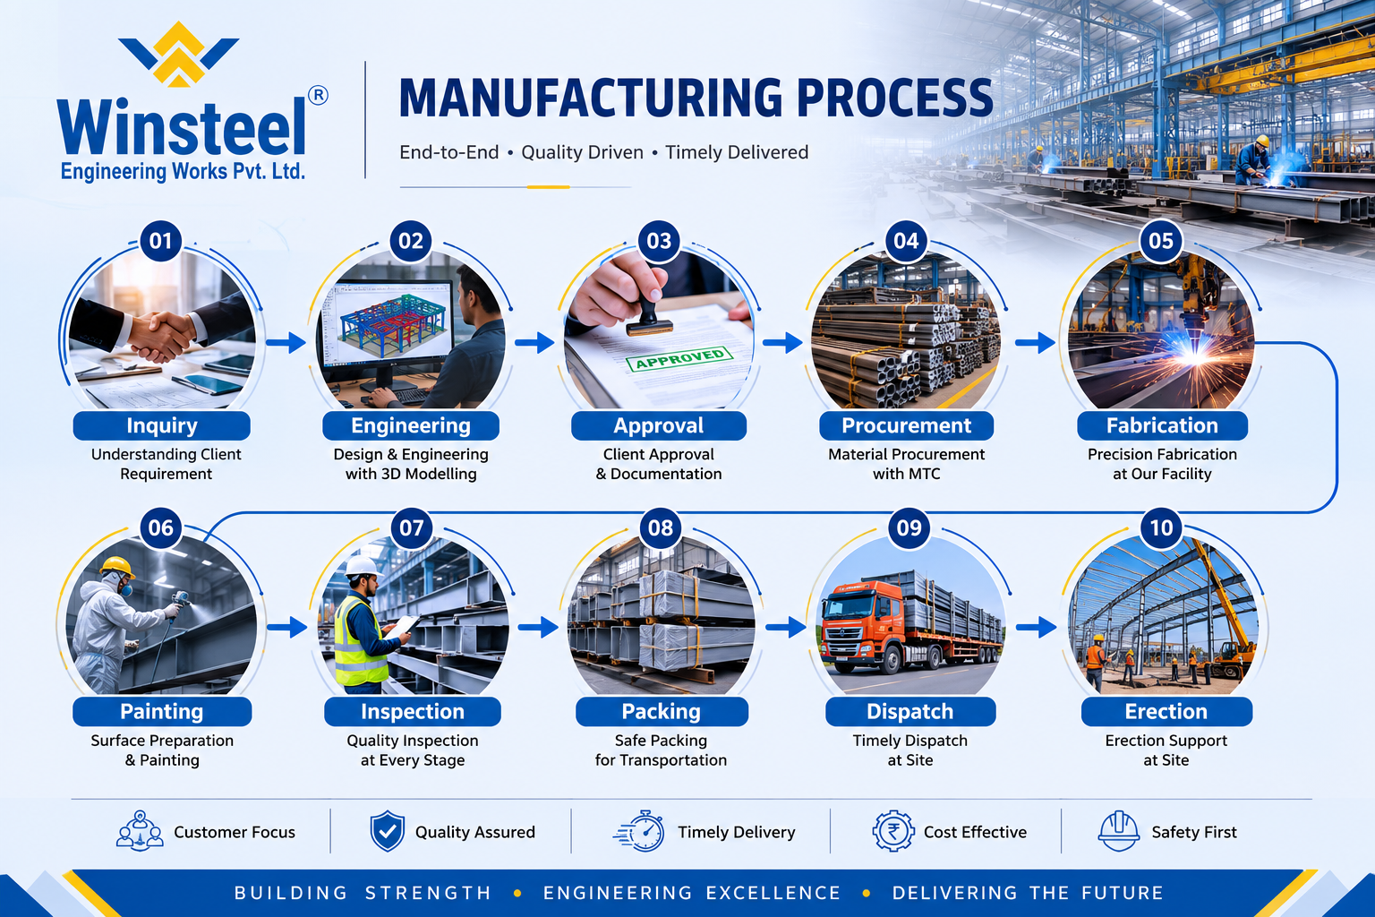
PROCESS FLOW CHART
Winsteel Engineering Works Pvt. Ltd.

Slide 6
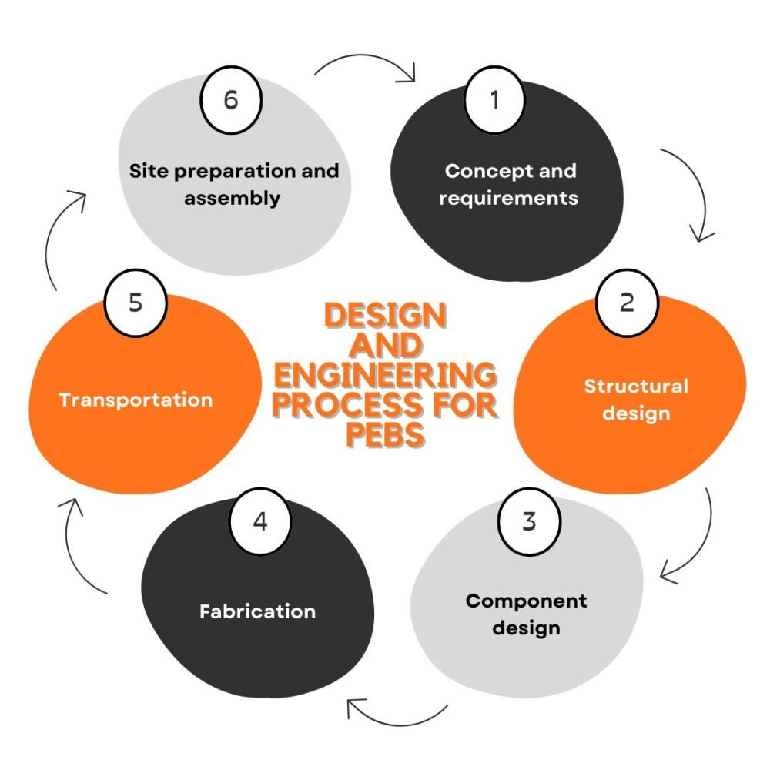
5. DETAILED PROCEDURE
5.1 Design & Engineering
Procedure
Review client drawings and specifications.
Perform structural analysis using approved software.
Prepare:
GA Drawings
Fabrication Drawings
Connection Details
BOM (Bill of Materials)
Ensure design compliance with IS codes.
Deliverables
Approved drawings
Design calculations
Material list
Winsteel Engineering Works Pvt. Ltd.

Slide 7
5.2 Raw Material Procurement
Procedure
Procure structural steel from approved vendors.
Verify:
Mill Test Certificates (MTC)
Grade & thickness
Heat number traceability
Inspection
Visual inspection
Dimension verification
Material traceability marking
Winsteel Engineering Works Pvt. Ltd.

Slide 8
5.3 Cutting & Fabrication
Procedure
CNC/Plasma/Laser/ oxy-fuel/ Profile cutting as per drawings.
Mark identification numbers on members.
Prepare built-up sections and assemblies.
Equipment Used
CNC Cutting Machine
Band Saw
Radial Drill
Plate Bending Machine
Winsteel Engineering Works Pvt. Ltd.

Slide 9
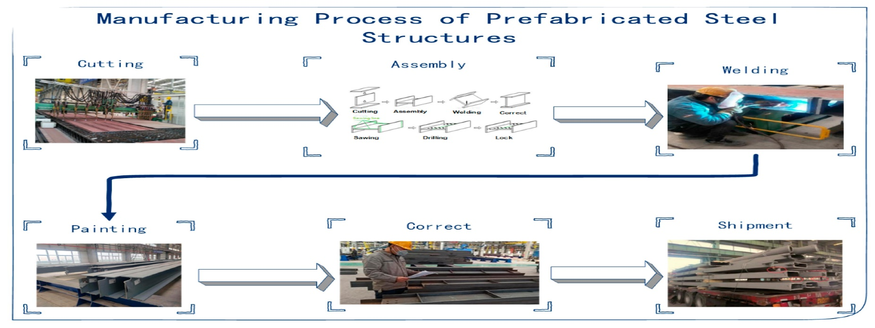

Slide 10
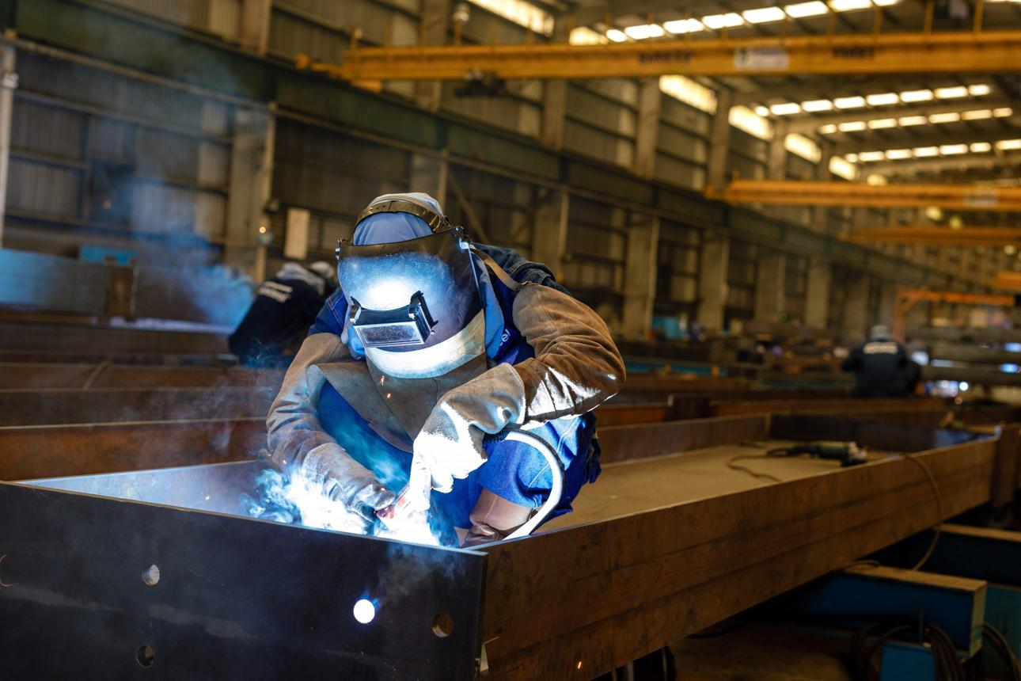
5.4 Fit-Up & Welding
Procedure
Align members using approved fixtures.
Maintain dimensions and tolerances.
Carry out welding as per approved WPS.
Inspection
Visual Inspection
Weld Size Verification
NDT (if required )
Winsteel Engineering Works Pvt. Ltd.
Welding Process
GMAW / SAW / SMAW

Slide 11
5.5 Quality Control Inspection
Checks
Dimensional inspection
Weld quality inspection
Alignment and straightness
Bolt hole matching
Testing
DPT / UT / MPI (as applicable )
Winsteel Engineering Works Pvt. Ltd.

Slide 12
5.6 Surface Preparation & Painting
Surface Preparation
Mechanical cleaning / shot blasting
Remove rust, oil, and scale
Typical Coating System
Total DFT: 100–120 Microns Minimum
Winsteel Engineering Works Pvt. Ltd.
Coat | DFT
Primer | 40–60 Microns
Intermediate | 40 Microns
Finish Coat | 40 Microns
Painting Procedure
Apply primer immediately after cleaning.
Maintain DFT as per specification.

Slide 13
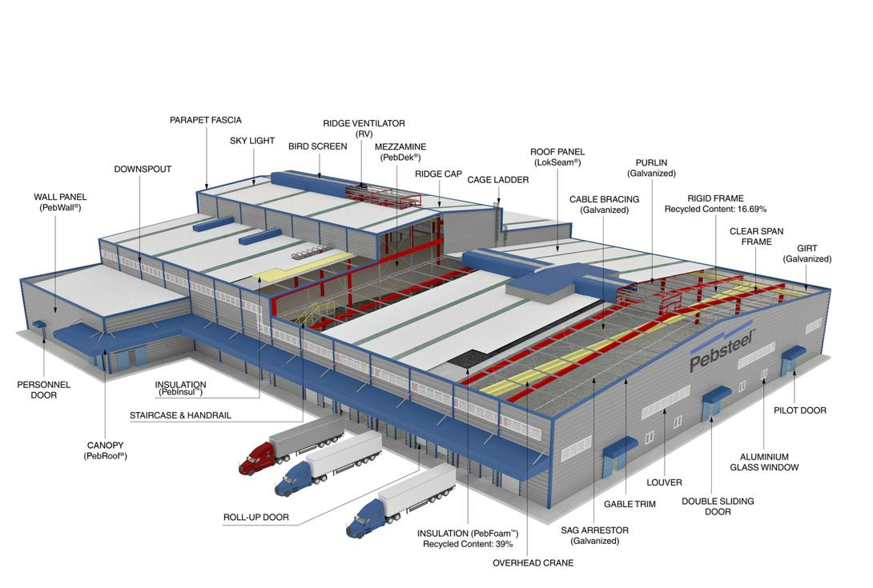
5.7 Assembly
Procedure
Carry out trial fit-up of major members.
Check:
Alignment
Bolt matching
Connection fitment
Winsteel Engineering Works Pvt. Ltd.

Slide 14
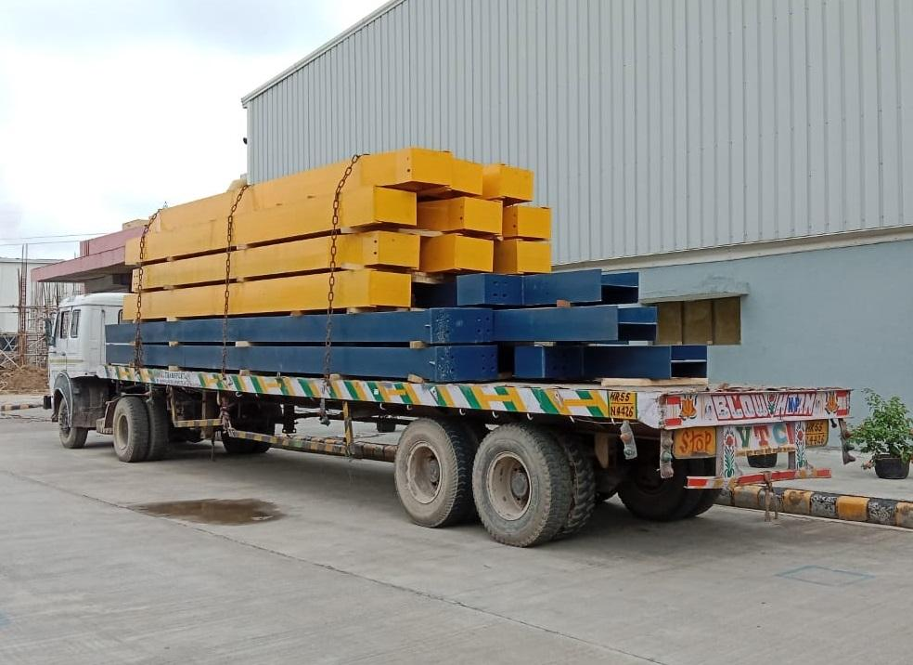
5.8 Packing & Dispatch
Procedure
Mark members clearly.
Protect painted surfaces.
Prepare dispatch list and packing list.
Winsteel Engineering Works Pvt. Ltd.
Documents
Inspection reports
Test certificates
Delivery challan
Packing list

Slide 15
6. SAFETY REQUIREMENTS
7. QUALITY RECORDS
PPE mandatory for all workers.
Follow welding and lifting safety procedures.
Use calibrated lifting tools and tackles.
Fire extinguishers shall be available near welding areas.
Maintain:
Material inspection reports
Welding inspection reports
Calibration certificates
Paint DFT reports
Dispatch records
Winsteel Engineering Works Pvt. Ltd.

Slide 16
8. ACCEPTANCE CRITERIA
Activity | Acceptance Requirement
Material | As per approved grade
Welding | No visible defects
Dimensions | Within drawing tolerance
Painting | Required DFT achieved
Final Inspection | Client/QA approved
Winsteel Engineering Works Pvt. Ltd.

Slide 17
9. CONCLUSION
This Standard Operating Procedure (SOP) establishes a structured and systematic approach for the execution of Pre-Engineered Building (PEB) fabrication activities, ensuring compliance with approved drawings, technical specifications, applicable codes, and client requirements.
The procedure emphasizes effective quality assurance, process control, material traceability, safety compliance, and inspection at every stage of fabrication to achieve consistent workmanship and reliable structural performance.
Winsteel Engineering Works Pvt. Ltd.
By implementing this SOP, the organization ensures:
High standards of fabrication quality and dimensional accuracy
Safe and efficient manufacturing practices
Timely project execution and delivery
Compliance with statutory, contractual, and international standards
Continuous monitoring, documentation, and accountability throughout the fabrication process
This SOP serves as a guiding framework for maintaining operational excellence, customer satisfaction, and continual improvement in PEB manufacturing and project execution.

Slide 18

THANK YOU
Winsteel Engineering Works Pvt. Ltd.

