Slide 1

Winsteel Engineering Works Pvt. Ltd.

Slide 2
About the Entrepreneur & Legacy (Since 1972)
Winsteel Engineering Works Pvt. Ltd.
Established in 1972, a pillar in India’s infrastructure journey
Vision: Engineering excellence, innovation, reliability
Growth reflects:
Strategic foresight in engineering innovation
Strong technical leadership
Winsteel Engineering Works Pvt. Ltd.

Slide 3
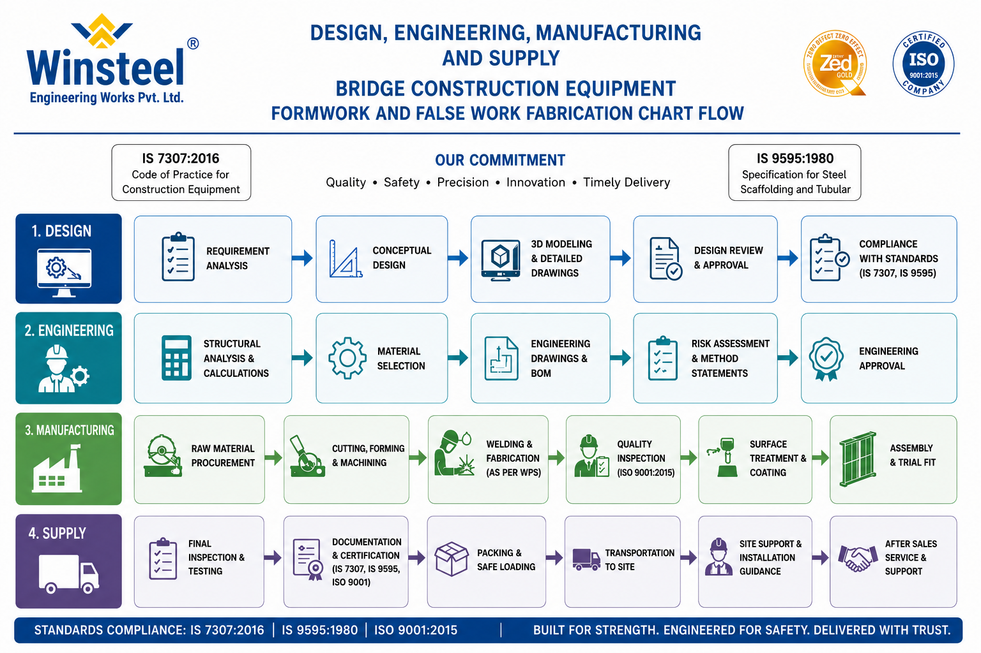

Slide 4


Slide 5
Five Decades of Excellence:
Resilience in adapting to evolving demands
Innovation in advanced construction systems
Integrity in national projects
Trusted partner to EPC contractors & global collaborators
Winsteel Engineering Works Pvt. Ltd.

Slide 6
Core Expertise: Formwork & False work Engineering
Lifecycle solutions: Design → Fabrication → Commissioning
Precision Design & Fabrication
High‑accuracy moulds, durable systems
Compliance Standards:
ISO 9001:2015 | AWS D1.1 | IS 9595 | ZED Gold
Winsteel Engineering Works Pvt. Ltd.
Hydraulic & Mechanical Innovation
Precision alignment, mechanized productivity
On‑Site Technical Support
Safety, reliability, performance optimization

Slide 7
Achievements & Landmark Contributions
India’s First Segmental Box Girder Full Span Mould (Fixed & Variable Type)
For Mumbai–Ahmedabad High‑Speed Rail (MAHSR) with L&T/NHSRCL
Innovative solutions for complex bridge projects nationwide
Benchmarks in:
Precision engineering
Construction efficiency
System repeatability
Winsteel Engineering Works Pvt. Ltd.

Slide 8
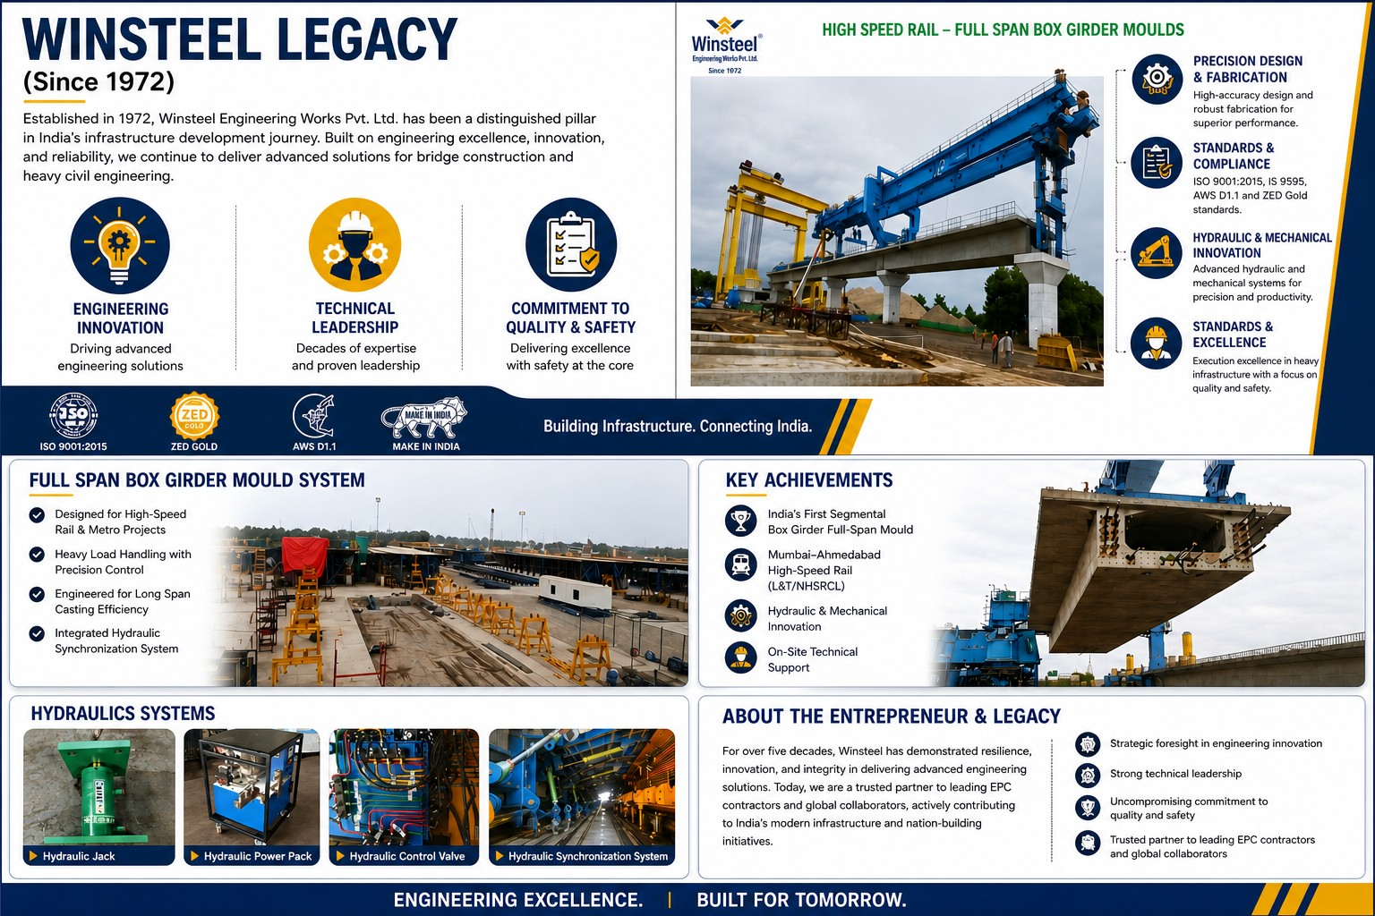

Slide 9
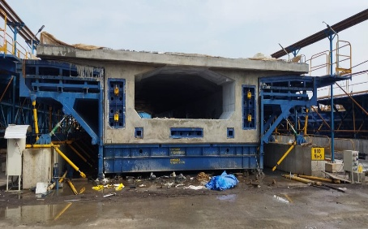
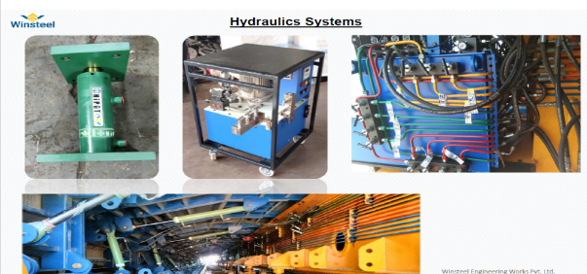
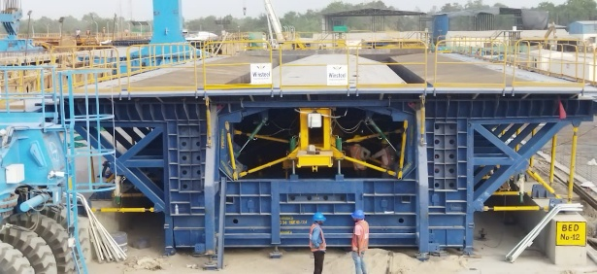
Flagship Solution: Full Span Box Girder Mould
Technical Features:
Modular steel construction — robust, adaptable
Hydraulic jacking system — precision alignment
Multi‑span compatibility: 31–35m | 36–40m | 40m
Integrated gear drive — smooth movement
Parking frame system — cycle efficiency
Superior Output:
High dimensional accuracy
Excellent surface finish
Consistent repeatability
Winsteel Engineering Works Pvt. Ltd.

Slide 10


Compliance & Nation‑Building Role
ISO 9001:2015 | AWS D1.1 | IS 9595 | ZED Gold
Partner in national infrastructure excellence
Contribution to modern India’s nation‑building initiatives
Winsteel Engineering Works Pvt. Ltd.

Slide 11

THANK YOU
Winsteel Engineering Works Pvt. Ltd.
Winsteel Engineering Works Pvt. Ltd. Plot No. I‑68, Road No. 06, GIDC Sachin, Surat – 394230, India
🌐 Website: www.winsteel.in & www.winsteelpeb.com
📧 Email: winsteel@winsteel.in & contact@winsteelpeb.com
📞 Phone: +91 97140 09019

