Slide 1

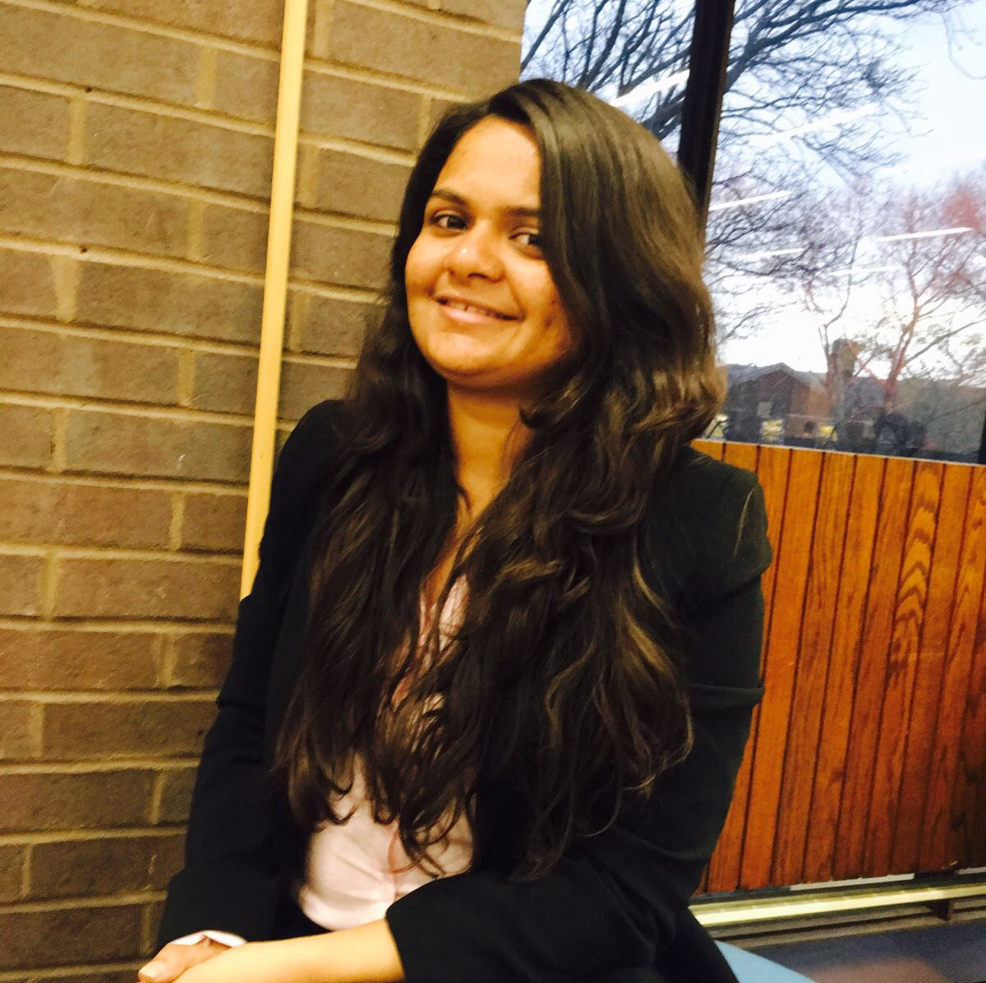
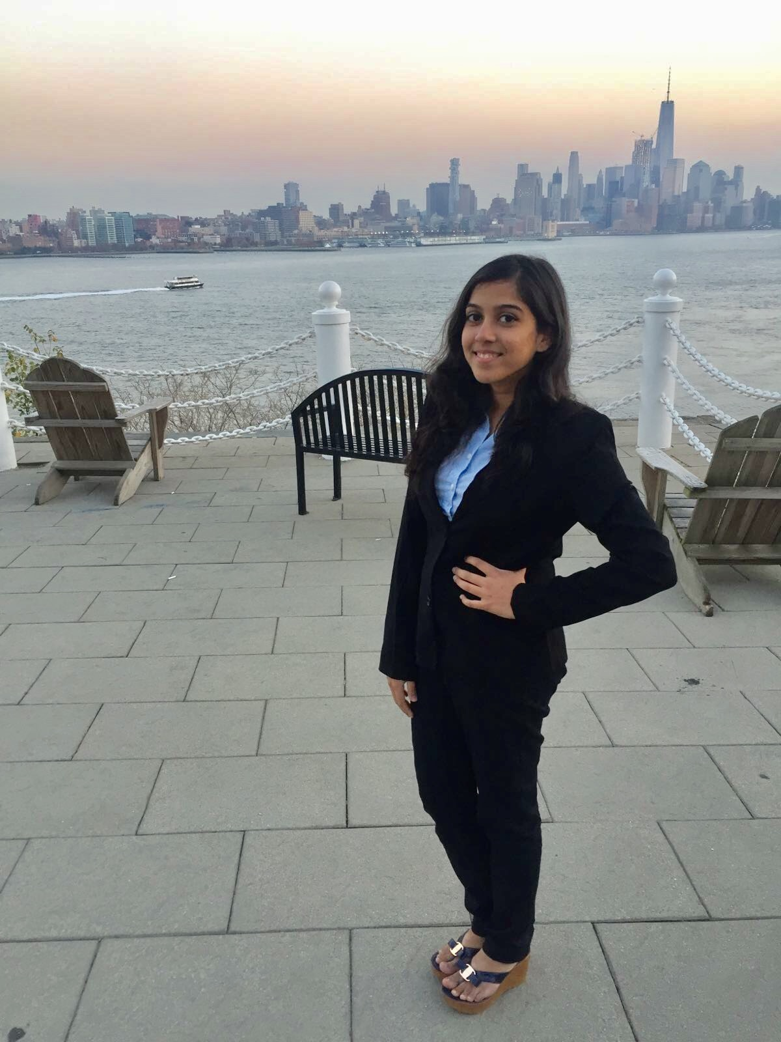

BIA - 672 Marketing Analytics
Presented by:
Sourabh Gune
CWID :10415591
Disha Chaudhari
CWID :10414540
Abigail Nicols
CWID:10420386
Tejas Bhandari
CWID :10411995

Slide 2
Marketing Analytics
BIA 672
Eat Smart and Move More

Slide 3
Content
Summary
Who are we?
Vision
Data Gathering and Understanding
Data Preparation
Our Analysis Strategy - Segmentation Analysis
Placement and Promotion
Future Scope

Slide 4
Summary
The data was obtained from U.S Government's Health Department, Centre of Disease control and prevention.
This data was cleaned according to the attributes that aligned according to our needs to make various clusters with regards to gender, income, age group.
We used the procedure Fastclus and sgplot etc which helped us narrow down the probable locations, and categories based on the gender, age and income which we leveraged in the making of our analysis.
To these clusters, we applied our marketing strategies in order to expand our customer base and increase potential growth in the future.

Slide 5
Who are we?
Our Consultant group is a consulting and analytics firm at a nascent stage trying to make its way to the top by giving tough competition to the existing counterparts.
Our Goal is to be a mediator between Companies like Blink, Planet fitness and citizens of US suffering from health issues like obesity, etc.
We believe that in order to convince customers to go for fitness alternatives, we need to have a competitive edge.

Slide 6
Vision
Use robust marketing strategies efficiently to provide better health initiatives.
Make people healthy and provide solutions.
Keep updating our data to provide newer strategies according to states.
Partner with numerous companies for bringing various things to platter.
Help people in need as quickly as possible with the best service.
Use different convenient channels to reach out to the market.

Slide 7
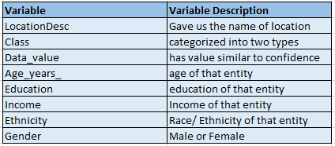
About Data?
This data was acquired from the U.S Government's Health Department, Centre of Disease control and prevention.
There are total 29 variables and around 48772 entries.
We will be using following 8 variables:

Slide 8
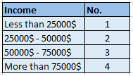

Data Preparation
First, we performed cleaning of data i.e.
Removed outliers
Removed Missing values
Performed Groups of variables.

Slide 9
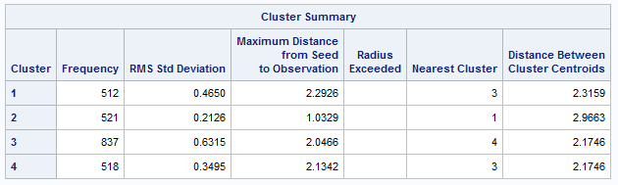
Segmentation Analysis
We formed 4 clusters of states on east coast.

Slide 10
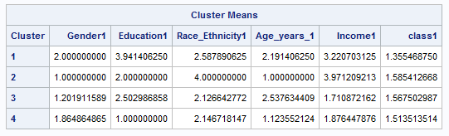
Cluster Means
Consider cluster 4 :
Gender = Female
Education = Less than high school
Ethnicity = Hispanic
Age = 34 - 54
Income = 25K - 50K $
Class = less physical activity

Slide 11
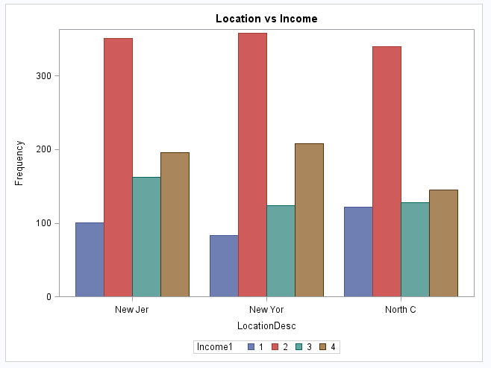
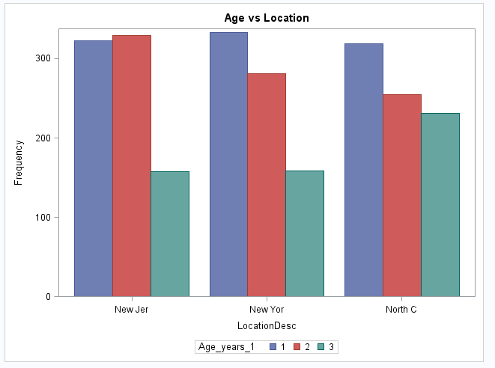
Frequency Distribution

Slide 12
Marketing Strategy (East coast)
18-34 : Introduction of fitbits which are economical, Newer energy drinks, healthy meals , Introduction of high intensity physical activity
34-54 : Introduction of Moderate Intensity Physical activity, Introduction of nutrition food
54+ : Nutrition Surveillance System, Health groups etc
DIFFERENT AGE GROUP
less than 25k : Encourage government to organize free health sessions like Yoga,
25k to 50 : Approaching gyms for reducing membership cost, Introduction of new gyms
50k and above : Personal Trainers, Nutrition rich diet,Encouraging them for stress free sessions.
DIFFERENT
INCOME
Government can introduce programs, initiatives or activities that are considered leading edge.
They can post awareness on social media like facebook, twitter , instagram etc.

Slide 13
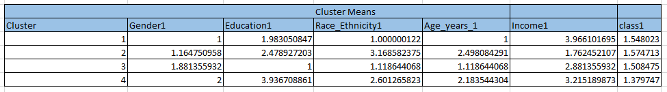
New York cluster
In the NY cluster, we acquired the following results:
In general, these are the overall observations

Slide 14
Marketing Strategy(NY)
Target Age Group(18-54)
NY has a large number of individuals living in a fast paced, high stress environment.
Considering the NY cluster, we can target the age group mentioned in this cluster by selling a strategy that offers a combination of various healthy alternatives.
Since this age group is also gadget conscious, Fitbit and other fitness tracking devices can be sold to this target group.
Companies can also propose mixed workout plans like Zumba, crossfit and other forms of workouts apart from the traditional options.
This age and income group form a good combination of people who will be likely to choose these options and even invest some amount of money in them.
Encourage people to walk or use bikes that will be an healthier option for them along with being cheaper.

Slide 15
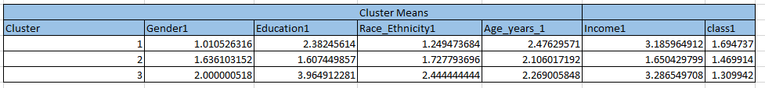

North Carolina Cluster
In the NC cluster, we acquired the following results:
In general, these are the overall observations

Slide 16
Marketing Strategy(NC)
Target Age Group(34-54)
This cluster in North Carolina has a large number of middle aged to elder aged individuals. Though their income group is lesser as compared to NY, so these individuals will prefer better and healthier food options at a cheaper rate.
Reducing the cost and advocating the health benefits of eating right needs to be expanded. Nutritionists and Trainers who offer their services at a lower price will encourage people to get fit.
Governments can introduce free physical activity plans for individuals and also motivate them to choose healthier alternatives.
Increase nutritional options at fast food chains and cater them at a cheaper rate to encourage healthier options.

Slide 17
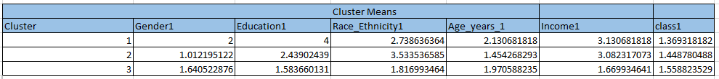
New Jersey Cluster
In general, these are the overall observations

Slide 18
Marketing Strategy (NJ)
Target Audience : We would recommend that the organizations target the customer segment on the demographic basis of age. The segmentation would be: 18-34 and 35-54
Pricing : The pricing should be different for different age groups, for ex: Protein shakes are interesting at 18 - 34, but 35-55 age group would like to build core strength for daily tasks & longevity
What our clients bring to our customers will be: a plethora of tailormade offerings for their health needs, and efficient customer service. One size doesn’t fit all, and customers want a more personal approach, especially health & wellbeing matters
Cross selling, Bundle Pricing Packs, Training Modules, Digital Marketing (B2B, B2C)

Slide 19
Analysis(All 3 states)
After performing individual analysis, we will focus on the age group 35-54 and contrast them across the three states:
Location | Gender | Education | Race_ethnicity | Income | Class
New York | Male | High school graduate | America / other | $ 75K and above | Less physical activity
New Jersey | Female | College graduate | Hispanic/ Asian | $ 50k - 75k | Obese
North Carolina | Female | High school grad | Hispanic | $ 25k - 50k | Obese

Slide 20
Conclusion
A specialized approach in a target customer segment goes a long way to help improve consumer impact.
This helps drive down costs and puts the customer first on an organizational priority, and customers appreciate that!
Broad spectrum strategies are passe’ especially in healthcare.
Our analysis about the physical activity of the people of USA found the target audience to offer recommendations for potential untapped markets.
With the analysis stated, we observe that targeting these states will be the best way forward for our clients.
And we will recommend that this is implemented for best customer outreach.

Slide 21
Future Scope
Essentially we would want there to be a targeted strategy for every age bracket in the demographic to enhance customer outreach.
The next step in this would be to implement algorithm based learning mechanisms, utilizing historic customer feedback as target data.
This would spur further growth and innovation in the healthcare segment, essentially setting high standards for competing players.
In the next implementation, with a growth of healthcare devices and supplies, we could be looking at a very robust customer share based on a “customer first” approach.

Slide 22
Thank You!!

