Slide 1
Amazon Product Recommendation System
Recommendation Systems Course
Nov 2024

Slide 2
Contents / Agenda
Business Problem and Data Overview
Exploratory Data Analysis
Rank Based Model
User-User Similarity-based Model
Item-Item Similarity-based Model
Matrix Factorization based Model
Conclusion and Recommendations

Slide 3
Business Problem and Data Overview
Business Problem:
Amazon aims to provide a personalized and engaging shopping experience for its customers. A key aspect of this is recommending relevant products that align with individual user preferences and needs.
By suggesting products that customers are likely to be interested in, Amazon can drive sales and increase revenue. Effective recommendations can lead to higher conversion rates and customer lifetime value.
With a vast catalog of products, it can be challenging for customers to discover items they might like. A recommendation system helps users explore new products and categories they might not have found otherwise.
By providing a personalized and helpful shopping experience, Amazon can foster customer loyalty and retention. Satisfied customers are more likely to return for future purchases.

Slide 4
Business Problem and Data Overview
What We Are Trying to Solve:
Analyzing user data, such as past purchases, ratings, browsing history, and product interactions, to identify patterns and infer individual preferences.
Leveraging collaborative filtering and/or content-based filtering techniques to find products that align with user preferences and are similar to items they have liked in the past.
Evaluating Performance: Measuring the effectiveness of the recommendation system using metrics like precision, recall, F1-score, and RMSE to ensure it's making accurate and relevant recommendations.

Slide 5
Business Problem and Data Overview
Overview of the dataset:
Analyzing user data, such as past purchases, ratings, browsing history, and product interactions, to identify patterns and infer individual preferences.
Leveraging collaborative filtering and/or content-based filtering techniques to find products that align with user preferences and are similar to items they have liked in the past.
Evaluating Performance: Measuring the effectiveness of the recommendation system using metrics like precision, recall, F1-score, and RMSE to ensure it's making accurate and relevant recommendations.
Overview of the dataset:
The Amazon dataset contains the following attributes:
userId: Every user identified with a unique id
productId: Every product identified with a unique id
Rating: The rating of the corresponding product by the corresponding user
timestamp: Time of the rating. We will not use this column to solve the current problem
Note: You can use more than one slide if needed

Slide 6
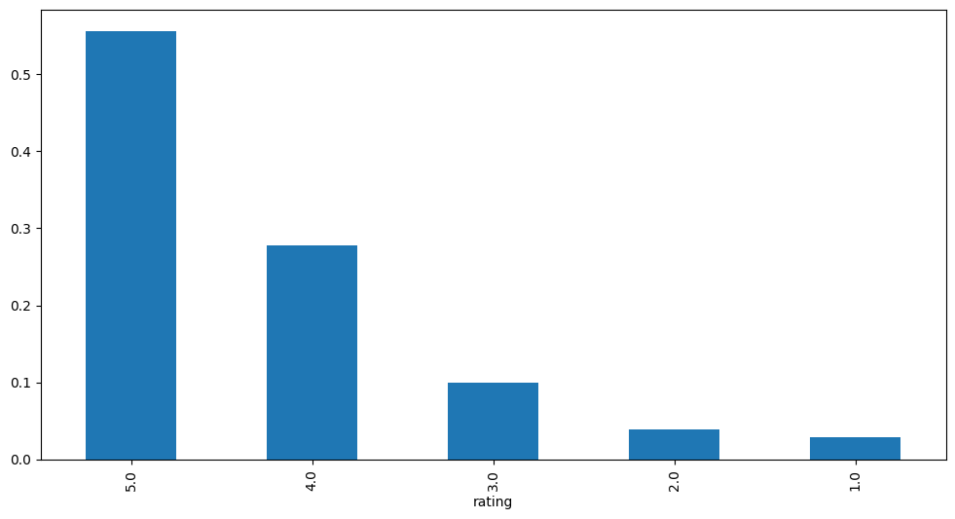
Exploratory Data Analysis
There are 7824482 records and 3 columns in the ratings Dataset.
user_id, prod_id are object and rating is float datatypes.
The DataFrame does not have any null values in any of the columns
There are 65290 records with a mean of 4.29, median as 5, standard deviation as 0.988 with the values ranging from 1 to 5.
The majority of the data has a rating between 5.0 and 4.0.
Out of the 65K records, There are 1540 unique users and 5689 unique products.

Slide 7
Rank Based Model
Calculated the average rating and count of ratings for each product
Created a DataFrame with calculated average and count of ratings
Defined a function to get the top n products based on the highest average rating and minimum interactions
Found products with minimum number of interactions
Sorted values with respect to average rating in a descending order
Using Rank Based Recommendation,
'B001TH7GUU', 'B003ES5ZUU', 'B0019EHU8G', 'B006W8U2MU', 'B000QUUFRW' are the top 5 products with 50 minimum interactions.
'B003ES5ZUU', 'B000N99BBC', 'B007WTAJTO', 'B002V88HFE', 'B004CLYEDC' are the top 5 products with 100 minimum interactions.

Slide 8
User-User Similarity-based Model
User-User Similarity Based
RMSE: 1.0012
Precision: 0.855
Recall: 0.858
F_1 score: 0.856
The root mean square error is 1 which indicates that our model is off by about 1 rating point. The precision is 0.85 and recall is 0.86 which means that 85% recommendation were correct and out of all the relevant items the model recommended 86% of them. The F1 score is 0.86 which indicating that the model is able to recommend relevant items.
For a user with userId=‘A3LDPF5FMB782Z’ and productId=‘1400501466’, The true rating was 5.00 and the model estimated 3.40 which gives a prediction error of 1.60 points. The model has used only 5 nearest neighbors to make the predictions this may have caused the error to be higher.
The model was unable predict the rating for userId=‘A34BZM6S9L7QI4’ and prod_id=‘1400501466’ because it couldn't find enough similar users(neighbors) who had rated the item. It may be due to very few interactions in the dataset who rated the same item.

Slide 9
User-User Similarity-based Model
User-User Similarity Based - tuned hyperparameter model
RMSE: 0.9526
Precision: 0.847
Recall: 0.894
F_1 score: 0.87
The RMSE after tuning hyperparameters for the KNN Basic algorithm decreased to 0.95 which is an improvement from the untuned model. The precision has reduced slightly to 0.847 and the recall has increased to 0.89 along with an increase in the F1 Score to 0.87. This indicates that the tuning of the hyperparameter has resulted in a better model. 84.7% of the recommended items are relevant and Out of all the relevant items, 89.4% of the them are recommended, according to the mode.
The model was unable predict the rating for userId=‘A34BZM6S9L7QI4’ and ‘A34BZM6S9L7QI4’ for prod_id=‘1400501466’ because it couldn't find enough similar users(neighbors) who had rated the item. It may be due to very few interactions in the dataset who rated the same item.

Slide 10
Item-Item Similarity-based Model
Item-Item Similarity-based
RMSE: 0.9950
Precision: 0.838
Recall: 0.845
F_1 score: 0.841
The RMSE for Item-Item Similarity-based Collaborative Filtering of the KNNBasic algorithm is 0.995 which is better than the untuned model user-user Similarity Model. 83.8% of the recommended items are relevant and Out of all the relevant items, 84.5% of the them are recommended, according to the mode.
The predicted rating of 4.27 is relatively close to the true rating of 5.00 for userId=‘A3LDPF5FMB782Z’ and prod_id=‘1400501466’ . This suggests that the model is capturing some of the user's preferences for this item.
The model was unable predict the rating for userId=‘A34BZM6S9L7QI4’ and prod_id=‘1400501466’ because it couldn't find the user-item pair in the training dataset. It may be due to insufficient information to make accurate recommendations.

Slide 11
Item-Item Similarity-based Model
Item-Item Similarity-based - tuned hyperparameter model
RMSE: 0.9615
Precision: 0.835
Recall: 0.878
F_1 score: 0.856
The RMSE after tuning hyperparameters for the Item-Item KNN Basic algorithm decreased to 0.96 which is an improvement from the untuned model. The precision has comparatively the same at 0.835 and the recall has increased to 0.878 along with an increase in the F1 Score to 0.856. This indicates that the tuning of the hyperparameter has resulted in a better model. 83.5% of the recommended items are relevant and Out of all the relevant items, 87.8% of the them are recommended, according to the mode.
While not perfectly accurate, the predicted rating of 4.27 is relatively close to the true rating of 5.00 for user = ‘A3LDPF5FMB782Z’. This suggests that the model is capturing some of the user's preferences for this item.
The model was not able to predict the rating accurately for ‘A34BZM6S9L7QI4’ as there are not enough neighbors.

Slide 12
Matrix Factorization based Model
Singular Value Decomposition (SVD): SVD is used to compute the latent features from the user-item matrix. But SVD does not work when we miss values in the user-item matrix.
RMSE: 0.8882
Precision: 0.853
Recall: 0.88
F_1 score: 0.866
The root mean square error is 0.88 which indicates that our model is off by about 0.88 rating point. The precision is 0.85 and recall is 0.88 which means that 85% recommendation were correct and out of all the relevant items the model recommended 88% of them. The F1 score is 0.86 which indicating that the model is able to recommend relevant items.
For a user with userId = "A3LDPF5FMB782Z" and prod_id = "1400501466, The true rating is 5 and the model's estimated rating is 4.08. The model is off by 0.92 rating points.
The model has estimated the rating of 4.4 for userId=“A34BZM6S9L7QI4” and product_id = “1400501466”.

Slide 13
Matrix Factorization based Model
We will be tuning only three hyperparameters:
n_epochs: The number of iterations of the SGD algorithm.
lr_all: The learning rate for all parameters.
reg_all: The regularization term for all parameters.
Singular Value Decomposition (SVD):
RMSE: 0.8882
Precision: 0.853
Recall: 0.88
F_1 score: 0.866
The root mean square error is 0.88 which indicates that our model is off by about 0.88 rating point. The precision is 0.85 and recall is 0.88 which means that 85% recommendation were correct and out of all the relevant items the model recommended 88% of them. The F1 score is 0.86 which indicating that the model is able to recommend relevant items.
The model predicted an estimated rating of 4.08 for userId=‘A3LDPF5FMB782Z’ and 4.40 for userId = ‘A34BZM6S9L7QI4’ for prod_id=‘1400501466’. ‘A34BZM6S9L7QI4’ is off by 0.92 rating points as the true rating is 5.00.

Slide 14
Conclusion
Model Performance: Both User-based Collaborative Filtering and Matrix Factorization-based methods (using SVD) were explored for building the recommendation system. User-User Similarity Based - tuned hyperparameter model demonstrated reasonable performance in predicting user ratings for products.
Hyperparameter Tuning: Grid search cross-validation was used to optimize the hyperparameters for both KNN-based and SVD-based models. This tuning process led to improvements in prediction accuracy, as indicated by lower RMSE values and higher precision and recall scores.
Recommendation Quality: Overall, the optimized recommendation models demonstrated the ability to provide relevant product suggestions to users, with a good balance between precision and recall.
Cold Start Problem: The cold start problem, where predictions are difficult for new users or items with limited interaction history, was identified as a challenge. While the models performed well for users and items with sufficient data, predictions for cold start scenarios were less reliable.
 | User-User Similarity Based | User-User Similarity Based - tuned hyperparameter model | Item-Item Similarity-based | Item-Item Similarity-based - tuned hyperparameter model | Matrix Factorization | Matrix Factorization - tuned hyperparameter model
RMSE | 1.0012 | 0.953 | 0.9950 | 0.9615 | 0.8882 | 0.8882
Precision | 0.855 | 0.847 | 0.838 | 0.835 | 0.853 | 0.853
Recall | 0.858 | 0.894 | 0.845 | 0.878 | 0.88 | 0.88
F1 score | 0.856 | 0.87 | 0.841 | 0.856 | 0.866 | 0.866

Slide 15
Recommendations
Hybrid Approach: We can consider exploring a hybrid approach that combines collaborative filtering with content-based filtering to mitigate the cold start problem. Content-based filtering can leverage product attributes and user preferences to make recommendations even when interaction data is sparse.
Data Enrichment: Enriching the dataset with additional information, such as product descriptions, categories, and user demographics, could potentially improve the accuracy of recommendations, especially for cold start scenarios.
Real-world Evaluation: Deploy the recommendation system in a real-world setting and gather user feedback to further assess its effectiveness and identify areas for improvement. A/B testing can be used to compare different recommendation strategies and measure their impact on user engagement and satisfaction.

Slide 16
APPENDIX

Slide 17
Slide Header
Please add any other pointers or screenshots (if needed)

