Slide 1
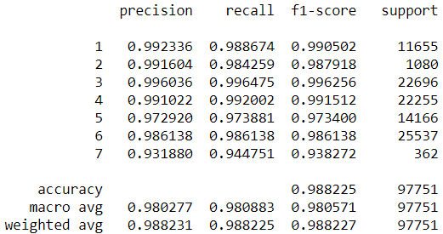
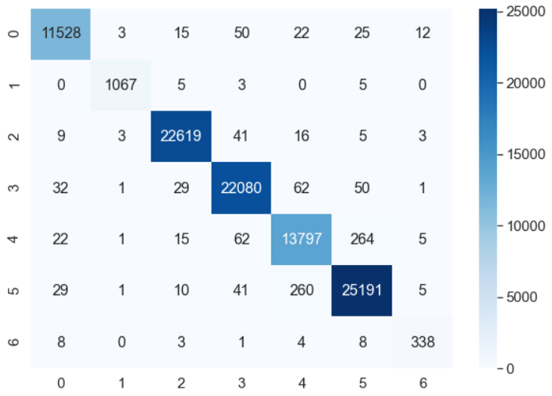
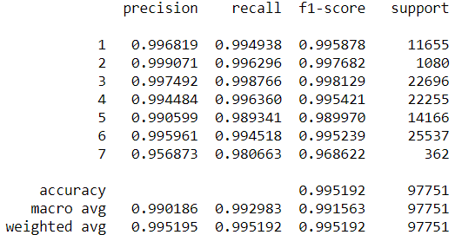
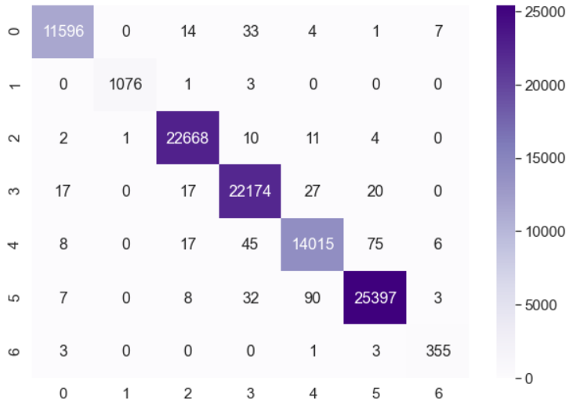
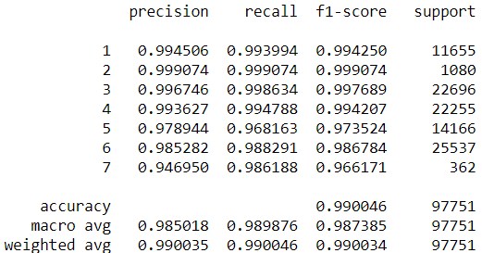
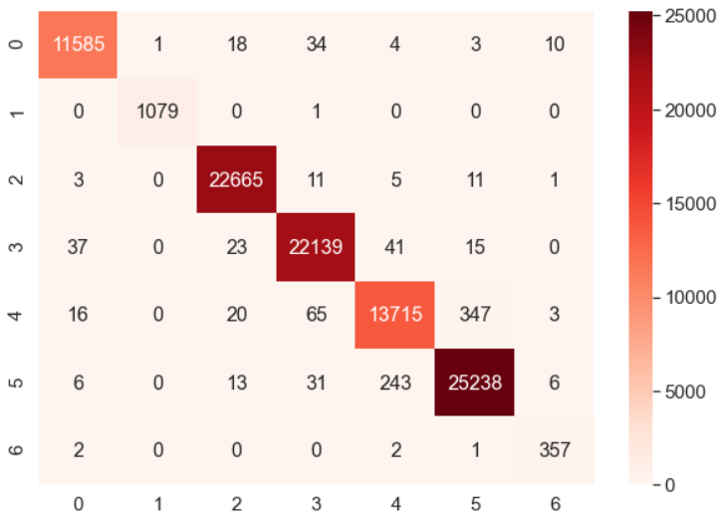
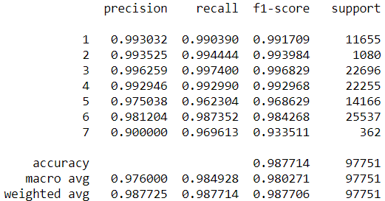
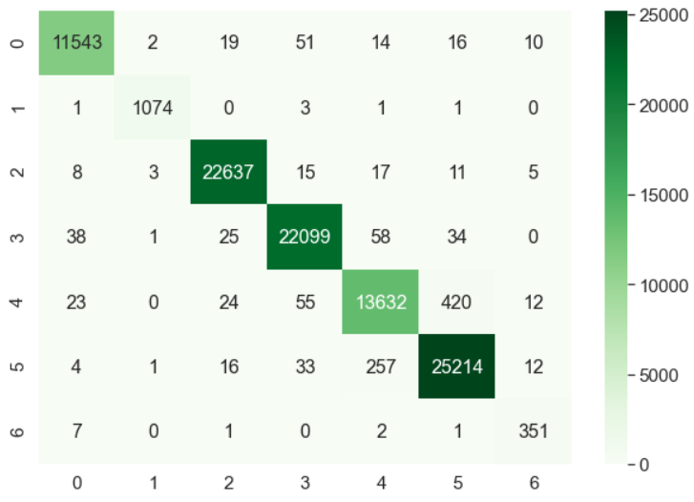
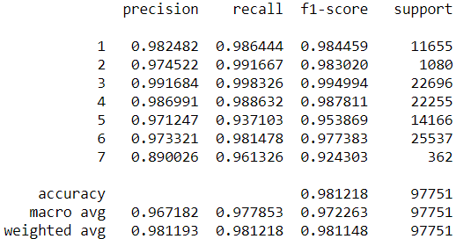
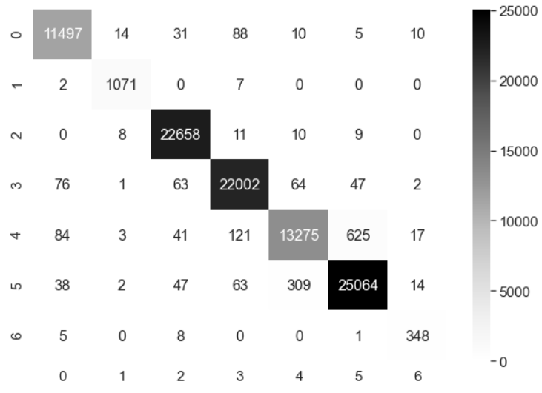
Comparison of Classification Report Metrics & Time Complexity for Multiclass Classification Models Aditya Bhandari, Andrew Assile, Eman Abdelfattah Ramapo College of New Jersey, Mahwah, NJ, 07430
The fused dataset of Bi-temporal optical & UAVSAR radar readings is crucial for classifying crop types over an agricultural region. These factors are used to obtain crop maps with great accuracy. Our research analyzes the time complexity, accuracy and other metric results for various multiclass classification models. The models below are Random Forest Classifier, Support Vector Machines, Logistic Regression & Stochastic Gradient Descent. Each conducted on data with temporal & radar readings. The models are developed in Python3. Classification report metrics are analyzed in the research for each model. Metrics such as F-1 score, precision, recall, and support count are obtained from the report to determine the strengths and weaknesses of the model. The results show that random forest regression the most accurate, and is a quick model for our dataset.
Analysis
Abstract
Dataset Description
Analyzing the classification report, the macro precision score for Random Forest was 0.990 and the weighted Avg was 0.995 which was the greatest among other models. The RF model also had the beset F-1 scores with 0.992 for macro avg and 0.995 for weighted average for the metric. Among the crop types, Soybean is the best performing for all the models. Logistic regression was the worst performing among the models according to the classification report with the least scores in all the classification metrics, 0.97 macro avg precision and 0.98 weighted avg precision with avg F-1 was 0.98. It was also the slowest model to compute
The data set chosen for this research is agricultural crop land data consisting of 2 * 38 optical and 2 * 49 radar features. The data consists of 7 distinct classes for crop types: Canola, Corn, Soybeans, Peas, Oats, Wheat & Broadleaf. As the data contained a voluminous amount of negative values, we scaled the data in order to compute the classification models. The Min-Max Scaling Algorithm was utilized to transform the dataset. It was chosen over Z-Score normalization to prevent the possibility of negative values occurring. The dataset has 175 attributes and 325,834 instances.
Experimental Results
Conclusion:
The classification models are ranked based on five categories: Computation Time, Accuracy, Precision, Recall, and F1-Score. They are awarded points based on their rankings in each category, and are ranked from lowest to highest. Due to a lack of a classification report, the Linear Regression model cannot be ranked in this way. Of the other five models Stochastic Gradient Descent is lowest performing model, followed by the Logistic Regression model as the second lowest performing model. The Decision Tree model is ranked third, and the second best performing model is the Support Vector Machine model. The top performing model for this dataset is the Random Forest Model. We conclude that the model best suited for classifying crop types based on this type of data is the Random Forest Classification algorithm.
Figure 1.1 & 1.2: Classification Report & Confusion Matrix for Decision Tree Classifier
Figure 4.1 & 4.2: Classification Report & Confusion Matrix for Random Forest Classifier
Figure 5.1 & 5.2: Classification Report & Confusion Matrix for Support Vector Machine
References:
Figure 2.1 & 2.2: Classification Report & Confusion Matrix for Logistic Regression
[IAS]Iman Khosravi, Abdolreza Safari & Saeid Homayouni (2018) MSMD: maximum separability and minimum dependency feature selection for cropland classification from optical and radar data, International Journal of Remote Sensing, 39:8, 2159-2176
[I S] Iman Khosravi & Seyed Kazem Alavipanah (2019) A random forest-based framework for crop mapping using temporal, spectral, textural and polarimetric observations, International Journal of Remote Sensing, 40:18, 7221-7251
[I N S H] Khosravi, Iman & Niazmardi, Saeid & Safari, Abdolreza & Homayouni, Saeid. (2018). Comparison of SVM and RF Algorithms for Crop Mapping Using Bi-Temporal Optical and Radar Data with Limited Training Samples. 10.13140/RG.2.2.35996.13442.
[R]Rei Sonobe, Hiroshi Tani, Xiufeng Wang, Nobuyuki Kobayashi & Hideki Shimamura (2014) Random forest classification of crop type using multi-temporal TerraSAR-X dual-polarimetric data, Remote Sensing Letters, 5:2, 157-164, DOI: 10.1080/2150704X.2014.889863
[B]B. Deschamps, H. McNairn, J. Shang & X. Jiao (2012) Towards operational radar-only crop type classification: comparison of a traditional decision tree with a random forest classifier, Canadian Journal of Remote Sensing, 38:1, 60-68, DOI: 10.5589/m12-012
Figure 3.1 & 3.2: Classification Report & Confusion Matrix for Stochastic Gradient Descent
Figure 6: Time To create each model
Figure 7: Accuracy of each model

