Slide 1
PANDITA AI
AI use cases for telecom
operations and growth
Fifteen ways to improve service, efficiency and revenue, backed by a live Fibre and NOC Assurance platform.
Customer value
and revenue growth
Stronger retention, faster B2B proposals and new paid services.
Revenue from
existing assets
Faster data-centre activation and higher sales from spare fibre and capacity.
Network reliability
and delivery
Pre-cut warning, street-accurate fault pinpointing and shorter outages.

Slide 2
USE CASE PORTFOLIO
Fifteen opportunities across three business priorities
Customer value
and B2B growth
01 Spam and fraud protection
Lower losses and paid protection
02 Voice analytics
Better service and sales follow-up
03 Next-best offer and retention
Better offers and lower churn
04 AI on business plans
New subscription revenue
11–13 B2B upsell, proposals and sentiment
Verified RFP route bids and account health
Revenue from
existing assets
05 Unused capacity
Sell spare dark fibre, wavelengths, voice and SMS
06 Data-centre interconnect
Verified diverse paths and faster activation
07 Roaming analytics
Better margins and roaming usage
14 PUE and energy management
Lower data-centre cooling waste
15 AI-compute capacity
More useful compute from GPU clusters
Network reliability
and delivery
08 Fibre-cut assurance
Dig warnings, slack-adjusted GPS and splice checks
09 Incident resolution
Alarm correlation and false-dispatch filtering
10 Optical planning
Zero-shared-duct routes and less overbuild
Live platform demonstration
Use cases 06, 08, 09, 10 and 12 are running live and illustrated in the product views that follow.
PANDITA AI
02

Slide 3
CUSTOMER REVENUE
Customer value and revenue growth
01 Spam and fraud protection
Lower fraud losses and a protection service to sell
Risk alerts and prioritised blocking or investigation actions for suspicious calls and messages.
02 Voice analytics
Better service and more relevant sales follow-up
Recurring issues, sales opportunities and service quality findings from consented call recordings.
Measures: Fraud losses and paid subscriptions
Measures: Call review time and issue resolution
03 Next-best offer and retention
More customers retained at a lower discount cost
Offers and retention actions based on each customer’s usage, service experience and complaints.
04 AI assistants on business plans
New subscription revenue from business customers
Paid assistants for enquiries, appointment booking and service requests, connected to customer tools.
Measures: Retention rate and discount cost
Measures: Paid adoption and revenue per account
PANDITA AI
03

Slide 4
ASSET REVENUE
Revenue from existing assets
05 Unused capacity monetisation
More revenue from dark fibre, wavelengths, ports, voice and SMS capacity
Identifies unlit fibre cores, spare 100G/400G optical channels and off-peak capacity matched to wholesale and enterprise demand, pricing and contract limits.
Data: GIS cable inventory, port occupancy, rates and contracts Measures: Extra revenue, margin and capacity sold
06 Data-centre interconnect
Faster customer activation and earlier billing
Instant diverse-path checks between data centres (confirming zero shared ducts or bridges), glass latency calculation, and pre-staged provisioning workflows.
07 Roaming analytics
Better roaming margins and more customer usage
Margin leakage reports, partner rate comparisons and targeted travel offers for subscribers who do not currently use roaming.
Data: Optical ports, GIS duct routes, latency targets and orders
Measure: Quote turnaround and order-to-activation time
Data: Roaming usage, partner rates and billing
Measure: Roaming margin and active users
PANDITA AI
04

Slide 5
NETWORK OPERATIONS
Network reliability and delivery
08
Fibre-cut assurance
Early warning and street-accurate repair
WHAT YOU GET
Pre-cut digging vibration alerts, binary OTDR trace analysis subtracting coiled manhole slack (avoiding 150–300m dig errors), subsea anchor watch and splice sign-off.
09
Incident resolution
Shorter outages and fewer wasted dispatches
WHAT YOU GET
Groups optical, IP and 5G alarm storms into one root cause, rules out site power loss, microwave rain fade and planned roadworks, and stages human-approved reroutes.
10
Optical planning
Verified route diversity and less overbuild
WHAT YOU GET
Primary and backup optical route designs guaranteed free of shared chambers, ducts or bridges, complete with optical loss budget and glass latency checks on existing plant.
Data: OTDR traces (.sor), GIS ducts and slack, optical SOP and AIS
Measures: Prevented cuts, restoration time and site visits
Data: Multi-vendor alarms, change tickets, GIS and SLA inventory
Measures: Triage minutes, avoided truck rolls and SLA credits saved
Data: GIS ducts and cables, DWDM spans, fibre counts and orders
Measures: Design time (seconds vs. days) and build cost saved
PANDITA AI
05

Slide 6
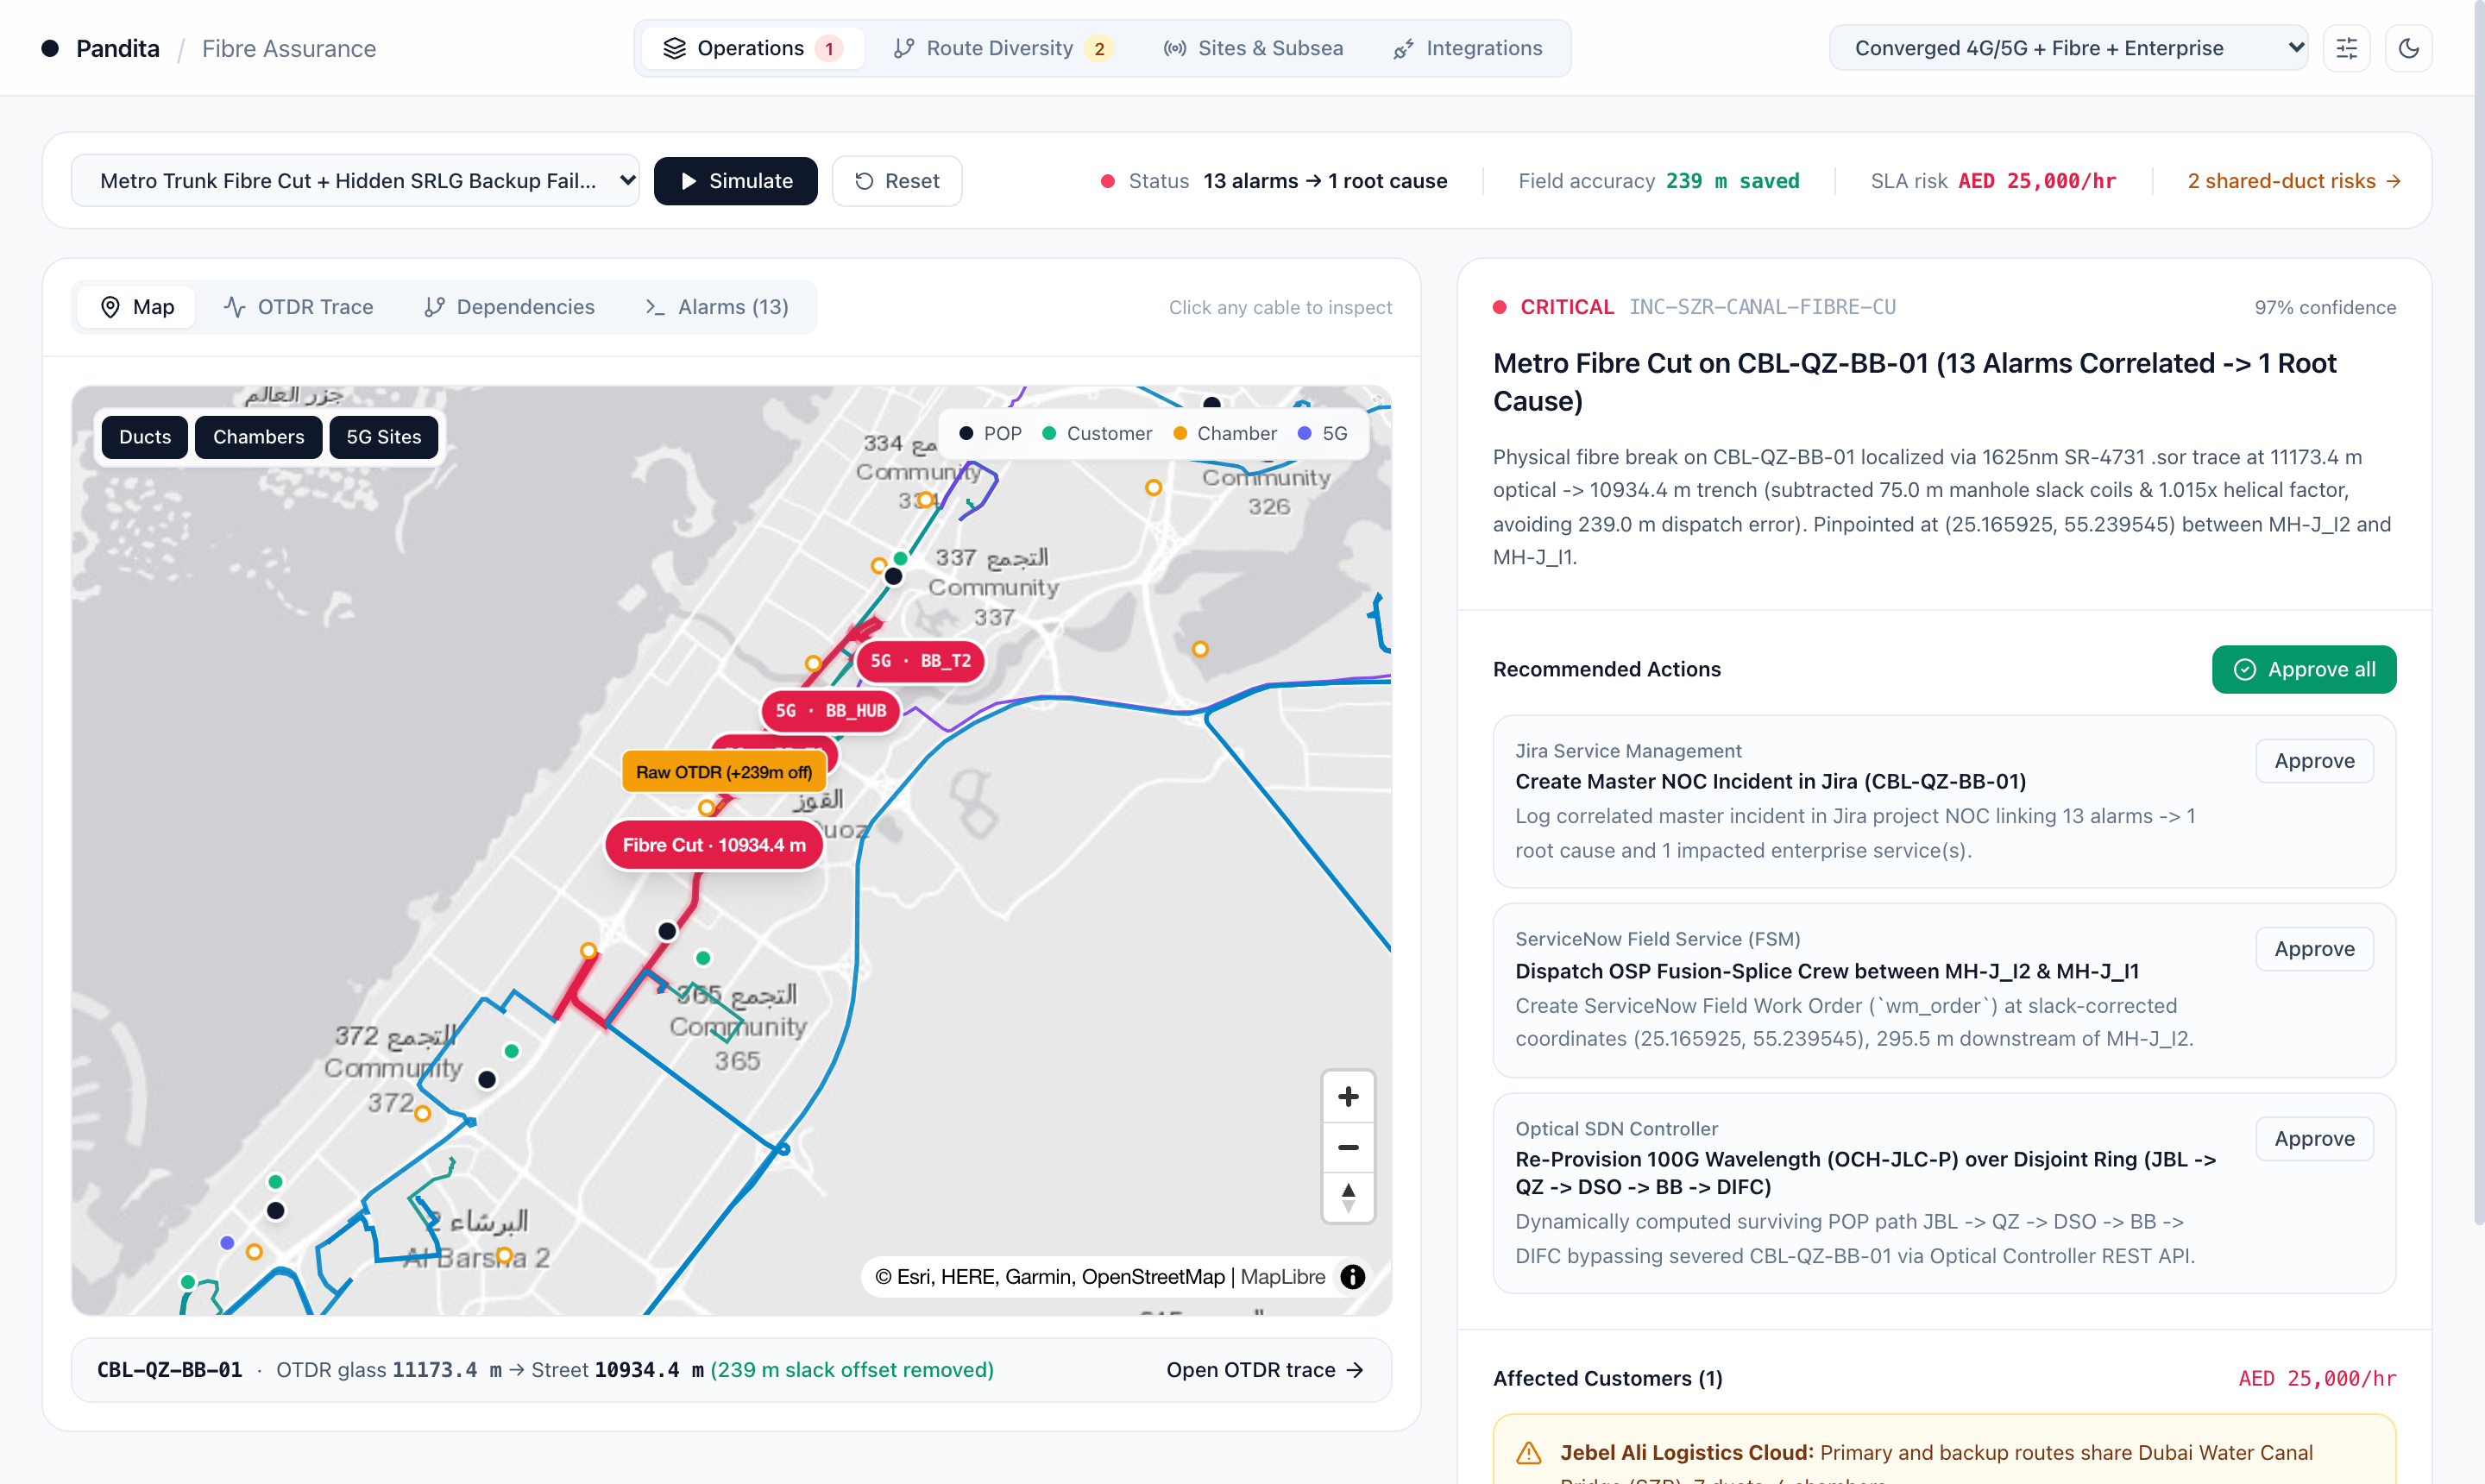
LIVE PLATFORM VIEW · USE CASES 08 & 09
Single-screen fibre-cut pinpointing and human-gated recovery
13 alarms → 1 physical root cause
Collapses optical LOS, IP/BGP drops and 5G cell alarms onto trunk cable CBL-QZ-BB-01 within seconds, ranking AED 25,000/hr SLA exposure first.
239 m dig error avoided on the map
Plots both the raw optical distance and the slack-corrected street trench point between chambers MH-J_I2 and MH-J_I1 so crews dig once.
1-click engineer-approved execution
Stages the Jira master ticket, ServiceNow splice dispatch and 100G disjoint-ring optical reroute behind explicit NOC approval gates.
PANDITA AI
06

Slide 7
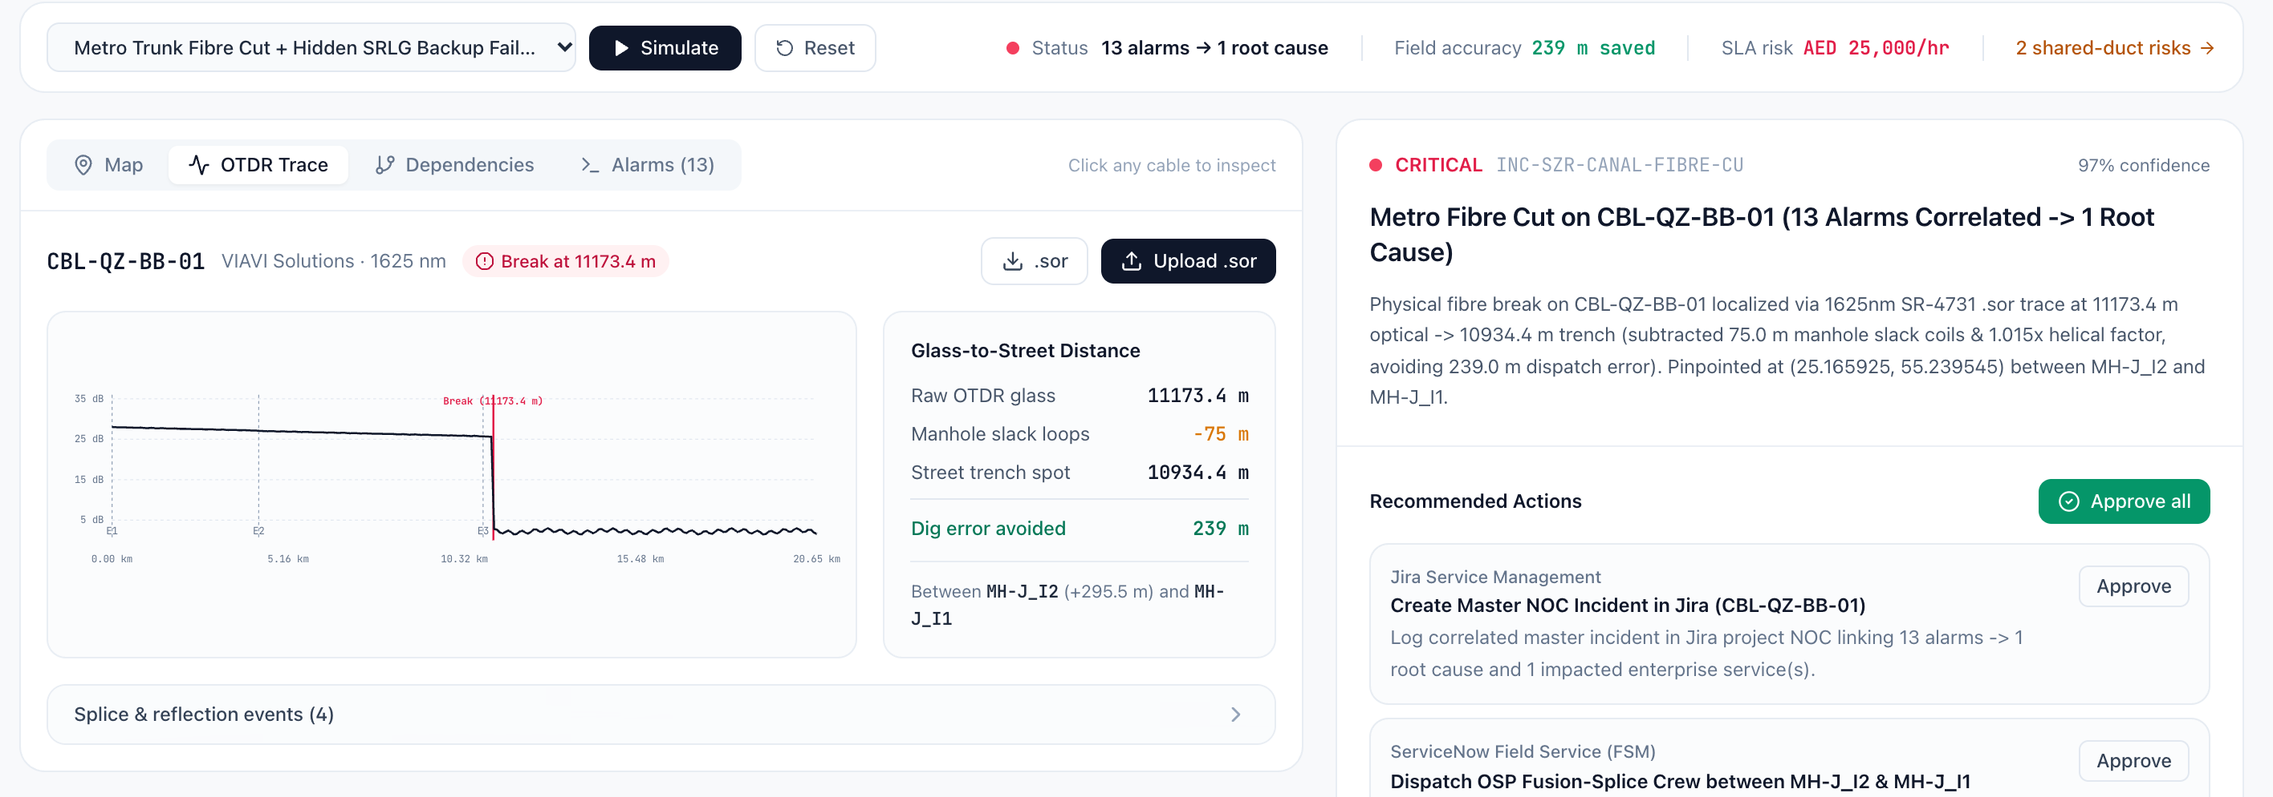
LIVE PLATFORM VIEW · USE CASE 08
Binary OTDR (.sor) trace parsing with manhole-slack subtraction
Native SR-4731 (.sor) parsing
Reads 1625 nm reflectometry waveforms directly from VIAVI and EXFO test heads without waiting for manual PDF exports.
Glass-to-street conversion
Subtracts 75 m of coiled manhole slack and 1.015x cable twist to turn 11,173.4 m of glass into 10,934.4 m on the street.
Remote splice quality sign-off
Verifies post-repair fusion splice loss (<=0.15 dB) before field technicians seal the chamber and close the work order.
PANDITA AI
07

Slide 8
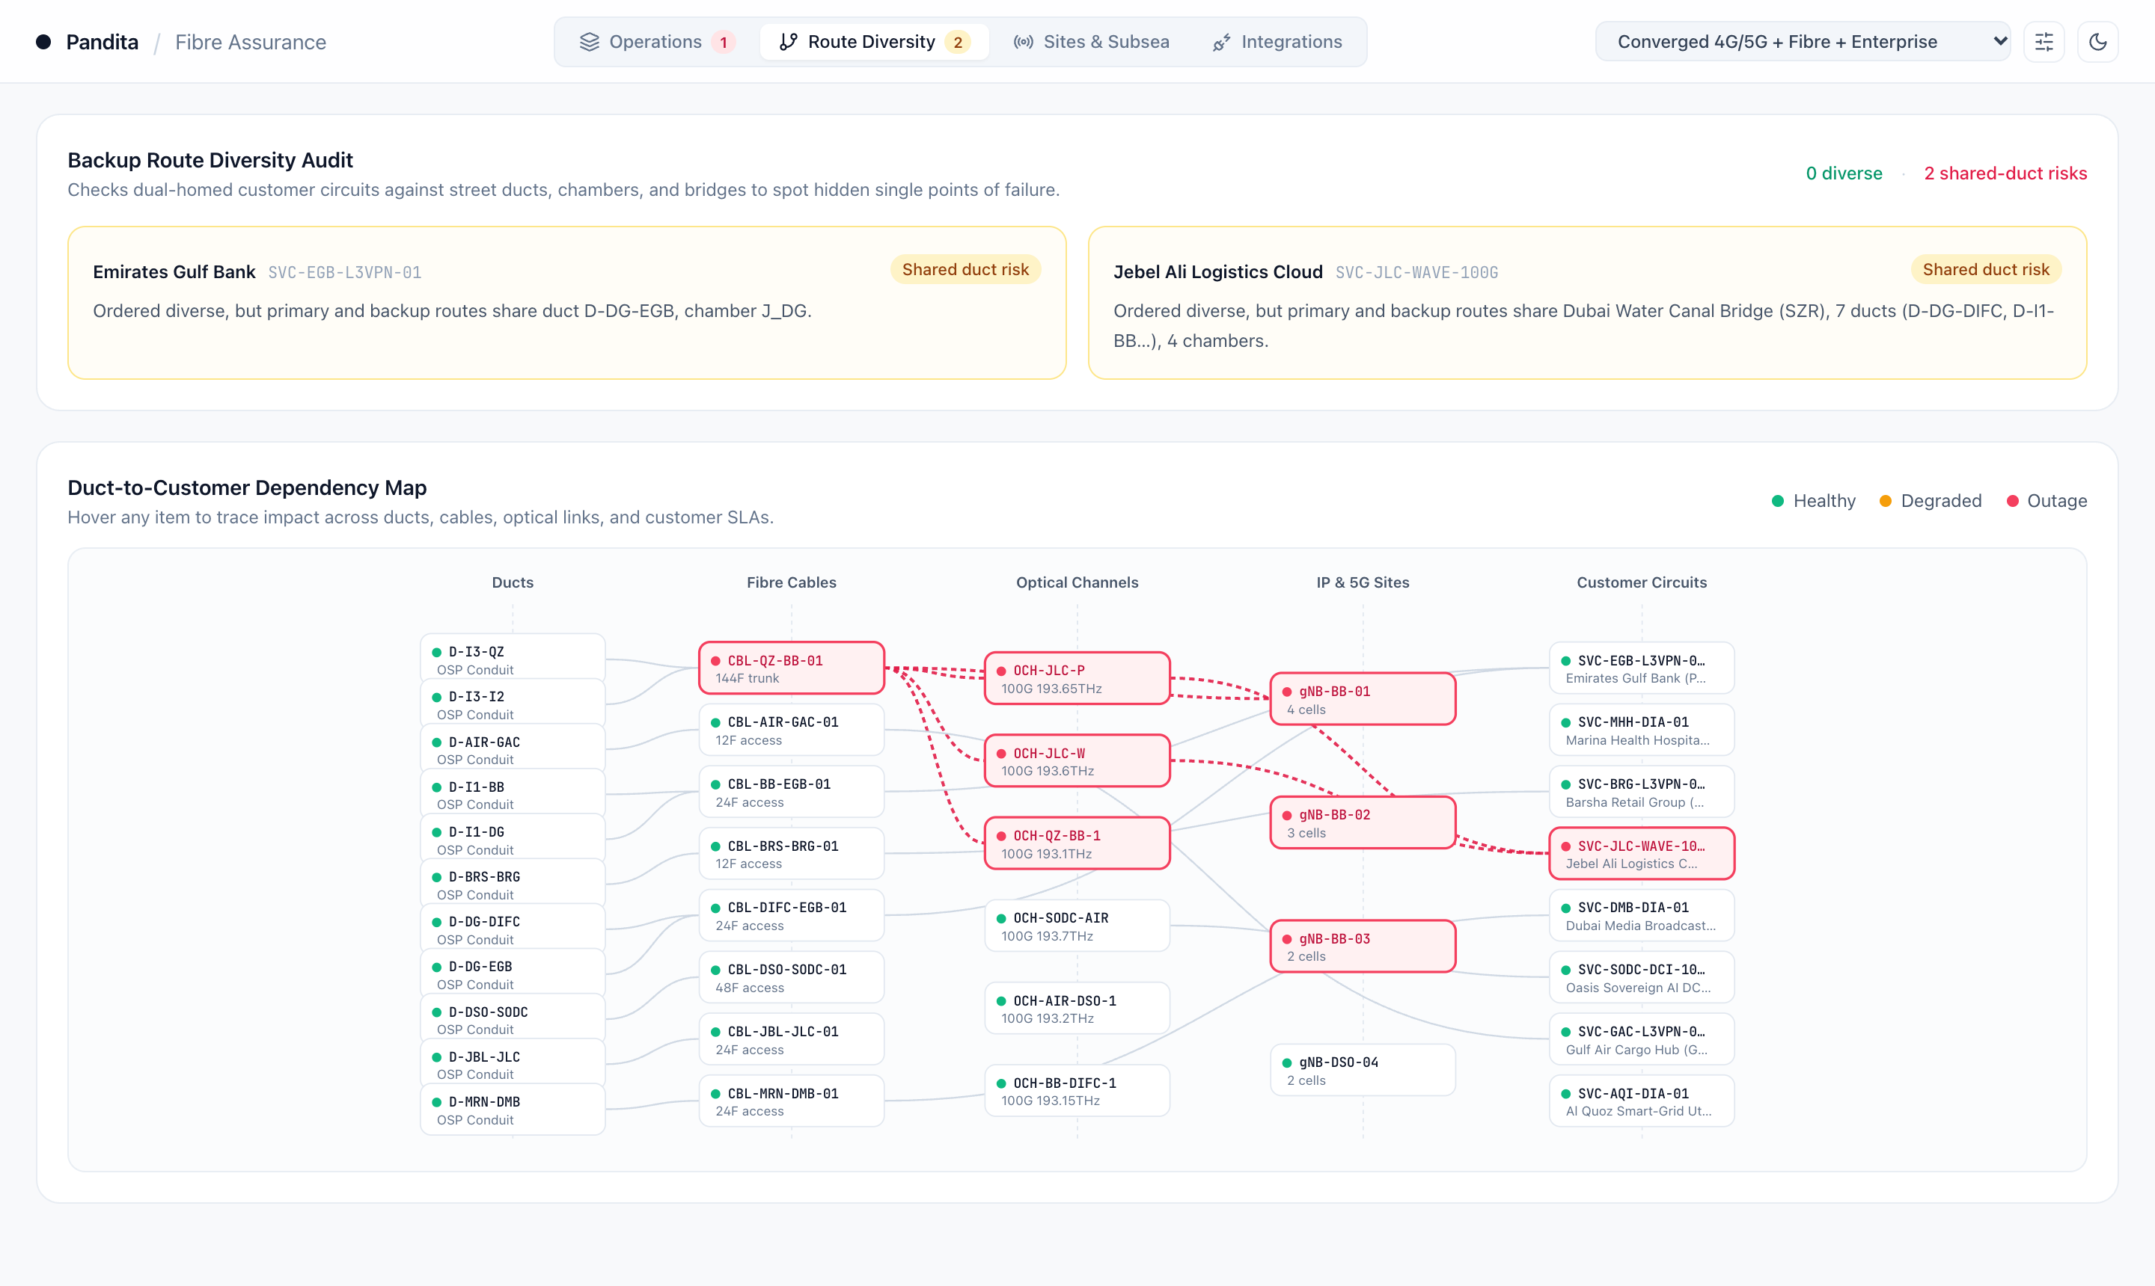
LIVE PLATFORM VIEW · USE CASES 06, 10 & 12
Shared-duct diversity audit and duct-to-customer impact graph
Exposes hidden shared-duct failures
Flags dual-homed circuits whose primary and backup paths quietly cross the same bridge, chamber or street conduit before a cut takes both down.
5-layer duct-to-SLA visibility
Maps every underground conduit through fibre trunks, 100G optical channels and 5G towers directly to affected enterprise circuits.
Seconds vs. days for DCI & RFP bids
Gives pre-sales and optical planners instant proof of diverse paths and glass latency for hyperscale, banking and wholesale quotes.
PANDITA AI
08

Slide 9
PROPOSED B2B USE CASES
AI for Telco B2B Growth & Sales
11
Cross-sell and up-sell
More revenue from existing accounts
PROPOSED APPROACH
Ranks account opportunities from bandwidth usage, contract gaps and single-duct route exposure so B2B teams can pitch concrete resilience upgrades.
12
Solution and proposal quality
Faster proposals with verified routes
PROPOSED APPROACH
Generates GIS-verified diverse route maps and optical latency sheets in seconds for enterprise RFPs, while flagging technical or SLA gaps before sign-off.
13
Customer sentiment
Earlier action on account concerns
PROPOSED APPROACH
Analyses consented calls, trouble tickets and SLA breach history to surface recurring service issues and renewal risks for account-team follow-up.
Data: CRM, usage, contracts, route diversity audits and catalogue
Measures: Offer conversion and revenue per account
Data: RFPs, GIS duct inventory, SLA catalogue and past proposals
Measures: Proposal cycle time and rework
Data: Customer interactions, NOC tickets and surveys
Measures: Issue resolution time and renewal rate
PANDITA AI
09

Slide 10
PROPOSED DATA-CENTRE USE CASES
AI for Data-Centre Efficiency & Capacity
14
PUE and energy management
Lower energy waste within operating limits
PROPOSED APPROACH
Combine facility and IT energy data with cooling telemetry. Detect unusual consumption and recommend cooling adjustments for operator approval.
15
AI-compute capacity optimisation
More useful compute from available capacity
PROPOSED APPROACH
Forecast GPU demand and identify bottlenecks across power, cooling and compute. Recommend workload placement and capacity plans within service targets.
Data: Power meters, cooling telemetry, IT load and weather
Measures: PUE, total kWh and thermal-limit breaches
Baseline comparisons account for IT load and ambient weather.
Data: GPU utilisation, job queues, rack power and cooling limits
Measures: GPU utilisation, queue time and SLA attainment
Placement decisions retain workload isolation and service targets.
PANDITA AI
10

Slide 11
FIBRE & NOC ASSURANCE PLATFORM
Six capabilities ready across metro, national and subsea networks
01 Pre-cut digging warning
Spots mechanical digging vibration along buried ducts and switches traffic to a backup path before the cable snaps.
02 Slack-adjusted street GPS
Subtracts coiled manhole slack from raw OTDR traces for exact dig coordinates, while ruling out site power loss and rain fade.
03 Pre-sales diverse route sheet
Checks two customer sites in seconds to confirm zero shared ducts or bridges, exporting a route and latency sheet for RFPs.
Fit: Metro & Dark Fibre (e.g., Constl)
Fit: Fixed, 5G Backhaul & Metro Carriers
Fit: DCI, Hyperscale & Enterprise Sales
04 Subsea vessel & wet-plant watch
Overlays live ship positions (AIS) onto shallow cable corridors alongside repeater power and C-OTDR telemetry to catch anchor drag.
05 Maintenance & roadwork match
Cross-checks alarms against active change windows and municipal roadwork permits within 500m to flag planned work immediately.
06 Field sign-off & customer RFO
Sends tube and core colour codes to crews, verifies splice loss (<=0.15 dB) before ticket closure, and drafts customer outage reports.
Fit: Subsea & Wholesale (e.g., PCCW Global)
Fit: National Telcos (e.g., e&, du, Vi)
Fit: Field Operations & Enterprise SLAs
PANDITA AI
11

Slide 12
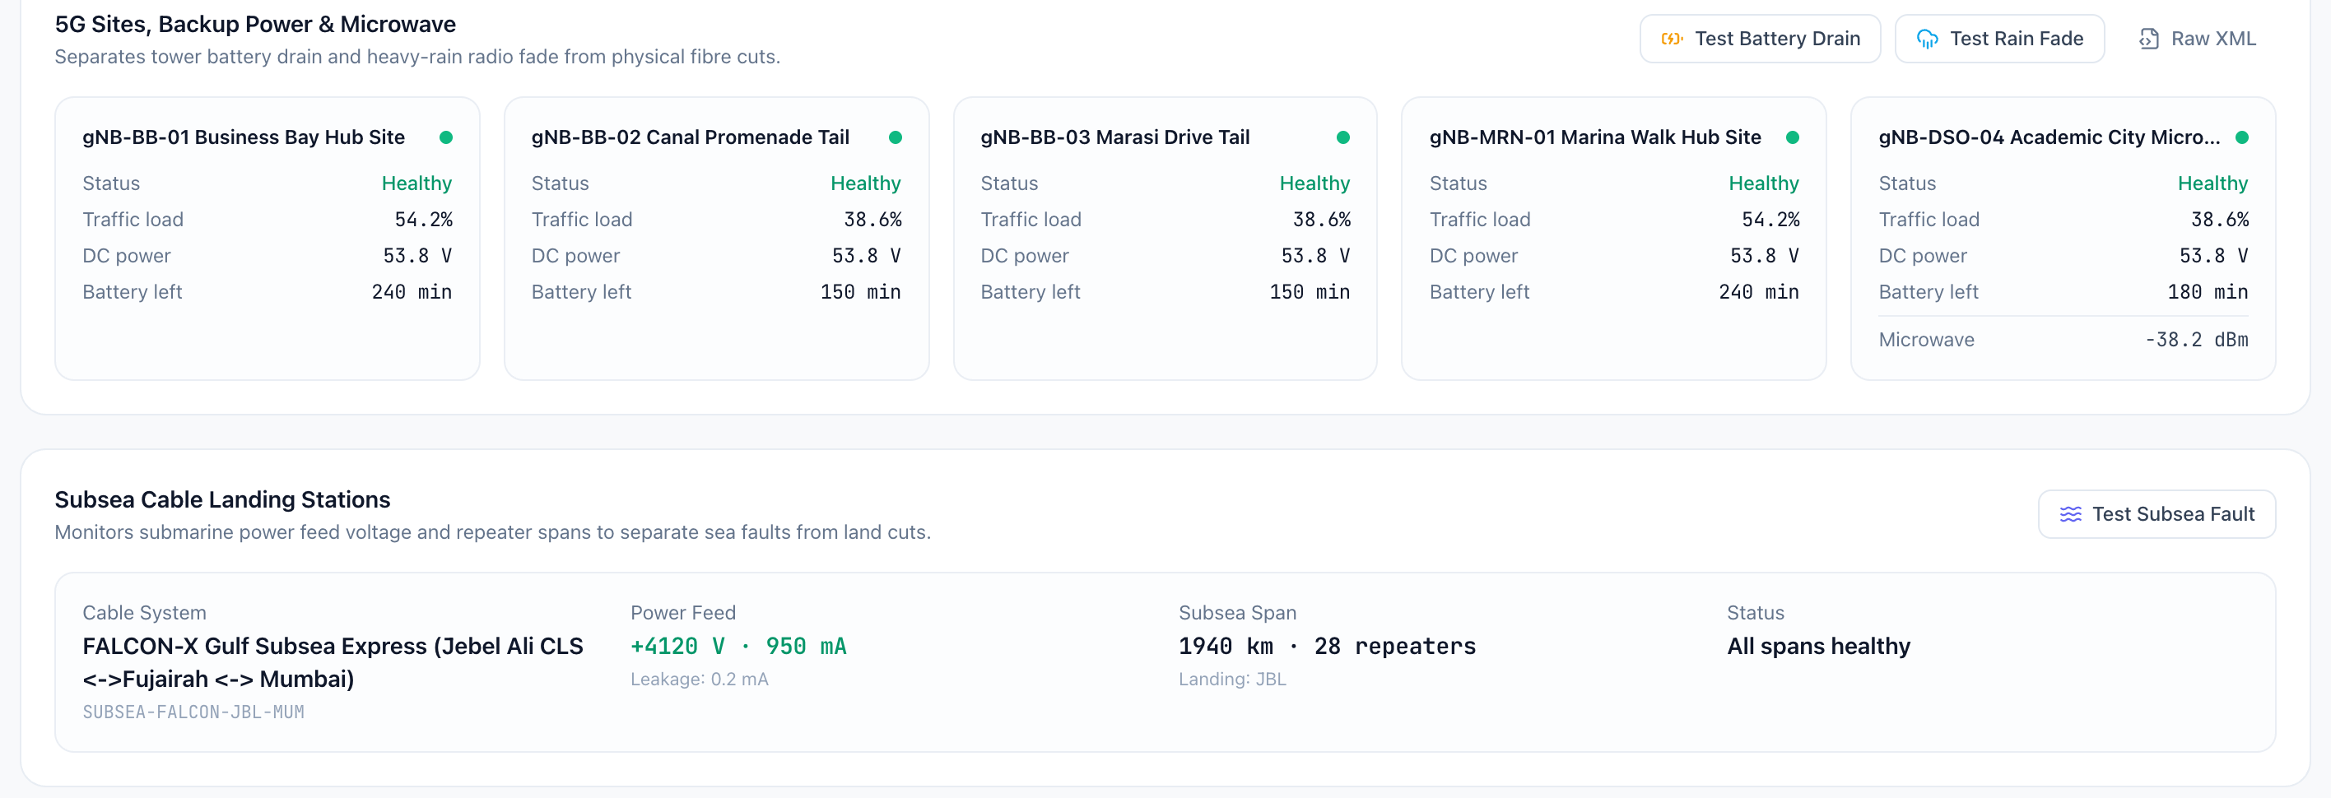
LIVE PLATFORM VIEW · FALSE-DISPATCH FILTER & SUBSEA ASSURANCE
Separating power loss, rain fade and subsea faults from fibre cuts
Tower power & battery check
Reads 5G site DC voltage and battery reserve before rolling a fibre crew, routing commercial power blackouts to facilities instead.
Microwave rain-fade filter
Distinguishes heavy-rain E-band attenuation (-38.2 dBm) on tail sites from physical backhaul breaks to stop wasted dispatches.
Subsea landing & wet-plant watch
Tracks +4120 V power-feed telemetry and 28 repeater spans from the landing station to separate wet-plant faults from terrestrial cuts.
PANDITA AI
12

Slide 13
AI MODELS & INTELLIGENCE LAYER
Grounded language models, vector RAG and signal analytics
01 Grounded LLMs for NOC & RFO synthesis
Anthropic Claude Sonnet 4, OpenAI GPT-4o, or on-prem Llama 3.3 / Qwen 2.5 (vLLM)
Drafts cited NOC incident briefs, step-by-step repair procedures, multilingual customer RFOs (EN/AR) and RFP answers strictly from verified JSON telemetry, with an offline fallback.
02 Vector embeddings & Runbook RAG
PostgreSQL pgvector + OpenAI text-embedding-3, local BGE, or 64-D telecom embeddings
Embeds live multi-vendor alarm symptoms and retrieves the closest approved carrier Methods of Procedure (MOPs) and historical resolved incident tickets via cosine similarity.
Guardrail: Zero free-form generation of GPS coordinates, circuit IDs or SLA figures
Corpus: Operator SOPs, vendor alarm dictionaries and historical MTTR post-mortems
03 Causal graph & fault-signature classifiers
NetworkX 6-layer dependency clustering + probabilistic root-cause scoring
Partitions 10,000-alarm bursts across ducts, DWDM, IP and 5G into independent fault clusters and scores competing hypotheses (97% fibre break vs. power loss, battery drain or rain fade).
04 Optical & vibration anomaly detection
NumPy signal & slope analytics over .sor waveforms, Pre-FEC BER and SOP streams
Detects mechanical digging vibration (polarization transients in rad/s), non-reflective splice pinches and Pre-FEC BER cliff slopes 15–40 minutes before complete span failure.
Outcome: Sub-second storm collapse and automated false-dispatch suppression
Outcome: Proactive hitless wavelength switchover before customers see packet loss
PANDITA AI
13

Slide 14
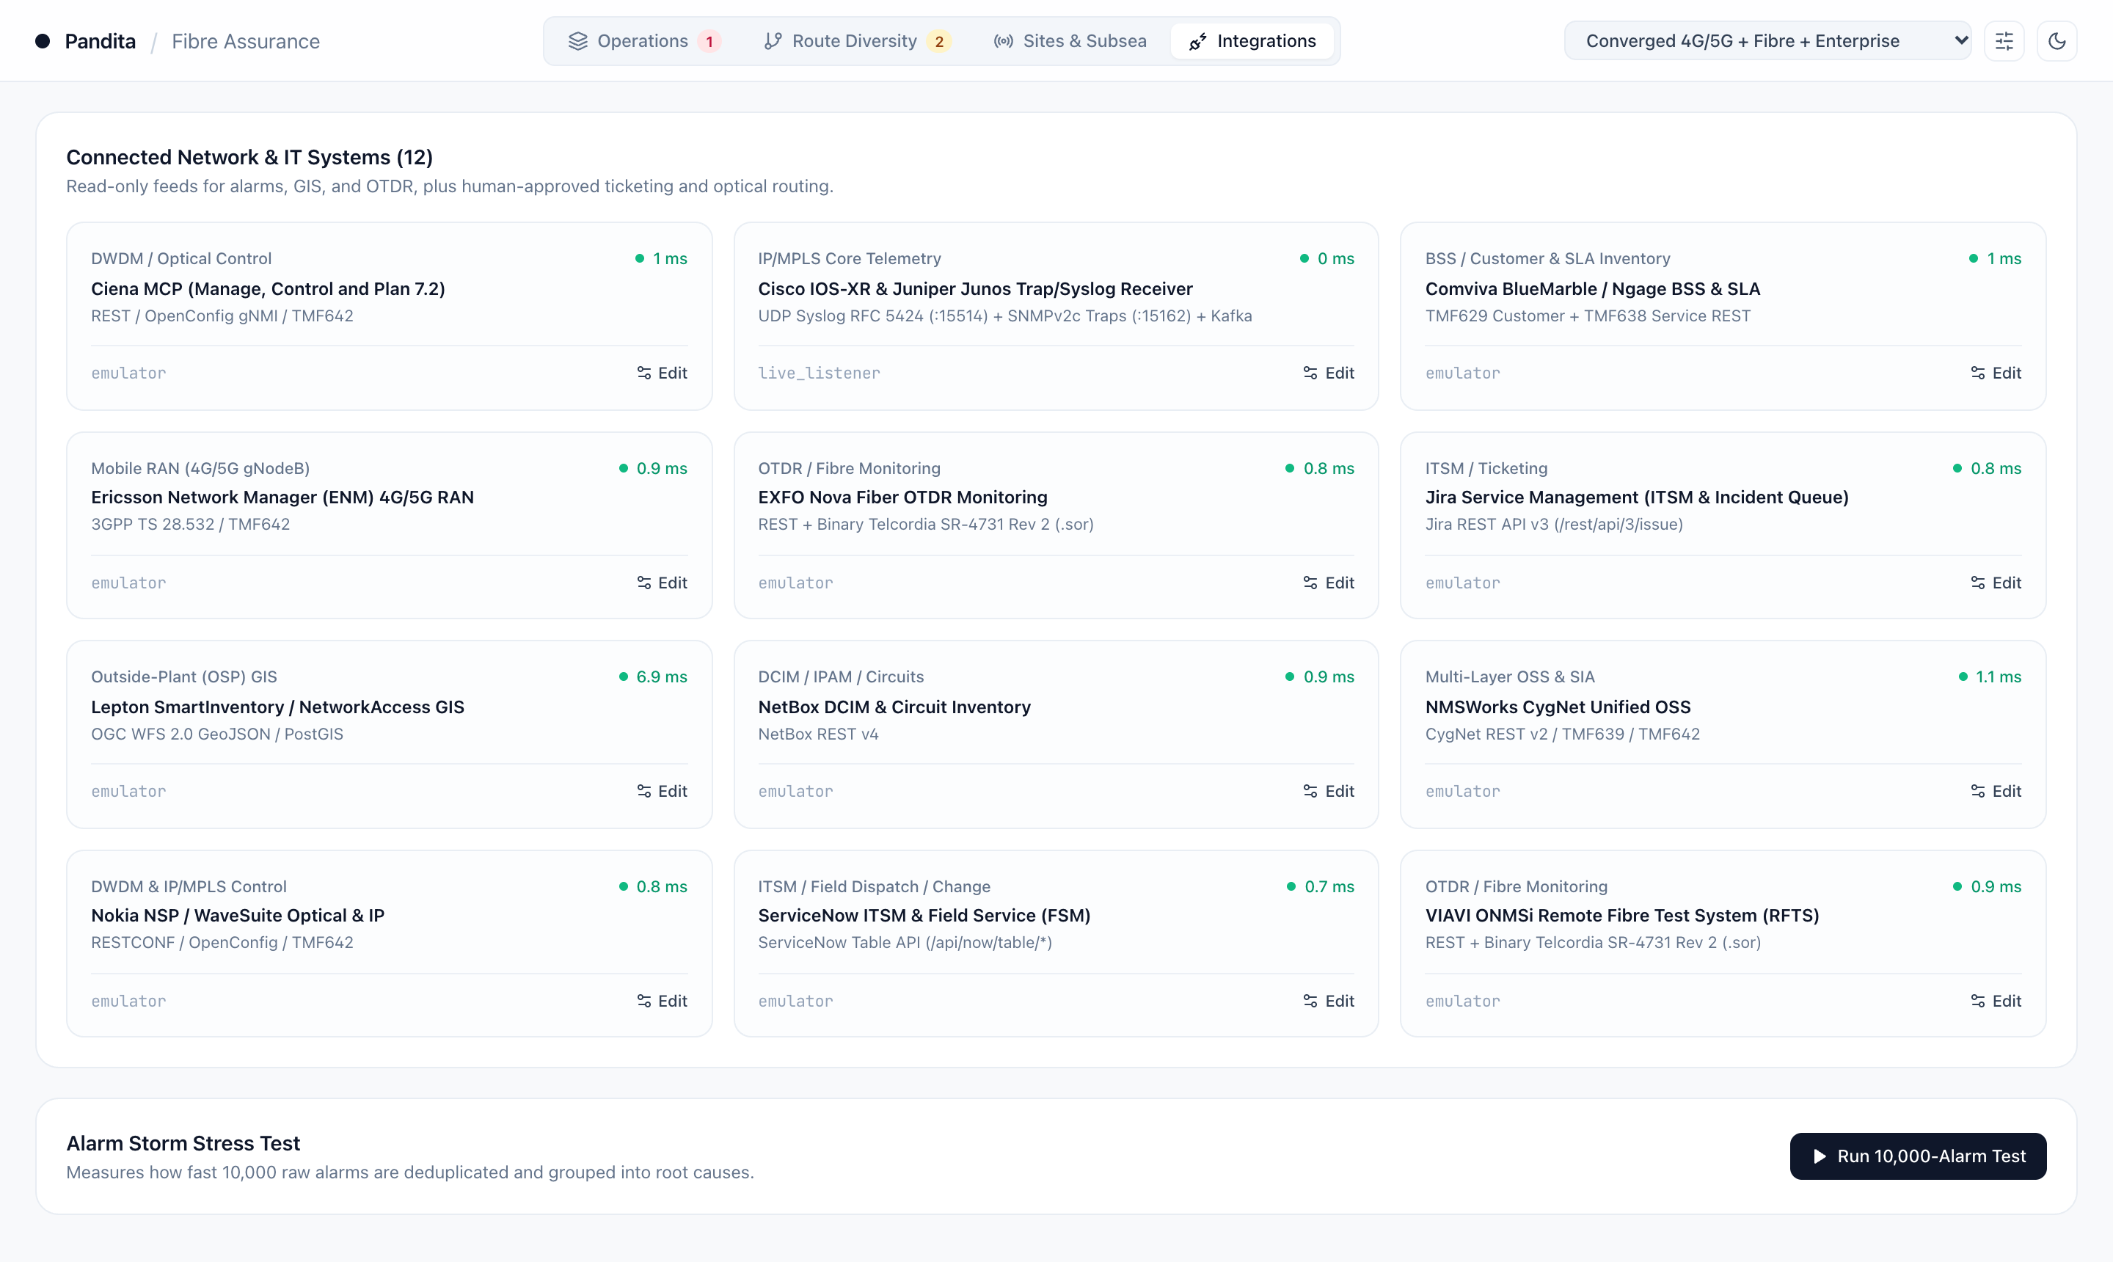
PLATFORM ENGINEERING & LIVE INTEGRATIONS
Deterministic core connected across twelve carrier systems
Spatial & optical physics engine
Built on Python 3.11, FastAPI, PostgreSQL 16 + PostGIS, Redpanda/Kafka and a binary Telcordia SR-4731 (.sor) codec so distances, slack offsets and disjoint routes are exact.
12 standards-native connectors
Plugs into Ciena, Nokia, VIAVI, EXFO, Ericsson, Cisco/Juniper, Lepton GIS, NetBox, ServiceNow and Jira via RESTCONF, gNMI, TMF642, WFS and Syslog/SNMP.
Cloud or air-gapped sovereign deploy
Runs in Docker or Kubernetes with zero subscriber PII, read-only southbound ingestion, human approval gates, and local LLM/embedding support for air-gapped NOCs.
PANDITA AI
14

Slide 15
DELIVERY
Delivery approach for a four-week corridor pilot
Scope and design
Week 1
Select one priority metro ring or inter-city corridor, agree clear success measures (triage speed, dispatch accuracy, quote turnaround), and connect read-only GIS and alarm feeds.
Build and integrate
Weeks 2–3
Connect optical management, OTDR test feeds and ticketing workflows in shadow mode alongside your NOC, validating fault pinpointing and false-dispatch filtering on live events.
Deploy and support
Week 4 onwards
Move into production with NOC team training, engineer-approved action gates, and a joint results review measuring avoided site visits, faster restoration and protected SLAs.
Your teams keep control of network changes and customer actions.
Pandita POD works with your NOC, outside-plant, IT and commercial teams through delivery.
PANDITA AI
15

Slide 16
PROPOSED STARTING SCOPE
We can start with your
top three priority use cases
The first three can come from any priority, or start with a live bundle tailored to your network.
Metro Fibre & DCI
e.g., Constl
06 Data-centre interconnect, 08 Fibre-cut assurance and 10 Optical diverse-route planning.
Converged National
e.g., e&, du, Vi
08 Fibre-cut assurance, 09 Multi-layer incident resolution and 10 Optical diversity audit.
Subsea & Wholesale
e.g., PCCW Global
06 400G DCI activation, 08 Coastal vessel & fibre watch and 12 Verified RFP route sheets.
PANDITA AI

