Slide 1
Mapping & Analyzing Participation
in Tutor/Mentor Leadership and Networking Conferences
Brian Hanley · Matthew Guschwan · Timothy Kelley · Patrick Green
Indiana University | Luddy School of Informatics, Computing, and Engineering
Client:
Daniel F. Bassill | Tutor/Mentor Institute, LLC
Course:
E483/E583 Information Visualization | Spring 2026
Submission:
Presentation of Project Plans — March 22, 2026

Slide 2
Stakeholders & Their Needs
Who uses this tool, and what do they need from it?
Daniel F. Bassill / T/MC
Nonprofits & Organizations
Conference Participants
Researchers & Civic Advocates
• Track who attends and their role in mentorship
• Communicate network history to funders & partners
• Color-coded, searchable Kumu.io map with org hyperlinks
• Understand which sectors engage in the network
• Identify peer organizations to contact
• Learn from & replicate Bassill's methodology
• See their own place in the network
• Discover who else attended the same events
• Explore connections within their sector
• Clean, documented, reproducible dataset
• Consistent labels for structural SNA analysis
• Open-source pipeline for future research teams
Mapping & Analyzing Participation | IU Luddy | Spring 2026

Slide 3
Research Questions
1
Network Navigability
2
Temporal Progression
How can the network be organized to be useful to someone who does not know any specific participants — what sectoral or structural entry points make it navigable?
Can we show how the network formed and expanded between 1994 and 2015 — revealing which sectors grew, which stayed consistent, and where gaps appeared?
3
Supernodes & Bridge Actors
4
Geographic & Outreach Gaps
Are there highly active or influential organizations beyond Bassill himself? How do they function as connectors between sectors and as bridges to under-represented groups?
Are there geographic or organizational gaps in participation that could inform targeted outreach to Chicago high-poverty neighborhoods?
Mapping & Analyzing Participation | IU Luddy | Spring 2026

Slide 4
Dataset Statistics
Source: TeamK-cleaned CSV (updated Feb 11, 2026) — 42 conferences, May 1994 – Nov 2014
6,410
41
2,163
20 yrs
Attendance Records
Conference Events
Unique Organizations
Data Coverage
SNA Category Distribution (after normalization)
18 fields per record
Geographically concentrated
in Chicago metro area
~70 raw SNA variants
normalized to 11
canonical categories
Significant blank fields
in Title & Org Name
(esp. pre-2000)
Category
Records
% of Total
Program
3,310
51.6%
Resource
612
9.5%
College/Univ
559
8.7%
K-12 School
418
6.5%
Other
572
8.9%
T/MC
239
3.7%
Intermediary
227
3.5%
Faith
148
2.3%
Government
136
2.1%
Business
131
2.0%
Foundation
58
0.9%
Mapping & Analyzing Participation | IU Luddy | Spring 2026

Slide 5
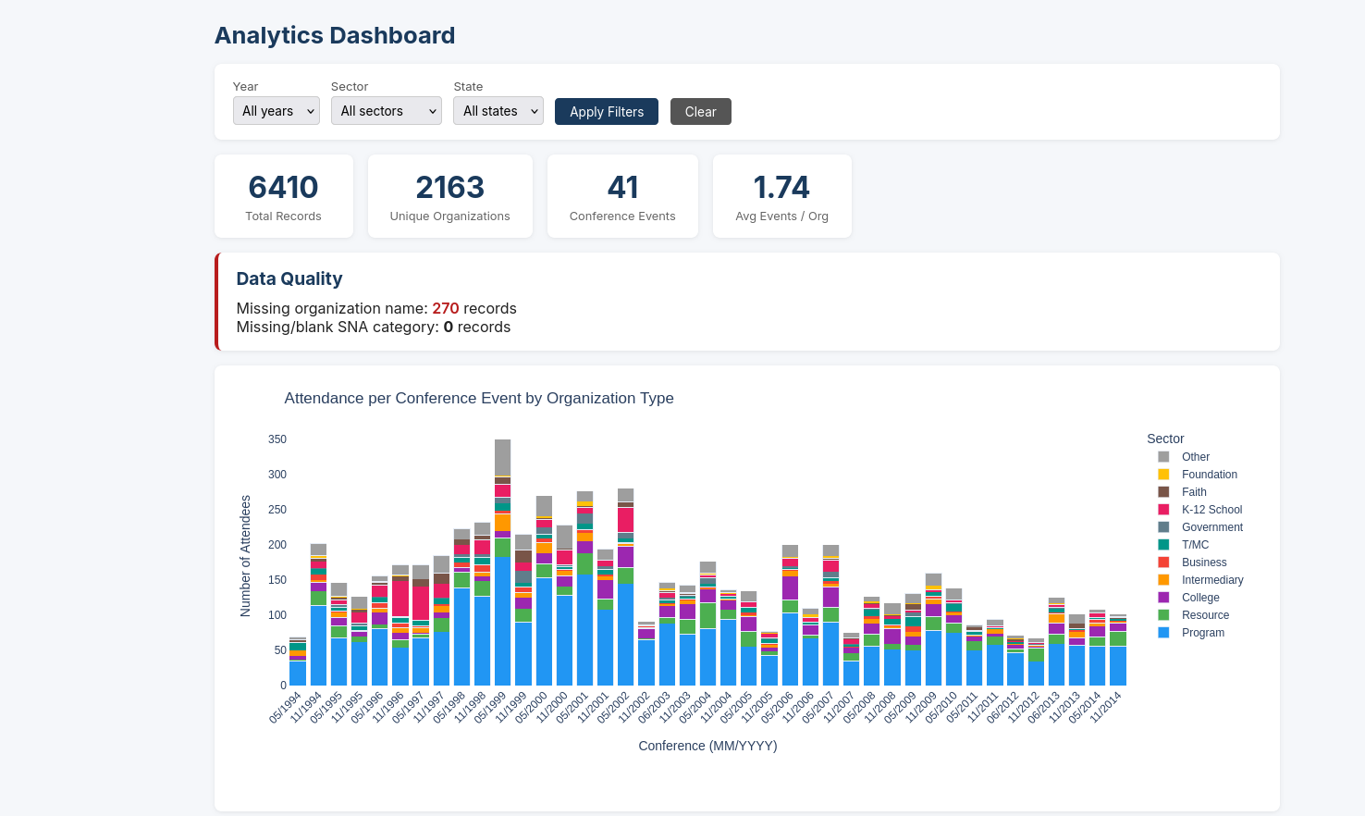
Visualization 1: Participation Frequency Chart
Interactive Plotly stacked bar — attendance per event, segmented by organization type
Key Insights
▸ Built with Plotly — fully interactive (hover, zoom, filter)
▸ Stacked bars show contribution of each sector per event
▸ Filterable by year, sector, and state via dashboard
▸ Reveals peak attendance years (mid-2000s)
▸ Program sector dominant across all 20 years
▸ College & Resource sectors grew steadily over time
▸ Gaps visible in early (pre-1998) and late (post-2012) years
[INSERT SCREENSHOT]
http://127.0.0.1:8000/chart/
Mapping & Analyzing Participation | IU Luddy | Spring 2026

Slide 6
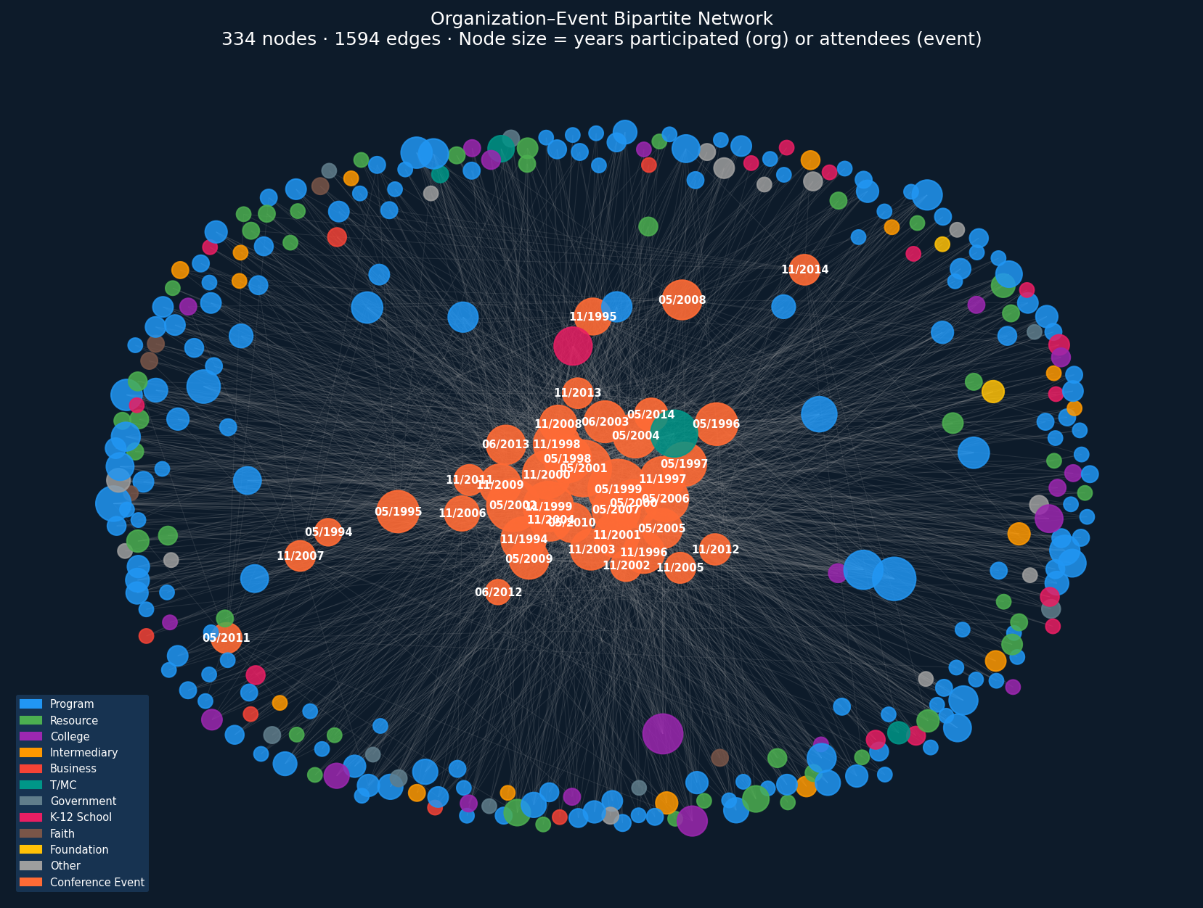
Visualization 2: Network Export for Kumu.io / Gephi
Django pipeline generates Nodes + Edges CSVs on-demand in 4 graph modes
Export Modes
Org ↔ Event
Bipartite: each attendance = one edge
Org ↔ Org
Co-attendance edges, weighted by shared events
Event→Sector→Org
Three-layer cross-sector network
Nodes Only
Organizations with sector, event count, record count
Color-coded by SNA category · Search by participant · Org hyperlinks (planned)
Mapping & Analyzing Participation | IU Luddy | Spring 2026

Slide 7
Key Insights & Next Steps
What we've learned from the initial analysis, and where we go from here
Initial Insights
Next Steps
▸ Program-sector orgs = 52% of all participation — the consistent core of the network
▸ 2,163 unique organizations attended — broad but Chicago-concentrated
▸ Co-attendance edges reveal candidate 'supernodes' that bridge sectors
▸ Peak attendance: mid-2000s; visible drops post-2012
▸ ~70 raw SNA variants successfully normalized to 11 canonical categories
▸ Data quality gaps concentrated in pre-2000 Title & Organization fields
▸ URL enrichment: cross-reference orgs against tutormentorexchange.net directory
▸ Identify & label supernodes in the org↔org co-attendance network
▸ Complete Kumu.io map with color-coding, search, and embedded hyperlinks
▸ Sector-based graph modes (Event→Sector→Org) fully functional
▸ Analytics dashboard: degree distribution, top-entity tables, data quality flags
▸ Meeting with Daniel Bassill to review results and gather feedback
▸ GitHub repository + Docker image published for future teams
Mapping & Analyzing Participation | IU Luddy | Spring 2026

