Slide 1

Mapping & Analyzing Participation
Intermediate Results — Spring 2026
Client: Daniel F. Bassill · Tutor/Mentor Connection (T/MC)
E583 / E483 Information Visualization · Indiana University · April 6, 2026
Matthew Guschwan
Brian Hanley
Timothy Kelley
Patrick Green
Presentations
Platform Lead
Data Cleaner
Data Visualization
Indiana University
Indiana University
Indiana University
Indiana University

Slide 2
2
Stakeholder & Needs
Daniel F. Bassill · Tutor/Mentor Connection (T/MC)
Who is the Stakeholder?
What the Client Needs
Daniel F. Bassill — founder, Tutor/Mentor Connection
Hosted 42 Leadership & Networking Conferences, 1994–2015
Builds coalitions between schools, nonprofits, business, and government to support youth mentoring in Chicago
tutormentorexchange.net
Future Stakeholders:
Conference Planners
Conference Consultants
›
Kumu.io network map updated with full 1994–2015 dataset
›
Organization search — full conference attendance history
›
Color-coded by sector type with filtering capability
›
Website addresses for participating organizations
›
Explanatory section on how to read the Kumu map
›
Links to Tutor/Mentor program lists for cross-reference
What problem are we solving?
›
Documented, reproducible methodology
20+ years of conference attendance data exists but has never been fully analyzed in terms of reproducibility
No system exists to visualize who participated, how often, or across which sectors
The data is the evidence base for Daniel's network-building work
Core question: Who shows up to build a community — and what patterns emerge across 20 years?

Slide 3
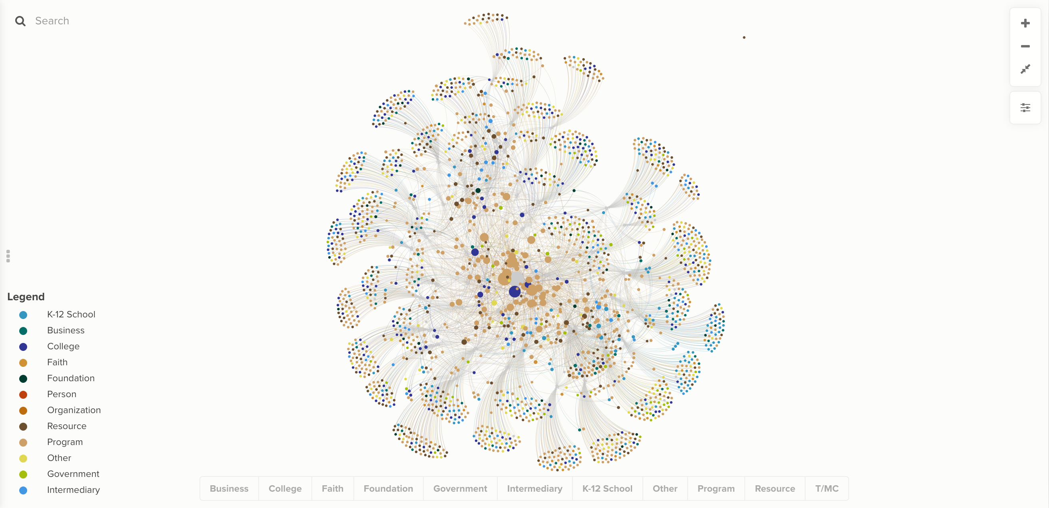
3
Data & Visualization — Kumu.io Colored Network
6,410 records · 42 conferences · 1994–2015 · 11 SNA sectors · 2,179 organizations
6,410
attendance records
42
conference events
21 yrs
1994 – 2015
11
SNA sectors
2,179
unique organizations
~50%
Program sector share
Exports at /export/ feed Kumu.io directly — nodes.csv and edges CSVs update with each data reload.

Slide 4
4
The Pivot — Methodology First
Why we changed direction from the previous iteration
Team K (Previous Iteration — NetworkMap)
Our Approach — Pipeline + Reproducibility
Built a visual tool for Dan to explore connections himself
6 typed relationship categories defined in the UI
Flask + React + MongoDB — interactive, user-driven
Sector taxonomy: 6 buckets, manually assigned
Strength: low barrier to entry for a non-technical user
Gap: no documented pipeline, no reproducible export, analysis lived inside the interface
Methodology at the forefront — every step is documented
SNA normalization: 73 raw variants → 11 canonical sectors in code
Django + SQLite — git clone → make setup → make run
Three graph models (bipartite, co-attendance, 3-layer directed)
CSV exports compatible with Kumu.io, Gephi, and PowerBI
Future classes and solo development can extend the pipeline without reverse-engineering what was built
Why this matters to Dan Bassill:
The Tutor/Mentor Connection's value is its network and its documented approach to building community. A reproducible pipeline mirrors that philosophy — it's not just what the data shows, it's that anyone can verify how we got there and extend it. That's the methodology Dan wants at the forefront.
Deliberate scope: substantial work intentionally left for Summer 2026 solo development and future E583/E483 classes.

Slide 5
5
Why the Data Pipeline Is the Deliverable
What makes this process replicable for any conference dataset
Normalization is Step Zero: the hardest step
Any real conference dataset will have messy category data. Mapping 73 raw SNA variants to 11 canonical sectors in code means the next team inherits a verified, auditable starting point rather than a manual guessing game. This step is what makes cross-conference comparison possible.
The graph models work on any org-event attendance dataset
The bipartite, co-attendance, and three-layer graphs are built from two columns: organization and event. Any organization running attendance-tracked conferences can load their spreadsheet into the same pipeline and get the same structural analysis out the other side.
Exports connect to tools stakeholders already use
nodes.csv and edges CSVs are formatted for Kumu.io, Gephi, and PowerBI directly. The analysis does not live inside the platform, but in files any stakeholder can open, share, or import into whatever tool they already know.
One-command setup is the handoff mechanism
git clone + make setup + make run is how this project passes to the next team. The pipeline is not documented separately from the code; the Makefile and load_data command are the documentation. A new team can be running in minutes, not weeks.
Documented data quality is institutional memory
Knowing 4.2% of records have blank org names, knowing what the 73 raw variants were, means future teams inherit a clear picture of the data's limitations rather than re-discovering them. Every quality decision is in code or in writing.

Slide 6
6
What's Next
Remaining work before April 26 final checkpoint
Platform
Data Cleaning
Writing & Presentation
Kumu.io step-by-step import guide
Surface org website URLs in search results
Final reproducibility audit
Incorporate peer + instructor feedback
Trim whitespace — 323 org entries
Flag/fill 272 blank org records
Website URLs for top 20–30 orgs
Reload pipeline with updated XLSX
Refine Kumu charts after today's feedback
2–3 actionable insights for final report
Final report
Final presentation
Intentionally deferred to Summer 2026 & future classes:
Kumu live API · Interactive D3 network · SNA centrality metrics · Admin data upload · Fuzzy org deduplication · Multi-dataset support
Roadmap is live at /roadmap/ — scope decisions are documented, not hidden.

