Slide 1
Work Progress Report
16 April 2021

Slide 2
Team : Mentor – Mahesh Dhage Manager – Kiran Hegde Onboarding Manager – Ajay Gandhe

Slide 3
Problem Statement:
Objective :
To develop an E2E Web Interface to showcase the ECI Environment details with TC service status and ability to modify the services status.
Technology Stack :
Back-End :
NodeJS, RESTful Services, ExpressJS, JSON.
Front-End :
HTML, CSS, BootStrap, JavaScript.

Slide 4
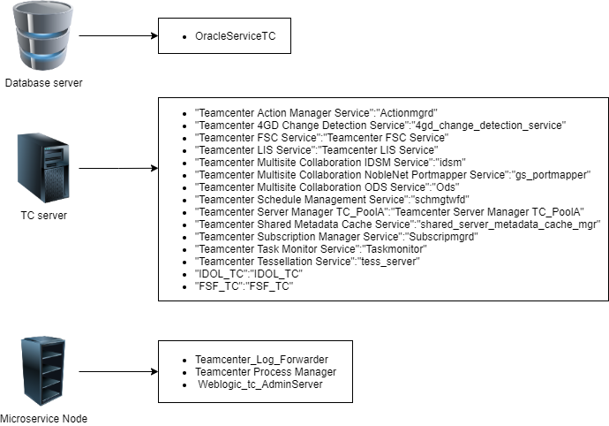
Overview of Backend

Slide 5
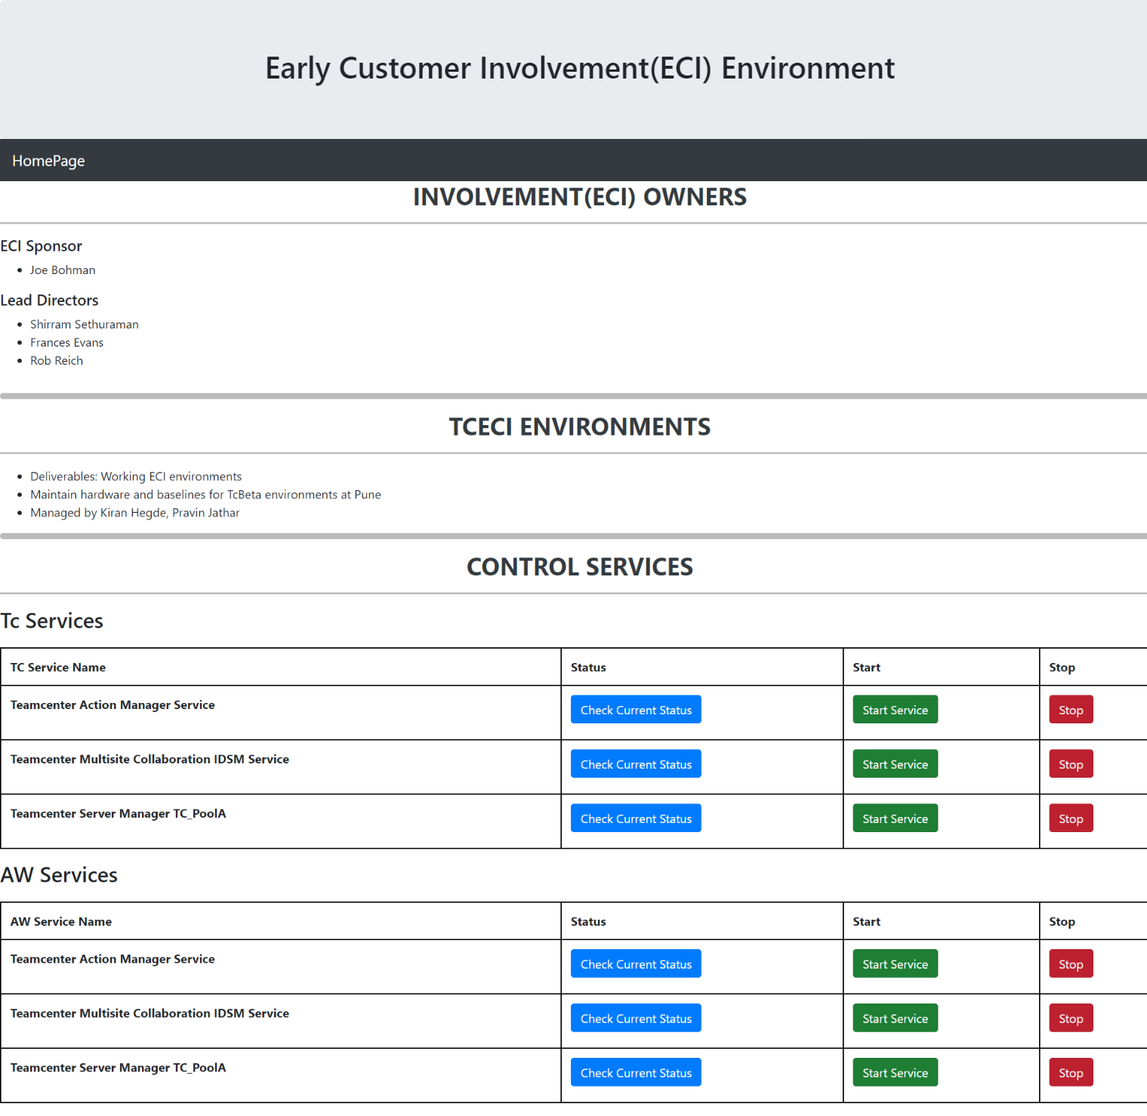
3. Demo => Just a basic UI for Testing purposes. => Design part will be brainstormed upon after completing the back-end part.

Slide 6
Role And Current Status
My part is to design and develop an architecture to make the remote login process smooth and as fast as possible.
Have been brainstorming with Mahesh about different architectures and produced a couple of solutions.
The first one was, to host an API on each VM and retrieve data from it by running scripts on them. But that solution was a bit heavy and non-trivial.
The second one, was to design a RESTful service and then pass the data between the client and the server with a XHR object in the form of JSON.
I’m currently learning how to design a RESTful API, which involves learning NodejS, ExpressJS, and Javascript.

Slide 7
Technical Learning
Powershell/SSH
Remote Login through Command Line
REST API
Python OS module
NodeJS, ExpressJS
SOLID Design Principles

Slide 8
TimeLine => Joined : 24th Feb => First Task : 6th March – 19th March - Complete 3 Coding Assignment following the SOLID Principles. => Second Task: 25th March – Present - Researched more about the problem statement and Learnt Remote Login Concepts, designed a mock UI for the first 2 weeks, and started developing an architecture this week.

Slide 9
Contacts
Published by Siemens DI SW Compensation
John Seiler – john.seiler@siemens.com
Brandi Morgan – brandi.morgan@siemens.com
Francisca Sabbe – fancisca.sabbe@siemens.com
Elizabeth Carter – elizabeth.carter@siemens.com

