Slide 1
Unveiling the Dynamics of the Used Car Market
UMBC Data Science Master Degree Capstone
Dr. CHAOJIE (JAY) WANG
Author: BHANUSRI OLETI (PY13171)

Slide 2

INTRODUCTION
This project aims to offer in-depth insights into the dynamics of the used car market. Through the analysis of factors impacting used car pricing and marketability the project aims to provide a thorough understanding of the complexities within this industry.
By employing data analysis and modeling methodologies, stakeholders within the automotive sector can acquire valuable insights into market trends and mainly pricing tactics. This, in turn, empowers them to make well-informed decisions within the ever-evolving landscape of the used car market.

Slide 3

SIGNIFICANCE
For a variety of stakeholders in the automotive industry, it is essential to comprehend the variables that influence used car pricing and sales. Understanding market trends can help sellers increase the effectiveness of their pricing strategies and boost sales. Researchers and analysts looking into consumer behavior, market trends, and pricing tactics in the automotive sector may also find this dataset useful.

Slide 4
RESEARCH QUESTIONS
What are the main variables affecting the cost of used cars? What impact do factors like powerPS, brand, mileage, and registration year have on the price?
What effect does the type of gearbox have on used car prices and saleability?
What impact does fuel type have on used car prices and marketability?

Slide 5
DATASET OVERVIEW
This dataset provides detailed information on used cars, covering various attributes that can influence their pricing and marketability.
Data Source: Used Cars Dataset
Data Size: 70.96 MB
Data Shape: 233531 rows, 21 columns

Slide 6
DATA DICTIONARY
dateCrawled: Date the car was crawled. (Date)
name: Name of the car. (String)
seller: Type of seller (private or dealer). (String)
offerType: Type of offer (e.g. sale, repair, etc.). (String)
price: Price of the car. (Integer)
abtest: Test type (A or B). (String)
vehicleType: Type of vehicle (e.g. SUV, sedan, etc.). (String)
yearOfRegistration: Year the car was registered. (Integer)
gearbox: Type of gearbox (manual or automatic). (String)
powerPS: Power of the car in PS. (Integer)
model: Model of the car. (String)
kilometer: Kilometers the car has been driven. (Integer)
monthOfRegistration: Month the car was registered. (Integer)
fuelType: Type of fuel (e.g. diesel, petrol, etc.). (String)
brand: Brand of the car. (String)
notRepairedDamage: Whether or not the car has any damage that has not been repaired. (String)
dateCreated: Date the car was created. (Date)
nrOfPictures: Number of pictures of the car. (Integer)
postalCode: Postal code of the car. (Integer)
lastSeen: Date the car was last seen. (Date)
TARGET COLUMN: Price

Slide 7
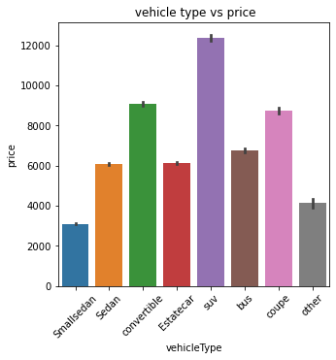
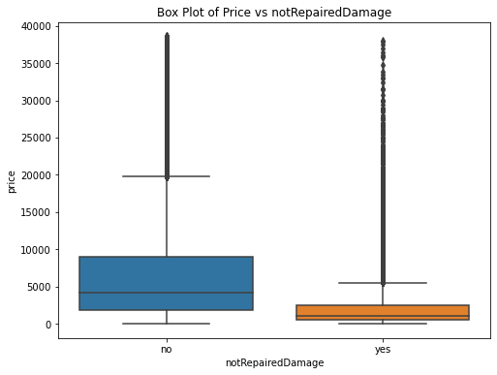
EXPLORATORY DATA ANALYSIS

Slide 8
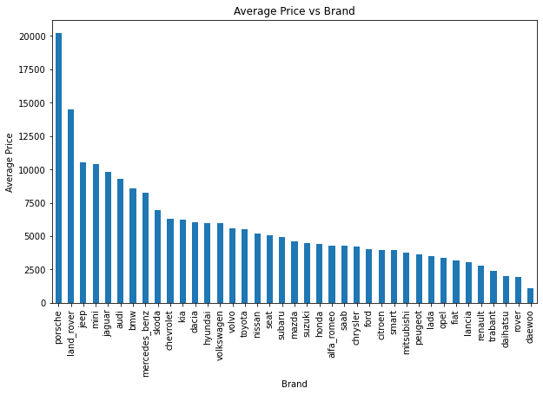
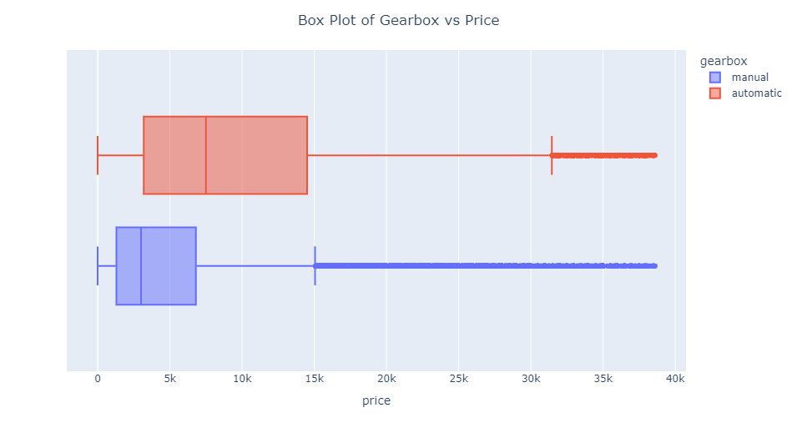

Slide 9
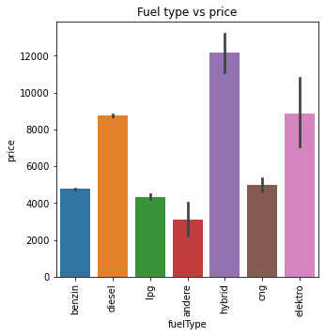
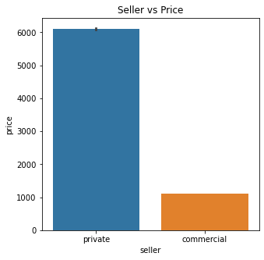

Slide 10
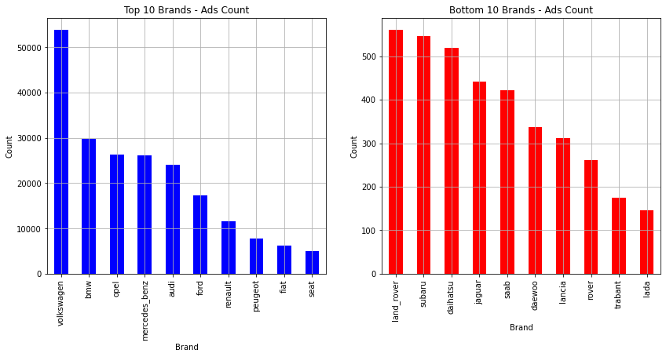

Slide 11
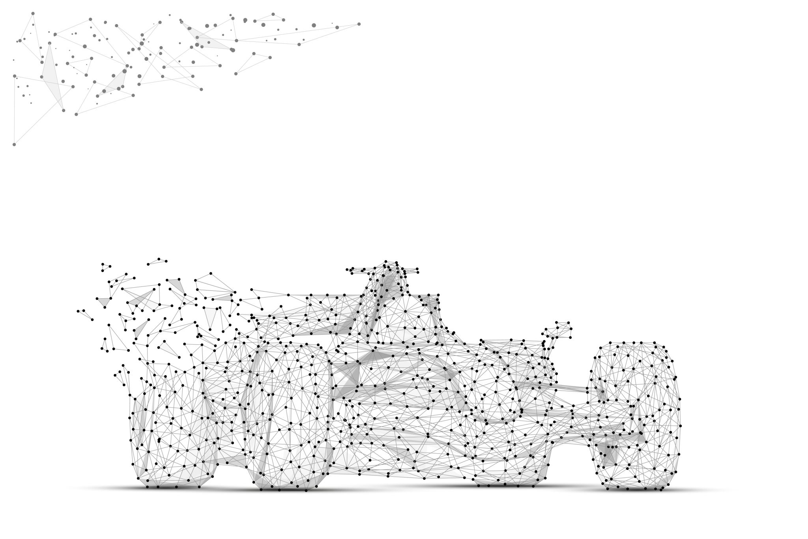
MODEL TRAINING
The primary objective of model training is to develop a predictive algorithm that accurately estimates the price of used cars based on their attributes. Through the utilization of machine learning methods, my aim is to discover patterns within the dataset, enabling the development of a model that can make dependable predictions.
The machine learning algorithms used for this predictions are:
Linear Regression
Random Forest
Gradient Booster

Slide 12
DATA PREPROCESSING
Encoding Categorical Variables: The categorical variables 'brand' and 'fuelType' are encoded using the LabelEncoder from the sklearn.preprocessing module.
Mapping Ordinal Variable: The 'gearbox' variable is mapped to numerical values where 'manual' is mapped to 0 and 'automatic' is mapped to 1. Similarly, the 'fuelType' variable is also mapped where 'benzin', 'diesel', and 'lpg' are mapped to 0, 1, and 2 respectively.
Feature Selection: The selected features for training the model are assigned to the variable X, which includes 'yearOfRegistration', 'powerPS', 'kilometer', 'monthOfRegistration', and the encoded 'brand'.
Target Variable Selection: The target variable 'price' is assigned to the variable y, representing the prices of the used cars.
Printing Preprocessed Data: Finally, the preprocessed feature matrix X and the target variable y are printed to verify the data before training the model.

Slide 13

MODEL BUILDING
Data Splitting: The dataset is split into training and testing sets using the train_test_split function from sklearn.model_selection. The features X and the target variable y are split into X_train, X_test, y_train, and y_test, with a test size of 20% and a specified random state for reproducibility.
Model Training: Machine Learning models are built by using sklearn module and models are trained on the training data (X_train, y_train) using the fit method, which learns the relationships between the features and the target variable.

Slide 14

MODEL EVALUATION
Prediction: The trained model is used to make predictions on the test data X_test using the predict method. The predicted values are stored in y_pred.
Evaluation Metrics: Three evaluation metrics are computed to assess the performance of the model:
Mean Absolute Error (MAE): It measures the average absolute difference between the predicted and actual values.
Mean Squared Error (MSE): It measures the average squared difference between the predicted and actual values.
R-squared Score (R2): It indicates the proportion of the variance in the target variable that is explained by the model. It ranges from 0 to 1, where a higher value indicates a better fit.

Slide 15
RESULTS
Linear Regression
Mean Absolute Error: 2235.57
Random Forest
Mean Absolute Error: 1092.74
Mean Squared Error: 4079283.74
R-squared: 0.87
Gradient Booster
Mean Absolute Error: 1266.07
Mean Squared Error: 4842543.72
R-squared: 0.84
Mean Squared Error: 11301011.58
R-squared: 0.63

Slide 16
From the evaluation metrics, we can say that Random Forest has the lowest Mean Absolute Error (MAE) and Mean Squared Error (MSE), indicating better accuracy in predicting the target variable compared to the other models.
Random Forest also has the highest R-squared value, suggesting that it explains a larger portion of the variance in the dependent variable compared to the other models.
Therefore, based on the provided metrics, the Random Forest model appears to be the best among the three for this particular prediction tasks. It offers the lowest errors and the highest R-squared value, indicating better performance in terms of accuracy and explanatory power.
So, We choose Random Forest Regression algorithm to design application for the price prediction of used cars.

Slide 17
WEB APPLICATION
Creating a web application with Flask to forecast used car prices using a Random Forest Regression model follows several steps.
Initially, it involves setting up routes in Flask to manage incoming requests and render HTML templates.
Within the prediction page route, a form is designed for users to input car details.
Upon form submission, Flask processes the data, feeding it into the trained Random Forest Regression model to predict the car's price.
The predicted price is then presented to the user on a results page. It's crucial to preprocess the input data consistently with the model's training preprocessing to ensure compatibility.
Finally, deploying the Flask app on a web server enables remote access, extending the predictive functionality to a broader audience.

Slide 18
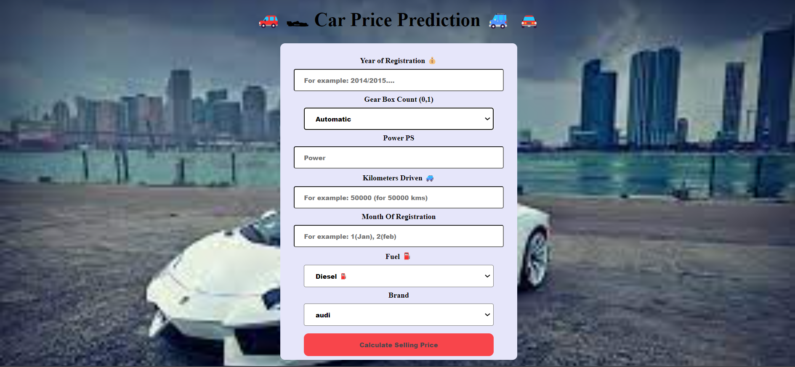

Slide 19

CONCLUSION
In conclusion, this project demonstrates the effective fusion of machine learning with web development using Flask, with a focus on predicting used car prices based on crucial features like registration year, gearbox type, power output, mileage, registration month, fuel type, and brand.
Upon assessing the predictive performance of Linear Regression, Random Forest, and Gradient Boosting models, it's clear that Random Forest stands out for its superior accuracy.
Utilizing a Random Forest Regression model, the application delivers precise price predictions, empowering users to make well-informed decisions within the ever-changing used car market.

Slide 20
LIMITATIONS
Market Dynamics
Model Complexity
Scalability
Limited Scope
Feature Selection

Slide 21
LESSONS LEARNED
Data Quality is Primary
Model Evaluation is Essential
Continuous Model Refinement
Learning from Failures

Slide 22

FUTURE SCOPE
Integration of Additional Data Sources: Incorporating the dataset with supplementary sources like vehicle history reports, market trends, and consumer sentiment can bolster the predictive capability of the models.
Advanced Feature Engineering: Delving into sophisticated feature engineering methods, such as text mining to extract insights from unstructured data and image processing for analyzing vehicle images, can enrich the dataset and enhance model precision.
Deployment in E-Commerce Platforms: Integrating predictive pricing models into e-commerce platforms and online marketplaces enables sellers to make well-informed pricing decisions promptly
User Integration with Blockchain Technology: Utilizing blockchain technology to establish transparent and immutable records of vehicle history, ownership, and transactions has the potential to boost trust and transparency within the used car market.

Slide 23
REFERENCES
Hao, J., & Ho, T. K. (2019). Machine Learning Made Easy: A Review of Scikit-learn Package in Python Programming Language. Educational and Psychological Measurement, 44(3). https://doi.org/10.3102/1076998619832248
Zhu, Y. (2023). Prediction of the price of used cars based on machine learning algorithms. Applied and Computational Engineering, 6(1), 785-791. https://doi.org/10.54254/2755-2721/6/20230917
Hunt-Walker, N. (2018, April). An introduction to the Flask Python web app framework. Opensource.com. https://opensource.com/article/18/4/flask

Slide 24

THANK YOU

