Slide 1

Internship Review-1 SIGN LANGUAGE PREDICTION USING HAND GESTURES Dt:30-01-2026
P. BHANU PRAKASH (23C11A6609)
Under the guidance of
Dr. G. JOHN BABUM.Tech.,Ph.D.
Associate professor
SIGNATURE OF THE SUPERVISOR
Department of CSE(AI&ML)

Slide 2
CONTENTS
INTRODUCTION TO TECHNOLOGY
HISTORY
APPLICATIONS
FEATURES
ARCHITECTURE
SERVICES
CONCLUSION
PROJECT TITLE
PROBLEM STATEMENT
OBJECTIVE
REQUIREMENTS
DATA SCIENCE

Slide 3
INTRODUCTION TO TECHNOLOGY
Data Science is the field that extracts useful information from data using
algorithms and models.
Computer Vision is a part of Data Science that helps computers understand
images and videos.
Hand gesture recognition is an important application of Computer Vision
and Machine Learning.
Sign language recognition helps in improving communication between
humans and computers.
This project combines Data Science, Computer Vision, and Assistant
Technology to recognize hand gestures and convert them into text.
DATA SCIENCE

Slide 4
HISTORY
In the early stage, data analysis was done using manual calculations and
basic statistics. Later, structured data like tables and databases were used
for decision making.
After ML is introduced, trained the numerical and textual data
→ as data increased, Big Data and advanced analytics became popular.
Deep Learning → learn complex patterns from large datasets.
Data Science → handling the unstructured data(images and videos)
Today, Data Science is used to build intelligent systems that can analyze
real-world data and support automation.
DATA SCIENCE

Slide 5
APPLICATIONS
Data Science is used to analyze large amounts of data to support decision
making.
Business Analytics - sales prediction and customer behavior analysis
Health Care - disease prediction and medical data analysis
Banking and Finance - fraud detection and risk analysis
Education - student performance analysis and recommendation systems
Social Media Platforms - analyze user data and personalize content
→ It is also supports assistant systems by learning patterns from data.
We concludes that Data Science plays a key role in automation.
DATA SCIENCE

Slide 6
FEATURES
Uses data-driven approach to learn patterns
Handles large datasets
Uses Machine Learning and Deep Learning models for prediction.
Works with structured and unstructured data
Provides high accuracy by learning from historical data
Helps in build intelligent and automated systems
More data uses, more efficient performance improved
DATA SCIENCE

Slide 7
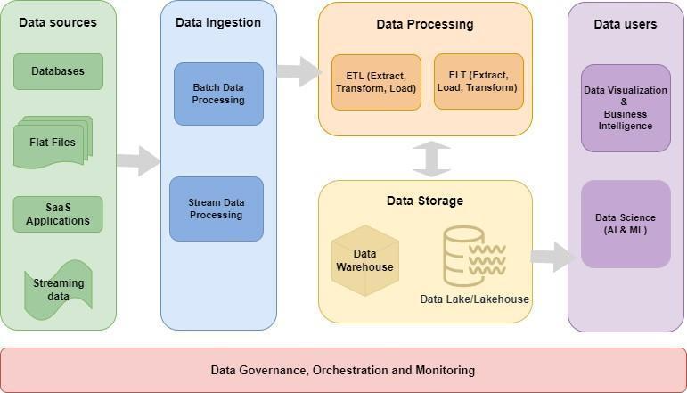
ARCHITECTURE

Slide 8
SERVICES
1. Data Collection Service - Collects raw data from different sources for analysis
2. Data Preprocessing Service - Cleans and prepares data for better accuracy.
3. Feature Extraction Service - Identifies important features from the data.
4. Model Training Service - Trains Machine Learning and Deep Learning
models using data.
5. Prediction Service - Generates predictions or classifications from trained
models.
6. Data Analysis Service - analyzes patterns and trends in the data.
7. Decision Support Service - Helps users make decisions based on data insights

Slide 9
CONCLUSION
Data Science helps computers learn from data and make correct
decisions. It is used to analyze data, find patterns, and build
intelligent systems. It reduces human effort by automating tasks.
This makes Data Science an important part of modern technology.

Slide 10
SIGN LANGUAGE PREDICTION USING HANDGESTURES

Slide 11
PROBLEM STATEMENT
Deaf and mute people communicate using sign language, which is difficult
for normal people to understand. In many situations, a human translator is
not available to convert sign language into text. Existing systems for sign
language recognition are either costly, require special hardware, or do not
work accurately for hand gestures with movement. Therefore, there is a
need for a simple, camera-based system that can recognize hand gestures in
real time and convert them into readable text for easy communication.
DATA SCIENCE

Slide 12
OBJECTIVE
To recognize Sign Language using hand gestures.
To capture hand movements using a camera without special
hardware.
To extract hand features using Computer Vision techniques.
To convert recognized hand gestures into text output.
To support communication and assistant-based applications.

Slide 13
REQUIREMENTS
Hardware Requirements
Computer or Laptop
Webcam or Built-in Camera
Required RAM and ROM
Software Requirements
Operating System: Windows
Programming Language: Python
Library: MediaPipe
TensorFlow / Keras
NumPy
OpenCV
Dataset: American sign language (ASL)
INTERNSHIP TITLE

Slide 14
THANK YOU

