Slide 1
MARKETING CAMPAIGN ANALYSIS
Data Analytics Project
Prepared by: Bhanu Pratap
Microsoft Excel | Data Cleaning | Pivot Tables | ROI | Dashboard

Slide 2
1. Project Overview
What was the business problem and why did I analyze it?
• Marketing teams need to know which campaigns and channels generate meaningful business results.
• The project evaluates campaign engagement, conversions, revenue, campaign cost and ROI.
• The analysis was performed in Microsoft Excel using formulas, Pivot Tables, Pivot Charts, KPI analysis.
• The final objective was to convert raw campaign data into actionable recommendations for marketing budget decisions.
Marketing Campaign Analysis | 2

Slide 3
2. Dataset Overview
Synthetic e-commerce marketing campaign dataset
Campaign records
Attributes
Marketing channels
Campaign types
10,101
20
6
4
• Channels covered: Google Ads, Meta Ads, Email, YouTube, LinkedIn and Instagram.
• The data includes campaign dates, region, city, audience, device type, impressions, clicks, CTR, conversions, conversion rate, cost, revenue, ROI, customers acquired and status.
• The workbook intentionally contains real-world quality issues to practice cleaning before analysis.
Marketing Campaign Analysis | 3

Slide 4
3. Data Cleaning & Preparation
Making the dataset reliable before analysis
• Removed duplicate campaign records and checked unique Campaign IDs.
• Handled missing values in campaign cost, revenue and conversions.
• Standardized campaign names, marketing channels, cities and regions by removing spaces and fixing capitalization.
• Converted mixed date formats into a consistent date format.
• Reviewed negative campaign costs and other outliers before KPI calculations.
• Verified numerical fields and prepared the data for Pivot Tables, Pivot Charts and dashboard reporting.
Marketing Campaign Analysis | 4

Slide 5
4. Campaign Metrics Analysis
The marketing funnel from reach to conversion
Impressions
Clicks
Overall CTR
Conversions
Conversion Rate
1,010,760,438
75,689,405
7.49%
12,805,223
16.92%
• CTR measures how effectively campaigns attract clicks from impressions.
• Conversion Rate measures how effectively clicks become desired actions.
• These metrics help identify where the marketing funnel is strong or weak.
Marketing Campaign Analysis | 5

Slide 6
5. ROI Calculation
Measuring the financial return from marketing investment
ROI Formula
ROI (%) = ((Revenue Generated − Campaign Cost) ÷ Campaign Cost) × 100
Total Campaign Cost
Revenue Generated
Aggregate ROI
₹39,555,040
₹243,172,395
514.77%
• A positive ROI means the revenue generated exceeded the campaign cost.
• A negative ROI indicates that the campaign did not recover its marketing investment.
• For channel comparison, I used aggregate ROI from total revenue and total cost to avoid mixing different campaign volumes.
Marketing Campaign Analysis | 6

Slide 7
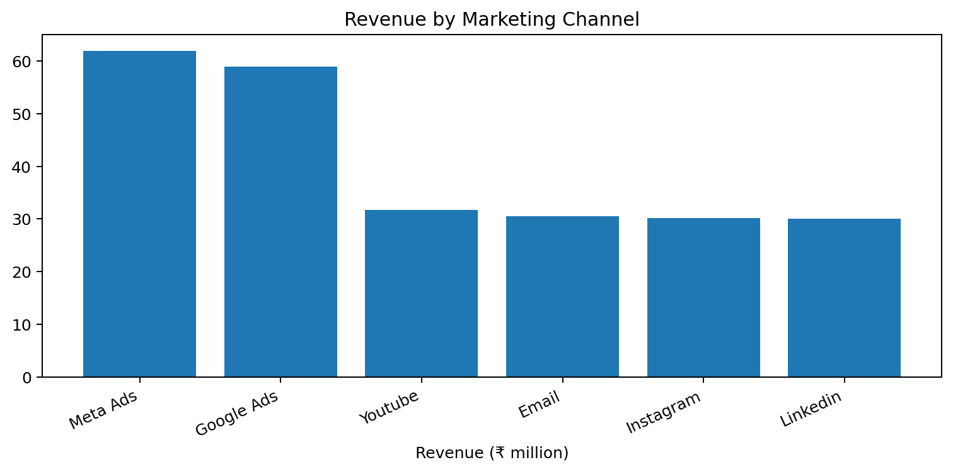
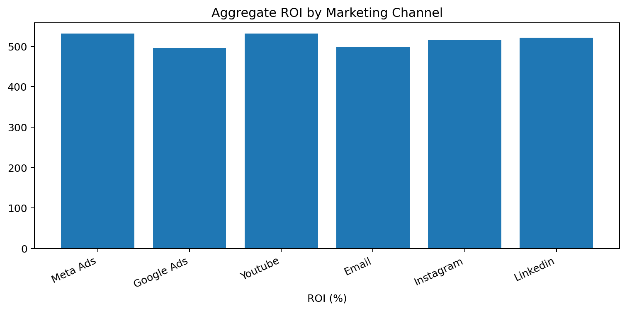
6. Channel Effectiveness
Which marketing channels deserve attention?
Highest revenue: Meta Ads (₹61,854,002)
Highest aggregate ROI: Youtube (531.20%)
Marketing Campaign Analysis | 7

Slide 8
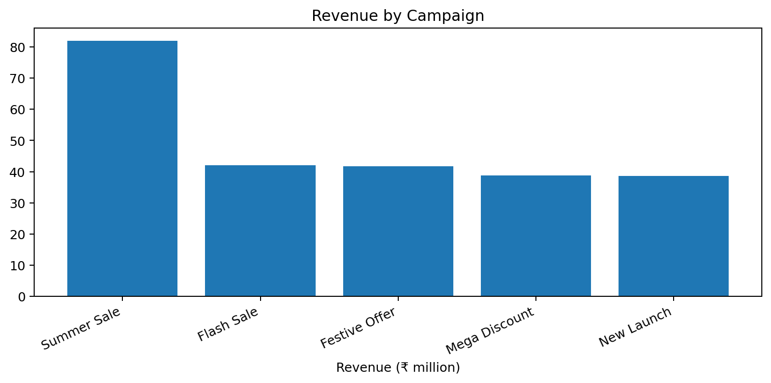
7. Campaign Performance
Comparing major campaign themes
• Summer Sale generated the highest revenue in the cleaned workbook: ₹81,912,217.
• New Launch had the highest aggregate ROI among campaign names: 535.59%.
• Campaign performance should be evaluated using both scale (revenue/conversions) and efficiency (cost/ROI).
Marketing Campaign Analysis | 8

Slide 9
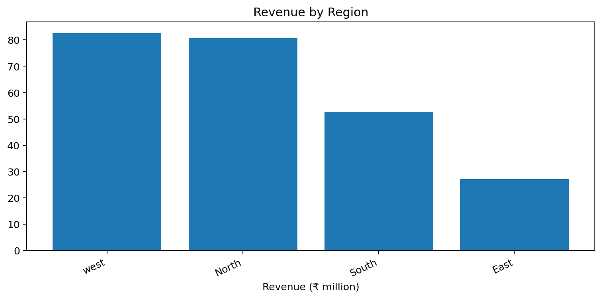
8. Regional Analysis
Location can change campaign performance
• west generated the highest revenue: ₹82,671,208.
• Regional comparisons help identify markets where budget allocation or targeting can be improved.
• Location-level analysis can be combined with channel and audience filters for more precise decisions.
Marketing Campaign Analysis | 9

Slide 10
9. Dashboard & Excel Techniques
How the analysis was converted into a usable BI view
• Pivot Tables: summarized revenue, conversions, campaign cost, ROI and customers acquired.
• Pivot Charts: visualized channel, campaign and regional performance.
• KPI cards: highlighted the most important campaign metrics.
• Excel formulas: calculated CTR, Conversion Rate and ROI where required.
• The dashboard was designed to help a decision-maker compare performance quickly rather than inspect raw rows.
Marketing Campaign Analysis | 10

Slide 11
10. Key Findings
What the analysis tells the business
• Overall marketing spend was ₹39,555,040 against revenue of ₹243,172,395.
• The aggregate ROI across the cleaned workbook is 514.77%.
• Meta Ads generated the highest channel revenue, while Youtube had the highest aggregate channel ROI.
• Summer Sale was the strongest campaign by total revenue.
• Campaign results vary by region, audience and channel, so a single budget strategy should not be applied everywhere.
• CTR, conversion rate and ROI should be reviewed together; a high-click campaign is not automatically the most profitable.
Marketing Campaign Analysis | 11

Slide 12
11. Business Recommendations
Turning the analysis into action
• Prioritize channels that combine strong revenue with efficient aggregate ROI, rather than optimizing for clicks alone.
• Scale high-performing campaign themes while testing their performance with controlled budget increases.
• Reduce or review spend on campaigns with weak ROI, low conversion efficiency or unusually high acquisition cost.
• Use region and audience-level segmentation to personalize campaign targeting.
• Track ROI, CTR, Conversion Rate and Customers Acquired together in a recurring dashboard.
• Recalculate ROI consistently at the campaign and channel level so budget decisions are comparable.
Marketing Campaign Analysis | 12

Slide 13
12. Conclusion
From raw marketing data to business decisions
• The project demonstrates an end-to-end Excel analytics workflow: cleaning → calculation → Pivot analysis → visualization → insight.
• The analysis makes campaign performance measurable across channels, campaign types and regions.
• The final outcome is not only a dashboard, but a framework for deciding where marketing budget should be increased, reviewed or optimized.
Marketing Campaign Analysis | 14

